Slide 1
BKT Model
Bayesian Knowledge Tracing Model

Slide 2
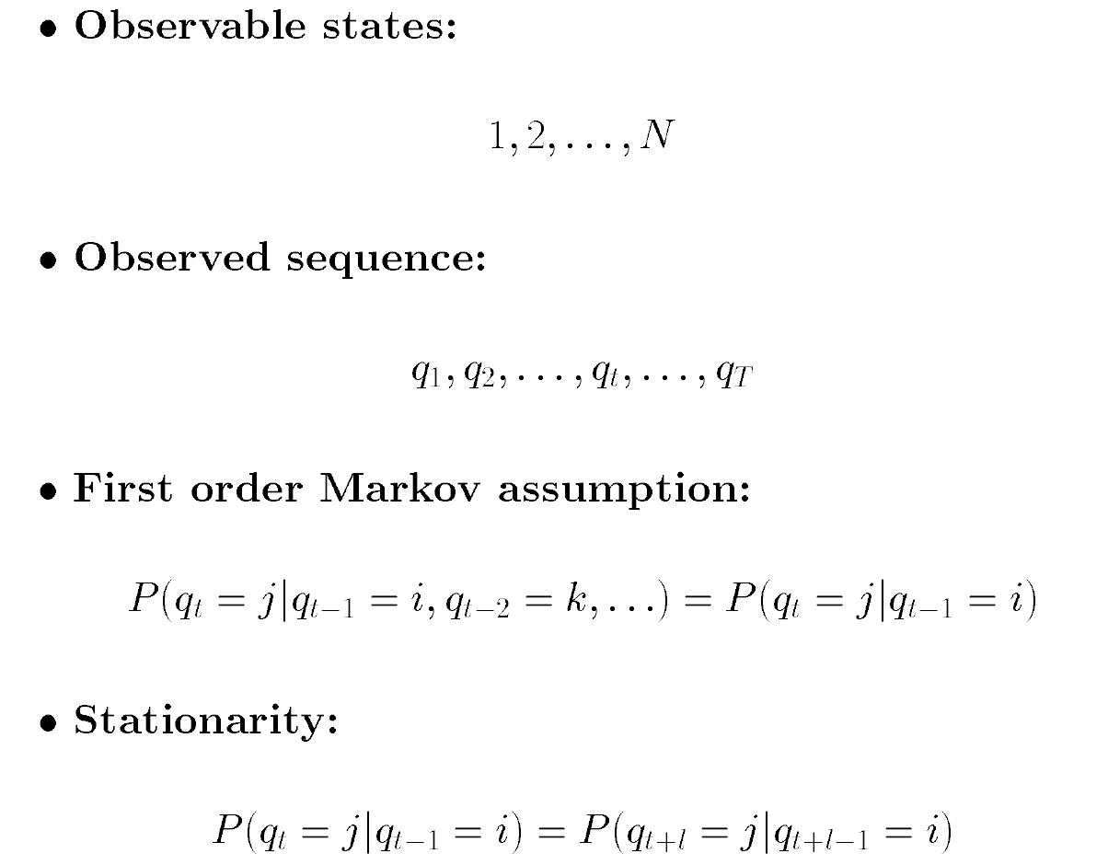
Markov Models

Slide 3

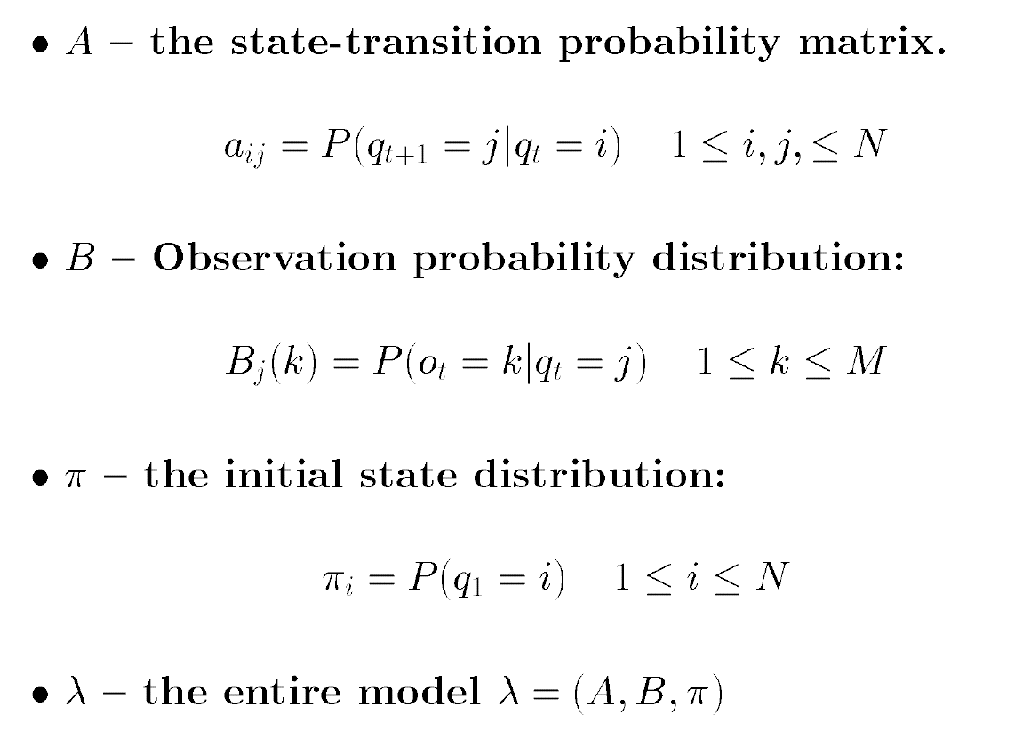
Hidden Markov Models

Slide 4
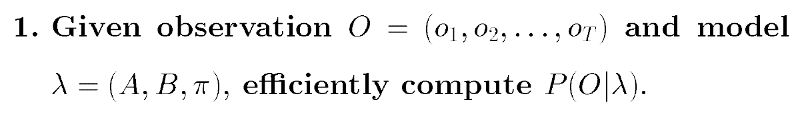
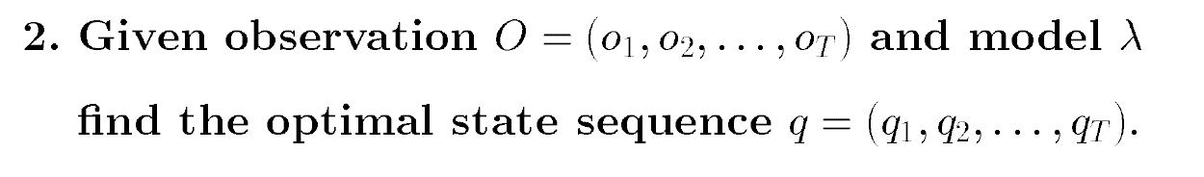
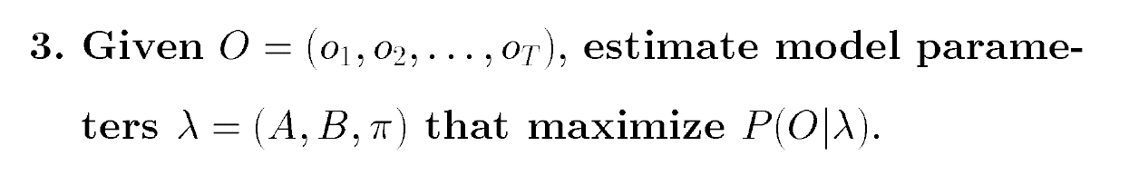
Three Basic Problems

Slide 5
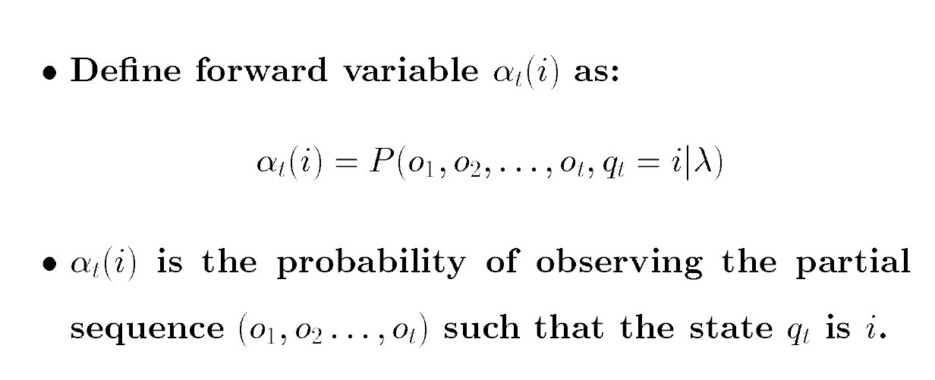
Forward Algorithm
Notes:
先求t+1时刻每个状态发生的概率
然后把每个状态下观察到O的概率相加

Slide 6
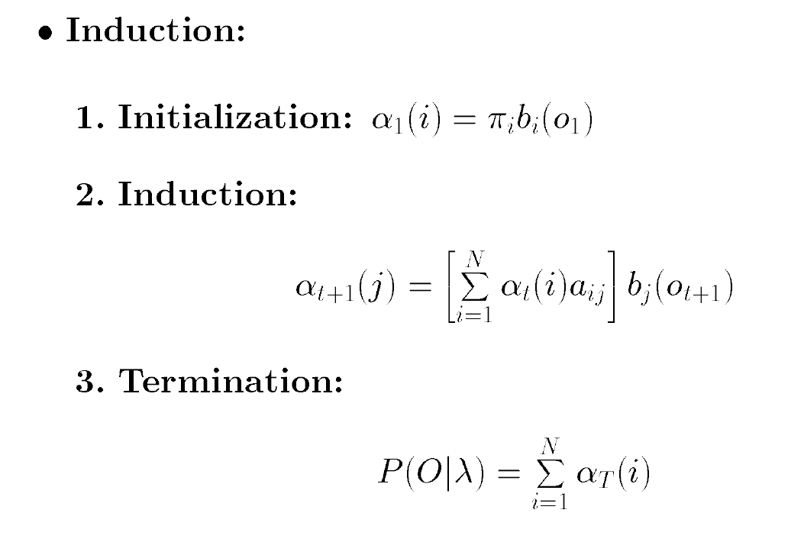
Forward Algorithm
Notes:
先求t+1时刻每个状态发生的概率
然后把每个状态下观察到O的概率相加

Slide 7
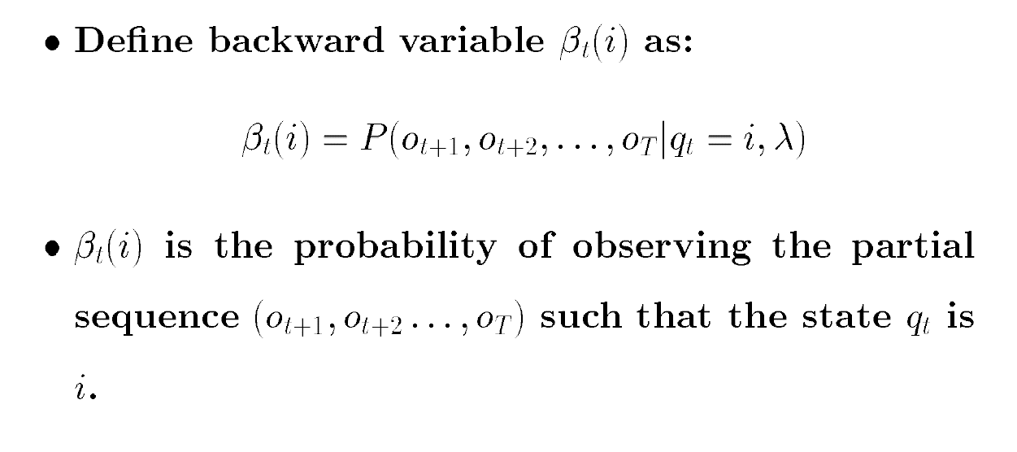
Backward Algorithm

Slide 8
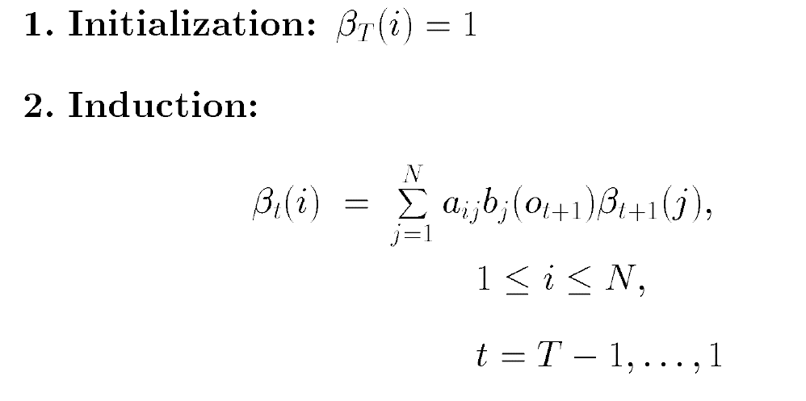
Backward Algorithm

Slide 9
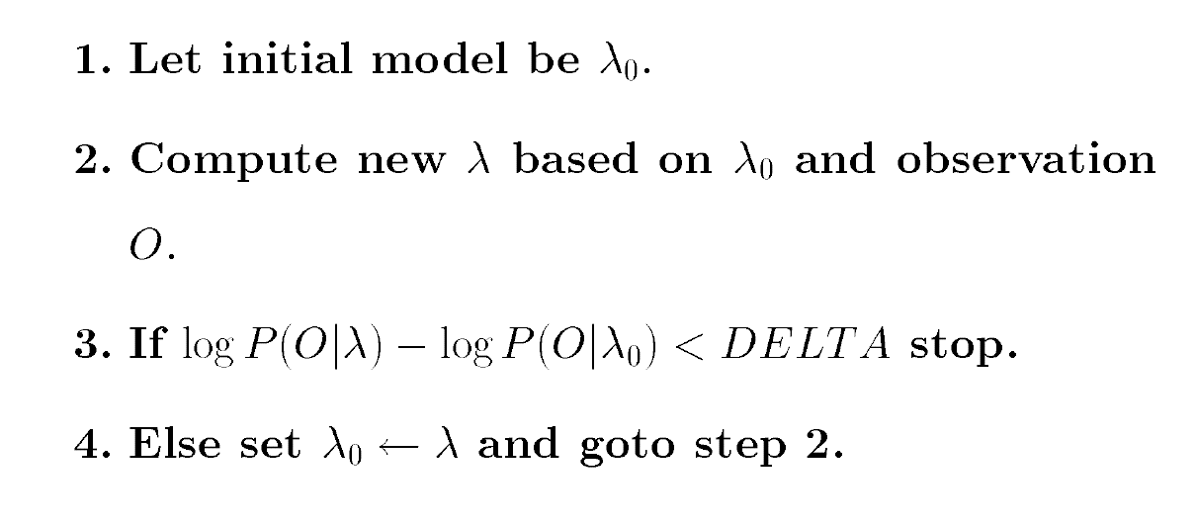
Baum-Welch Algorithm

Slide 10
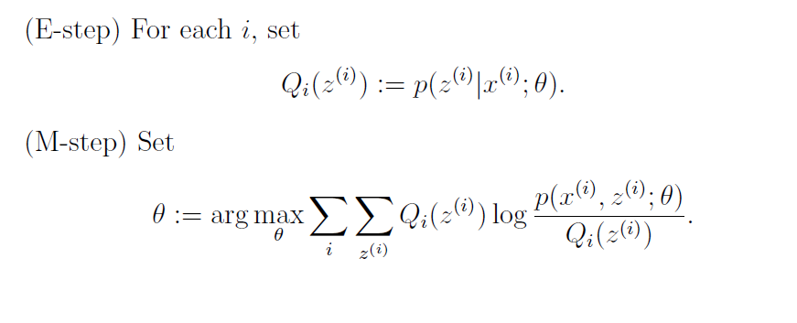
Expectation Maximization Algorithm

Slide 11
pyBKT
Data
Model
Estimation parameters
Predict next step
？？？

Slide 12
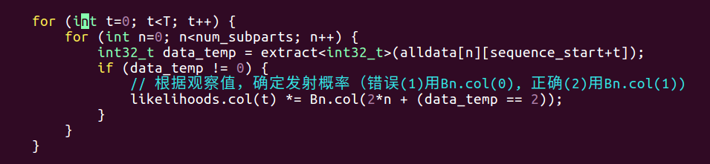
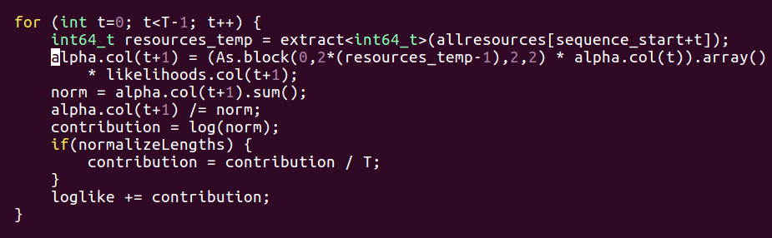
pyBKT: Forward

Slide 13
pyBKT: Backward

