Slide 1
BKT Model
Bayesian Knowledge Tracing Model

Slide 2
BKT
Estimate parameters
Prediction

Slide 3
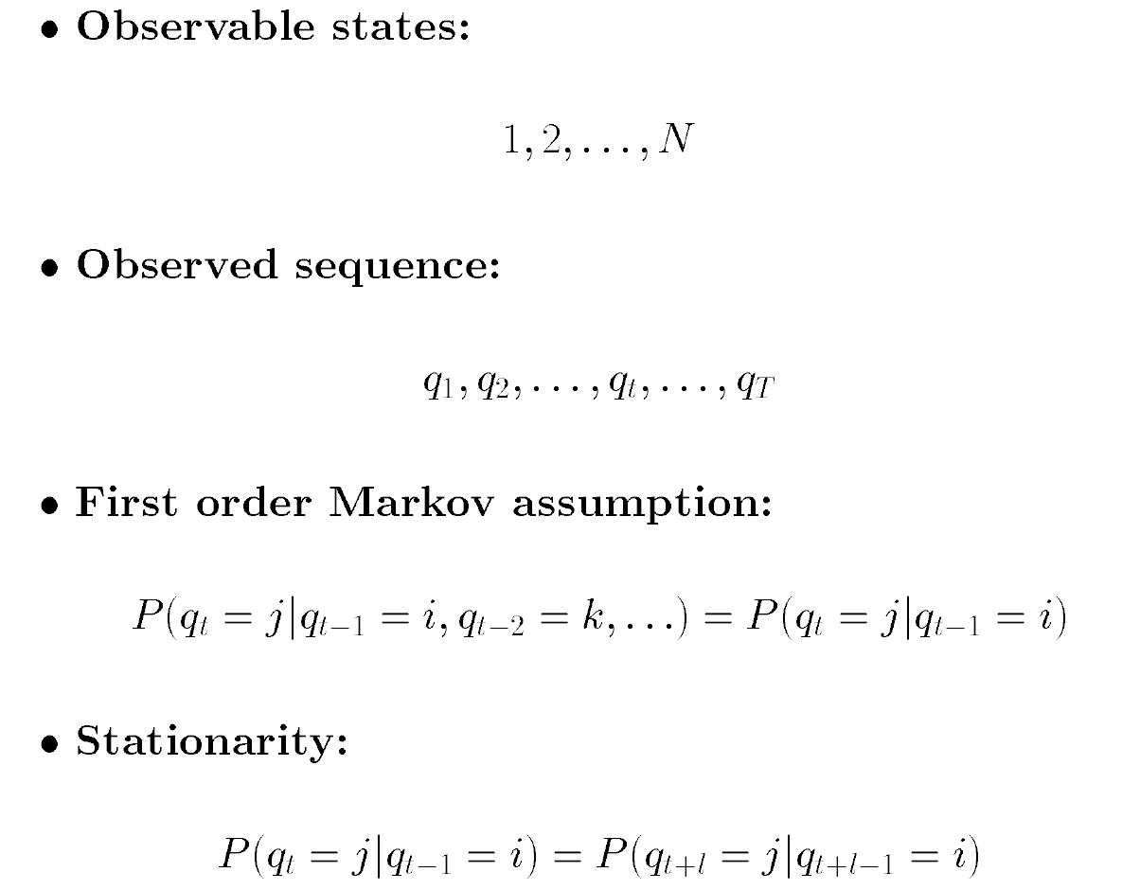
Markov Models

Slide 4

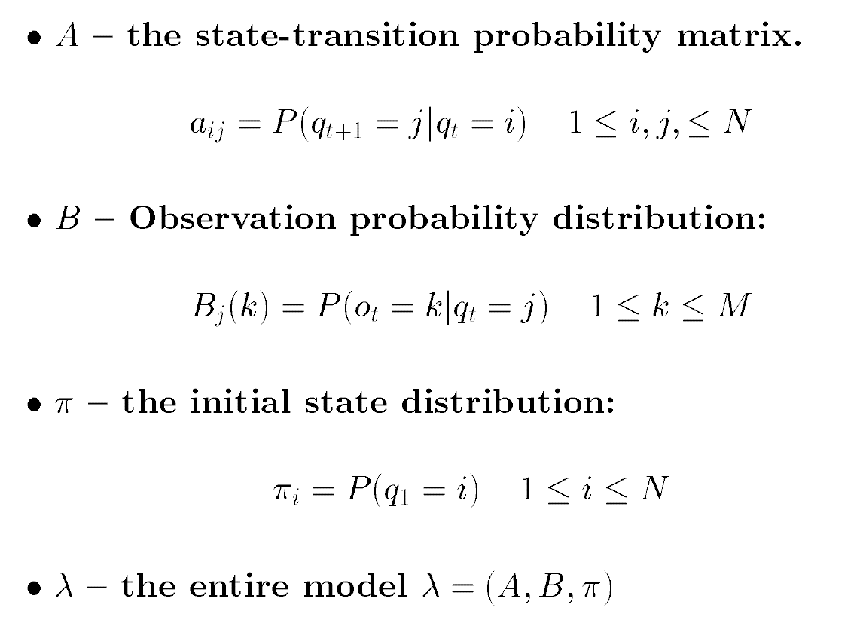
Hidden Markov Models

Slide 5
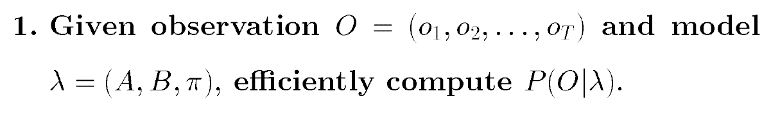
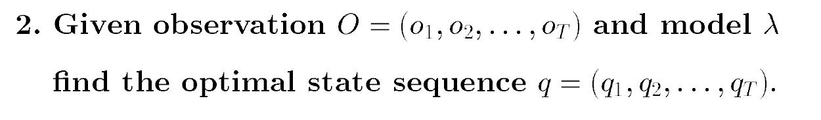
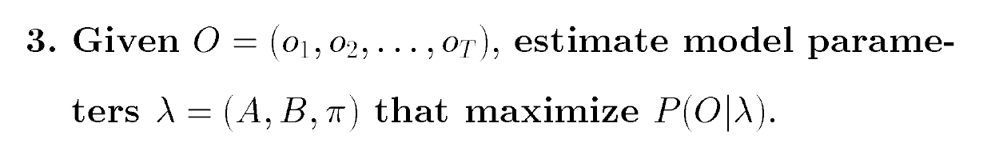
Three Basic Problems

Slide 6
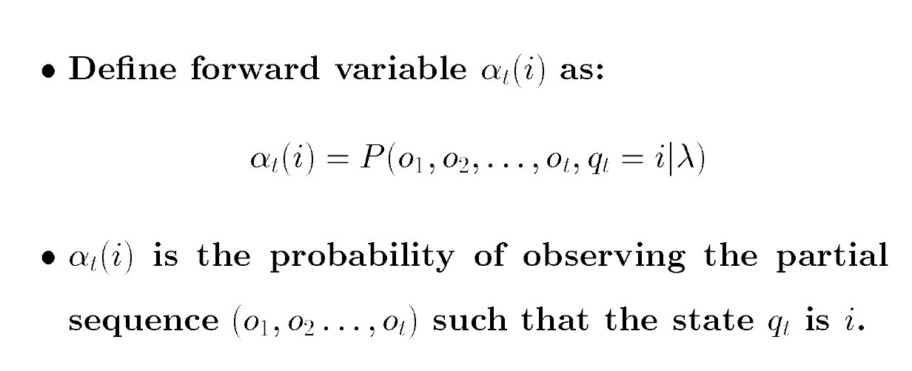
Forward Algorithm
Notes:
先求t+1时刻每个状态发生的概率
然后把每个状态下观察到O的概率相加

Slide 7
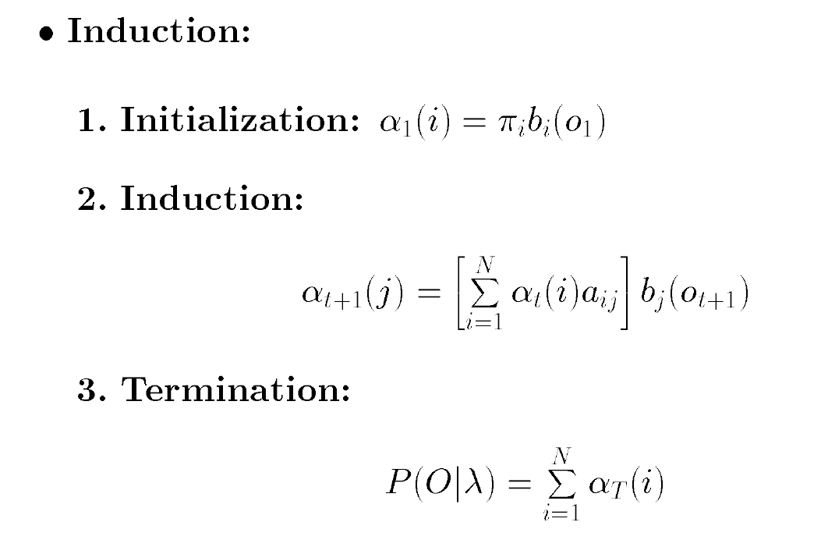
Forward Algorithm
Notes:
先求t+1时刻每个状态发生的概率
然后把每个状态下观察到O的概率相加

Slide 8
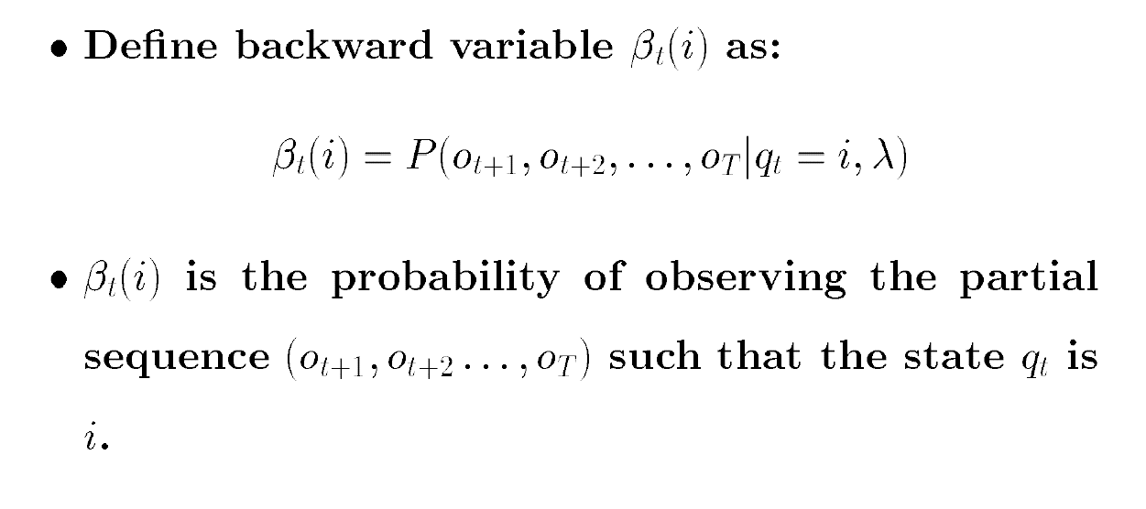
Backward Algorithm

Slide 9
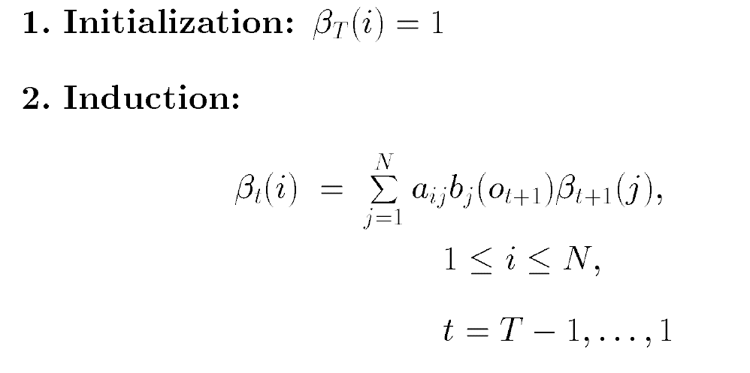
Backward Algorithm

Slide 10
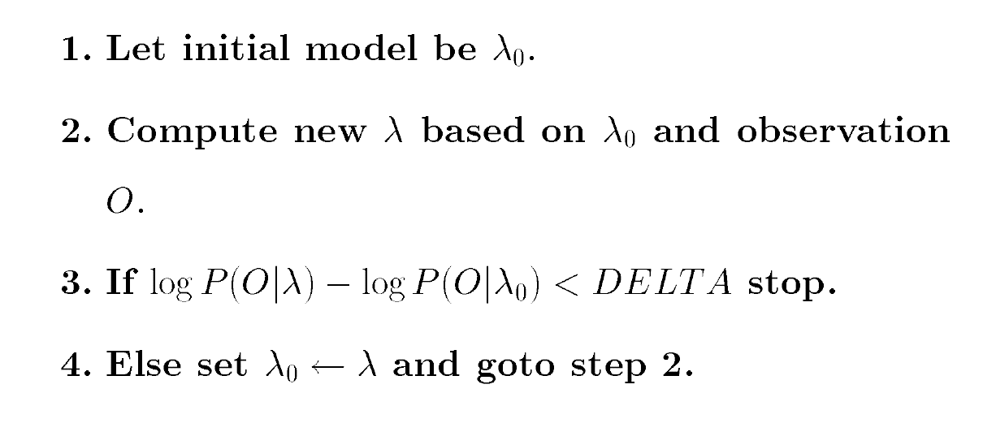
Baum-Welch Algorithm

Slide 11
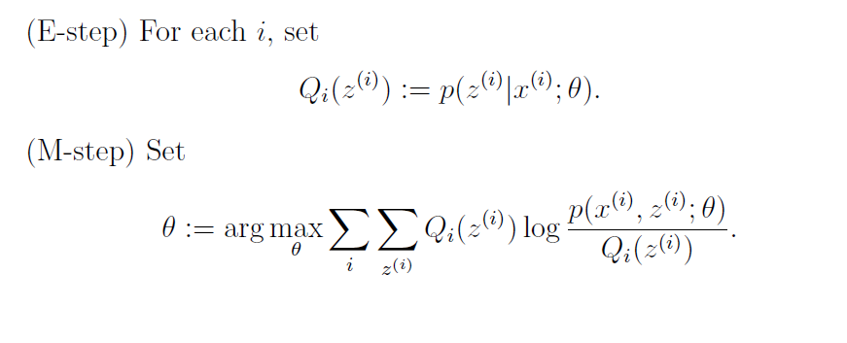
Expectation Maximization Algorithm

Slide 12
pyBKT
Data
Model
Estimation parameters
Predict next step

Slide 13
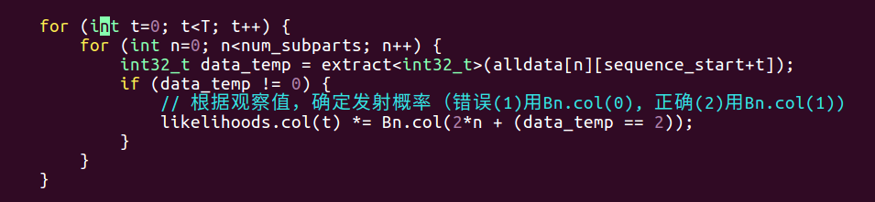
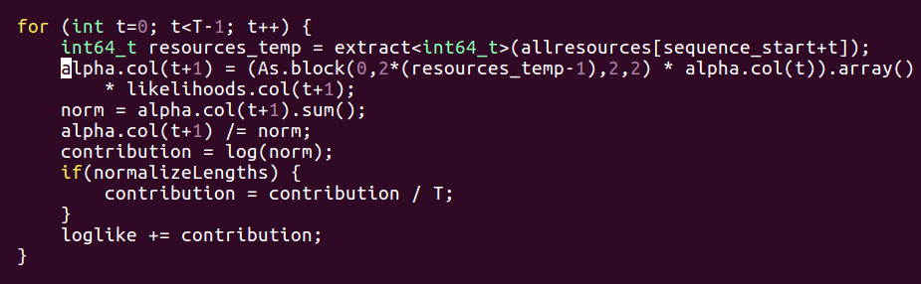
pyBKT: Forward

Slide 14
pyBKT: Backward

