Slide 1
Explainable Artificial Intelligence
孟庆钢 2019.03.27

Slide 2
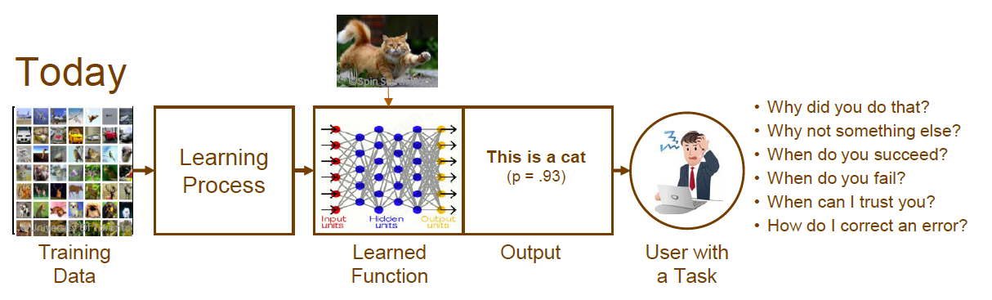
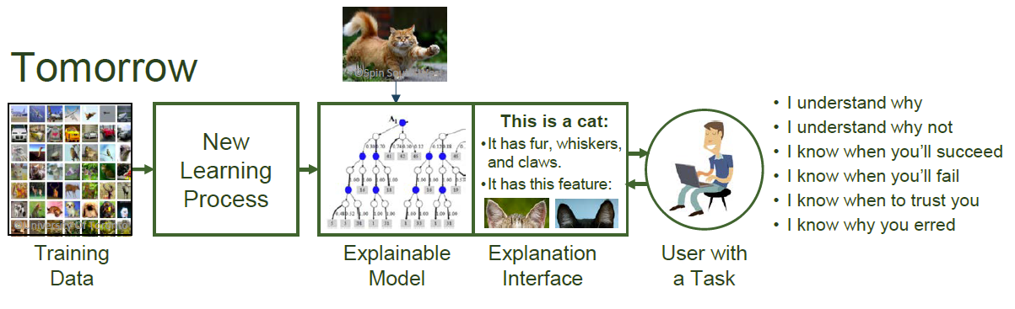
Notes:
But you model something doesn’t mean you really know how it works.

Slide 3
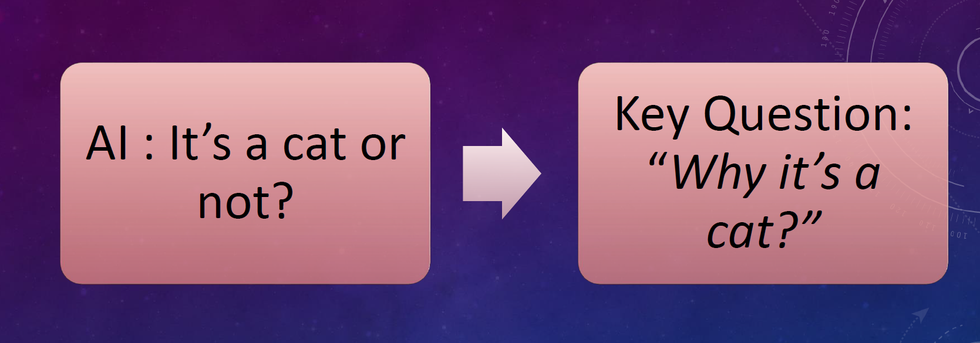
Explainable Artificial Intelligence (XAI)
From Prediction To Understanding link

Slide 4
Why？
Human Readability link
Justifiability link
Discrimination link
Facilitating improvement link
Eliminating Overfitting link
Notes:
Human Readability: When you’re making decisions for a company, your director or CEO isn’t interested in the data itself. Instead, they may be looking for reasons behind the interpretation and specifically what to do about it. Explainable AI gives the reasoning behind certain decisions, and that can both increase transparency and help offer better business understanding.
Justifiability: In Europe, hiring and firing are often driven by large data sets, but employees have the right for a clear justification with any decision made that involves them. If you don’t know how the machine came to a conclusion, you don’t satisfy this fundamental right and could be subject to legal consequences.
Discrimination(歧视): It’s possible to unintentionally replicate discrimination through data sets. Discrimination can also take the form of feedback loops.
Facilitating improvement (促进改进): Black box models don’t always list reasons behind the predictions. That can be good for prediction’s sake, but it makes it difficult to fix any problems that may come up. If your employees are leaving, black box machine learning may be able to predict who will leave, but it won’t tell you why.
Eliminating Overfitting (消除过拟合): Black box models don’t always pick up the right kinds of relationships. Attempting to understand what relationships actually work and which ones aren’t valid can help you teach your machine to make better predictions overall.

Slide 5
Methods For Understanding Data
Non-Topological
Dimensionality reduction (manifold learning)
PCA, T-SNE, Isometry
Topological Data Analysis
TDA

Slide 6
What is Explainable AI (XAI)?
Explainable AI (XAI) is any technology that can accurately explain a decision or action at the individual level.

Slide 7
PERFORMANCE VS. EXPLAINABILITY

Slide 8
Methods
Ante-Hoc Methods
Ante-hoc techniques entail baking explainability into a model from the beginning.
Post-Hoc Methods
Post-hoc techniques allow models to be trained normally, with explainability only being incorporated at testing time.

Slide 9
Ante-Hoc Methods
Reversed Time Attention Model (RETAIN)
The attention mechanism helped explain which part the neural network was focusing on and which features helped influence its choice.

Slide 10
Ante-Hoc Methods
Bayesian Deep Learning (BDL)
BDL enables one to gauge how uncertain a neural network is about its predictions. These deep architectures can model complex tasks by leveraging the hierarchical representation power of deep learning, while also being able to infer complex multi-modal posterior distributions. Bayesian deep learning models typically form uncertainty estimates by either placing distributions over model weights, or by learning a direct mapping to probabilistic outputs. By knowing the weight distributions of various predictions and classes, we can tell a lot about what feature led to what decisions and the relative important of it.

Slide 11
Post-Hoc Methods
Local Interpretable Model-Agnostic Explanations (LIME)
This isn’t a purely transparent model as it provides the explanation after a decision has been made. Hence it can have wide range of applications as it isn’t customized to one domain unlike RETAIN. For example for an image classification problem using a CNN, we get the probability distribution over classes. Then we make small changes to input to see how it affects the distribution and collect the results. Then using a linear interpretable model, on the collected perturbation set, we can explain changed in the key features extracted with their weights telling us how prominent they are. It blacks out different parts of the original image and feeds the resulting “perturbed” images back through the model, checking to see which perturbations throw the algorithm off the furthest to derive reasoning behind the algorithms decisions. For example, for an image of a tree frog, LIME found that erasing parts of the frog’s face made it much harder for the model to identify the image, showing that much of the original classification decision was based on the frog’s face. LIME is generally applicable to image classifications tasks.
Notes:
perturbation： 微扰， 小变异，忧虑，不安，烦恼
prominent：重要的，显著的，突出的

Slide 12
Post-Hoc Methods
Layer-wise Relevance Propagation (LRP)
This approach is based on the principles of redistribution and conservation. Here when we have an image and probability distribution of classes, we redistribute these to the input pixels, layer by layer. We can decide the relevance of inputs and features by going backwards using Deep CNN to extract relevant features before identifying similarity between the images in feature space. We try to infer pixel-level details of the images that may have significantly informed the model’s choice.

Slide 13
Post-Hoc Methods
BETA
BETA is closely connected to Interpretable Decision Sets. BETA learns a compact two-level decision set in which each rule explains part of the model behavior unambiguously. It uses a objective function so that the learning process is optimized for high fidelity (high agreement between explanation and the model), low unambiguity (little overlaps between decision rules in the explanation), and high interpretability (the explanation decision set is lightweight and small). These aspects are combined into one objection function to optimize for.

