Slide 1
Knowledge Tracing: Modeling the Acquisition of Procedural Knowledge
Corbett A T, Anderson J R. Knowledge Tracing: Modeling the Acquisition of Procedural Knowledge[J]. User Modeling and User-adapted Interaction, 1995, 4(4): 253-278.

Slide 2
Mastery Learning
The core idea is that virtually all students can achieve expertise in a domain if two conditions are met:
the domain knowledge is appropriately analyzed into a hierarchy of component skills
learning experiences are structured to ensure that students master prerequisite skills before tackling higher level skills in the hierarchy

Slide 3
Programming Tutor

Slide 4
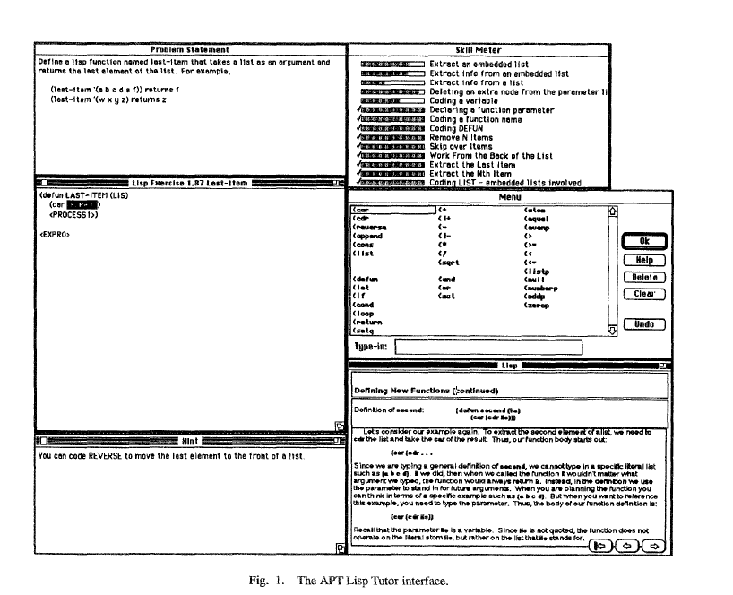

Slide 5
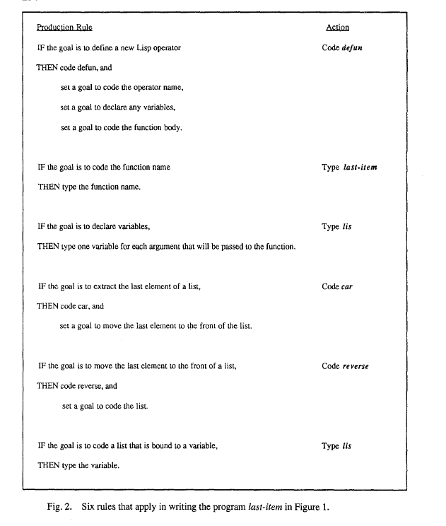

Slide 6
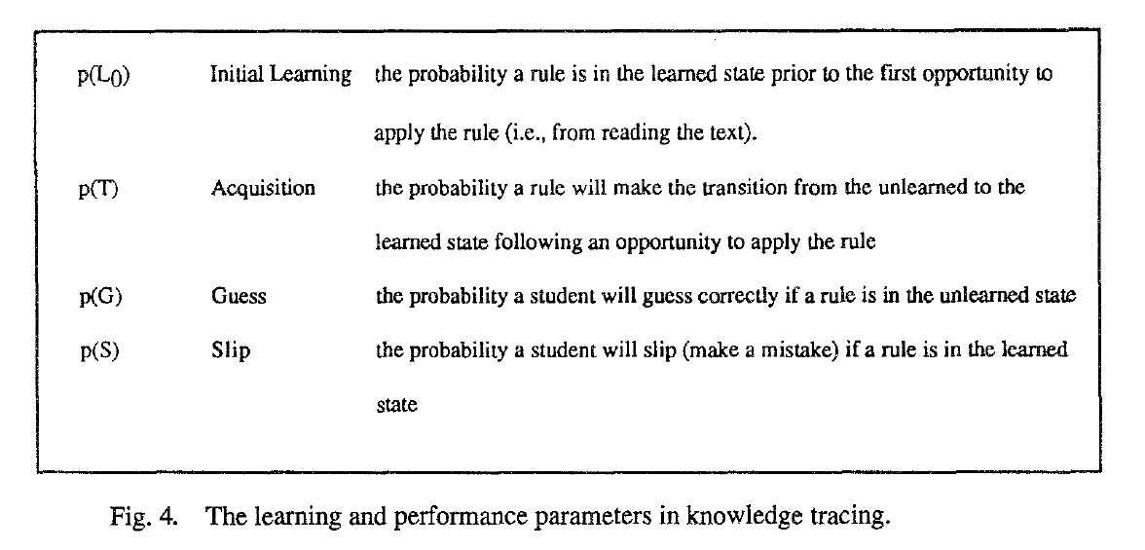
Knowledge Tracing and Mastery Learning

Slide 7
Empirical Evaluation of KT
Four studies:
performance, revise rule set, adjust parameter estimates
individual differences
assesse individual differences

Slide 8
Internal Validity
Predict Formula for One Goal:
p(C_{is}) = p(L_{rs}) * (1 - p(S_{r})) + (1 - p(L_{rs})) * p(G_{r}), i: goal, s: student, r: rule
parameters is constant (estimated from an earlier group of students)
Three Statistics:
correlation between actual accuracy and predicted accuracy
mean error (expected accuracy minus actual accuracy)
mean absolute error (average absolute value of predicted accuracy minus actual accuracy)

Slide 9
Internal Validity
Result:
moderately correlated: r=0.47, p<0.05
mean error rate: 0.06
mean absolute error rate: 0.16(relatively high).
Revise in two ways
allow parameters to vary across rules
r=0.85, mean error: -0.01, absolute error: 0.07
revise rule set

Slide 10
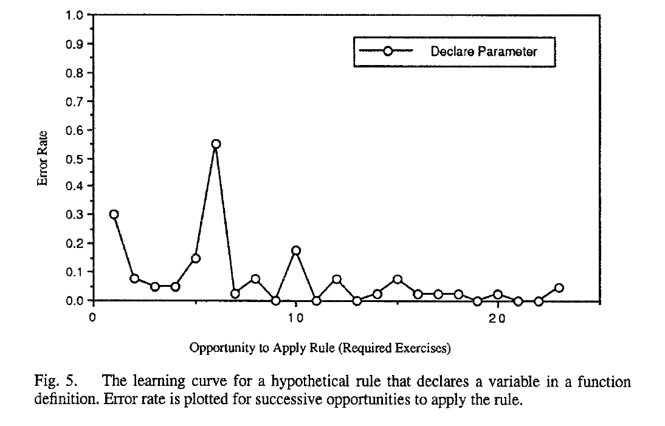
Revise Rule Set
Rule: In defining a Lisp function, declare one parameter variable in the parameter list for each argument (input value) that will be passed when the function is called.
Error Rate
0-4, 7-8, : 1 parameter
5-6: 2 parameters
9-10: multiple parameters
Notes:
5-6 说明很多学生没有理解函数定义

Slide 11
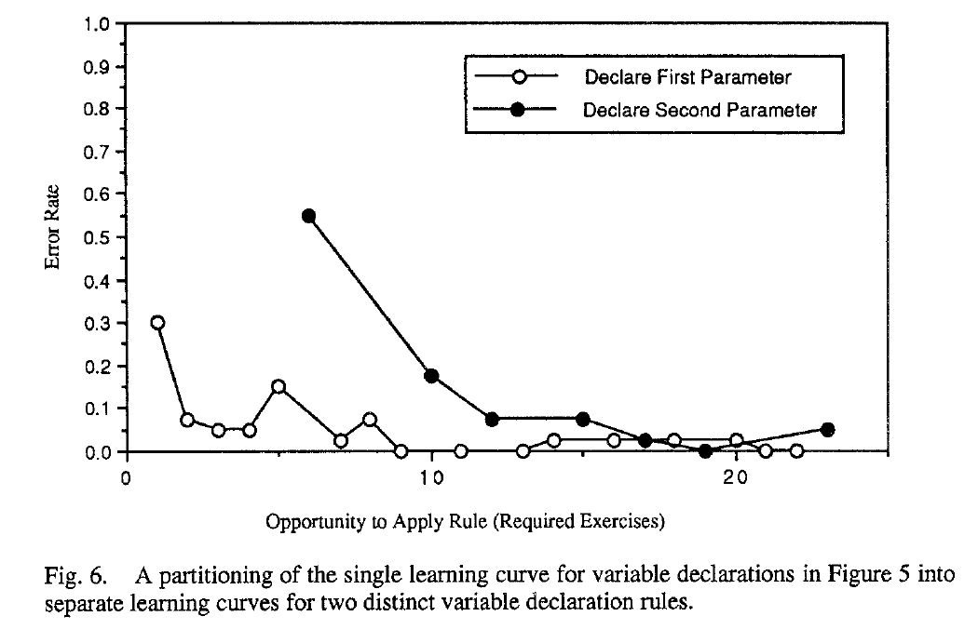
Revise Rule Set
Rule：
In defining a Lisp function, declare one variable for the first argument that will be passed.
In defining a Lisp function, declare one additional variable for each additional argument that will be passed.

Slide 12

External Validity: Differ from the internal validity
measurement unit: exercise, rather than individual programming goal
$\prod{p(Cis)}$
model predicts individual differences across students rather than across programming tasks.

Slide 13
External Validity: Experiment Process
curriculum: six sections, 64 exercises, 345 goals
first five section: mastery, individualized remedial exercises (average 18 exercise, range across 3 to 63)
final section: not mastery, fixed exercise, no remediation
test (exercises without tutor), after 1, 4, 6 sections
mastery: 1, 4
intermediate level: 6

Slide 14
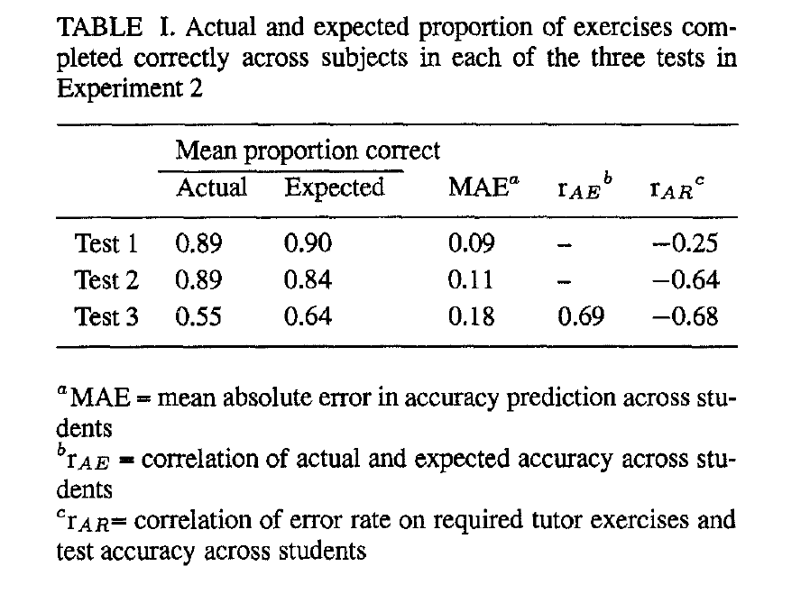
External Validity: Experiment Result

Slide 15
Individual Differences in Learning and Performance
Parameters varied across rules: reflects rule difficulty, but mis-estimates the learning state of students
above-average students: few errors -> underestimates -> more remedial exercises
below-average students: many errors -> overestimates -> less remedial exercises
This results in the observed negative correlation of tutor errors and posttest accuracy.

Slide 16
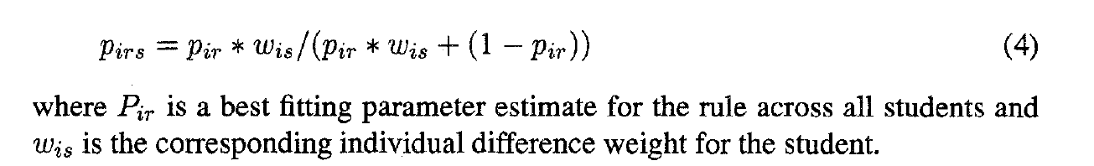
Individual Difference weights
one weight for each of the four parameters

