Slide 1
Explaining Explanations: An Overview of Interpretability of Machine Learning
Gilpin L H, Bau D, Yuan B Z, et al. Explaining Explanations: An Overview of Interpretability of Machine Learning[J]. ieee international conference on data science and advanced analytics, 2018.

Slide 2
Abstract
This research area tackles the important problem that complex machines and algorithms often cannot provide insights into their behavior and thought processes.

Slide 3
Introduction
Interpretability → Explainability
We take the stance that interpretability alone is insufficient. In order for humans to trust black-box methods, we need explainability - models that are able to summarize the reasons for neural network behavior, gain the trust of users, or produce insights about the causes of their decisions.
While interpetability is a substantial first step, these mechanisms need to also be complete, with the capacity to defend their actions, provide relevant responses to questions, and be audited.
Explainable models are interpretable by default, but the reverse is not always true.

Slide 4
Introduction
In this survey, we present a set of definitions, construct a taxonomy, and present best practices to start to standardize interpretability and explanatory work in AI.

Slide 5
Background and Foundational Concepts
What is an Explanation?
Interpretability vs. Completeness
Explainability of Deep Networks

Slide 6
What is an Explanation?
why-shouldn’t and why-should

Slide 7
Interpretability vs. Completeness
An explanation can be evaluated in two ways: according to its interpretability, and according to its completeness.
The goal of interpretability is to describe the internals of a system in a way that is understandable to humans.
The goal of completeness is to describe the operation of a system in an accurate way.

Slide 8
Interpretability vs. Completeness
When explaining a self-contained computer program such as a deep neural network, a perfectly complete explanation can always be given by revealing all the mathematical operations and parameters in the system.
It is difficult to achieve interpretability and completeness simultaneously.

Slide 9
Explainability of Deep Networks
Explanations of the operation of deep networks have focused on either explaining the processing of the data by a network, or explaining the representation of data inside a network.
Why does this particular input lead to that particular output?
What information does the network contain?
A third approach to interpretability is to create explanation-producing systems.

Slide 10
Review
Explanations of Deep Network Processing
Explanations of Deep Network Representations
Explanation-Producing Systems

Slide 11
Explanations of Deep Network Processing
ResNet
5×107 learned parameters
executes about 10¹⁰ floating point operations
Reduce the complexity of operations
Proxy Model: similarly to the original model but easier to explain.
Salience Map: highlight a small portion of the computation which is the most relevant.

Slide 12
Explanations of Deep Network Processing
Proxy Model
Linear Proxy Models
Decision Trees
Automatic-Rule Extraction
Salience Mapping

Slide 13
Linear Proxy Models
LIME (Local Interpretable Model-Agnostic Explanations)
With LIME, a black-box system is explained by probing behavior on perturbations of an input, and then that data is used to construct a local linear model that serves as a simplified proxy for the full model in the neighborhood of the input.
can be used to identify regions of the input that are most influential for a decision
Notes:
Model-Agnostic：模型不可知论

Slide 14
Decision Trees
DeepRED
RxREN: prune unnecessary input
C4.5: a statistical method for creating a parsimonious decision tree.
But the generated tree can be quite large.
ANN-DT
Use sampling to expand training using a nearest neighbor method.

Slide 15
Automatic-Rule Extraction
KT
Goes through each neuron, layer-by-layer and applies an if-then rule by finding a threshold.
DeepRED
There is a merging step which creates rules in terms of the inputs rather than the outputs of the preceding layer.
Fuzzy Rules
By transforming each neuron into an approximate rule.
Validity Interval Analysis, Sampling, Reverse Engineer

Slide 16
Automatic-Rule Extraction
MofN
Try to find rules that explain single neurons by clustering and ignoring insignificant neurons.
FERNN
Try to identify the meaningful hidden neurons and inputs to a particular network.

Slide 17
Salience Mapping
Where a network is repeatedly tested with portions of the input occluded to create a map showing which parts of the data actually have influence on the network output.
LRP, DeepLIFT, CAM, Grad-CAM, Integrated gradients, SmoothGrad

Slide 18
Explanations of Deep Network Representations
To understand the role and structure of the data flowing through these bottlenecks.
Granularity
Layer
Unit
Vector

Slide 19
Role of Layers
Layers can be understood by testing their ability to help solve different problems from the problems the network was originally trained on.
Transfer Learning
This method of using a layer from one network to solve a new problem is called transfer learning,

Slide 20
Role of Individual Units
The information within a layer can be further subdivided into individual neurons or individual convolutional filters.
Qualitatively
By creating visualizations of the input patterns that maximize the response of a single unit.
Visualizations can be created by optimizing an input image using gradient descent, by sampling images that maximize activation, or by training a generative network to create such images.
Quantitatively
By testing the ability of a unit to solve a transfer problem.
Units can also be characterized quantitatively by testing their ability to solve a task.
Network Dissection

Slide 21
Network Dissection
One example of a such a method is network dissection [51], which measures the ability of individual units solve a segmentation problem over a broad set of labeled visual concepts. By quantifying the ability of individual units to locate emergent concepts such as objects, parts, textures, and colors that are not explicit in the original training set, network dissection can be used characterize the kind of information represented by visual networks at each unit of a network.

Slide 22
Role of Representation Vectors
Concept Activation Vectors (CAVs) [54] are a framework for interpretation of a neural nets representations by identifying and probing directions that align with human-interpretable concepts.

Slide 23
Explanation-Producing Systems
Attention Networks
Disentangled Representations
Generated Explanations

Slide 24
Attention Networks
Attention-based networks learn functions that provide a weighting over inputs or internal features to steer the information visible to other parts of a network.
Application area
Natural language translation models to process words in an appropriate non-sequential order.
Fine-grained image classification
Visual question answer

Slide 25
Disentangled Representations
Disentangled representations have individual dimensions that describe meaningful and independent factors of variation.
Separating Latent Factors
Principal Component Analysis, Independent Component Analysis, Nonnegative Matrix Factorization

Slide 26
Generated Explanations
Finally, deep networks can also be designed to generate their own human-understandable explanations as part of the explicit training of the system.
Demonstrated in visual question answering and fine-grained image classification.
In addition to solving their primary task, these systems synthesize a “because” sentence that explains the decision in natural language.
Multimodal explanations that incorporate both visual pointing and textual explanations can be generated.

Slide 27
Related Work
Interpretability
Explainable AI for HCI
Explanations for Black-Box Models
Explainability in Other Domains

Slide 28
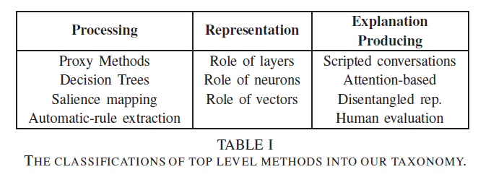
Taxonomy
Notice that the processing and explanation-producing roles are much more populated than the representation role.

Slide 29
Evaluation
Completeness compared to the original model.
Completeness as measured on a substitute task.
Ability to detect models with biases.
Human evaluation.

Slide 30
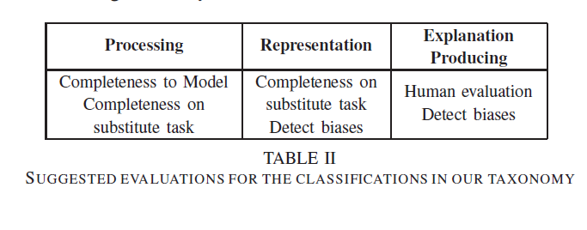
Evaluation

Slide 31
Conclusions

