Slide 1
Knowledge Tracing: Modeling the Acquisition of Procedural Knowledge
Corbett A T, Anderson J R. Knowledge Tracing: Modeling the Acquisition of Procedural Knowledge[J]. User Modeling and User-adapted Interaction, 1995, 4(4): 253-278.

Slide 2
Abstract
This paper describes an efforts to models students’ changing knowledge state during skill acquisition
Students are learning to write programs with the ACT? Programming Tutor (APT)
APT:
APT is constructed around a production rule cognitive model of programming knowledge

Slide 3
Abstract
Ideal Student Model
can solve exercises and provide assistance as necessary.
maintains an estimate of the probability that the student has learned each of rules in the model , in a process called knowledge tracing.
presents an individualized sequence of exercises to the students.
Current model is quite successful in predicting test performance.

Slide 4
Mastery Learning
virtually all students can achieve expertise in a domain with two conditions:
the domain knowledge is appropriately analyzed into a hierarchy of component skills.
learning experiences are structured to ensure that students master prerequisite skills before tackling higher level skills in the hierarchy.
this idea became entrenched in American education during the 70’s
review articles overwhelming confirm that mastery learning leads to higher mean achievement level than conventional conditions
but critics note that the effect sizes are appreciably smaller than predicted and the underlying assumptions concerning skill decomposition are controversial

Slide 5
This paper
bring a cognitive model of skill acquisition to bear on the goals of mastery learning
monitor students’ changing knowledge state
individualize the practice sequence to enable students to master the skill efficiently
accurately predict students’ performance

Slide 6
The following sections
intelligent tutoring environment
curriculum
underlying cognitive model
learning and performance assumptions

Slide 7
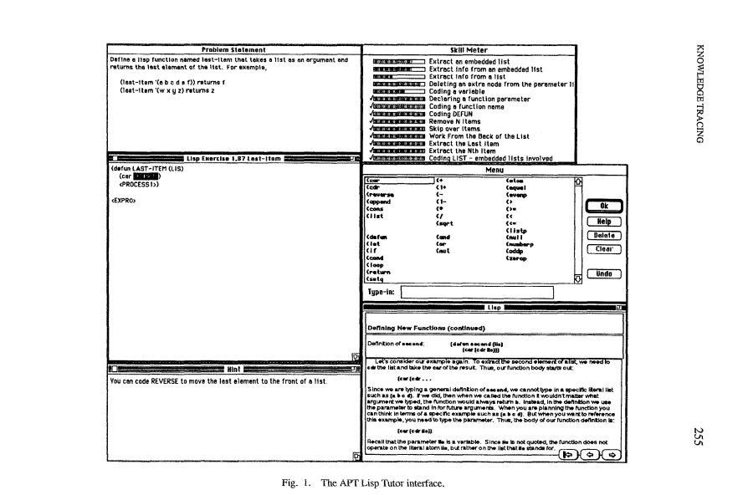
The ACT Programming Tutor

Slide 8
ideal student model
constructed around a set of several hundred language-specific rules for writing programs
is a complete, executable model of procedural knowledge in the domain
ensure the student always remains on a recognized solution path.
action matches rule, accept and fires the rule
if not, gives a brief message

Slide 9
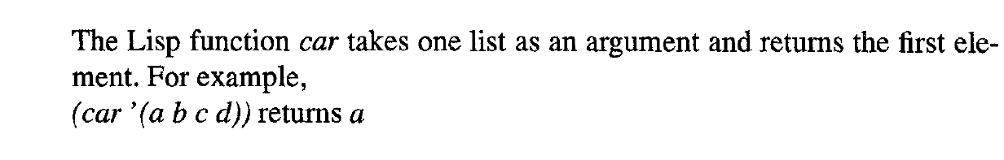
The Cognitive Model
The tutor reflect the ACT-R theory of skill knowledge
ACT-R assumes a fundamental distinction between declarative knowledge and procedural knowledge
Declarative knowledge is factual or experiential
Procedural knowledge is goal-oriented and mediates problem-solving behavior

Slide 10
Assume
ACT-R assumes that knowledge is encoded initially in declarative form through experience such as reading.
early practice use procedural rules
then domain-specific procedural knowledge is acquired
with subsequent practice, both declarative and procedural knowledge are strengthened, and performance grows more rapid and reliable

Slide 11
Assume
ACT-R assumes that procedural knowledge can be represented as a set of independent production rules that associate problem states and problem-solving goals with actions and consequent state changes.
The following two goal-oriented productions can be derived from the declarative examples above through practice in writing function calls and evaluating function calls respectively

Slide 12
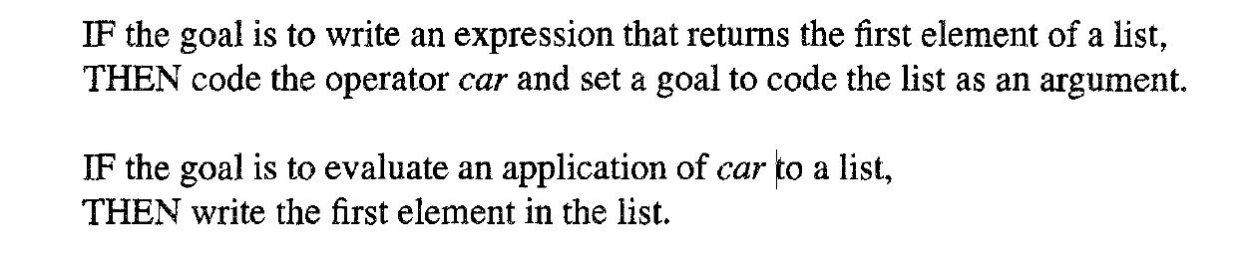

Slide 13
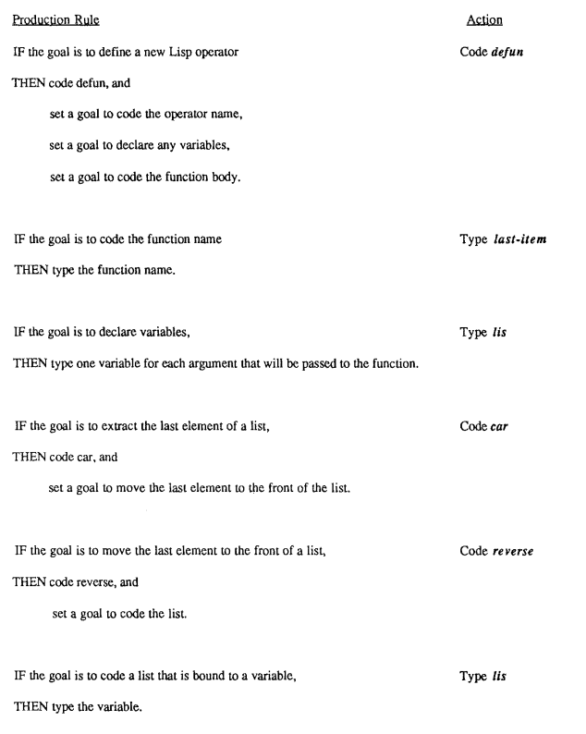
six production are employed for figure 1
(defun last-item (lis) (car (reverse lis)))

Slide 14
Ideal Model Plays Two Roles
model tracing
match action to rule,
if match, accepts the symbol and updates its internal representation of the problem state
if not, requires students try other action
knowledge tracing
estimate of the probability that the student has learned each rule

Slide 15
Evaluating ACT-R Procedural Knowledge Assumptions
One of the primary goals in our tutoring research has been to evaluate the ACT-R assumption that procedural knowledge maps onto independent production rules.
Three types of results provides support for this assumption:
A production rule model provides a regular analysis of learning trends.
Production rule analyses have proven successful in predicting transfer among programming languages and across text editors.
A variety of results supports the assumption that procedural knowledge is goal-specific.

Slide 16
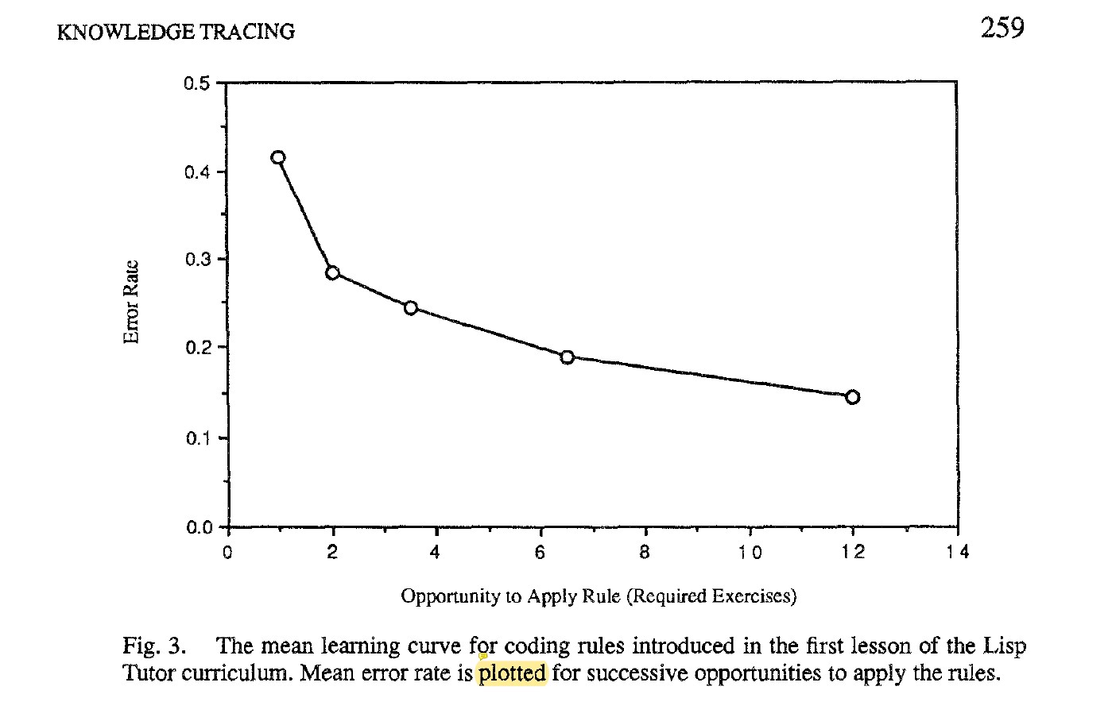
A production rule model provides a regular analysis of learning trends

Slide 17
Model Tracing
interpret each student action
follow the student’s step-by-step path through the problem space
Primary goal: provide whatever guidance is needed for the student to reach a successful conclusion to problem solving.

Slide 18
Knowledge Tracing and Mastery Learning
Students work through one-third exercises, while performing well or better on tests.
We recognized early on that some students were floundering.

Slide 19
Knowledge Tracing
Primary goal: monitor the student’s changing knowledge state during practice.
Student Model: is an overlay of the ideal student model
Each time the student has an opportunity to apply a rule in the model, the tutor updates its estimate of whether the student knows the rule, based on the student's action.

Slide 20
A simpler set of learning and performance assumptions because ACT-R are complex
Knowledge tracing assumes a two-state learning model.
Each coding rule is either in the learned state or in the unlearned state.
Transition: unlearned to learned, no forgetting
prior to practice through reading the text
at each opportunity to apply the rule in practice.
No forgetting
Performance in applying a rule is governed by its learning state, but only probabilistically.

Slide 21
A simpler set of learning and performance assumptions because ACT-R are complex
Slip and Guess
P(L) updated after each opportunity on whether the student’s action was correct or not.
Learning parameters
p(L₀), p(T)
Performance parameters
p(G), p(S)
These parameters are estimated empirically for each rule.

Slide 22
The equation to update the estimate of the student's knowledge state

Slide 23
Knowledge Tracing:
assessment is continuously integrated with practice.
learning and memory assumptions are the simplest
avoid the complexities in modeling students’ misconceptions
mastery learning simplifies a potentially complex ruel-attribution problem.

Slide 24
Empirical Evaluation of Knowledge Tracing
Goal
estimate student’s knowledge
ensure a high probability that each rule is in the learned state.
Four studies:
assess the psychological validity of the student modeling process.
Notes:
经验主义的评估

Slide 25
First study
examines how well the model predicts students' performance in completing tutor exercises.
revise the initial cognitive rule set
adjust the learning and performance parameter setimates

Slide 26
The remaining three studies
examined the external validity of the model in predicting test performance
Knowledge tracing is ultimately useful only if it predicts students' performance when they are working on their own.
In these studies we focus on the students' ability to write the programs correctly without tutorial assistance.
The first of these three studies revealed the need to incorporate individual differences in learning and performance parameters in the model.
The final two studies assessed a procedure for doing this.

Slide 27
General Experimental Procedure
focuses on the first chapter in the Lisp Tutor curriculum
knowledge
two data types;
atoms (symbols)
lists (hierarchical groupings of symbols)
function calls
unary functions (extract information from or transform a list): car, cdr, reverse
three constructor functions (build new list): append, cons, list
function definitions
defun (define new function)
The curriculum structure has evolved across studies, but in each study, the chapter is divided into sections.

Slide 28
General Experimental Procedure
In each section the student reads text and then completes a fixed set of required exercises.
The tutor monitors the student's growing knowledge of the applicable programming rules as the student completes these required exercises.
Then the tutor presents remedial exercises as needed for the student to master the rules introduced in the section.
Students also complete one or more quizzes that similar to the tutor exercises during a study.

Slide 29
General Experimental Procedure
The primary goal of the first study is to examine how well the model predicts goal-by-goal performance in the tutor environment and to adjust the model accordingly.
The ultimate goal is addressed in the remaining three studies: predicting students' performance when working on their own outside the tutor environment.

Slide 30
First Study: Internal Validity, Predicting Tutor Performance
The tutor does not accept an incorrect programming action, the student is always on a recognizable solution path.
The model can predict the probability of a correct action at each successive goal in writing programs.
student s will perform a correct action at goal i:

Slide 31
First Study: Internal Validity, Predicting Tutor Performance
To assess the validity of the model in fitting the tutor data, we compute two measures at each coding goal in the fixed set of required exercises:
the actual probability of a correct response averaged across students
the model's predicted probability of a correct response averaged across subjects

Slide 32
First Study: Internal Validity, Predicting Tutor Performance
Three statistics to assess the predictive validity of the model
correlate the actual accuracy and predicted accuracy estimates across goals.
compute the mean error in prediction.
compute the mean absolute error in prediction.

Slide 33
Experiment 1: Internal Validity
examine the adequacy of the rule set and parameter estimates
cognitive model consisted of 21 coding rules for the dozen Lisp constructs being introduced.
The two learning and two performance parameter estimates were held constant across the twenty-one rules and the four values were estimated from an earlier group of students.
158 programming goals across 25 exercises
Students completed 14 remedial exercises, with a range from 1 t0 38.

Slide 34
Experiment 1: Internal Validity
The expected and actual probabilities were moderately correlated (r -- 0.47, p < 0.05), the mean error rate was 0.06 and the mean absolute error rate was 0.16.
The absolute error rate is relatively high and visual inspection of the data revealed that the predicted and actual values clearly deviated in systematic ways from the observed values. This led us to revise the knowledge tracing model in two ways.

Slide 35
Experiment 1: Internal Validity
First, it was apparent that the data is not well fit when learning and performance parameters are held constant.
Not surprisingly, some rules are harder to learn than others. Perhaps less obviously, the probability of slips and guesses also varies across rules.
If we allow the learning and performance parameter estimates to vary across rules, best fitting estimates provide a substantially better fit, r ≈ 0.85. The mean error in prediction, -0.01, and the absolute error in prediction, 0.07, are both reduced in the revised fit.

Slide 36
Experiment 1: Internal Validity
Second, it became obvious that some of the rules in the ideal model were too general, at least for some students, and were not well fit by the model.
Ultimately the cognitive model for this curriculum has grown to 55 rules.

Slide 37
External Validity: Predicting Test Performance
The more important issue is whether the model predicts students’ performance in working on their own after having archived “mastery”.
Students complete cumulative tests, the same types of programming exercises.

Slide 38
External Validity: Predicting Test Performance
External validity assessments differ from the internal validity assessments in two ways:
the unit of measurement is the complete exercise rather than the individual programming goal. Since students are not constrained to remain on a successful solution path in testing.
we are interested in how well the model predicts individual differences across students rather than across programming tasks.
Two measures for each student across all the exercises in a test:
the actual probability of completing an exercise correctly and the predicted probability of completing an exercise correctly.
three statistics to compare these two measures

Slide 39
Experiment2: External validity
Goal: examine the predictive validity of the model for test performance.
Twenty college students participated in the first study of external validity.
They worked through six curriculum sections in this study and completed cumulative tests following the first, fourth and sixth sections.
64 exercises and 345 programming goals

Slide 40
Experiment2: External validity
Students worked to mastery in the first five curriculum sections, but not in the sixth and final section.
In the first five sections students completed an individualized sequence of remedial exercises governed by the knowledge tracing process.
In the final section, students, students completed affixed set of exercise with no remediation.

Slide 41
Future Directions
Slip parameter is importance in test predictions.

