Slide 1
Deep Knowledge Tracing
Piech C, Bassen J, Huang J, et al. Deep knowledge tracing[J]. neural information processing systems, 2015: 505-513.

Slide 2
Abstract
using RNN to model student learning
have important advantages over previous methods.
not require the explicit encoding of human domain knowledge.
can capture more complex representation of student knowledge.
using RNN results in substantial improvements in prediction
the learned model can be used:
intelligent curriculum design
straightforward interpretation ?
discovery of structure in students tasks

Slide 3
Introduction
DKT
using large vectors of artificial neurons
allows the latent variable represent knowledge to be learned from data rather than hard-coded?
The main contributions of this work are:
a novel application of RNN to tracing student knowledge
a 25% gain in AUC over the best previous result
not need expert annotations
discovery of exercise influence and generation of improved exercise curricula.

Slide 4
Knowledge Tracing
given observations of interactions x₀…x_{t} taken by a student on a particular task
predict aspects of their next interaction x_{t+1}
not need exercise tags
can autonomously learn content substructure

Slide 5
Related Work
the human mind, and its learning process, are recursive and driven by analogy

Slide 6
Bayesian Knowledge Tracing
the most popular approach for building temporal models of student learning
use binary data represent known and unknown
never forget
recent extensions:
contextualization of guessing and slipping estimates
estimating prior knowledge for individual learners
estimating problem difficulty

Slide 7
Bayesian Knowledge Tracing
several difficulties:
the binary representation may be unrealistic
the meaning of the hidden variables and their mappings onto exercises can be ambiguous, rarely meeting the model’s expectation of a single concept per exercise
the binary response data used to model transitions imposes a limit on the kinds of exercises that can be modeled?

Slide 8
Other Dynamic Probabilistic Models
Partially Observable Markov Decision Processes (POMDPs)
the learner follows an open-ended path to arrive at a solution
require exploration of an exponentially large state space
current implementations:
restricted to a discrete state space
hard-coded meanings for latent variables
Performance Factors Analysis (PFA) & Learning Factors Analysis (LFA)
Ensemble Models
AdaBoost, Random Forest, linear regression, logistic regression a feed-forward neural network
ensemble techniques require accurate concept labeling

Slide 9
Recurrent Neural Networks
flexible dynamic models which connect artificial neurons over times
the propagation of information is recursive in hidden neurons
hidden neurons evolve based on both the input and their previous activation
hmm models are also dynamic, RNNs have a high dimensional, continuous, representation of latent state.
RNNs can use information from an input in a prediction at a much later point in time.

Slide 10
Deep Knowledge Tracing
human learning is governed by many diverse properties, many of which are difficult to quantify
two different types of RNNs:
a vanilla RNN model with sigmoid units
a Long Short Term Memory model

Slide 11
Model: RNNs
x, hidden states, y
hidden state: successive encodings of relevant information from past observations that will be useful for future predictions

Slide 12
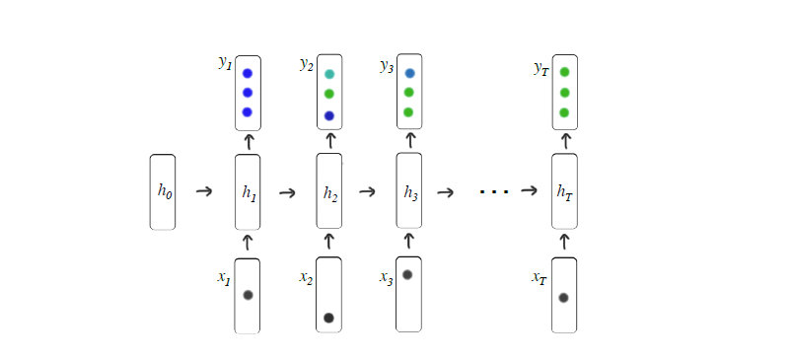
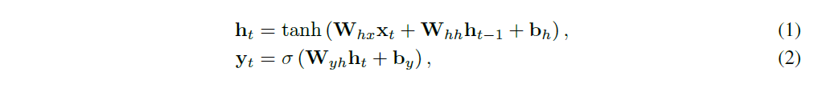
Model: RNNs

Slide 13
Model: LSTM
prove more powerful
latent units retain their values until explicitly cleared by the action of a “forget gate”
retain information for many time steps, which is believed to make them easier to train
hidden units are updated using multiplicative interactions, they can perform more complicated transformations

Slide 14
Input and Output Time Series
convert input vectors x_{t} into a sequence of fixed length
two methods:
with a small M of unique exercises: one-hot encodings
h_{t} = { q_{t}, a_{t} }
x_{t}∈{0, 1}^{2M}
having separate representations for q_{t} and a_{t} degraded performance?
for large number of exercises: random vector n_{q,a}~ N(0, I)
n_{q,a}∈R^{N}, N << M
x^{t} = n_{qt}, a_{t}
compressed sensing

Slide 15
Input and Output Time Series
y_{t} is a vector of length equal to the number of problems
each entry represents the predicted probability that the student would answer that particular problem correctly.

Slide 16

Optimization
negative log likelihood of the observed sequence of student responses under the model
δ(q_{t+1}): the one-hot encoding of which exercise is answered at time t+1
ι: binary cross entropy
stochastic gradient descent on mini batches

Slide 17
Optimization
dropout to h_{t} when computing y_{t}, but not when computing the next hidden state h_{t+1}
to prevent gradients from exploding:
backpropagate through time by truncating the length of gradient whose norm is above a threshold
consistently used hidden dimensionality of 200 and a mini-batch size of 100

Slide 18
Educational Applications
Improving Curricula
choosing the best sequence of learning items to present to a student.
Discovering Exercise Relationships
discovering latent structure or concepts in the data

Slide 19
Dataset
three dataset:
Simulated Data:
Khan Academy Data
the Assistments benchmark dataset
for non-simulated data
5-fold cross validation

Slide 20
Simulated Data
2000 students, 50 exercises, 5 concepts
each student has a latent knowledge state for each concept
each exercise has both a single concept and a difficulty
skill α, difficulty β
Item Response Theory: p(correct| α, β) = c + (1-c)/(1+e^{-αβ})
c is the probability of a random guess (0.25)
input: exercise index and whether answered correctly

Slide 21
Khan Academy Data
47495 students, 1.4million exercises, 69 different exercise types
It did not contain any personal information.

Slide 22
Benchmark Dataset
The largest publicly available knowledge tracing dataset
The Assistments 2009-2010 public benchmark dataset

Slide 23
Results
On all three dataset, DKT substantially outperformed previous models
Khan dataset: AUC: LSTM, 0.85; BKT, 0.68; Baseline, 0.63?
Assistments dataset: DKT has a 25% gain, 0.69-> 0.86

