Slide 1
Individualized Bayesian Knowledge Tracing Models
Yudelson M, Koedinger K R, Gordon G J, et al. Individualized Bayesian Knowledge Tracing Models[C]. artificial intelligence in education, 2013: 171-180.

Slide 2
Abstract
Standard BKT: only skill-specific parameters
Many research suggests: student-specific parameters
Result:
Student-specific parameters lead to a tangible improvement
Parameterizing P(T) is more beneficial than P(L₀)

Slide 3
Introduction
Before individualized bkt models
Quite different approaches to defining and learing student-specific parameters
Report radically different performance measures
This paper
In a more systematic manner
In an incremental manner
Adding student-specific parameters in batches

Slide 4
Related Work: Bayesian Knowledge Tracing
four types of parameters:
p(L₀)
pT
pF
pG
pS

Slide 5
Student-specific Parameters in BKT
student proficiency: student prior ability
logistic regression: Rasch model (1PL IRT)
Additive Factors Models

Slide 6
Original BKT
Skill parameters
Data of all students practicing skill k
Student parameters
All data of student u
Using a special function to combine skill parameters and student parameters yield a value to be used for updating the probability of skill mastery.

Slide 7
Original BKT
Better correlation between actual and expected accuracy across students
Accuracy of predicting test scores not improve tangibly

Slide 8
Pardos and Heernan individualized P(L₀)^{k}
Initial P(L₀) by assigning according to a set of heuristics:
Randomly, by selecting from two pre-set values based on first student response correctness, by suing overall percent correct.

Slide 9
Lee & Brunskill individualizing all four BKT paras
They only fit per-student parameters for each student.
assuming there is one skill for all students to learn
Whether schedule fewer or more practice opportunities.
Save time for stronger students and allocate more time for struggling ones.

Slide 10
Methods
Unify and extend prior work on individualized BKT models.
Construct four variants of individualized BKT models.
Rank the constructed models with respect to predictive accuracy on unseen data.

Slide 11
Not use EM
EM not directly optimize a likelihood of the student observations .
EM could make adjustments to BKT parameters that would actually worsen the fit.
Using gradient-based optimization techniques allows us to introduce students-specific parameters to BKT without expanding the structure of the underlying HMM.

Slide 12
objective function: negative log likelihood, J = -log(L_{tot}).
L_{tot}:
The sum of all likelihoods p{O|λ} for all student-skill practice sequences in our data.

Slide 13
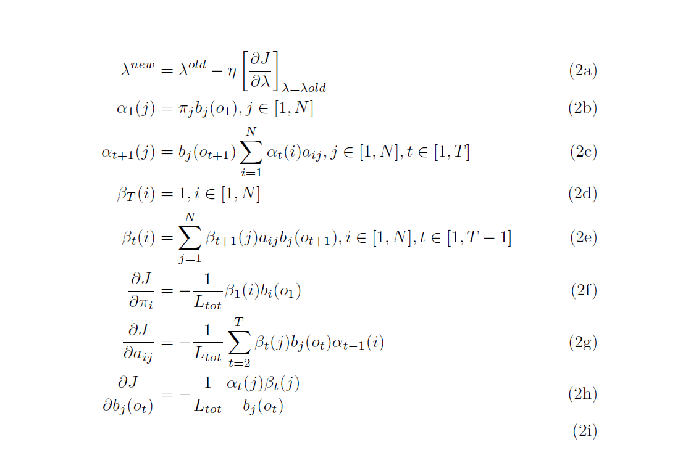
η is the search step size.

Slide 14
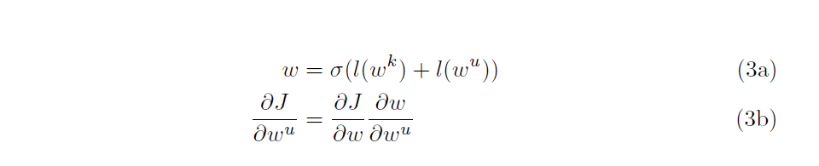
Using ω to substitute for each of the corresponding skill-specific BKT parameters (π_{i} a_{ij,} b_{j}(m)).
ω^{k} is the skill-specific component of the parameter.
ω^{u} is the student-specific component of the parameters.
l(p) = log[p/(1-p)] is a logit function
σ(x) = 1/(1+e^{-x}) is a sigmoid function (inverse of logit).

Slide 15
Data: KDD Cup 2010 Educational Datamining Challenge
Algebra I:
3310 students, 8918054 rows.
Model1: 515 distinct skills, 4419705 rows.
Model2: 541 distinct skills, 6442137 rows.
Bridge to Algebra:
6043 students, 20012498rows.
Model1: 807 skills, 11239188 rows.
Model2: 933 skills, 12350449 rows.

Slide 16
Fitting Procedures
Created a tool fitting and cross-validating standard and individualized BKT model.
Classical BKT: EM
Classical and Individualized BKT:
gradient descent(using linear step size search).
a set of versions of conjugate gradient descent method.

Slide 17
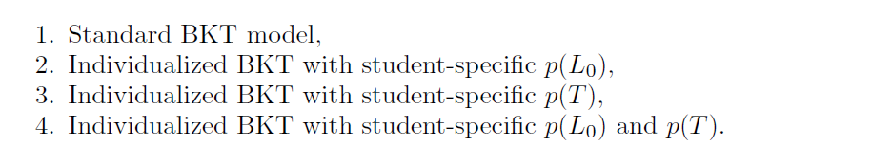
Variants BKT models

Slide 18
Variants BKT models
Constrained model values for all guess and slip parameters to prevent the occurrence of a phenomenon called model degeneracy.
All of the models were cross-validated using 10 randomly assigned user-stratified folds.
For each of the cross-validation results we computed root mean squared error (RMSE) and accuracy.

Slide 19
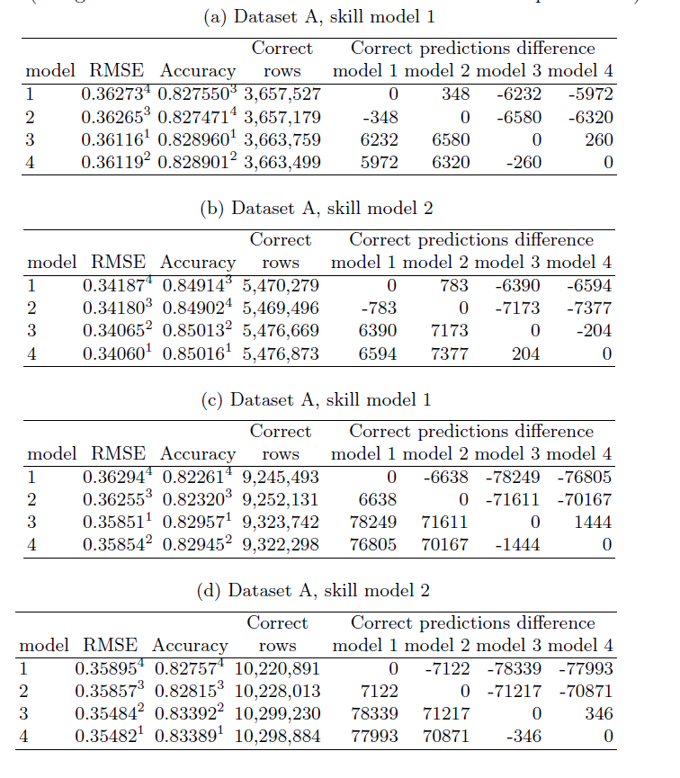
Results

Slide 20
Results
student-specific a priori p(L₀) has no effect on model performance.
Individualized p(T) can be considered superior to the standard BKT and other individualized models.

Slide 21
Conclusions

