Slide 1
AZURE STORAGE
Complete Lab Guide - 11 Hands-On Labs
A step-by-step guide with real portal screenshots.
Every screen is marked so you know exactly where to click.
IIMT University, Meerut
BCA 3rd Semester | Cloud Computing with Microsoft Azure
Prepared by: Sahil

Slide 2
What is Azure Storage?
Azure Storage is a cloud service from Microsoft where you can keep your files, folders, backups and application data. You do not need your own hard disk or server - Microsoft keeps your data safe in their data centres and you can open it from anywhere using the internet.
Blob Storage
File Share
Queue Storage
Table Storage
For files like photos, videos, documents, backups. "Blob" means a big file. This is the most used type.
A shared folder in the cloud. You can connect it to your computer like a normal network drive (Z: drive).
For sending small messages between two applications so they can work one after another.
For storing simple data in rows and columns, like a very light database.
SIMPLE EXAMPLE
Think of a Storage Account as a cupboard that Microsoft gives you in the cloud. Inside that cupboard you make folders (called containers), and inside the folders you keep your files (called blobs). The cupboard has one address, and only people you give a key to can open it.
IIMT University, Meerut | BCA 3rd Semester | Cloud Computing with Microsoft Azure
Introduction

Slide 3
The 11 Labs - What We Will Do
1
Create a Storage Account
7
Snapshot
Make your own storage in Azure
Take a manual backup copy of a file
2
Blob Storage
8
Access Tiers
Make a container and upload a file
Change Hot / Cool / Archive to save money
3
SAS Token
9
Lifecycle Policy
Share a file safely for a limited time
Let Azure move old files automatically
4
File Share
10
Soft Delete
Create a shared folder in the cloud
Get back a file after deleting it
5
Mount File Share
11
Static Website
Connect that folder to a computer
Host a real website from storage
6
Versioning
Keep old copies of a file automatically
IIMT University, Meerut | BCA 3rd Semester | Cloud Computing with Microsoft Azure
Course map

Slide 4
How to Read These Slides
Every lab slide has the same four parts. Once you understand them, you can follow any lab without help.
1
The screenshot (left)
The real Azure portal screen. Red boxes with numbers show exactly where you have to click or type. Number 1 is done first, then 2, then 3.
2
Goal of this step (top right)
One line telling you why you are doing this step.
3
Steps to follow (right)
The exact clicks in order. The numbers match the red boxes on the screenshot.
4
Expected result (bottom right, green)
What you should see on your screen after finishing. If you see this, your step is correct.
IIMT University, Meerut | BCA 3rd Semester | Cloud Computing with Microsoft Azure
Guide

Slide 5
Goal of this lab
LAB
Create your own storage account in the Azure portal. This is the base for every other lab - without it you cannot store anything.
01
What you will learn
Where to find Storage accounts in the Azure portal
What a Resource Group is and why we need one
Why the storage account name must be lowercase and unique
What LRS redundancy means
How to read the Review + create page before clicking Create
Create a Storage Account
IIMT University, Meerut | BCA 3rd Semester | Cloud Computing with Microsoft Azure
Lab 1

Slide 6
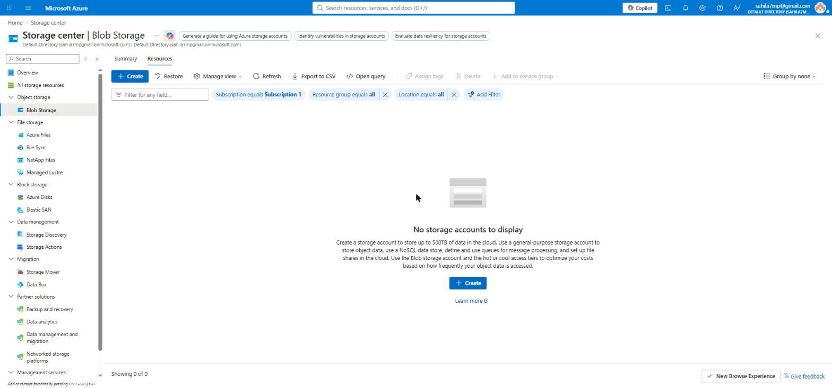
LAB 1
Step 1 of 6
Open Storage accounts and click + Create
GOAL OF THIS STEP
Reach the page where new storage accounts are created.
1
STEPS TO FOLLOW
1. Open portal.azure.com and sign in.
2. In the top search bar type "Storage accounts" and open it.
3. The list is empty because you have not made any account yet.
4. Click the blue + Create button in the toolbar (marker 1). The big + Create button in the middle (marker 2) does the same thing.
2
WHAT THIS SCREEN SHOWS
This is the Storage center page. The left side menu lists every type of Azure storage - Blob Storage, Azure Files, Azure Disks and more. The message "No storage accounts to display" simply means your subscription has no storage account yet.
EXPECTED RESULT
The "Create a storage account" form opens, showing the Basics tab.
IIMT University, Meerut | BCA 3rd Semester | Cloud Computing with Microsoft Azure
Lab 1 - Storage Account

Slide 7
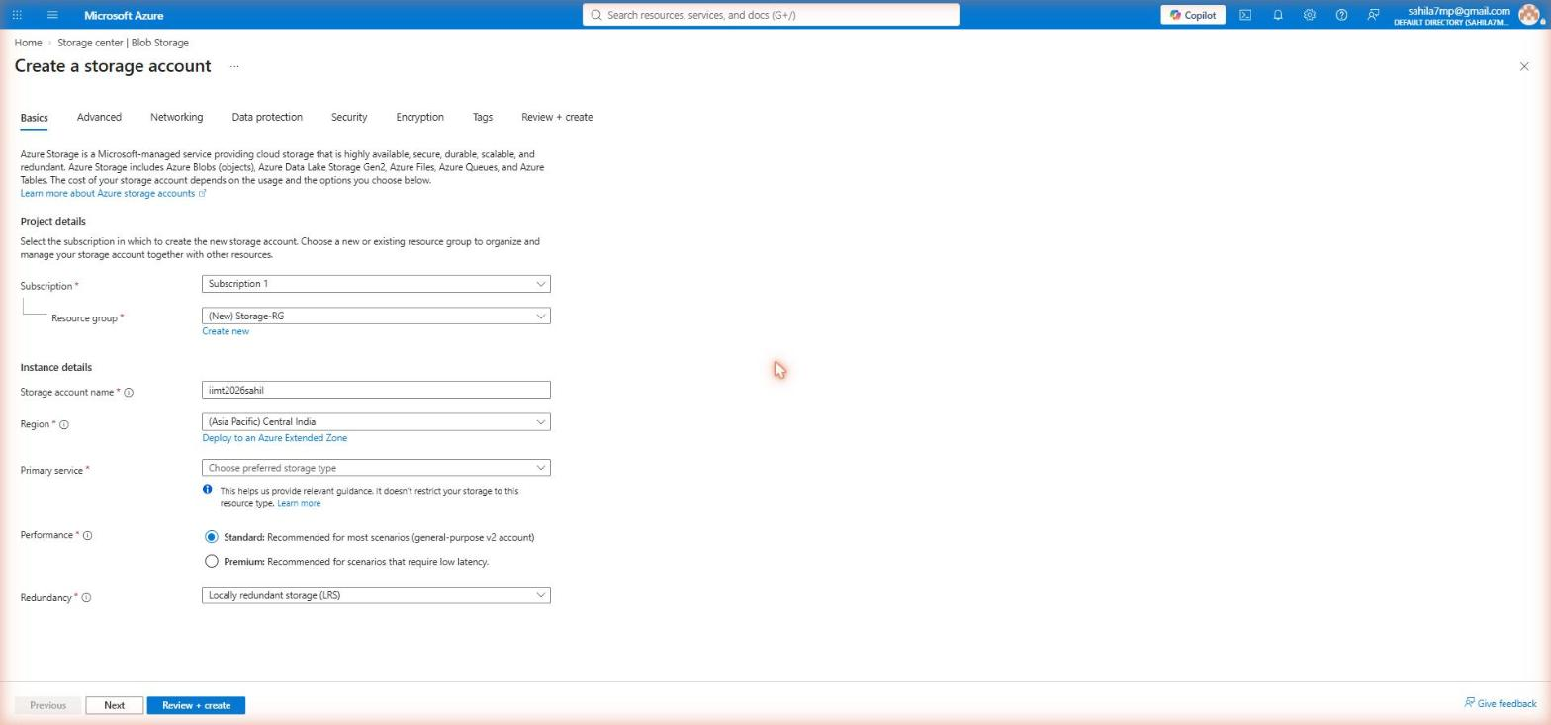
LAB 1
Step 2 of 6
Fill the Basics tab
GOAL OF THIS STEP
Give the storage account its name, location and basic settings.
STEPS TO FOLLOW
1. Subscription: keep "Subscription 1".
2. Resource group: click "Create new" and type Storage-RG (marker 1). A resource group is just a folder that holds related Azure resources.
3. Storage account name: type iimt2026sahil (marker 2). Use small letters and numbers only - this name must be unique in the whole world.
4. Region: choose Central India (marker 3) so the data stays close to you.
5. Performance: Standard. Redundancy: LRS.
6. Click Review + create (marker 4).
1
2
3
4
IMPORTANT TERMS ON THIS SCREEN
Resource group = a folder for your Azure resources, so you can manage or delete them together. Region = the city whose data centre will hold your data. LRS (Locally Redundant Storage) = Azure keeps 3 copies of your data inside one data centre. It is the cheapest option and is enough for practice.
EXPECTED RESULT
Azure validates your input and moves you to the Review + create page.
IIMT University, Meerut | BCA 3rd Semester | Cloud Computing with Microsoft Azure
Lab 1 - Storage Account

Slide 8
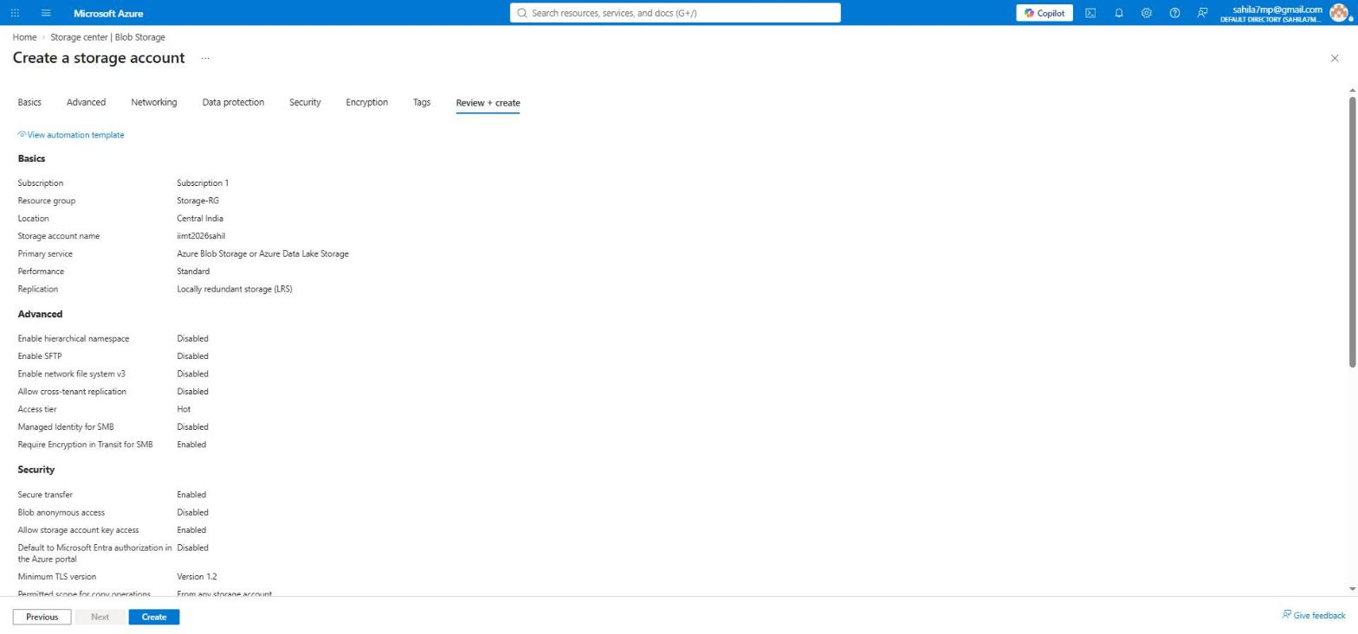
LAB 1
Step 3 of 6
Review + create - check your settings
GOAL OF THIS STEP
Read every setting once before Azure creates the account.
1
STEPS TO FOLLOW
1. The Review + create tab is now selected (marker 1).
2. Check the Basics section: name, region, performance and replication.
3. Check the Advanced section: Access tier should be Hot.
4. If something is wrong, click Previous and fix it.
5. When everything looks correct, click Create (marker 2).
2
WHAT THIS SCREEN SHOWS
This page is a summary of all seven tabs. "Hierarchical namespace" and "SFTP" are disabled - we do not need them. "Access tier: Hot" means the data will be used often, so reading it is fast and cheap.
EXPECTED RESULT
Deployment starts. You will see "Deployment is in progress" for about 30 seconds.
IIMT University, Meerut | BCA 3rd Semester | Cloud Computing with Microsoft Azure
Lab 1 - Storage Account

Slide 9
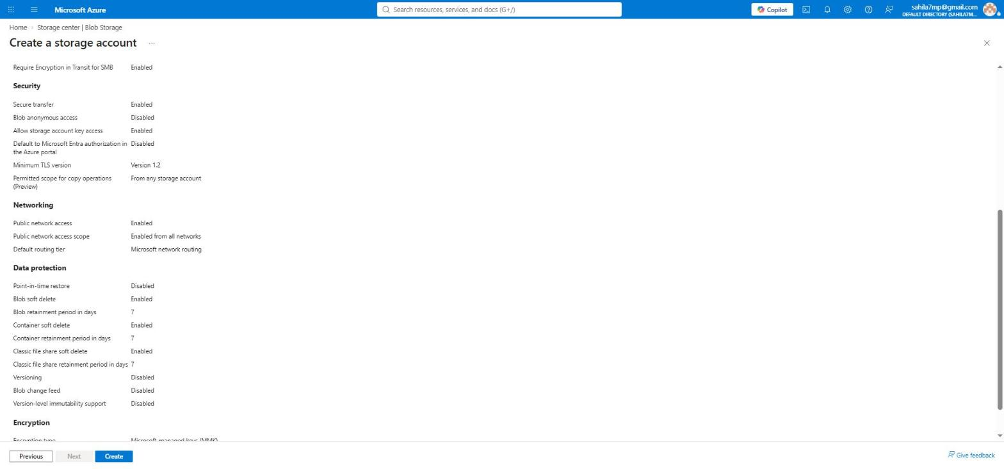
LAB 1
Step 4 of 6
Review page - Security, Networking and Data protection
GOAL OF THIS STEP
Understand the safety settings Azure has turned on by default.
STEPS TO FOLLOW
1. Scroll down on the same Review + create page.
2. Secure transfer: Enabled - data can travel only over HTTPS.
3. Blob anonymous access: Disabled - nobody can open your files without permission.
4. Minimum TLS version: 1.2 - an old, weak encryption is not allowed.
5. Data protection: soft delete is on for 7 days for blobs, containers and file shares.
WHY THIS MATTERS
These defaults are the reason a new storage account is private and safe. Soft delete (7 days) is the setting we will actually use later in Lab 10, when we delete a file and bring it back.
EXPECTED RESULT
You now know which safety features are already protecting your account.
IIMT University, Meerut | BCA 3rd Semester | Cloud Computing with Microsoft Azure
Lab 1 - Storage Account

Slide 10
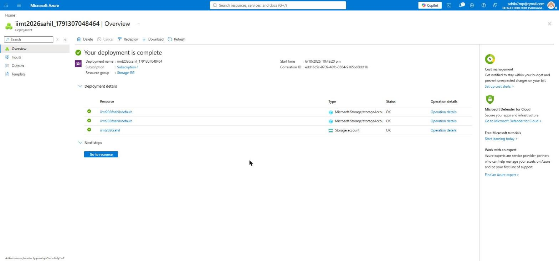
LAB 1
Step 5 of 6
Deployment complete
GOAL OF THIS STEP
Confirm the storage account was created and open it.
STEPS TO FOLLOW
1. Wait until you see the green tick and "Your deployment is complete".
2. Expand Deployment details - all three resources show Status = OK.
3. Click the blue "Go to resource" button (marker 1).
1
WHAT THIS SCREEN SHOWS
Azure created three items: the storage account itself plus two default sub-resources (blob service and file service settings). A green tick on every row means nothing failed.
EXPECTED RESULT
The overview page of your storage account iimt2026sahil opens.
IIMT University, Meerut | BCA 3rd Semester | Cloud Computing with Microsoft Azure
Lab 1 - Storage Account

Slide 11
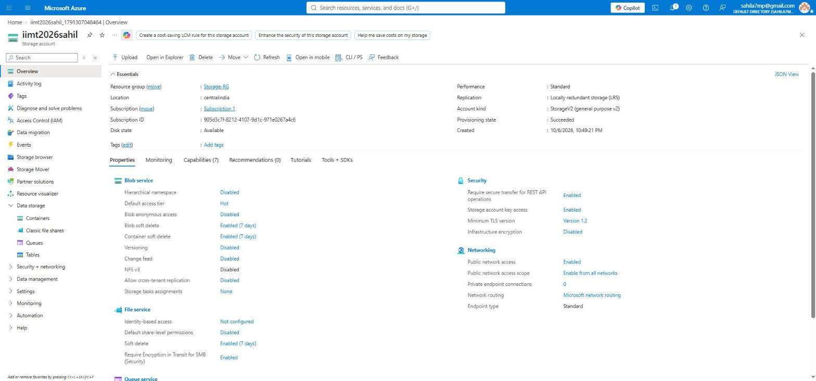
LAB 1
Step 6 of 6
Storage Account Overview - your home page
GOAL OF THIS STEP
Learn the layout of this page, because every later lab starts from here.
2
STEPS TO FOLLOW
1. Look at the Essentials box: Location, Replication and Account kind.
2. Account kind is StorageV2 - the modern general purpose account.
3. In the left menu open "Data storage" (marker 1). It has Containers, Classic file shares, Queues and Tables.
4. Remember this menu - Labs 2 to 11 all start from here.
1
LAB 1 COMPLETE
You created a storage account named iimt2026sahil in Central India with LRS replication. The Properties section on this page is a quick health report - it shows which features are on (soft delete) and which are off (versioning, change feed). We will switch some of these on in later labs.
EXPECTED RESULT
Lab 1 is finished. Your storage account is live and ready to use.
IIMT University, Meerut | BCA 3rd Semester | Cloud Computing with Microsoft Azure
Lab 1 complete

Slide 12
Goal of this lab
LAB
Create a container inside your storage account and upload your first file into it.
02
What you will learn
What a container is and why files cannot be uploaded without one
How to upload a file (a blob) from your computer
The three blob types: Block blob, Page blob and Append blob
How to read the blob list: type, access tier and size
Blob Storage - Container and Upload
IIMT University, Meerut | BCA 3rd Semester | Cloud Computing with Microsoft Azure
Lab 2

Slide 13
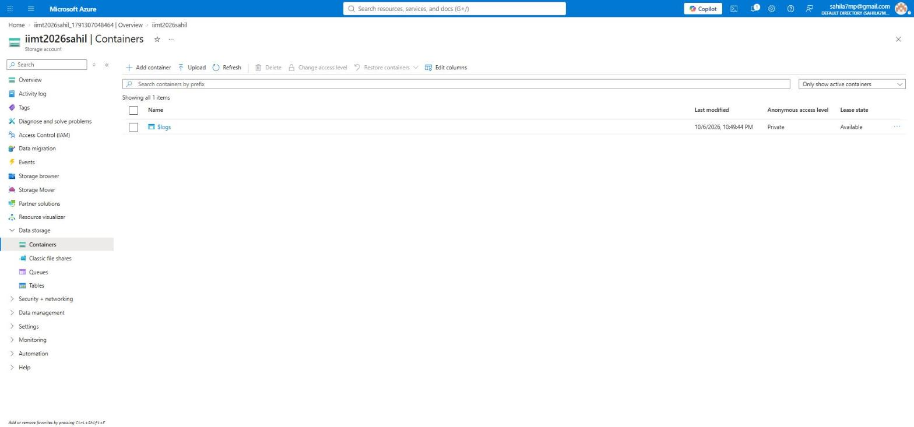
LAB 2
Step 1 of 6
Open Containers and click + Add container
GOAL OF THIS STEP
Start making a container, which is the folder that will hold your files.
1
STEPS TO FOLLOW
1. In the left menu click Data storage, then Containers.
2. You will see one container called $logs. Azure made it by itself to store system logs - do not touch it.
3. Click "+ Add container" in the toolbar (marker 1).
WHAT THIS SCREEN SHOWS
A container is like a folder. Azure does not allow you to upload a file directly into the storage account - the file must go inside a container. Container names must be in small letters, and you can use a hyphen but not a space.
EXPECTED RESULT
A "New container" panel slides in from the right side of the screen.
IIMT University, Meerut | BCA 3rd Semester | Cloud Computing with Microsoft Azure
Lab 2 - Blob Storage

Slide 14
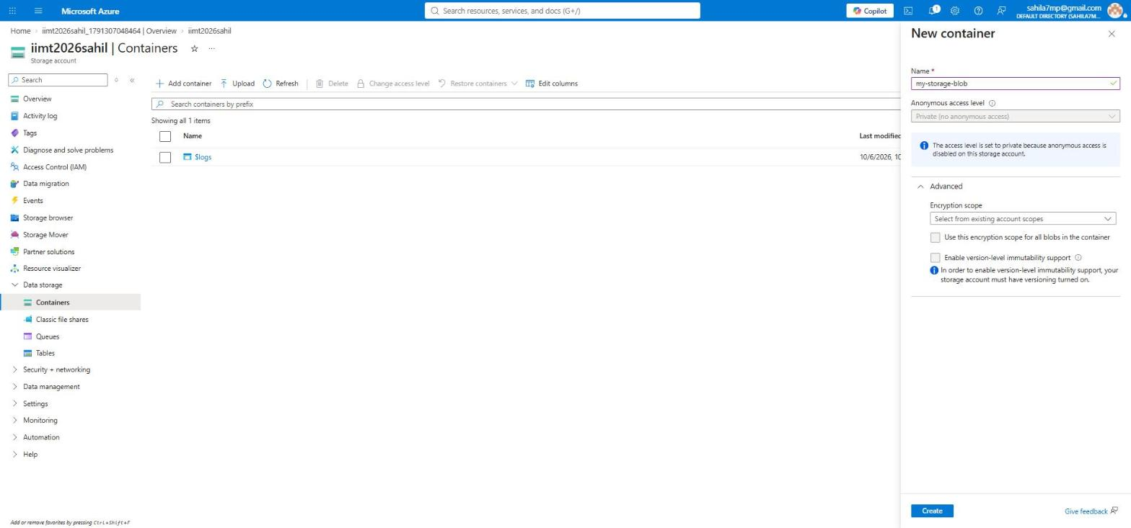
LAB 2
Step 2 of 6
Name the container and create it
GOAL OF THIS STEP
Give the container a name and keep it private.
1
STEPS TO FOLLOW
1. In the Name box type my-storage-blob (marker 1).
2. Anonymous access level is grey and fixed on "Private". You cannot change it here because anonymous access was disabled when we created the account.
3. Leave the Advanced options as they are.
4. Click the blue Create button at the bottom (marker 2).
2
PRIVATE MEANS SAFE
"Private (no anonymous access)" means a person with only the link cannot open your file. They also need a key or a SAS token. That is exactly what we will create in Lab 3.
EXPECTED RESULT
The panel closes and my-storage-blob appears in the container list.
IIMT University, Meerut | BCA 3rd Semester | Cloud Computing with Microsoft Azure
Lab 2 - Blob Storage

Slide 15

LAB 2
Step 3 of 6
Container created
GOAL OF THIS STEP
Check that the container was made, then open it.
1
STEPS TO FOLLOW
1. The list now shows 2 items: $logs (system) and my-storage-blob (yours).
2. Anonymous access level shows Private for both - this is correct.
3. Click on the name my-storage-blob to open it (marker 1).
WHAT THIS SCREEN SHOWS
Lease state "Available" means no process is currently locking the container, so you are free to add or delete files inside it.
EXPECTED RESULT
You go inside the container. It is empty for now.
IIMT University, Meerut | BCA 3rd Semester | Cloud Computing with Microsoft Azure
Lab 2 - Blob Storage

Slide 16
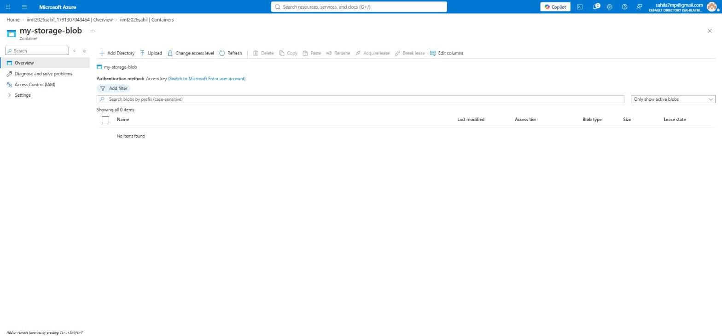
LAB 2
Step 4 of 6
Inside the container - click Upload
GOAL OF THIS STEP
Open the upload panel so you can send a file from your computer.
1
STEPS TO FOLLOW
1. The message "No items found" confirms the container is empty.
2. Click Upload in the toolbar (marker 1).
WHAT THIS SCREEN SHOWS
The toolbar here works on files, not on containers: Add Directory, Upload, Change access level, Delete, Copy, Paste and Rename. "Authentication method: Access key" means the portal is using your account key to show you this list.
EXPECTED RESULT
The "Upload blob" panel opens on the right.
IIMT University, Meerut | BCA 3rd Semester | Cloud Computing with Microsoft Azure
Lab 2 - Blob Storage

Slide 17
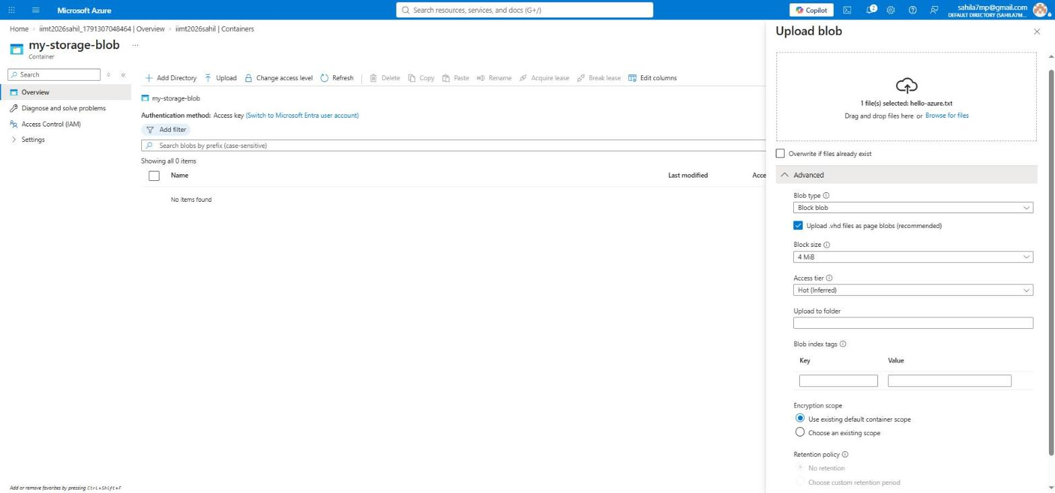
LAB 2
Step 5 of 6
Choose the file and check the settings
GOAL OF THIS STEP
Pick a file from your computer and confirm how it will be stored.
1
STEPS TO FOLLOW
1. Click "Browse for files" and pick hello-azure.txt, or drag the file into the box (marker 1).
2. Open Advanced. Blob type should be "Block blob" (marker 2).
3. Access tier shows "Hot (Inferred)" (marker 3) - it copies the account default.
4. Leave the other boxes empty and click Upload at the bottom of the panel.
2
3
WHAT IS "INFERRED"?
"Hot (Inferred)" means you did not choose a tier for this file, so it quietly takes the account default, which is Hot. In Lab 8 we will change this file to Cool and the word Inferred will disappear.
EXPECTED RESULT
A green notification appears and the file shows up in the container list.
IIMT University, Meerut | BCA 3rd Semester | Cloud Computing with Microsoft Azure
Lab 2 - Blob Storage

Slide 18
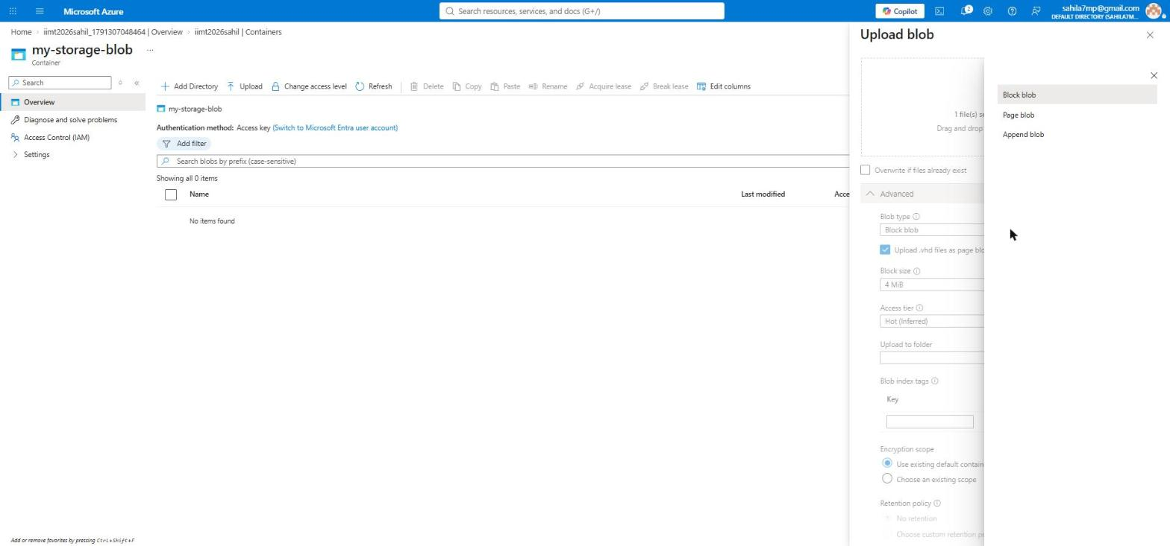
LAB 2
Concept
The three blob types - which one to choose
GOAL OF THIS STEP
Understand why we always pick Block blob for normal files.
1
STEPS TO FOLLOW
1. Open the Blob type dropdown to see all three choices (marker 1).
2. Block blob - for normal files: photos, videos, documents, backups. This is the default and the one we use.
3. Page blob - used by Azure for virtual machine disks, where data is read and written at random positions.
4. Append blob - for log files, where new lines are only added at the end.
5. Keep Block blob selected.
EASY WAY TO REMEMBER
Block = a normal file you upload once. Page = a hard disk for a virtual machine. Append = a diary where you only write at the bottom, never in the middle. Over 95% of real work uses Block blob.
EXPECTED RESULT
You can now explain the difference between the three blob types in a viva.
IIMT University, Meerut | BCA 3rd Semester | Cloud Computing with Microsoft Azure
Lab 2 - Blob Storage

Slide 19
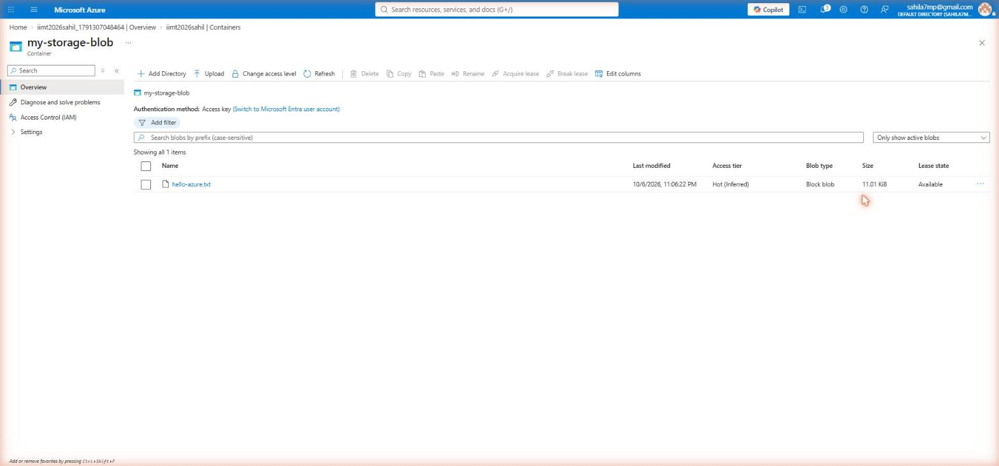
LAB 2
Step 6 of 6
File uploaded successfully
GOAL OF THIS STEP
Confirm the upload and read what each column means.
STEPS TO FOLLOW
1
2
1. hello-azure.txt now appears in the list (marker 1).
2. Access tier shows Hot (Inferred) (marker 2).
3. Blob type shows Block blob and Size shows 11.01 KiB.
4. Click on the file name to open its detail panel - we need it in Lab 3.
LAB 2 COMPLETE
You made a container named my-storage-blob and uploaded hello-azure.txt into it as a Block blob. The file now has its own URL: https://iimt2026sahil.blob.core.windows.net/my-storage-blob/hello-azure.txt - but nobody can open that link yet, because the container is private.
EXPECTED RESULT
Lab 2 is finished. Your first blob is stored in Azure.
IIMT University, Meerut | BCA 3rd Semester | Cloud Computing with Microsoft Azure
Lab 2 complete

Slide 20
Goal of this lab
LAB
Create a link that lets someone read your file for a limited time, without giving them your account key.
03
What you will learn
Why sharing the account key is dangerous
What SAS (Shared Access Signature) means
How to set permissions, start time and expiry time
How to read a SAS URL and understand its parts
SAS Token - Share a File Safely
IIMT University, Meerut | BCA 3rd Semester | Cloud Computing with Microsoft Azure
Lab 3

Slide 21
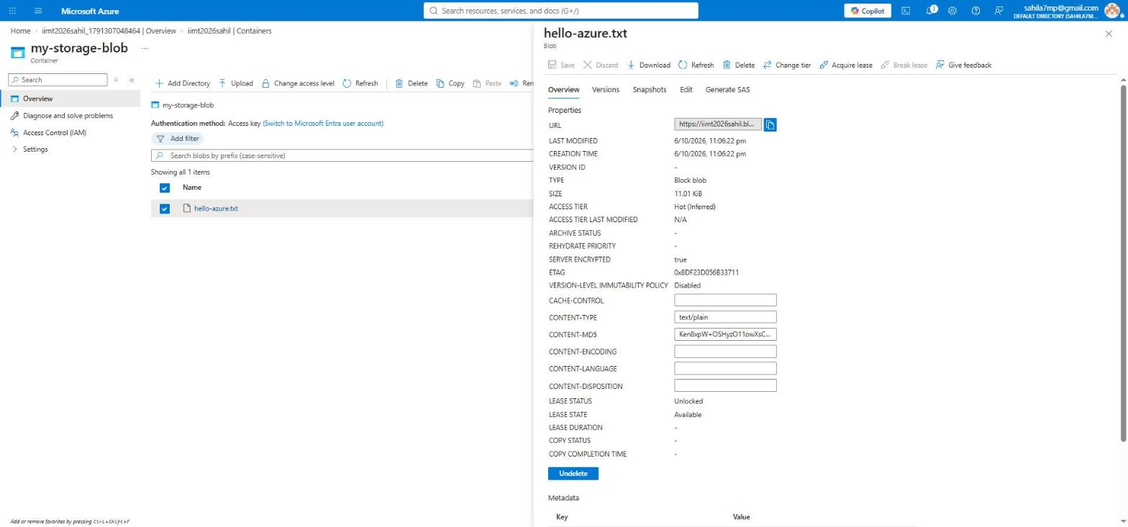
LAB 3
Step 1 of 3
Open the blob and go to the Generate SAS tab
GOAL OF THIS STEP
2
Open the settings page of the file you want to share.
1
STEPS TO FOLLOW
1. Click on hello-azure.txt in the container list.
2. The detail panel opens with five tabs: Overview, Versions, Snapshots, Edit and Generate SAS.
3. Read the Overview properties: TYPE = Block blob, SIZE = 11.01 KiB, ACCESS TIER = Hot, SERVER ENCRYPTED = true.
4. Click the "Generate SAS" tab (marker 1).
SERVER ENCRYPTED = TRUE
Azure encrypts every blob automatically when it is saved to disk. You do not have to switch this on and you cannot switch it off. "Change tier" in the top toolbar (marker 2) is what we will use in Lab 8.
EXPECTED RESULT
The SAS settings form opens inside the same panel.
IIMT University, Meerut | BCA 3rd Semester | Cloud Computing with Microsoft Azure
Lab 3 - SAS Token

Slide 22
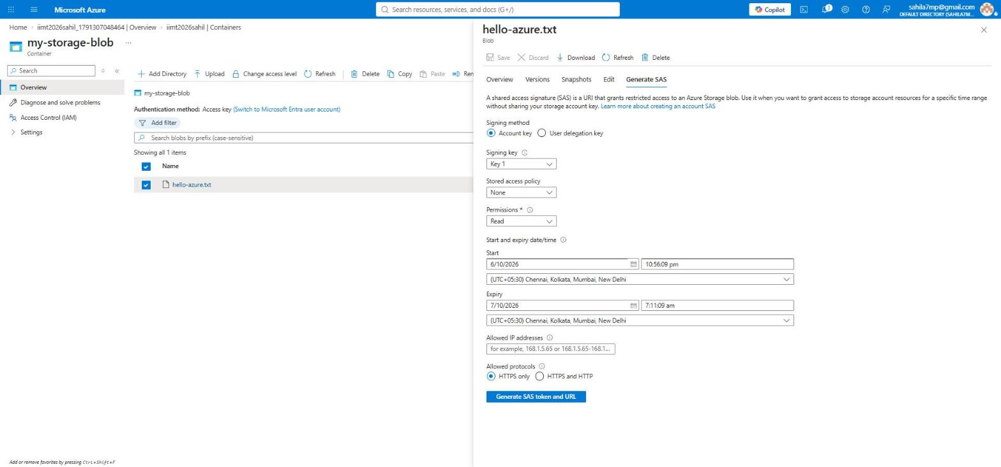
LAB 3
Step 2 of 3
Set the permissions and expiry time
GOAL OF THIS STEP
Decide what the other person can do and for how long.
STEPS TO FOLLOW
1. Signing method: keep "Account key".
2. Permissions: choose Read only (marker 1). The person can open the file but cannot change or delete it.
3. Start: keep today's date and time.
4. Expiry: set a date about one month ahead (marker 2). After this, the link stops working.
5. Allowed protocols: keep "HTTPS only".
6. Click "Generate SAS token and URL" (marker 3).
1
2
3
RULE OF LEAST PRIVILEGE
Always give the smallest permission and the shortest time that still does the job. If somebody only needs to read a file, never give Write or Delete. A SAS cannot be cancelled once it is given out, so a short expiry is your main protection.
EXPECTED RESULT
Two new boxes appear below the button: Blob SAS token and Blob SAS URL.
IIMT University, Meerut | BCA 3rd Semester | Cloud Computing with Microsoft Azure
Lab 3 - SAS Token

Slide 23
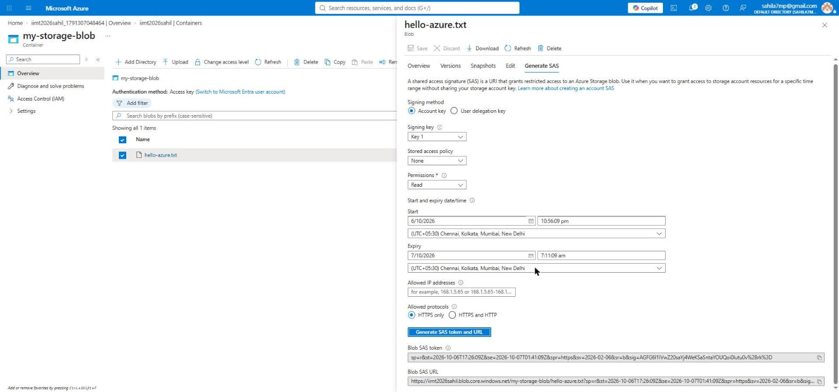
LAB 3
Step 3 of 3
SAS token and URL generated
GOAL OF THIS STEP
Copy the link and understand what each part of it means.
STEPS TO FOLLOW
1. Copy the "Blob SAS URL" using the copy icon on the right (marker 1).
2. Paste it in a new browser tab - the file opens without any login.
3. Copy it now, because Azure will not show this token again after you close the panel.
4. Try removing the part after the "?" and open it again - you will get an error. That proves the token is what gives access.
1
HOW TO READ A SAS URL
https://iimt2026sahil.blob.core.windows.net/my-storage-blob/hello-azure.txt?sp=r&st=...&se=...&sig=... sp=r means permission is read. st = start time. se = expiry time. spr=https means HTTPS only. sig is the signature Azure checks - if even one letter is changed, access is refused.
EXPECTED RESULT
Lab 3 is finished. You have a safe, time-limited sharing link.
IIMT University, Meerut | BCA 3rd Semester | Cloud Computing with Microsoft Azure
Lab 3 complete

Slide 24
Goal of this lab
LAB
Create a shared folder in the cloud that behaves like a normal network drive.
04
What you will learn
The difference between Blob Storage and File Share
What the SMB protocol is
How to create a classic file share
Where to find the Share URL you need for mounting
Azure File Share
IIMT University, Meerut | BCA 3rd Semester | Cloud Computing with Microsoft Azure
Lab 4

Slide 25
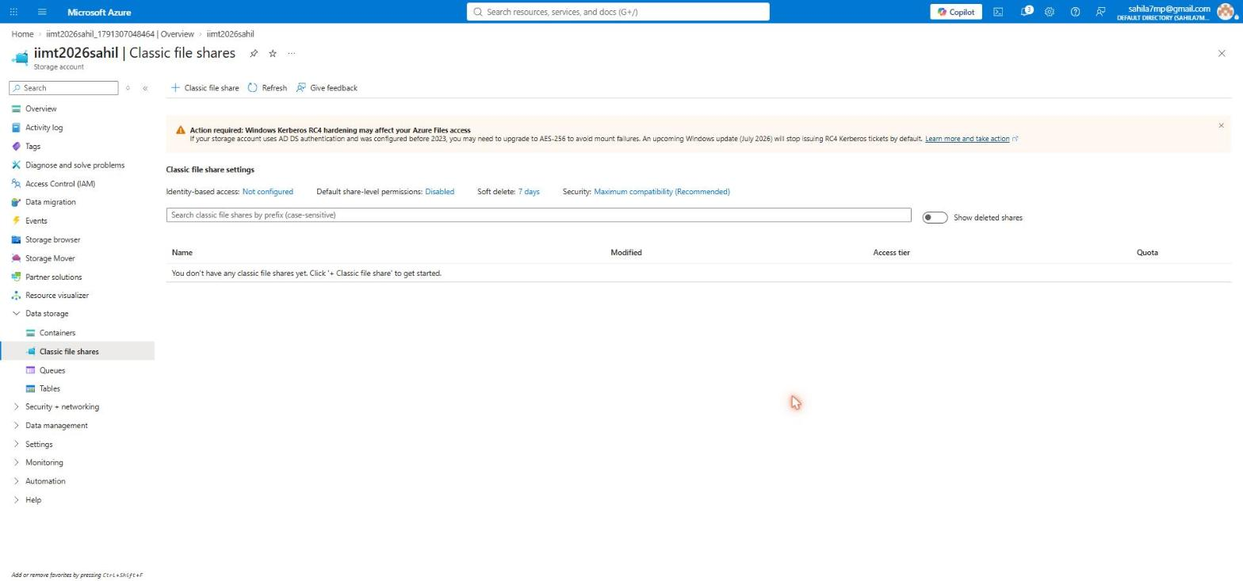
LAB 4
Step 1 of 3
Open Classic file shares and create one
GOAL OF THIS STEP
Reach the page where file shares are created.
2
STEPS TO FOLLOW
1. In the left menu, under Data storage, click "Classic file shares" (marker 1).
2. The message says you do not have any file shares yet.
3. Click "+ Classic file share" in the toolbar (marker 2).
1
BLOB vs FILE SHARE
Blob Storage is for applications - you reach a file through a URL or through code. A File Share is for people - you connect it to Windows or Linux and it appears as a normal drive or folder, so you can open, edit and save files directly.
EXPECTED RESULT
The "New classic file share" wizard opens with a Basics tab.
IIMT University, Meerut | BCA 3rd Semester | Cloud Computing with Microsoft Azure
Lab 4 - File Share

Slide 26
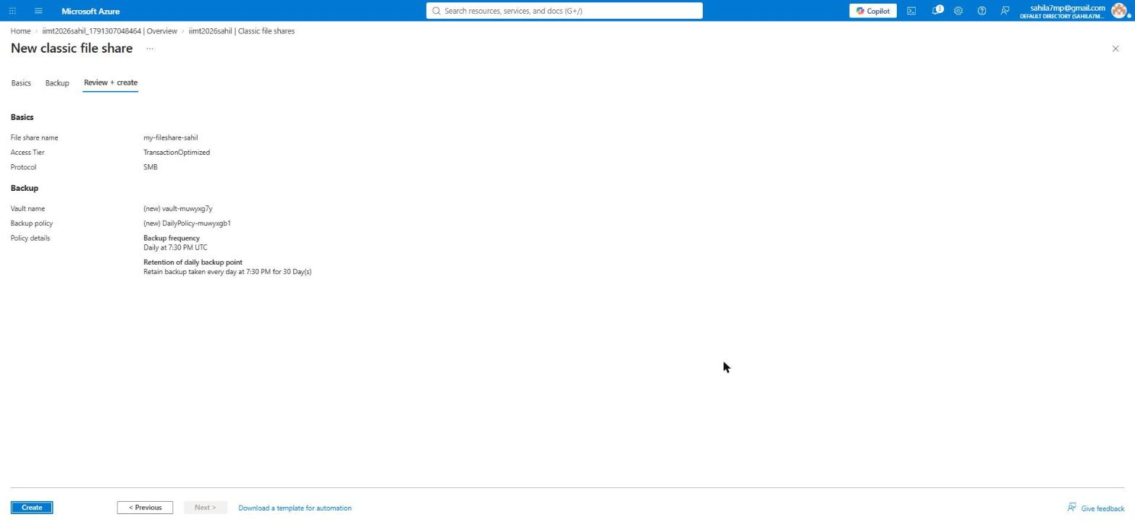
LAB 4
Step 2 of 3
Review the file share settings and create
GOAL OF THIS STEP
Confirm the name, tier and protocol before creating.
STEPS TO FOLLOW
1. File share name: my-fileshare-sahil.
2. Access Tier: TransactionOptimized - good for a share that is used often.
3. Protocol: SMB - the standard Windows file sharing protocol.
4. Backup: Azure offers a daily backup at 7:30 PM UTC kept for 30 days.
5. Click Create (marker 1).
1
WHAT IS SMB?
SMB (Server Message Block) is the protocol Windows has always used for shared folders on a network. Because Azure Files speaks SMB, your computer treats a cloud folder exactly like a folder on the office server - no special software needed.
EXPECTED RESULT
Azure creates the file share in a few seconds and opens its overview page.
IIMT University, Meerut | BCA 3rd Semester | Cloud Computing with Microsoft Azure
Lab 4 - File Share

Slide 27
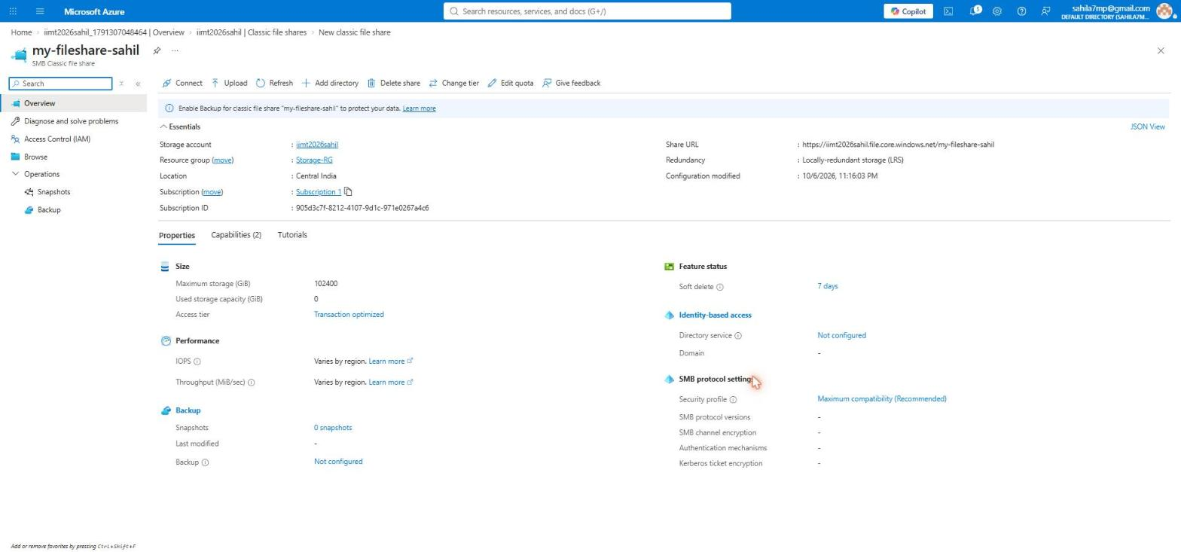
LAB 4
Step 3 of 3
File share created - note the Share URL
GOAL OF THIS STEP
Find the address you will need to connect this share to a computer.
2
1
STEPS TO FOLLOW
1. Copy the Share URL from the Essentials box (marker 1): https://iimt2026sahil.file.core.windows.net/my-fileshare-sahil
2. Note Max storage = 102400 GiB (100 TB) and Used = 0.
3. The Connect button in the toolbar (marker 2) gives the mounting script - we use it in Lab 5.
LAB 4 COMPLETE
Notice the address ends with file.core.windows.net, while a blob address ends with blob.core.windows.net. The word in the middle tells you which Azure storage service you are talking to. Used storage is 0 GiB because the share is still empty, and you only pay for what you actually use.
EXPECTED RESULT
Lab 4 is finished. Your cloud folder exists and is ready to be connected.
IIMT University, Meerut | BCA 3rd Semester | Cloud Computing with Microsoft Azure
Lab 4 complete

Slide 28
Goal of this lab
LAB
Connect the Azure file share to a real computer so it appears as a drive or folder.
05
What you will learn
How to get the ready-made mounting script from Azure
Why port 445 matters and why it is often blocked in India
How to mount on Windows (PowerShell) and on Linux (CIFS)
How to check the mount with the df -h command
Mount the File Share
IIMT University, Meerut | BCA 3rd Semester | Cloud Computing with Microsoft Azure
Lab 5

Slide 29
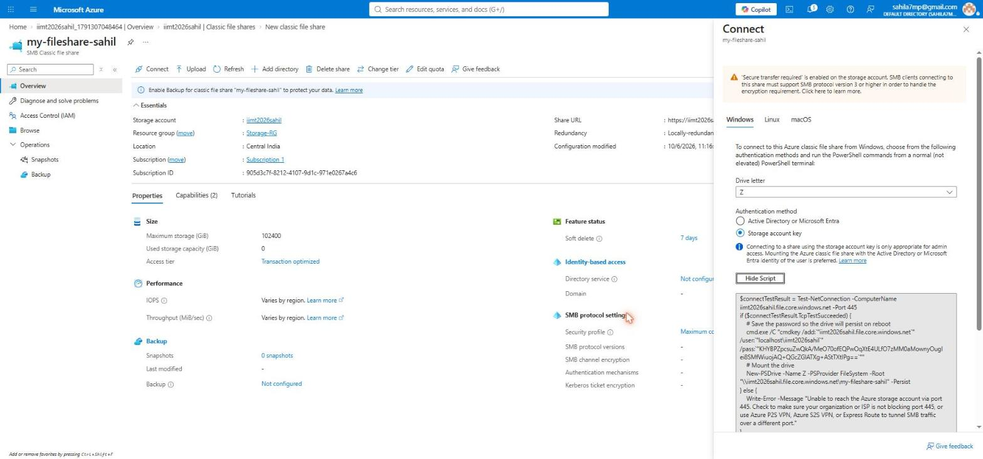
LAB 5
Step 1 of 3
Get the Windows mounting script
GOAL OF THIS STEP
Let Azure write the connection script for you.
1
STEPS TO FOLLOW
1. On the file share page click Connect in the toolbar.
2. The Connect panel opens with three tabs: Windows, Linux and macOS. Keep Windows (marker 1).
3. Drive letter: choose Z (marker 2). This is the letter the folder will get in This PC.
4. Authentication method: Storage account key.
5. Click "Show Script" (marker 3) and copy the whole script.
2
3
DO NOT SHARE THIS SCRIPT
The script contains your storage account key in plain text. Anyone who has that key has full control of your storage account. Never paste this script into WhatsApp, a public document or GitHub.
EXPECTED RESULT
A ready PowerShell script appears, already filled with your account name and key.
IIMT University, Meerut | BCA 3rd Semester | Cloud Computing with Microsoft Azure
Lab 5 - Mount File Share

Slide 30
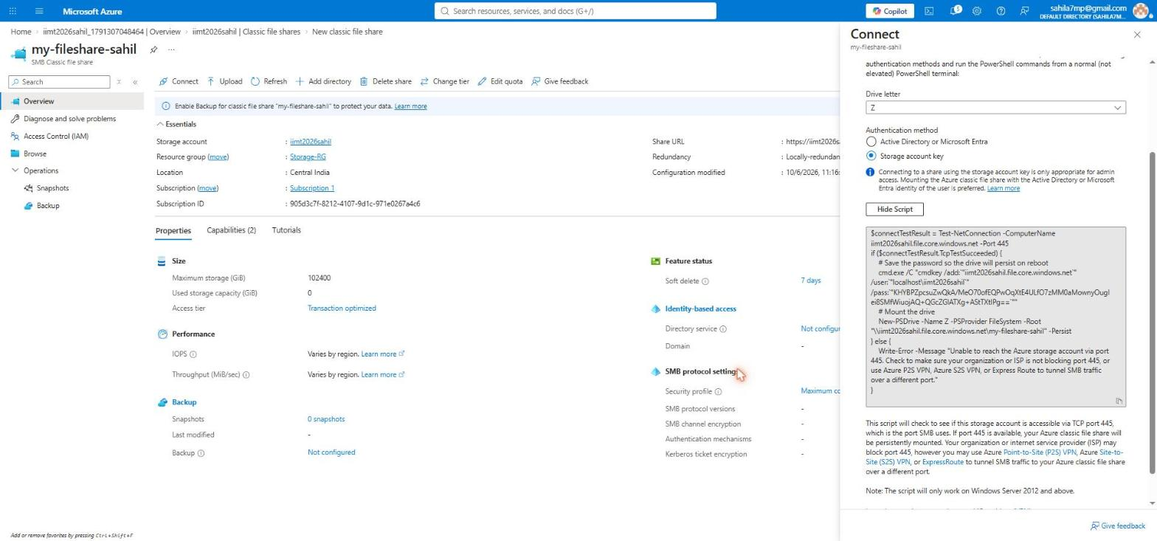
LAB 5
Step 2 of 3
Read the script - what each line does
GOAL OF THIS STEP
Understand the script instead of only copying it.
STEPS TO FOLLOW
1. Line 1 - Test-NetConnection checks if port 445 is open.
2. Line 2 - cmdkey saves your username and key in Windows Credential Manager, so the drive reconnects after restart.
3. Line 3 - New-PSDrive maps the share as drive Z. The -Persist flag makes it permanent.
4. The else part prints a clear error if port 445 is blocked.
5. Open PowerShell as a normal user, paste the script and press Enter.
THE PORT 445 PROBLEM IN INDIA
SMB uses TCP port 445. Most Indian home and college internet providers block this port for security reasons, so the mount fails from a normal PC. The fix is to mount from inside an Azure virtual machine, or over a VPN. This is why we used an Azure Linux VM in the next step.
EXPECTED RESULT
If port 445 is open, drive Z appears in This PC and you can copy files into it.
IIMT University, Meerut | BCA 3rd Semester | Cloud Computing with Microsoft Azure
Lab 5 - Mount File Share

Slide 31
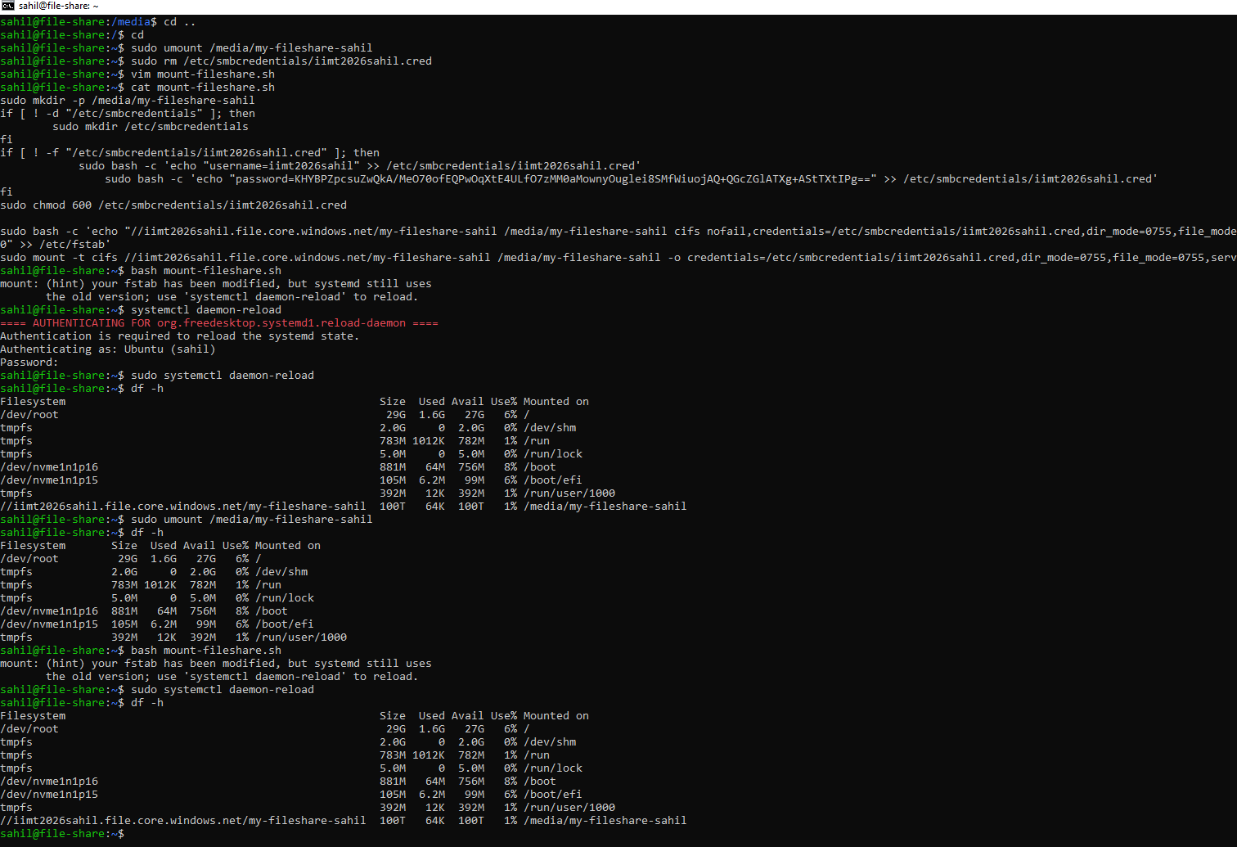
LAB 5
Step 3 of 3
Mounting on a Linux VM and verifying
GOAL OF THIS STEP
Mount the same share on Linux and prove that it worked.
STEPS TO FOLLOW
1. On the Azure Linux VM, create a script with: vim mount-fileshare.sh
2. The script makes the folder /media/my-fileshare-sahil and saves the credentials in /etc/smbcredentials.
3. chmod 600 makes sure only root can read the credentials file.
4. The mount command uses type cifs (the Linux name for SMB).
5. Run it with: bash mount-fileshare.sh
6. Check with: df -h
HOW TO READ THE OUTPUT
The last line of df -h shows //iimt2026sahil.file.core.windows.net/my-fileshare-sahil mounted on /media/my-fileshare-sahil with 100T total and 64K used. Mounting worked from the Azure VM because inside Azure port 445 is not blocked. The entry added to /etc/fstab makes the mount come back automatically after a reboot.
EXPECTED RESULT
df -h shows the share mounted at /media/my-fileshare-sahil with size 100T. Lab 5 is finished.
IIMT University, Meerut | BCA 3rd Semester | Cloud Computing with Microsoft Azure
Lab 5 complete

Slide 32
Goal of this lab
LAB
Switch on versioning so Azure keeps the old copy of a file automatically every time you change it.
06
What you will learn
What versioning does and when a version is created
The difference between soft delete and versioning
How to view, restore and delete old versions
The cost side: every version is stored and billed
Blob Versioning
IIMT University, Meerut | BCA 3rd Semester | Cloud Computing with Microsoft Azure
Lab 6

Slide 33
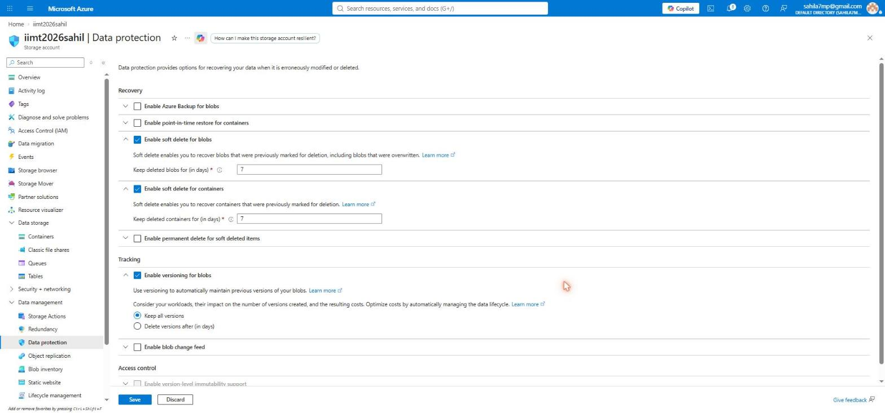
LAB 6
Step 1 of 2
Enable versioning on the Data protection page
GOAL OF THIS STEP
Turn on automatic version history for all blobs in this account.
STEPS TO FOLLOW
1
1. In the left menu open Data management, then "Data protection".
2. Under Recovery, "Enable soft delete for blobs" is already ticked with 7 days (marker 1).
3. Under Tracking, tick "Enable versioning for blobs" (marker 2).
4. Choose "Keep all versions".
5. Click Save at the bottom (marker 3).
2
3
VERSIONING vs SOFT DELETE
Versioning protects you when a file is CHANGED - the old content is saved as a version. Soft delete protects you when a file is DELETED - the file is hidden but recoverable for 7 days. They solve two different accidents, so most companies switch on both.
EXPECTED RESULT
A green notification confirms the settings were saved. From now on, every change creates a version.
IIMT University, Meerut | BCA 3rd Semester | Cloud Computing with Microsoft Azure
Lab 6 - Versioning

Slide 34
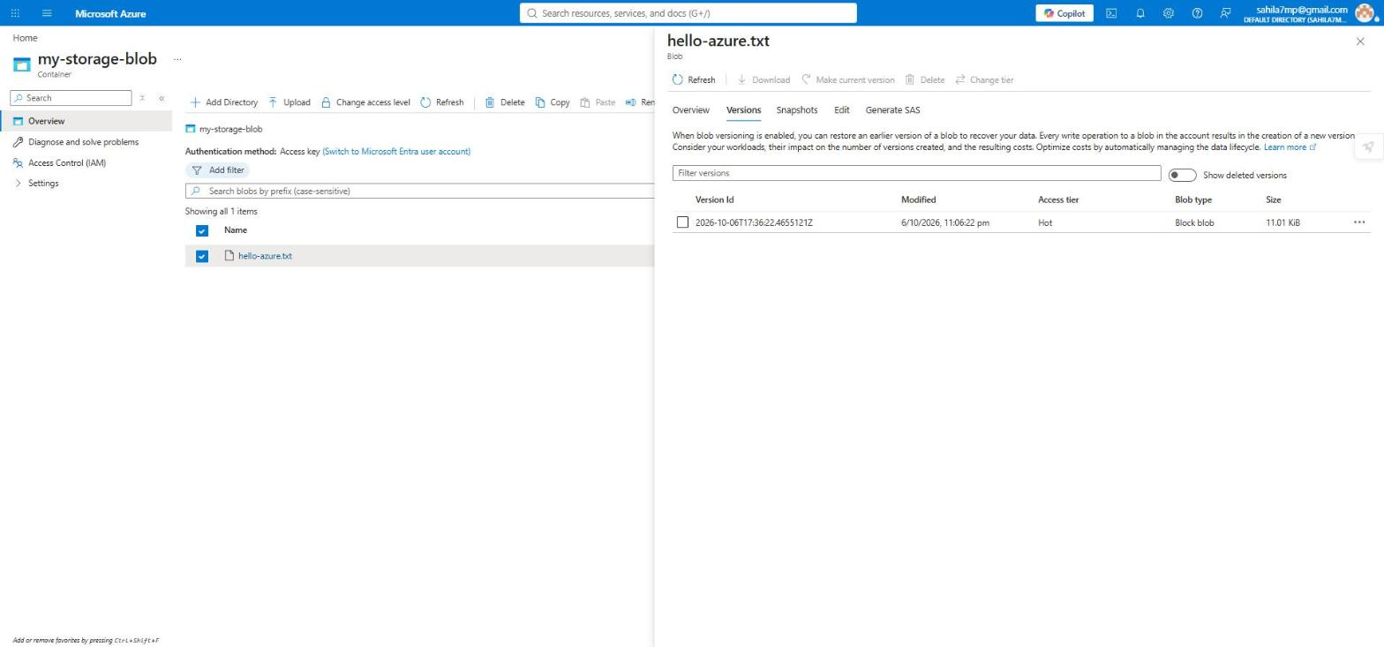
LAB 6
Step 2 of 2
See the versions of your file
GOAL OF THIS STEP
Upload the same file again and check that the old copy was kept.
1
STEPS TO FOLLOW
2
1. Upload hello-azure.txt again and tick "Overwrite if files already exist".
2. Open the blob and click the "Versions" tab (marker 1).
3. You now see the older version with its Version Id - a date and time stamp (marker 2).
4. Select a version and use "Make current version" to restore it, or Download to save it.
IMPORTANT POINTS
The Version Id is the exact UTC time the version was created, for example 2026-10-06T17:36:22. Versions are created automatically - you never have to remember to do it. But every version uses storage and is charged, so in real projects teams use the Lifecycle policy from Lab 9 to delete versions older than a few months.
EXPECTED RESULT
Lab 6 is finished. Old copies of the file are kept automatically.
IIMT University, Meerut | BCA 3rd Semester | Cloud Computing with Microsoft Azure
Lab 6 complete

Slide 35
Goal of this lab
LAB
Take a manual, read-only copy of a blob at a point in time, before you make a risky change.
07
What you will learn
What a snapshot is
How a snapshot is different from a version
How to promote a snapshot back to the live file
When to use a snapshot in real work
Blob Snapshot
IIMT University, Meerut | BCA 3rd Semester | Cloud Computing with Microsoft Azure
Lab 7

Slide 36
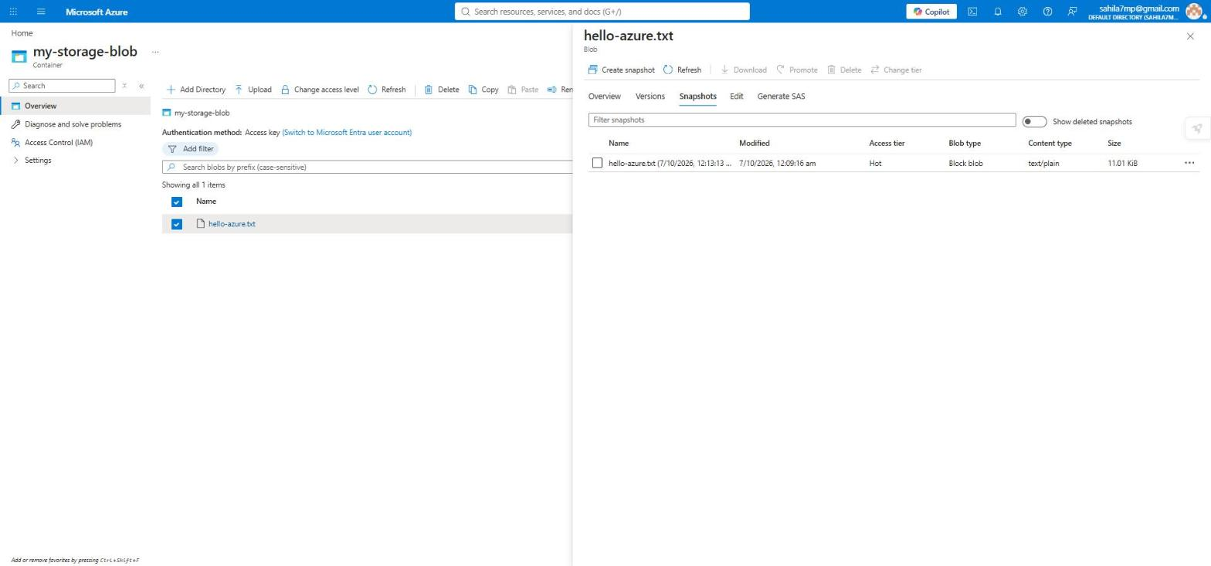
LAB 7
Step 1 of 1
Create a snapshot of the blob
GOAL OF THIS STEP
2
Save a manual point-in-time copy of hello-azure.txt.
1
STEPS TO FOLLOW
1. Open the blob hello-azure.txt.
2. Click the "Snapshots" tab (marker 1).
3. Click "Create snapshot" in the toolbar (marker 2).
4. The snapshot appears in the list with the date and time it was taken.
5. Use Promote to make this snapshot the live file again, or Download to save it.
SNAPSHOT vs VERSION
A version is created AUTOMATICALLY by Azure every time the file changes. A snapshot is created MANUALLY by you, whenever you want. Use a snapshot before doing something risky - for example before replacing a working configuration file - so you have a known good copy to go back to. A snapshot is read-only and can never be edited.
EXPECTED RESULT
Lab 7 is finished. A read-only copy of the file is stored with a timestamp.
IIMT University, Meerut | BCA 3rd Semester | Cloud Computing with Microsoft Azure
Lab 7 complete

Slide 37
Goal of this lab
LAB
Change the storage tier of a blob so that rarely used data costs you much less money.
08
What you will learn
What Hot, Cool and Archive tiers mean
The trade-off: cheap storage but costly access
The minimum days rule for each tier
How to change the tier of a single blob
Access Tiers - Hot, Cool, Archive
IIMT University, Meerut | BCA 3rd Semester | Cloud Computing with Microsoft Azure
Lab 8

Slide 38
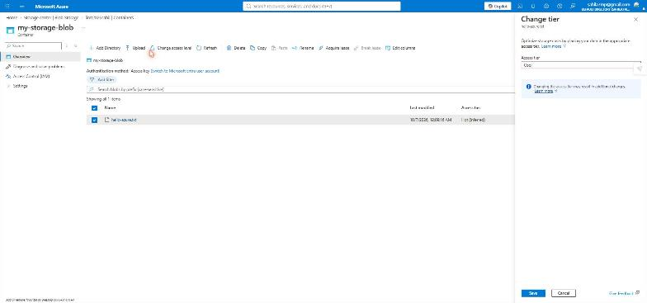
LAB 8
Step 1 of 1
Change the access tier from Hot to Cool
GOAL OF THIS STEP
Move a file that is not used often into a cheaper tier.
1
STEPS TO FOLLOW
1. Open the blob hello-azure.txt and click "Change tier" in the toolbar.
2. The "Change tier" panel opens on the right.
3. Open the Access tier dropdown and choose Cool (marker 1).
4. Read the blue note - changing the tier may cost a small transaction charge.
5. Click Save (marker 2).
2
WHEN TO USE COOL
Use Cool for data you will keep for at least 30 days and open only once in a while - last year's reports, old project files, monthly backups. Storage is cheaper than Hot, but every read costs more. If you delete or move the file before 30 days, Azure charges an early deletion fee.
EXPECTED RESULT
Lab 8 is finished. The Access tier column now shows Cool instead of Hot (Inferred).
IIMT University, Meerut | BCA 3rd Semester | Cloud Computing with Microsoft Azure
Lab 8 complete

Slide 39
LAB 8
Hot vs Cool vs Archive - full comparison
Tier
Use it for
Minimum days
Storage cost
Read cost
Time to open
Hot
Data used every day
No minimum
Highest
Lowest
Instant
Cool
Data used once in a while
30 days
Lower
Higher
Instant
Cold
Data used very rarely
90 days
Even lower
Even higher
Instant
Archive
Data kept only for records
180 days
Lowest
Highest
1 to 15 hours
THE GOLDEN RULE
The colder the tier, the cheaper it is to keep the data - but the more expensive it is to read it. So choose the tier by how often the file will be opened, not by how big it is.
Archive is special
An archived blob is offline. You cannot read it directly - you must first "rehydrate" it back to Hot or Cool, and that takes between 1 and 15 hours. Use Archive only for data you must keep by law or by company policy, such as old bills and audit records.
IIMT University, Meerut | BCA 3rd Semester | Cloud Computing with Microsoft Azure
Lab 8 - Concept

Slide 40
Goal of this lab
LAB
Write a rule that tells Azure to move or delete old files by itself, so you never have to do it manually.
09
What you will learn
What a lifecycle rule is
The IF ... THEN structure of a rule
How to move blobs to Cool and Archive automatically
How to delete blobs after a fixed number of days
Lifecycle Management Policy
IIMT University, Meerut | BCA 3rd Semester | Cloud Computing with Microsoft Azure
Lab 9

Slide 41
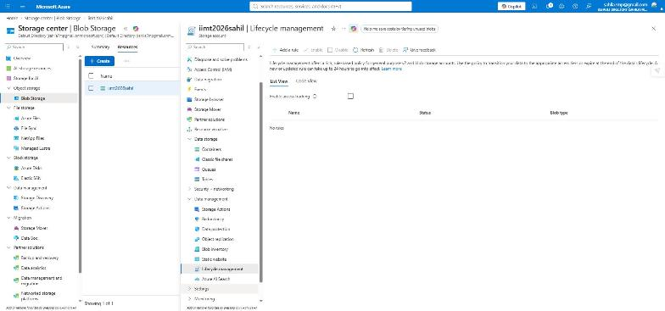
LAB 9
Step 1 of 4
Open Lifecycle management and add a rule
GOAL OF THIS STEP
Reach the page where automatic rules are written.
2
STEPS TO FOLLOW
1. In the left menu open Data management, then "Lifecycle management" (marker 1).
2. The List View shows "No rules" because none exist yet.
3. Click "+ Add rule" (marker 2).
1
WHY WE NEED THIS
Doing Lab 8 by hand for one file is easy. Doing it for fifty thousand files is impossible. A lifecycle policy lets Azure check every blob once a day and move or delete it according to your rule - with no person and no script involved.
EXPECTED RESULT
The "Add a rule" wizard opens on the Details tab.
IIMT University, Meerut | BCA 3rd Semester | Cloud Computing with Microsoft Azure
Lab 9 - Lifecycle Policy

Slide 42
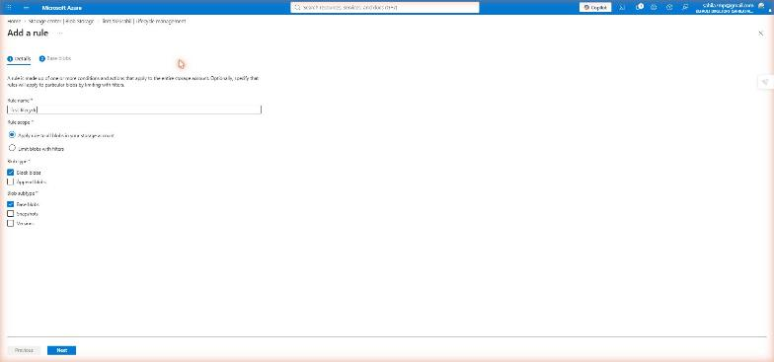
LAB 9
Step 2 of 4
Details tab - name the rule and set its scope
GOAL OF THIS STEP
Tell Azure what to call the rule and which blobs it applies to.
1
STEPS TO FOLLOW
1. Rule name: type iimt-rule (marker 1). Use small letters and numbers only.
2. Rule scope: choose "Apply rule to all blobs in your storage account".
3. Blob type: tick "Block blobs".
4. Blob subtype: tick "Base blobs" (marker 2). Base blob means the current live file.
5. Click Next (marker 3).
2
3
SCOPE OPTIONS
"Apply to all blobs" is the simple choice and is what we use here. "Limit blobs with filters" lets you apply the rule only to a certain container or to files whose name starts with a certain word - useful when one storage account holds data for several projects.
EXPECTED RESULT
The wizard moves to the "Base blobs" tab, where you set the conditions.
IIMT University, Meerut | BCA 3rd Semester | Cloud Computing with Microsoft Azure
Lab 9 - Lifecycle Policy

Slide 43
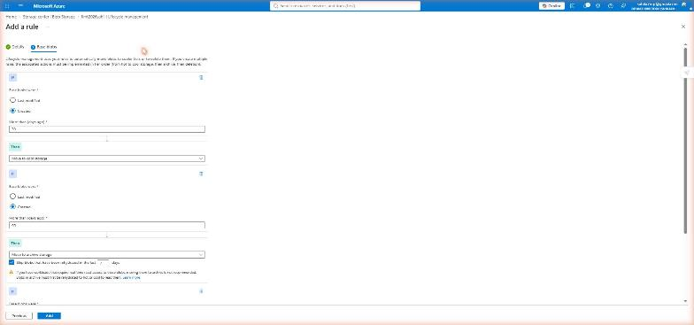
LAB 9
Step 3 of 4
Base blobs tab - write the IF and THEN conditions
GOAL OF THIS STEP
Define when Azure should act and what action it should take.
STEPS TO FOLLOW
1
1. First condition - IF: "Last modified", More than 30 days ago (marker 1).
2. THEN: choose "Move to cool storage" (marker 2).
3. Click "+ Add condition" to add a second rule.
4. Second condition - IF last modified more than 90 days, THEN move to archive storage.
5. Click Add to save (marker 3).
2
3
HOW A RULE IS BUILT
Every lifecycle rule is one sentence: IF <this condition is true> THEN <do this action>. The condition is always about age - how many days since the blob was last modified, created or accessed. The action is: move to Cool, move to Cold, move to Archive, or Delete.
EXPECTED RESULT
The rule is saved and you are taken back to the rule summary page.
IIMT University, Meerut | BCA 3rd Semester | Cloud Computing with Microsoft Azure
Lab 9 - Lifecycle Policy

Slide 44
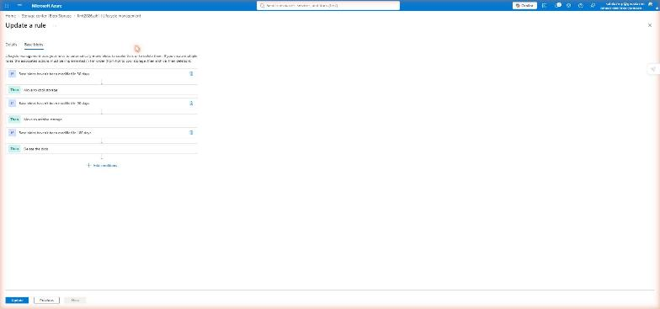
LAB 9
Step 4 of 4
The finished rule - three conditions
GOAL OF THIS STEP
Read the complete rule and understand the full journey of a file.
1
2
STEPS TO FOLLOW
1. Condition 1 (marker 1): If last modified more than 30 days, move to cool storage.
2. Condition 2 (marker 2): If last modified more than 90 days, move to archive storage.
3. Condition 3 (marker 3): If last modified more than 365 days, delete the blob.
4. Click Update to save any change (marker 4).
3
4
THE LIFE OF A FILE UNDER THIS RULE
Day 0 to 30 the file stays Hot and is fast and cheap to read. Day 31 it moves to Cool and storage becomes cheaper. Day 91 it moves to Archive, the cheapest tier. Day 366 Azure deletes it. Azure runs this check once every 24 hours, so a change can take up to a day to appear.
EXPECTED RESULT
Lab 9 is finished. Azure will now manage your old files automatically.
IIMT University, Meerut | BCA 3rd Semester | Cloud Computing with Microsoft Azure
Lab 9 complete

Slide 45
Goal of this lab
LAB
Delete a blob by mistake and bring it back, using the soft delete safety net.
10
What you will learn
What soft delete is and how long it keeps your data
Why a deleted blob disappears from the normal list
How to show deleted blobs
How to use Undelete to recover a file
Soft Delete - Recover a Deleted File
IIMT University, Meerut | BCA 3rd Semester | Cloud Computing with Microsoft Azure
Lab 10

Slide 46
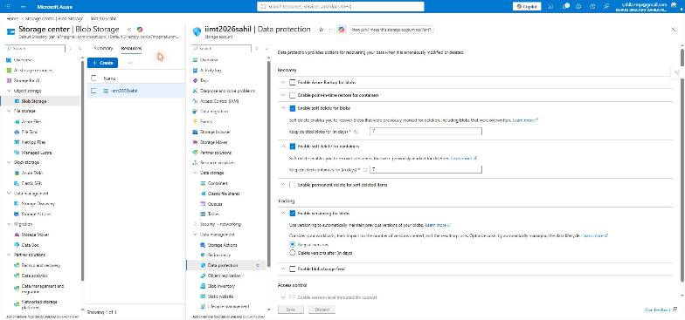
LAB 10
Step 1 of 3
Check that soft delete is enabled
GOAL OF THIS STEP
Make sure the safety net is switched on before you delete anything.
STEPS TO FOLLOW
1
1. In the left menu open Data management, then "Data protection".
2. Confirm "Enable soft delete for blobs" is ticked (marker 1).
3. Keep deleted blobs for (in days) should be 7 (marker 2).
4. If you changed anything, click Save (marker 3).
2
3
WHAT SOFT DELETE REALLY DOES
When you delete a blob, Azure does not erase it. It only marks it as deleted and hides it from the normal list. The data stays on disk for the number of days you set, and you still pay for that storage. After the retention period ends, Azure removes it permanently and nobody can bring it back.
EXPECTED RESULT
Soft delete is active. Any blob you delete can be recovered for the next 7 days.
IIMT University, Meerut | BCA 3rd Semester | Cloud Computing with Microsoft Azure
Lab 10 - Soft Delete

Slide 47
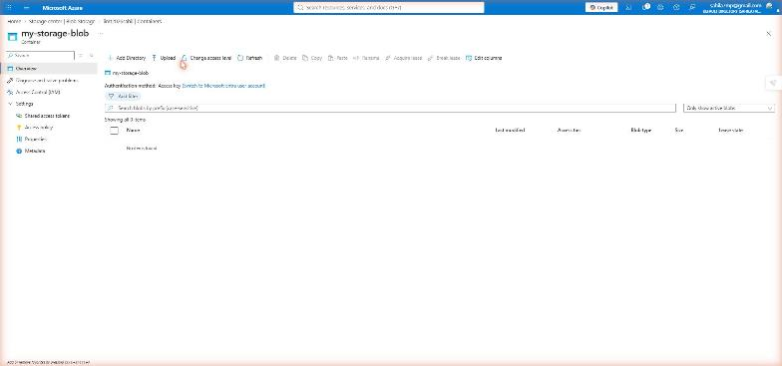
LAB 10
Step 2 of 3
Delete the blob - the container looks empty
GOAL OF THIS STEP
Delete the file on purpose and see what happens.
2
STEPS TO FOLLOW
1
1. Open the container my-storage-blob.
2. Tick hello-azure.txt and click Delete in the toolbar. Confirm it.
3. The list now shows "No items found" (marker 1) - the file seems gone.
4. Open the dropdown on the right and change it from "Only show active blobs" to "Show active and deleted blobs" (marker 2).
DO NOT PANIC
The file is not lost. The portal shows only active blobs by default, which is why the container looks empty. Changing the filter is what reveals soft-deleted blobs. This single dropdown is the thing most students forget in the exam.
EXPECTED RESULT
The deleted file appears again in the list, this time with a "Previously deleted" status.
IIMT University, Meerut | BCA 3rd Semester | Cloud Computing with Microsoft Azure
Lab 10 - Soft Delete

Slide 48
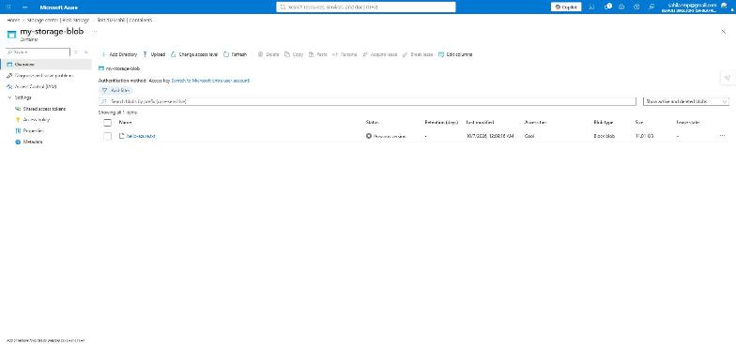
LAB 10
Step 3 of 3
Undelete - the file is back
GOAL OF THIS STEP
Recover the deleted file and confirm it is usable again.
2
STEPS TO FOLLOW
1
1. With the filter set to "Show active and deleted blobs" (marker 2), the file is visible again.
2. The Status column shows "Previously deleted" (marker 1).
3. Click the file name, then click Undelete in the toolbar.
4. Refresh the page - the Status column becomes empty, which means the blob is active again.
ALSO NOTICE
The Access tier column still shows Cool. That is the change we made back in Lab 8 - recovering a blob brings back all of its properties, not just the data. Soft delete works the same way for containers and for file shares, and 7 days is the default Azure sets for a new account.
EXPECTED RESULT
Lab 10 is finished. The deleted file has been fully recovered.
IIMT University, Meerut | BCA 3rd Semester | Cloud Computing with Microsoft Azure
Lab 10 complete

Slide 49
Goal of this lab
LAB
Host a real, public website straight from Blob Storage - with no virtual machine and no web server.
11
What you will learn
What a static website is
The special $web container Azure creates
How to set the index and error document
How to open your live website on the internet
Static Website Hosting
IIMT University, Meerut | BCA 3rd Semester | Cloud Computing with Microsoft Azure
Lab 11

Slide 50
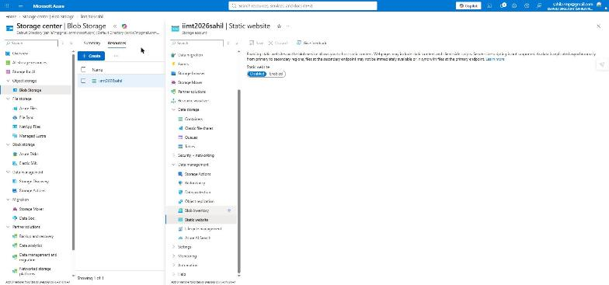
LAB 11
Step 1 of 4
Open Static website and switch it on
GOAL OF THIS STEP
Turn on the website hosting feature of your storage account.
2
STEPS TO FOLLOW
1. In the left menu open Data management, then "Static website" (marker 1).
2. The current state is Disabled.
3. Click the Enabled button (marker 2).
4. Two new boxes appear: Index document name and Error document path.
1
WHAT IS A STATIC WEBSITE?
A static website is made only of files that never change on the server - HTML, CSS, JavaScript and images. There is no PHP, no database and no server-side code. Because nothing has to run on the server, Blob Storage alone can serve the whole site, which makes it extremely cheap and very fast.
EXPECTED RESULT
The page now shows the settings you need to fill in before saving.
IIMT University, Meerut | BCA 3rd Semester | Cloud Computing with Microsoft Azure
Lab 11 - Static Website

Slide 51
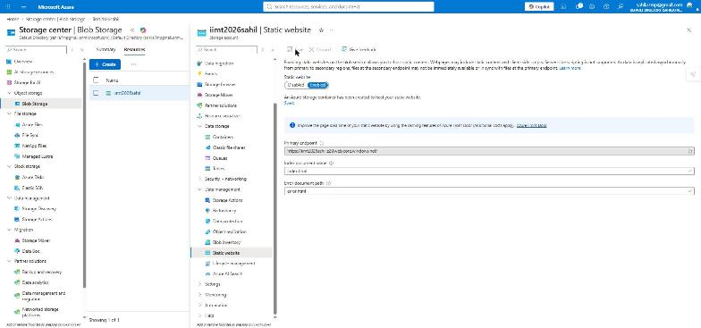
LAB 11
Step 2 of 4
Set the index document and save
GOAL OF THIS STEP
Tell Azure which file to open when someone visits your site.
1
STEPS TO FOLLOW
2
1. Index document name: type index.html.
2. Error document path: type error.html.
3. Click Save (marker 1).
4. Azure creates a special container called $web and shows the Primary endpoint URL (marker 2).
5. Copy that URL - it is your website address.
THE $web CONTAINER
Azure makes a container named $web by itself. Anything you put inside $web becomes publicly readable through the website URL - and only through that URL. Files in your other containers stay private. The index document is the page shown when a visitor opens the site without naming a file.
EXPECTED RESULT
Your public website URL is ready: https://iimt2026sahil.z29.web.core.windows.net/
IIMT University, Meerut | BCA 3rd Semester | Cloud Computing with Microsoft Azure
Lab 11 - Static Website

Slide 52
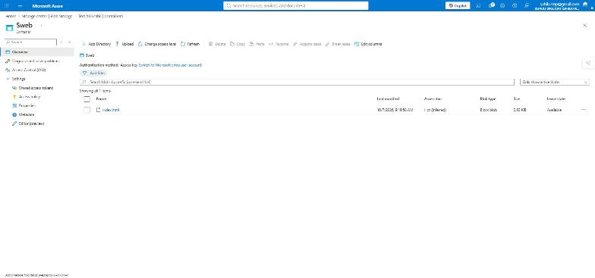
LAB 11
Step 3 of 4
Upload index.html into the $web container
GOAL OF THIS STEP
Put your web page inside the container that serves the website.
1
STEPS TO FOLLOW
2
1. Open Data storage, then Containers, then the $web container.
2. Click Upload (marker 1) and select your index.html file.
3. The file appears in the list (marker 2) with Blob type Block blob.
4. Access tier is Hot, which is correct for a website - pages must load fast.
BEFORE YOU UPLOAD
The file name must be exactly index.html, all in small letters, and it must match the index document name you typed in the previous step. If the names do not match, visitors will see an error page instead of your site.
EXPECTED RESULT
index.html is stored in $web and is now being served to the internet.
IIMT University, Meerut | BCA 3rd Semester | Cloud Computing with Microsoft Azure
Lab 11 - Static Website

Slide 53
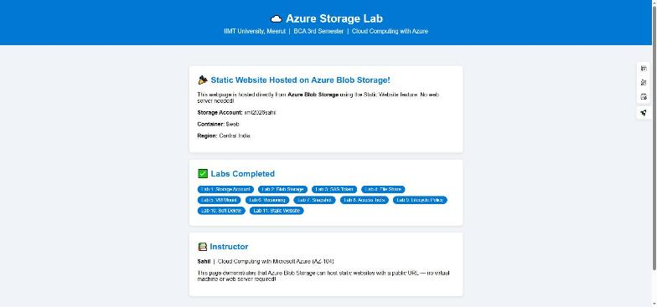
LAB 11
Step 4 of 4
The website is live on the internet
GOAL OF THIS STEP
Open your website in a browser and prove that it works.
STEPS TO FOLLOW
1. Open a new browser tab.
2. Paste the Primary endpoint URL and press Enter.
3. Your page loads from Azure Blob Storage.
4. Share the link with anyone - it works from any device, anywhere.
ALL 11 LABS COMPLETE
The page is live at https://iimt2026sahil.z29.web.core.windows.net/ and is served directly from the $web container. There is no virtual machine, no IIS, no Apache and nothing to patch or restart. This is the cheapest way to host a portfolio site, documentation or a college project on Azure.
EXPECTED RESULT
Lab 11 is finished. You are hosting a public website with no server at all.
IIMT University, Meerut | BCA 3rd Semester | Cloud Computing with Microsoft Azure
Lab 11 complete

Slide 54
Quick Revision - All 11 Labs
Lab
Topic
Key idea to remember
1
Storage Account
The base container for everything. Name must be lowercase and globally unique.
2
Blob Storage
Container holds blobs. Block blob is used for normal files.
3
SAS Token
Time-limited link. Share access without sharing the account key.
4
File Share
A cloud folder that speaks SMB, so it behaves like a network drive.
5
Mount Share
Needs port 445 open. Mount from an Azure VM if your ISP blocks it.
6
Versioning
Automatic. Keeps the old copy whenever a file is changed.
7
Snapshot
Manual. A read-only copy taken by you at a chosen moment.
Labs 8 to 11 continue on the next slide
IIMT University, Meerut | BCA 3rd Semester | Cloud Computing with Microsoft Azure
Summary

Slide 55
Quick Revision - Labs 8 to 11
Lab
Topic
Key idea to remember
8
Access Tiers
Hot, Cool, Cold, Archive. Colder is cheaper to store, costlier to read.
9
Lifecycle Policy
IF a blob is older than N days THEN move it or delete it. Runs daily.
10
Soft Delete
Deleted blobs are hidden, not erased. Recoverable for 7 days using Undelete.
11
Static Website
Files in the $web container are served as a public website. No server needed.
THE THREE ADDRESSES YOU MUST REMEMBER
Blob: https://<account>.blob.core.windows.net/<container>/<file>
File share: https://<account>.file.core.windows.net/<share>
Website: https://<account>.z29.web.core.windows.net/
EXAM TIP
Three questions are asked again and again: (1) Versioning is automatic, a snapshot is manual. (2) Soft delete protects a DELETED file, versioning protects a CHANGED file. (3) Archive data cannot be read directly - it must be rehydrated first, and that takes 1 to 15 hours.
IIMT University, Meerut | BCA 3rd Semester | Cloud Computing with Microsoft Azure
Summary

Slide 56
All 11 Labs Completed
You have created a storage account, stored files, shared them safely, mounted a cloud folder,
protected data with versioning and soft delete, saved cost with access tiers and lifecycle rules,
and hosted a live website - all on Microsoft Azure.
Live demo site: https://iimt2026sahil.z29.web.core.windows.net/
IIMT University, Meerut | BCA 3rd Semester | Prepared by Sahil

