Slide 1
PROBLEM STATEMENT
In the present world, many business programs are more diversified and want to reside away from the firewall. These companies may use in-house SaaS-based CRM program or be hosting sites onto the cloud. Even though this might improve flexibility, nevertheless it induces a struggle for developers to make an internet application that could quickly integrate with other programs
A site page loading period (full-page, first, etc generally depends upon a lot more items than only the media dimensions. Just squeezing the pictures won't fix the objective.
Nowadays, we are seeing a brand new wave of intelligent devices like eyeglasses, watches, TVs, and more. Thus, it could be hard for any web development program to accommodate and match these platforms and devices.
Practically, it's not simple to generate a site to function across all the browsers and variations.

Slide 2
DATA SET

Slide 3
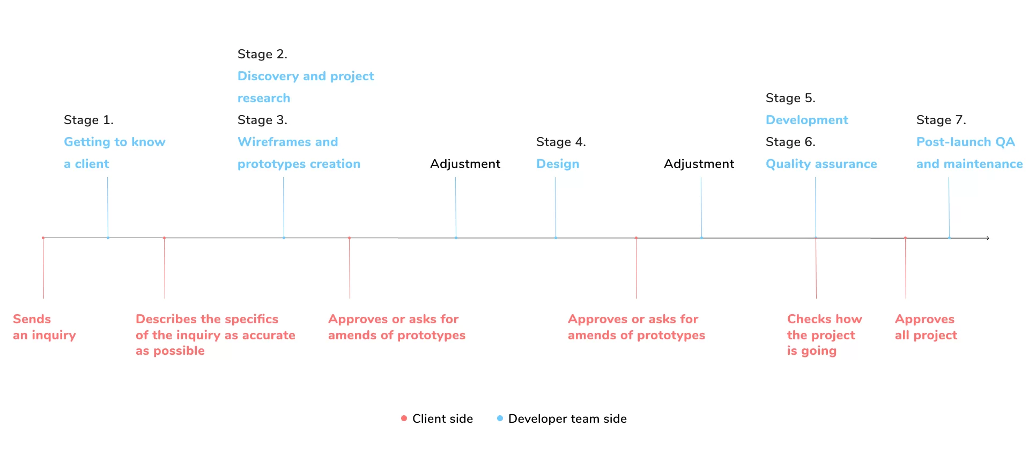
METHODOLOGY

Slide 4
CONTRIBUTION
Open-source tools are a boon to web designers and open source project. It seems like there is something to help with virtually every aspect of building or maintaining a website.
Creating and share my own Resources This can take a number of forms. It could be in building your own open-source app.
Promote Best Practices and and ethical behavior in the web design community. It spreads the good word about these subjects and it can help to convince web designers to adopt them.
While creating a new application, think about the past array of apparatus for cross-browser compatibility, display dimensions, pixel, density and ratios which can fluctuate between devices issues to be resolved.

