Slide 1
HPS IPE

Slide 2
UI Automation Overview and Environment
Overview
Open source tools with free distribution
Base code framework is a layer on top of selenium to simplify automation effort ( Reusability )
Base code could be used for any Web UI automation (Extendibility)
Can be enabled with minimal coding skill
C#/.NET Code Base of OPC
(Bangalore Dev VM/Laptop)
Visual Studio
Browser( Chrome/Firefox/IE)
.net
Git Client
Automation code
(Bangalore Dev VM/Laptop)
Intellij
MVN
Git Client
JDK 1.8.x
MS Excel
Browser( Chrome/Firefox/IE)
Selenium/Java/Apache POI
Automation Execution Env
(Cloud Lab VM)
MVN
Git Client
JDK 1.8.x
Browser( Chrome/Firefox/IE)
.net
Reports Generated
( Part of build )
Mail on Failure
(Within pom xml)
bitbucket

Slide 3
DEMO
Demo
Steps to run test
Login to cloud lab VM
HPSIPE is running as service
On restart of machine (validate the same)
Open a command prompt
>cd C:\Projects\projectdigitization\Honeywell.IPE.UIAutomation
>runtest.bat
All test cases included in the resources\testing.xml will be execute and reports are generated
Error screenshots are captured and stored in screenshot folder
Mail is sent on failure of test run

Slide 4
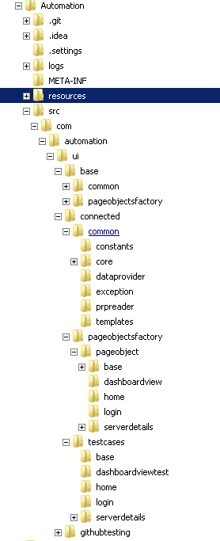

Codebase Layout ( Source Code)
Base Code
Page Object
Test Cases
pom.xml ( maven build file)
runtest.bat ( execute test)

Slide 5
Source Files to look into
META-INF\
\src\com\automation\ui\base
Has the base code base used for all UI tests Abstraction of selenium
\src\com\automation\ui\connected
Sample project did for connected programs-. Kept for refence
\src\com\automation\ui\ipe
Code for ipe program
\target
Output class files generated for every run of build

Slide 6
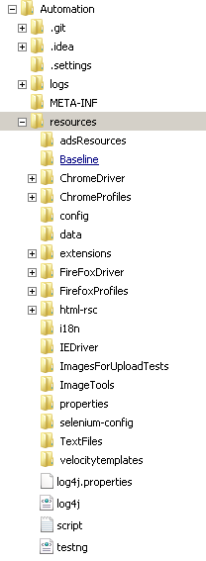
Codebase Layout ( Resources)
Drivers Executables
Config Files
Test data files ( Excel/json)
File with credential are not Checked in to github
Kept locally in c:\software\selenium
Browser Extensions
Real report code
I18n bundles
Properties file
Velocity templates
Log4j properties
Testng xml

Slide 7
Resource files
\resources\config\
config.yml -Framework specific configuration ( overriding)
config_default.yml –default framework configurations
\resources\data\
All test specific data for data driven testing
resources\properties\
Test module specific property files
resources\velocitytemplates\
Velocity template used for reporting
resources\selenium-config\
VPN or internal credential information stored in a private repository modules
Folder to skip for now
BaseLine,*Profiles,ImageTools,ImageForUploadTests,TextFiles

Slide 8
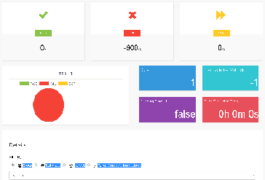
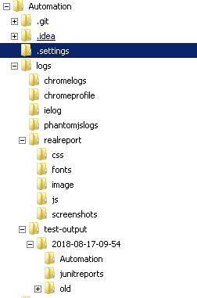
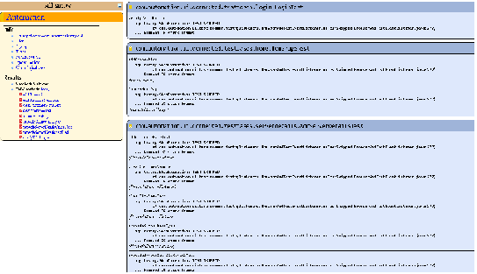

Codebase Layout ( Logs and Reports)
Logs and Reports
Browser logs
Custom UI reports
Error screenshots
Daily run reports
Project logs
Velocity Templates logs

Slide 9
Log Files to look into
logs\
Velocity.log has the output from the velocity reporting template
Automation.logs have the output from the automation framework
Realreports have test report and error screenshots

Slide 10
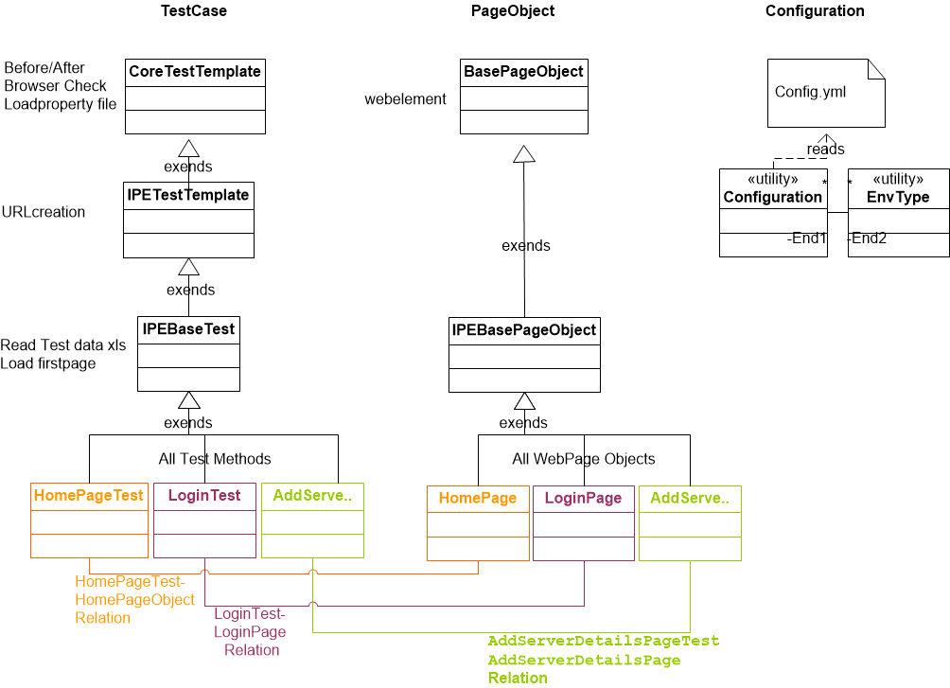
Test case Class Design layout

Slide 11
Implemented Test Cases
Test Cases
verifyInValidUserNullPassword
verifyValidUserNullPassword
verifyInValidUserInvalidPassword
verifyNullUserNullPassword
verifyValidLogin
launchHomePage

Slide 12
Sample Test Scenario
Log into application( valid login credentials)
Launch home page
Navigate to Provide Server Details
Provide details without security enabled
Add CustomerName and Site name, clearing if it pre-exists.
Add OPCUA client Authentication
Navigate to Select Tags
Export config file
More scenarios with negative test cases to be added.

Slide 13
Thank You

