Slide 1
Introduction to Infrastructure as Code in AWS using Terraform

Slide 2
about
Intelematics
Cloud Migration Journey
AWS cloud platform
Terraform for Infrastructure As Code tool

Slide 3
Infrastructure as code
Technique for provisioning infrastructure configuration by means of codes
Allows you to control and implement changes to your environment through code changes pushed into a source repository, resulting to a more maintainable and predictable infrastructure.

Slide 4
Benefits
Reduced manual admin tasks
Stable and predictable environment
Planned infrastructure changes are reviewed by to the team
Easily replicable environment

Slide 5
What is terraform?
Infrastructure as Code Software from HashiCorp
Terraform is agnostic to the underlying platform
Has ”Providers” which drives API interaction to different IaaS, PaaS, or SaaS services
AWS Provider - DEMO

Slide 6
Exercise 1: Basic Terraform Commands
“aws s3 ls” – check your AWS credentials access
git clone https://github.com/cloudtinkerer/terraform-aws-vpc-meetup.git
git checkout tags/ex01 -f

Slide 7
Exercise 1: Basic Terraform Commands
“terraform init” - Initialize a working directory containing Terraform configuration files
“terraform plan” - Create an execution plan
“terraform apply” – apply the changes
“terraform destroy” – destroy the Terraform-managed infrastructure

Slide 8
Exercise 1: State file
terraform.tfstate – Terraform state file. This is where the managed infrastructure and configuration are stored
By default the state file is saved locally, but it can be stored remotely.

Slide 9
Exercise 1: remote state file
State File saved in a remote S3 Backend
Suited in a team environment

Slide 10
Exercise 1: remote state file
Create an S3 Bucket in Sydney region
Create a file “remote-state.tf” and save it in the project root directory
Add the codes shown and replace it with your created bucket name
Run “terraform init” then “terraform apply”
Check your S3 Bucket

Slide 11
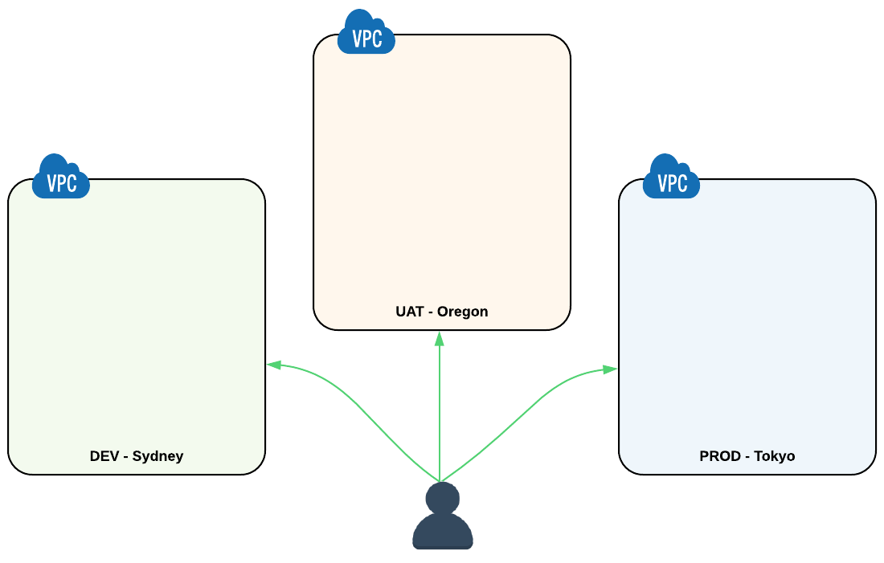
Exercise 2: Terraform workspace and variables

Slide 12
Exercise 2: terraform workspace
“terraform destroy” – clean up default workspace
“git checkout tags/ex02 –f”
“terraform workspace list” – lists workspaces
“terraform workspace new dev” – creates a workspace named dev, and automatically selects it
“terraform workspace select dev” – explicitly select a workspace with name dev

Slide 13
Exercise 2: terraform variables
Files added and updated
main.tf
variables.tf (NEW)
env/dev/vpc.tfvars
terraform apply -var-file=env/dev/vpc.tfvars

Slide 14
Exercise 2: terraform variables
For Exercise 2, provision a VPC in the UAT environment Oregon AWS region.
env/uat/vpc.tfvars – update this file
terraform workspace new uat
terraform apply -var-file=env/uat/vpc.tfvars
terraform workspace select dev

Slide 15
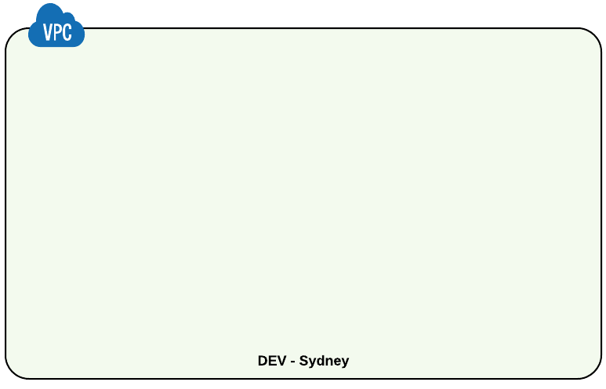
Exercise 3: state of our vpc

Slide 16
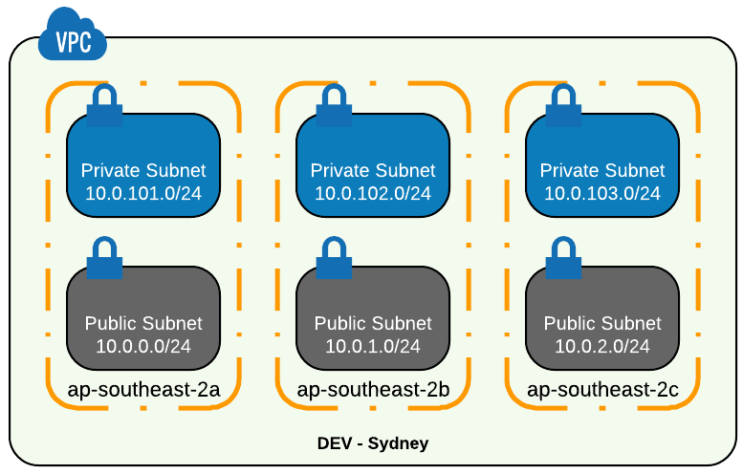
Exercise 3: state of our vpc

Slide 17
Exercise 3: creating subnets
terraform workspace select dev
git checkout tags/ex03 –f
Files updated:
main.tf
variables.tf
env/dev/vpc.tfvars
terraform apply -var-file=env/dev/vpc.tfvars

Slide 18
Exercise 3: creating subnets
For Exercise 3: Create a Private Subnet
main.tf
variables.tf
env/dev/vpc.tfvars
terraform apply -var-file=env/dev/vpc.tfvars

Slide 19
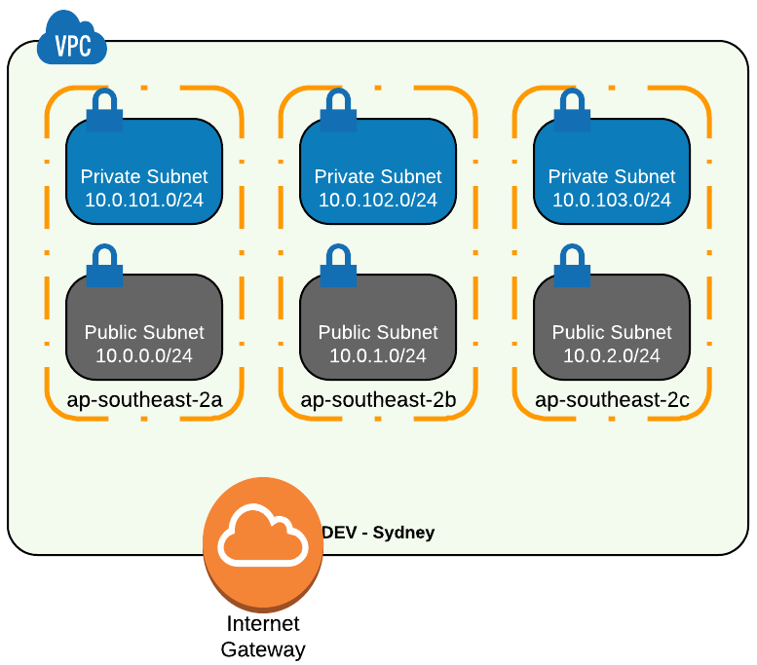
Exercise 4: internet gateway

Slide 20
Exercise 4: internet gateway
git checkout tags/ex04 –f
Updated File
main.tf
terraform apply -var-file=env/dev/vpc.tfvars

Slide 21
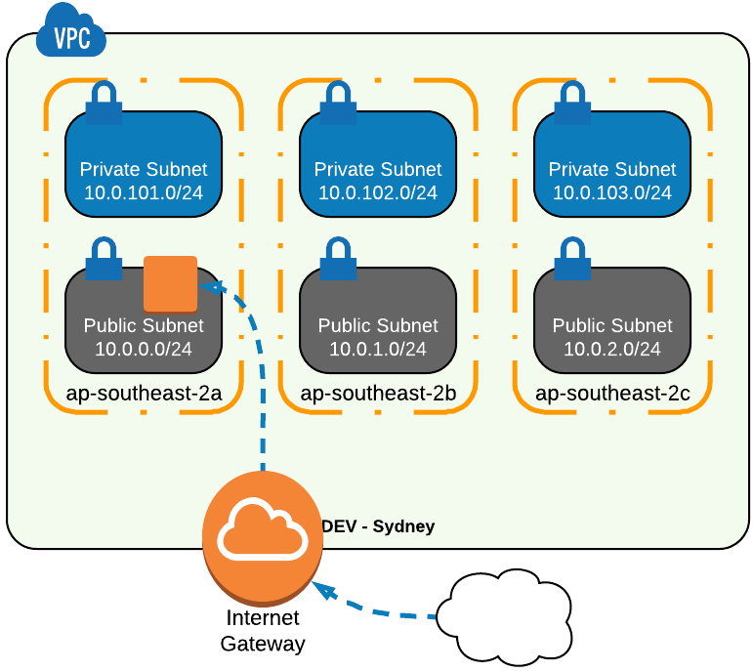
Exercise 5: EC2 instance

Slide 22
Exercise 5: EC2 instance
git checkout tags/ex05 –f
Updated this file
main.tf
terraform apply -var-file=env/dev/vpc.tfvars

Slide 23
Exercise 6: Terraform module registry
git checkout tags/ex06 –f
New file and folder
/terraform-module-registry/main.tf
terraform plan
terraform apply

Slide 24
END

