Slide 1
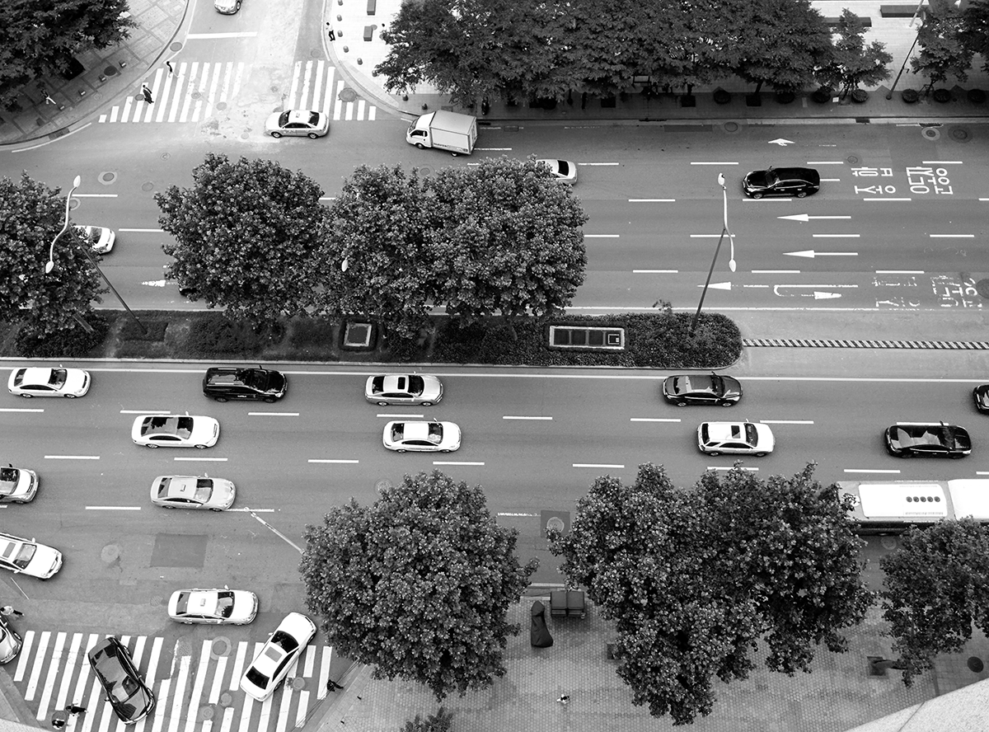
Project Kalexa with AWS
Creative Integrated Design, 2016 Fall
[Group D] Yeongjin Choi •Junhyuck Kim•Sanghoon Lee
Channy Yun (AWS, Tech Evangelist)

Slide 2
Contents
Table of Contents
Overview
Goal/Problem & Requirement
Approach
Development Environment
Architecture
Implementation
Result
Division and Assignment of work
Demo

Slide 3

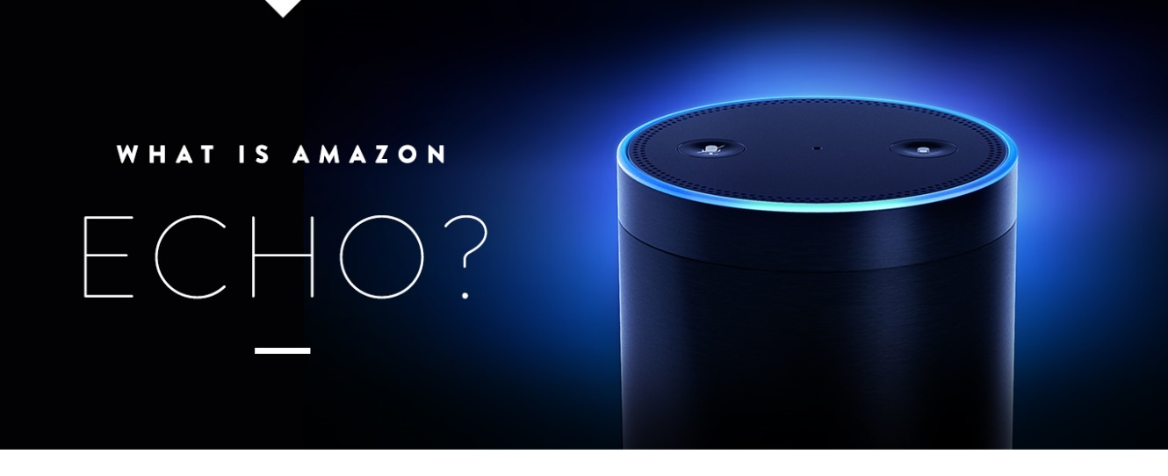
Amazon Alexa Echo
Overview

Slide 4
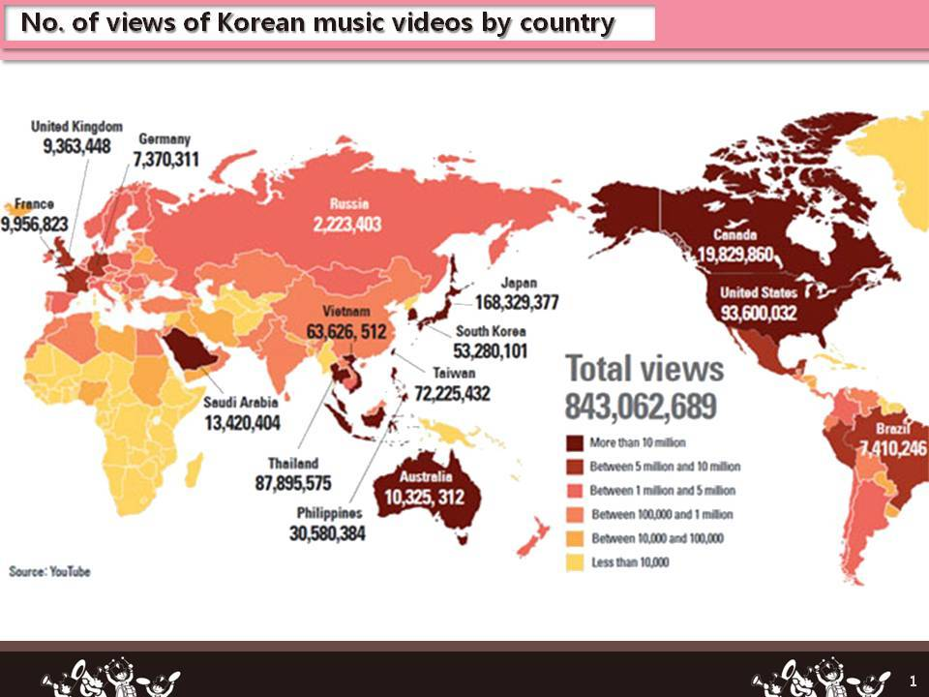
Motive
Overview

Slide 5
Project Kalexa
Goal & Requirement
Learning Korean
Translation
Quiz
K-POP Information
K-POP chart information
Lyrics
Play songs
Music Recommendation
Emotion based
User based

Slide 6
Project Design
Approach
Basic Implementation
Challengeable
Amazon Web Service
Translate API
Text to Speech API
Melon API
ffmpeg
Scalability
Performance
Accuracy
Recommendation

Slide 7




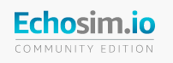

Platform & Tools
Development Env.

Slide 8
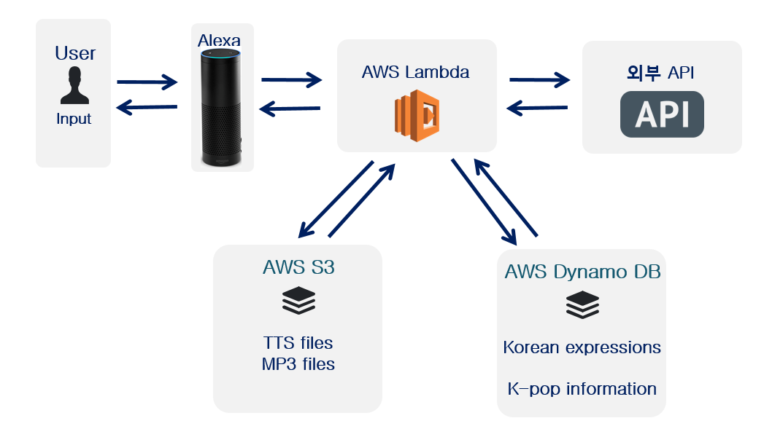
Architecture Design
Architecture
Naver / Google / Melon API
Node.js Packages
FFMPEG Library

Slide 9
Features
Implementation
기본 로직 및 api연계
Translation
Quiz

Slide 10
Scalability Recommen-dation
Implementation
그림하나넣을것 Learning Korean
Translation
Quiz

Slide 11
Accuracy
Implementation
ddd
Translation
Quiz

Slide 12
Performance
Implementation
ddd
Translation
Quiz
캐싱 이야기도(레디스?)

Slide 13
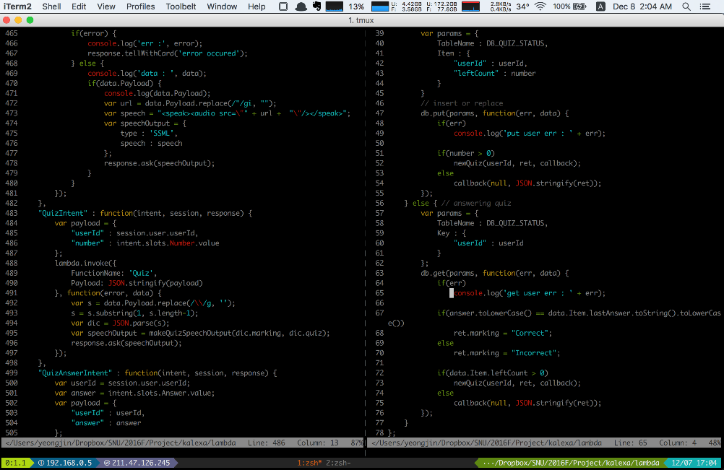
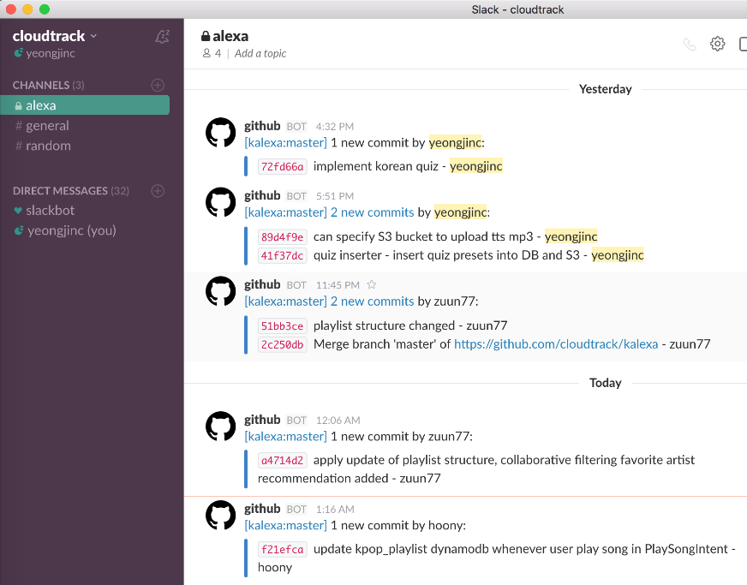
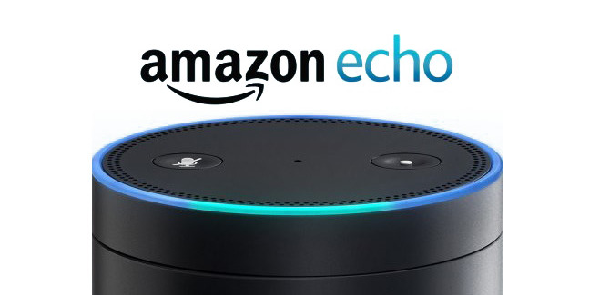
Output
Result

Slide 14
Limit Future Plan
Result
If Alexa itself start to support Korean?
Cannot parse sentences not in predefined set
Detailed Recommend
Profound Quiz
Failover
Refact-oring
Other
Contents

Slide 15
Schedule Role
Division & Assignment

Slide 16
Execution of Project Kalexa
Demo
Learning
Korean
Translate
Quiz
K-POP
Information
Chart
Lyrics
Play
Emotion
Based
User
Based
Recommendation

