Slide 1
Core elements
Message
Consumer
Producer

Slide 2
<<System>> Order Mgm
Core elements
Consumer
<<IC>> Mule ESB
<<IC>> Mule ESB
Producer
Producer
<<Schema>> Order
WSDL
XSD

Slide 3
Exchange Patterns
Request
Message
Message
Consumer
Producer
Consumer
Producer
Response
Message
Message
Producer
Request
Message
Consumer
Producer
Consumer
Producer
Response
Message
Producer

Slide 4
Message Flow
System B
System A
<<IC>> Mule ESB
Producer
Producer
Consumer
Consumer
Producer
Consumer
Producer
Producer
System C
Producer

Slide 5
System A
Integration Component 1
System C
Consumer
Service
Producer
Service
Consumer
Producer
Service
System B
System D
Integration Component 2
Producer
Consumer
Consumer
Integration Component 3
Service
Description Component 1
Service
Description Component 2
WSDL
XSD
Service
Description Component 3

Slide 6
System A
<<IC>> Mule ESB
System B
Consumer
Producer
System A
<<IC>> Mule ESB
System B
Consumer
Producer

Slide 7
System B
Producer
System A
<<IC>> Mule ESB
System B
Consumer
Producer
System B
Producer

Slide 8
Request - Response pattern
<<IC>>
Consumer
Producer
Consumer
<<IC>>
Producer
Consumer
Producer
Consumer
<<IC>>
Producer
Consumer
Producer
Consumer
<<Servlet>>
<<IC>>
Consumer
Producer
Consumer
Producer
Consumer

Slide 9
Request - Response pattern
System A
SOAP
<<IC>> Mule ESB
System B
REST
JMS
Consumer
Producer
JMS
Tomcat
SOAP
SOAP
<<Servlet>>
REST
REST
VM
JDBC
Consumer
Producer

Slide 10
Request - Response pattern
System A
<<IC>> Mule ESB
SOAP
REST
Consumer
System A
Tomcat
<<IC>> Mule ESB
SOAP
<<Servlet>>
REST
VM
Consumer

Slide 11
Request - Response pattern
<<IC>> Mule ESB
System B
JMS
JMS
Producer
<<IC>> Mule ESB
System B
SOAP
REST
JDBC
Producer
System A
<<IC>> Mule ESB
System B
JMS/CSV
SOAP
Consumer
JMS/CSV
Producer

Slide 12
Source code elements –
request/response
<<java>>
Test -
Consumer
<<mule>>
Mule -
Service
<<mule>>
Teststub -
Producer
<<java>>
Request-Transformer
<<java>>
Response-Transformer
Property-
file
<<integration-test>>
End-to-end-tests
<<unit-test>>
Request-Transformer-
Tests
<<unit-test>>
Response-Transformer-
Tests

Slide 13
JMS
JDBC
File
FTP
SFTP
HTTP
POP3
IMAP
VM
One Way pattern
System A
<<IC>> Mule ESB
Consumer
System A
Tomcat
<<IC>> Mule ESB
<<Servlet>>
HTTP
VM
Consumer
inboundTransportCombo.setItems (new String [] {"VM", "JMS", "JDBC", "File", "FTP", "SFTP", "HTTP (Multipart POST)", "Servlet (Multipart POST)", "POP3", "IMAP"});
outboundTransportCombo.setItems (new String [] {"VM", "JMS", "JDBC", "File", "FTP", "SFTP", "SMTP"});

Slide 14
One Way pattern
JMS
JDBC
File
FTP
SFTP
SMTP
VM
<<IC>> Mule ESB
System B
Producer
System A
<<IC>> Mule ESB
System B
JMS
JMS
Consumer
Producer
inboundTransportCombo.setItems (new String [] {"VM", "JMS", "JDBC", "File", "FTP", "SFTP", "HTTP (Multipart POST)", "Servlet (Multipart POST)", "POP3", "IMAP"});
outboundTransportCombo.setItems (new String [] {"VM", "JMS", "JDBC", "File", "FTP", "SFTP", "SMTP"});

Slide 15
One Way pattern
System A
<<IC>> Mule ESB
System B
SFTP
SFTP
Consumer
Producer
inboundTransportCombo.setItems (new String [] {"VM", "JMS", "JDBC", "File", "FTP", "SFTP", "HTTP (Multipart POST)", "Servlet (Multipart POST)", "POP3", "IMAP"});
outboundTransportCombo.setItems (new String [] {"VM", "JMS", "JDBC", "File", "FTP", "SFTP", "SMTP"});

Slide 16
Source code elements – one way
<<java>>
Test -
Consumer
<<mule>>
Mule -
Service
<<mule>>
Teststub -
Producer
<<java>>
Transformer
Property-
file
<<integration-test>>
End-to-end-tests
<<unit-test>>
Transformer-
Tests

Slide 17
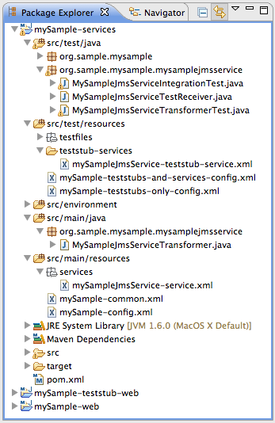
<<java>>
Test -
Consumer
<<mule>>
Mule -
Service
<<mule>>
Teststub -
Producer
<<java>>
Transformer
Property-
file
<<integration-test>>
End-to-end-tests
<<unit-test>>
Transformer-
Tests

