Slide 1
Clouducate
Enabling Cloud-based IT Hands-on Education
Norbert Monfort & Robert Fortunato

Slide 2

Clouducate Overview
AWSVPCB (AWS Virtual Private Cloud Builder) is a set of BASH Shell scripts designed to create a small enterprise IT-like environment in AWS to provide college-level students with hands-on experience individually working on IT problems. These scripts are now focused on the use of the AWS Academy Learner Lab but still support running outside of the AWS Academy Learner, with configuration adjustments.
These scripts work in conjunction with AWS images (AMIs) with pre-loaded applications and a method for automatically changing the environment for assignment purposes. These scripts are open source and free to be used for any purpose. These scripts, the associated AMIs and applications they house make up what is called the "Clouducate Suite", which we continue to work on.

Slide 3
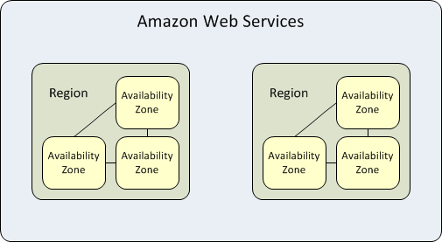
AWS Concepts & Glossary
AWS Academy – Courses and “Learner Lab” Offering for Universities (FIU has agreement)
  The “Learner Lab” offers $50 per student, and this is the preferred approach for using AWSVPCB
AWS Region – One or more AWS data centers within a nearby area (within 250 miles) – By default, AWSVPCB uses “us-east-1” as all of the AMIs are in this region
AWS Availability zone – One or more data centers within a region – AWSVPCB uses 2 AZs by default (“us-east-1A” – primary defined in vpcb-config and “us-east-1b” secondary defined in assignment json files
AWS VPC (Virtual Private Cloud) – Private network within AWS includes large private address space; can span Availability zones, but not regions
  Used in AWSVPCB to simulate an Enterprise environment
AWS VPC Subnet – Portion of VPC addresses used to group instances & services; Cannot span availability zones
IAM User – It’s recommended to create an Admin level user, if using AWSVPCB outside of AWS Academy to avoid using ROOT user
EC2 (Elastic Compute Cloud) Instance – A VM server in AWS (can be associated to a VPC subnet and a security group)
S3 Storage – AWS’ Simple Storage Service (object storage via Internet access)
  Used for Load Balancer logs and Professor DIAGLOG uploads

Slide 4
AWS Concepts & Glossary
ec2-user – Userid to login to your Linux EC2 instances
Administrator – Userid to login to your Windows instances
EC2 instance states – running, stopped and terminated (deleted)
Routing table – Associated to VPC subnets – how to route network requests
Security Group – Associated to EC2 instances/AWS services – firewall rules for access in & out of instance/service
NAT Instance – A pre-configured EC2 instance that allows outbound access to Internet
BASTION Instance - A pre-configured EC2 instance that allows RDP access into VPC
Internet Gateway - Allows Internet access out of VPC
Client VPN Endpoint – Legacy feature of AWSVPCB that allows VPN access into VPC - Associated to a VPC subnet
Route 53 – AWS’ DNS service – By default setup up with private zone (e.g. AWSVPCB.edu) for DNS resolution within VPC
ELB (Elastic Load Balancer) – AWS’ load balancer service (there are multiple options – we will utilize the Classic LB) - Associated to subnet & security group

Slide 5




AWS Basic Config
Problems with this config:
  Not representative of Enterprise IT shops
    All servers are exposed to the Internet (no private addressing)
    No local DNS domain or servers
    No firewall zones
    No load balancing
    No subnetting
  Overly simplistic – can’t simulate real world problems
PUBLIC
IP
Home PC
AWS EC2 Instance
Internet
PUBLIC
IP
AWS EC2 Instance
PUBLIC
IP
AWS EC2 Instance

Slide 6






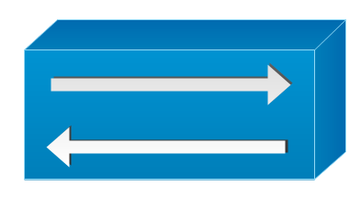
AWSVPCB DEFAULT Config (vpc0)
AWSVPCB comes with 2 pre-defined VPC configurations (vpc0 & vpc1). The difference is how students connect into the VPC with vpc0 (default and recommended) shown below using a BASTION host and vpc1 displayed in the appendix using a client VPN.
VPC
Web Servers
AWS ELB
Home PC
Bastion Server
Internet
Database Servers
Private Routing Table
AWS Route 53
Public Routing Table
EC2 NAT Instance
AWS Internet Gateway
AWSVPCB Scripts – Run from AWS Academy Learner Lab
Legend:
Security Group
Subnet
Internet

Slide 7

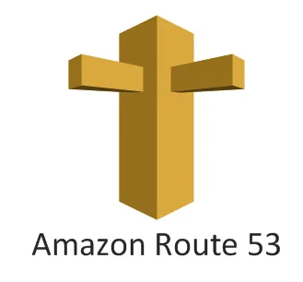
AWSVPCB Default Assignment Diagrams
AWSVPCB comes with 17 pre-defined assignments. Assignments 1-3 have no issues; these are the baseline or example assignments. Assignments 4-17 have one or more issues. Below are the number of issues for each assignment:
Assignments 1-3: No issues
Assignments 12-17: 1 problem to fix
Assignments 4-8: 2 problems to fix
Assignments 9-10: 3 problems to fix
Assignment 11: 4 problems to fix (one is for extra credit)
Assignments #1, #4, #5, #6, #7, #13, #14, #15, #17
IIS1 Server (MyFIU site)
VPC
Port 80 (IIS)
Student Machine
Port 53 (DNS)
Port 1433 (SQL)
AWS VPN
Linux1 Server (Rainforest Site)
Internet
NAT Instance
MSSQL Server (Windows SQL Server)
Port 80 (nginx)
Port 5000 (dot net)
AWSVPCB Scripts

Slide 8
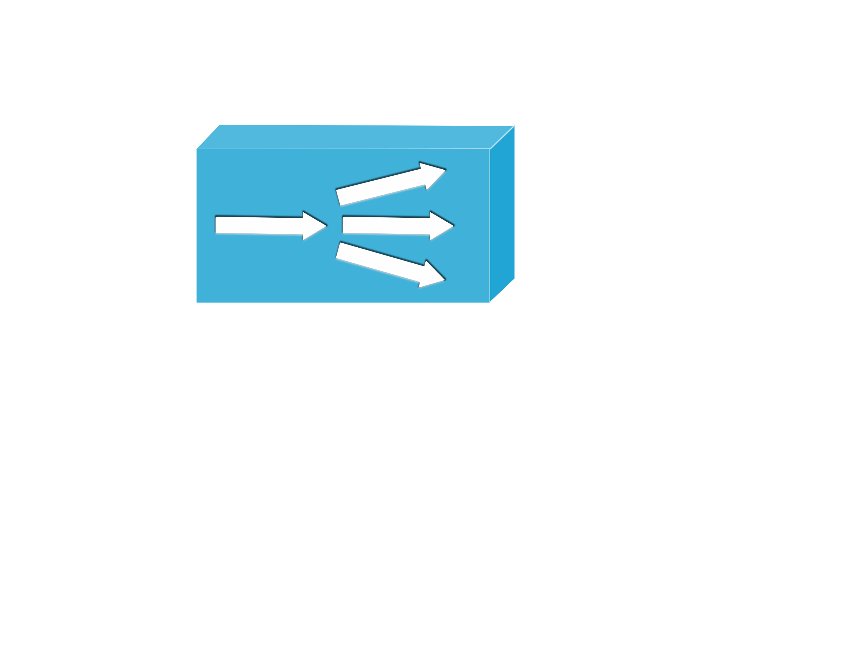
AWSVPCB Default Assignment Diagrams
Assignments #9, #11, #16
Only Rainforest App
Linux1 Server (Rainforest Site)
VPC
Port 80 (nginx)
Port 5000 (dot net)
Student Machine
AWS ELB
External web service
Port 443
Internet
Linux2 Server (Rainforest Site)
NAT Instance
AWS VPN
Port 80 (nginx)
Port 5000 (dot net)
Port 1433 (SQL)
Port 53 (DNS)
MSSQL Server (Windows SQL Server)
AWSVPCB Scripts
Assignments #8, #10, #12
Only MyFIU App
IIS1 Server (MyFIU site)
VPC
Port 80 (IIS)
Student Machine
AWS ELB
External web service
Port 443
Internet
NAT Instance
AWS VPN
IIS2 Server (MyFIU site)
Port 1433 (SQL)
Port 80 (IIS)
Port 53 (DNS)
MSSQL Server (Windows SQL Server)
AWSVPCB Scripts

Slide 9
AWSVPCB SCRIPTS
In this course you will be provided with several scripts to manage your VPC
3 one-time scripts as follows, 1 recovery script and 1 diagnostics:
  AWSVPCB.CONFIGURE – Only needed at start of course, but can be run again without issue; Student may be asked to select their professor & course, if vpcb-config is defined in this way
  AWSVPCB.VPC.CREATE – This script runs VPC.REGISTER, creates your VPC, Internet Gateway, route tables, subnets, security groups, S3 buckets, NAT instance, BASTION server, etc. and registers all AWS unique IDs
    You should only need to run this script once. If you need to start from scratch, you need to run AWSVPCB.VPC.DESTROY before re-running this.
  AWSVPCB.VPC.DESTROY – May never be needed – runs VPC.REGISTER to ensure AWS is in synch with the AWSVPCB registry and then destroys your VPC and everything in it
  AWSVPCB.VPC.REGISTER – May never be needed. It will find your AWS-VPCB VPC in AWS and register all its components for the other scripts to be able to work as expected – run automatically by VPC.CREATE & VPC.DESTROY
  AWSVPCB.DIAGLOG – May never be needed. It will upload your environment to an S3 bucket for professor review in case of an issue
4 multi-use assignment scripts as follows:
  AWSVPCB.ASSIGNMENT.CREATE # – Destroys existing instances and ELB targets if any exist, then Adjusts VPC settings, Creates assignment instances and ELB (if applicable) based on number passed in as parameter; Destroys any existing work you’ve done on assignment.
  AWSVPCB.ASSIGNMENT.START – Starts instances, Creates Route 53 Private zone and resource records; Can run multiple times without destroying work.
  AWSVPCB.ASSIGNMENT.STOP – Stops instances, Deletes Route 53 Private zone; Can run multiple times without destroying work.
  AWSVPCB.ASSIGNMENT.DESTROY – May never be needed - Destroys existing ELB and instances
    Called by AWSVPCB.ASSIGNMENT.CREATE; Destroys all the work you’ve done on assignment.

Slide 10
AWSVPCB Automation & Credits
Credit Usage Implications of Scripts: The below assumes you are using the AWS Academy Learner Lab.
AWSVPCB.VPC.CREATE - Instances started when first run, but once assignment is stopped, this represents no charges.
AWSVPCB.ASSIGNMENT.CREATE – Instances started when first run, but once assignment is stopped, this accounts for charges only in later assignments that use the ELB - a few cents will begin to be billed to your account on a daily basis.
AWSVPCB.ASSIGNMENT.START - You will not be able to use your services until you run this script. After you run this script, you will begin to draw down on your credits at a much steeper rate (several dollars per day). The course is designed to allow you hundreds of hours of time, but not 24x7 time for days. If you do not run the AWSVPCB.ASSIGNMENT.STOP script, whenever you are done working on your assignment, you will run out of credits. Ending the AWS Academy Lab alone does not stop all services!
AWSVPCB.ASSIGNMENT.STOP - will stop the necessary services so that you are no longer using a heavy number of credits while saving all of your changes. While your changes are saved, you will not be able to work until you perform an ASSIGNMENT.START again.
AWSVPCB.VPC.DESTROY - If you find that you need to destroy your VPC for a while to save on credits by running this script, that is fine, but please note that you will lose any customizations made to your Bastion server.

Slide 11
Clouducate Components & Interdependencies
AWS Virtual Private Cloud Builder
(AWSVPCB)
Collection of BASH shell scripts that take as input json files as definitions for a VPC and assignments. Capabilities include:
  Creation of subnets
  Creation of security groups with associated rules
  Creation of instances
  Creation of Load Balancers with associated definitions (e.g. targets, health checks, etc.)
  Creation of DNS zone with associated DNS entries
  Creation of NAT instance for Internet access
  Creation of Client VPN Endpoint for private access over the Internet
  Userdata files with instance startup scripts
Domain Name Parameter
must match
Havoc Circus (HC) Images
Custom AMIs with pre-built Linux & Windows web applications
Domain names defined in web configuration files to access DB and define domain in web servers
Hardcoded admin and database passwords
HC AMI (images)
In AWSVPCB json
Instance & DB PWDs
In AWSVPCB Directory
Logs & Diag Info
To professor S3 Bucket
CA & Domain Certs
In AWSVPCB Directory
VPC & Assignment json
In AWSVPCB Dir or S3 Bucket

Slide 12
Sample AWSVPCB Configuration Files
VPC json – in secfiles/vpc#
{
"AWSVPCB": {
"VPC":
{ "VPCCIDR": "172.31.0.0/16" }
},
{
"Subnets": [
{
"SubnetName": "DEFAULT",
"SubnetCIDR": "172.31.131.0/24",
"SecurityGroup": "yes",
"RoutingTable": "DEFAULT"
},
……….
{
"PossibleInstanceNames": [
{
"InstanceName": "IIS1"
},
………….
{
"PossibleELBs": [
{
"ELBName": "myfiu"
},
………….
{
"BASTIONDefinition":
{
"IPAddress": "172.31.132.20",
"Subnet": "PUBLIC",
"AMI": "ami-041bd92954e73c009"
}
},
{
"RemoteConnFlag": "bastion"
}
……………
{
"NATDefinition":
{
"IPAddress": "172.31.132.151",
"Subnet": "PUBLIC",
"AMI": "ami-00d1f8201864cc10c"
}
},
{
"ServerPrivateKey": "privkey"
}
Assignment jsons – in secfiles/assignment#
vpcb-config – in main directory
{
"AWSVPCB": {
"Instances": [
{
"InstanceName": "LINUX1",
"InstanceIP": "172.31.128.43",
"InstanceSubnet": "WEB",
"InstanceAMI": "ami-0fb4c2197eba775de",
"InstanceType": "t2.micro"
},
…………
{
"FirewallRules": [
{
"SecurityGroup": "DEFAULT",
"RuleType": "inbound",
"Protocol": "all",
"Port": "all",
"SourceGroup": "172.31.0.0/16"
},
…………..
{
"DNSEntriesFile": "assignment9/awsvpcb.assignment9.DNS.json"
},
{
"ELBs": [
{
"ELBName": "rainforest",
"ListenerProtocol": "HTTPS",
"ListenerPort": "443",
"InstanceProtocol": "HTTP",
"InstancePort": "80",
"ELBSubnet": "AWSVPCB_ELB",
"HealthCheckTarget": "TCP:80",
"HealthCheckInterval": "5",
"HealthCheckTimeout": "3",
"HealthCheckUnhealthyThreshold": "2",
"HealthCheckHealthyThreshold": "2",
"ELBInstances": [
{
"InstanceName": "LINUX1"
},
{
"InstanceName": "LINUX2"
}
………..
{
"Changes": [
{
"Action": "CREATE",
"ResourceRecordSet": {
"Name": "nat.awsvpcb.edu",
"Type": "A",
"TTL": 300,
"ResourceRecords": [
{
"Value": "172.31.132.151"
}
]
}
},
……………..
{
"Action": "CREATE",
"ResourceRecordSet": {
"Name": "linux2.awsvpcb.edu",
"Type": "A",
"TTL": 300,
"ResourceRecords": [
{
"Value": "172.31.128.44"
}
]
}
},
{
"Action": "CREATE",
"ResourceRecordSet": {
"Name": "mssql.awsvpcb.edu",
"Type": "A",
"TTL": 300,
"ResourceRecords": [
{
"Value": "172.31.129.75"
}
…………
export INSTITUTION="FIU“
export PROFESSOR=“Name“
export COURSE=DYNAMIC
export AVAILABLE_COURSES=“… …”
export AWSVPCB_SEM=DYNAMIC
export ERRORMSG="please run ./AWSVPCB.DIAGLOG and let the professor know to review....“
export DOMAIN=awsvpcb.edu
export AWS_ACADEMY=yes
export AWS_REGION=us-east-1 export PRIMARY_AWS_AZ=us-east-1a
export DIAGLOG_LAMBDA_URL=https://…. # Unique per professor

Slide 13
AWSVPCB Miscellaneous Features/Limitations
FEATURES:
Automatic creation of OVPN file for VPN connectivity
Automatic creating of DNS records for ELBs
Automatic assignment of SSL certs to ELBs, but files (.cert & .key) with ELB names must exist in secfiles directory
Automatic saving of any changes to DNS or Firewall rules in between START and STOP scripts; NOTE: ELB(s) are created with the first START and not deleted until the ASSIGNMENT DESTROY
Ability to copy all VPC information to S3 bucket (DIAGLOG script), but professor must run aws-setup to create necessary resources in their account
LIMITATIONS:
At this time json file syntax validation is non-existent; this is in the backlog to be built
  Mitigation offered through MANIFEST.DISPLAY script, but it still requires manual verification
Security groups are only created with association to subnet. Thus, two subnets cannot share the same security group
Only a subset of parameters are accepted for each AWS instance
By default, AWS limits the number of SSL certificate uploads, so too many VPC creations will cause errors – try to limit the number of VPC creations – there is no limit to number of assignment creations
Active VPC entities are stored in files within the AWSVPCB directory, so you must run the scripts from the same directory
  Portability to another system offered through CONFIGURE and VPC.REGISTER scripts

Slide 14
AWSVPCB – How to start quickly #1
USE awsvpcb-setup (instructions here - https://github.com/clouducate/awsvpcb/raw/refs/heads/main/awsvpcb-setup%20instructions.docx)
  NOTE: This requires you to create an AWS account with a credit card provided for AWS, however, expenses are minimal (less than $1 per month)
  NOTE: By default the awsvpcb-setup script will send logs and resulting vpcb-config file generated to centralized admin S3 bucket, but you can override this when prompted whether to add to registry or not as indicated in the instructions.
  NOTE: Your login credentials expire after 12 hours, so you will need to re-login at that point using the "aws login" command
From the same device as used in step #1, perform the following:
  TYPE: wget https://github.com/clouducate/awsvpcb/raw/refs/heads/main/awsvpcb-scripts.zip
  TYPE: unzip awsvpcb-scripts.zip
  TYPE: cd awsvpcb-scripts
  TYPE: chmod 755 *
  TYPE: chmod 755 procs/*
COPY the vpcb-config file created in step #1 to this directory then do the following:
  TYPE: ./AWSVPCB.CONFIGURE # If you have multiple course, then you will be asked to choose one
  TYPE: ./AWSVPCB.VPC.CREATE # Up to this point there are no cost implications to what's been done
  TYPE: ./AWSVPCB.ASSIGNMENT.CREATE 2 # Answer “y” at the prompt - NOTE: costs start here, but it's negligible for a few hours.
AT THIS POINT YOU HAVE CREATED A FULL AWS ENVIRONMENT WITH EC2 INSTANCES, SUBNETS, ROUTE TABLES, LOAD BALANCERS, A DATABASE, ETC. FEEL FREE TO PERUSE IT FROM THE AWS CONSOLE. IF YOU WISH TO LOG INTO YOUR VPC AND TEST AN APPLICATION, YOU CAN DO THE BELOW. IF NOT SKIP TO STEP 15.

Slide 15
AWSVPCB – How to start quickly #2
Log into the AWS console. Place your cursor on the “Search” box and type: ec2
Click on the “EC2” selection in the drop down. Scroll down on the left-side pane until you see “Security Groups” and click on it.
Click on the checkbox next to the “AWS-VPCB-PUBLIC” security group. When you do, the bottom portion of the screen will populate. Click on “inbound rules” and then on the “Edit inbound rules” button.
You should be presented with the below screen. Click on the “Add rule” button. Then, click on the “Custom TCP” button and type RDP to select it. Then, click on the “Custom” button and select “My IP” from the drop-down menu. Finally, click on the “Save rules” button.
Scroll up on the left-side pane until you see “Instances” and click on it. Then click on the checkbox next to “AWS-VPCB-BASTION”. This will populate the bottom part of the page with the details about this server. Click on the boxes under “Public IPv4 DNS” to copy the public name of the server.
Open a Remote Desktop Tool
  ON MAC - Download Microsoft Remote Desktop 10 or higher from the MAC App Store and install.
  ON WINDOWS – There are several Remote Desktop options, but “Remote Desktop Connection” comes pre-installed on all Windows machines. You simply need to “rdp” on the Windows search bar. However, you will need to constantly re-enter your credentials each time you connect.
Now, let’s connect to your Bastion host! Within RDP, click on “Show options” to expand the window. Paste in the DNS name you just copied in the “Computer” field. Type “administrator” in the “User name” field. Finally, click on the “Connect” button.
You may be asked “Do you trust this remote connection?”. Simply click “Connect” again.
You should then be prompted for the password. Copy and paste the following as the password: P@oDxV)4-nPUfp$Ar?V@N9Lpjbsnp@W!

Slide 16
AWSVPCB – How to start quickly #3
You will then be prompted again with something like “The identity of the remote computer cannot be verified. Do you want to connect anyway?”. Click “yes”. You are now logged into your Bastion host!
To test the applications associated to this particular assignment number, simply open a browser on your Bastion server and type HTTP://myfiu.awsvpcb.edu
AT THIS POINT YOU ARE IN YOUR VPC AND LOOGED INTO A WINDOWS SERVER WITH MANY TOOLS PRE-INSTALLED. FEEL FREE TO LOOK AROUND.
Once you are done testing, you should destroy the assignment to avoid AWS costs. To do so, simply go back to the awsvpcb-scripts directory and run ./AWSVPCB.ASSIGNMNET.DESTROY.
You can experiment with other assignments and/or destroy it all whenever you wish.
  NOTE: Assignment numbers beyond 3 have purposefully created errors and the applications (HTTP://myfiu.awsvpcb.edu and HTTP://rainforest.awsvpcb.edu) will not work as expected.

Slide 17
Next Steps for your course
MAP OUT TARGET ENVIRONMENT
What AMIs do you plan to use? Are the default AMIs provided sufficient, or do you want to take those and create custom AMIs?
What applications will the students be testing? Are the default rainforest and myfiu applications sufficient or do I want to build/use others?
What do you want your VPC to look like (IP range, subnets, possible instances, possible ELBs)? Is the default sufficient?
What do you want your assignments to look like (instances, firewall rules, DNS entries, ELBs)? Are the default assignments sufficient?
What do you want your assignments to do (e.g. setup a security vulnerability or break the environment in some way)?
Use default awsvpcb.edu domain OR create your own domain and provide the following:
  Public CA cert for import into student client machines or use public CA (e.g., Sectigo)
  Client & Server VPN certs (if using VPN – not recommended) and private keys
  ELB certs and private keys
Use pre-defined VPC and assignment AWSVPCB json files OR create your own
Use the AWS Academy Learner Lab for the students (recommended) OR each student needs to create AWS account (with credit card) and install the AWS CLI; the awsvpcb-student-setup script with the following instructions (https://github.com/clouducate/awsvpcb/raw/refs/heads/main/awsvpcb-student-setup%20instructions.docx ) can also be provided.

Slide 18
Appendix
Older features (e.g., VPN, Havoc Circus Windows Service, Cloudwatch Logging) that are still supported, but not actively used

Slide 19
AWSVPCB Legacy Config (vpc1)
Legend:
Security Group
Subnet
AWS Client Side IP Range
VPC
Web Servers
AWS ELB
Home PC
Internet
Client VPN Endpoint
Database Servers
VPN Tunnel
Requirements:
OpenVPN SW
AWS Client VPN Endpoint config with client & server certificates
Private Routing Table
AWS Route 53
Public Routing Table
EC2 NAT Instance
AWS Internet Gateway
AWSVPCB Scripts
Internet

Slide 20
Legacy Clouducate Components & Interdependencies
AWS Virtual Private Cloud Builder
(AWSVPCB)
Collection of BASH shell scripts that take as input json files as definitions for a VPC and assignments. Capabilities include:
  Creation of subnets
  Creation of security groups with associated rules
  Creation of instances
  Creation of Load Balancers with associated definitions (e.g. targets, health checks, etc.)
  Creation of DNS zone with associated DNS entries
  Creation of NAT instance for Internet access
  Creation of Client VPN Endpoint for private access over the Internet
Domain Name Parameter
must match
Havoc Circus (HC)
Windows Service written in C-Sharp that takes as input json files as definitions for modifications for assignments. Capabilities include:
  Custom AMIs with pre-built Linux & Windows web applications
  Reading of assignment # from DNS TXT record
  Running a remote command on any system within the VPC. In this way just about any problem can be created dynamically
  At shutdown, verifying whether a problem was addressed and if so, marking it as complete to avoid restarting a solved problem
HC AMI (images)
In AWSVPCB json
AWSVPCB DNS IPs
In HC AMIs
AWSVPCB Assignment #
In DNS TXT Record
Instance & DB PWDs
In AWSVPCB Directory
Logs & Diag Info
To S3 Bucket
CA & Domain Certs
In AWSVPCB Directory
VPC & Assignment json
In AWSVPCB Dir or S3 Bucket
Assignment files
In S3 Bucket
Assignment json
In S3 Bucket

Slide 21
Sample Havoc Circus json Files
{
"HavocMonkey": {
"PrimateAssembly": {
"PrimateTypeName": "Assignment5.HavocMonkey",
"PrimateFileName": "Assignment5.HavocMonkey.dll",
"PrimateDependencies": [
{
"DependencyFileName": "Primate.dll"
}
]
},
"PrimatePackages": [
{
"PrimatePackage": {
"TargetHostName": "iis1.cts4743.edu",
"TargetUserName": "Administrator",
"TargetUserPassword": "P@oDxV)4-nPUfp$Ar?V@N9Lpjbsnp@W!",
"TargetPlatform": "Windows",
"TargetPackageFiles": [
{
"FileName": "MemoryLocker.exe",
"FilePath": "C$\\Apps\\MemoryLocker\\"
},
{
……..
},
{
"FileName": "MemoryWorker.runtimeconfig.json",
"FilePath": "C$\\Apps\\MemoryWorker\\"
}
]
}
},
{
"PrimatePackage": {
"TargetHostName": "linux1.cts4743.edu",
"TargetUserName": "ec2-user",
"TargetUserPassword": "cts4743",
"TargetPlatform": "Linux",
"TargetPackageFiles": [
{
"FileName": "CPUWorker.exe",
"FilePath": "/usr/bin/cts4743/apps/cpu_worker/"
},
{
……..
{
"FileName": "CPUWorker.runtimeconfig.json",
"FilePath": "/usr/bin/cts4743/apps/cpu_worker/"
}
]
}
}
],
"PrimateTasks": [
{
"PrimateTask": {
"TaskLabel": "MemoryWorker",
"TargetHostName": "iis1.cts4743.edu",
"TargetUserName": "Administrator",
"TargetUserPassword": "P@oDxV)4-nPUfp$Ar?V@N9Lpjbsnp@W!",
"TargetPlatform": "Windows",
"TaskInitializationCommands": [
{
"CommandExecutable": "C:\\Apps\\MemoryLocker\\MemoryLocker.exe",
"CommandArguments": "384"
…….
}
},
{
"PrimateTask": {
"TaskLabel": "CPUWorker",
"TargetHostName": "linux1.cts4743.edu",
"TargetUserName": "ec2-user",
"TargetUserPassword": "cts4743",
"TargetPlatform": "Linux",
"TaskInitializationCommands": [
{
"CommandExecutable": "\"`nohup dotnet \"/usr/bin/cts4743/apps/cpu_worker/CPUWorker.dll 1 20000000000 125\" > /dev/null 2>&1 &`\"",
"CommandArguments": ""
},
……….
{
"HavocMonkey": {
"PrimateAssembly": {
"PrimateTypeName": "Assignment8.HavocMonkey",
"PrimateFileName": "Assignment8.HavocMonkey.dll",
"PrimateDependencies": [
{
"DependencyFileName": "Primate.dll"
}
]
},
"PrimatePackages": [
{
"PrimatePackage": {
"TargetHostName": "iis1.cts4743.edu",
"TargetUserName": "Administrator",
"TargetUserPassword": "P@oDxV)4-nPUfp$Ar?V@N9Lpjbsnp@W!",
"TargetPlatform": "Windows",
"TargetPackageFiles": [
{
"FileName": "Web.config",
"FilePath": "C$\\Web\\MyFIU\\",
"ForceOverwrite": "true"
}
]
}
}
],
"PrimateTasks": [
{
"PrimateTask": {
"TaskLabel": "IISWebConfigMangler",
"TargetHostName": "iis1.cts4743.edu",
"TargetUserName": "Administrator",
"TargetUserPassword": "P@oDxV)4-nPUfp$Ar?V@N9Lpjbsnp@W!",
"TargetPlatform": "Windows",
"TaskInitializationCommands": [
{
"CommandExecutable": "C:\\Windows\\System32\\cmd.exe",
"CommandArguments": "/C echo Assignment 8 initialization success on %DATE% %TIME%! > C:\\Assignment8.txt"
}
]
}
}
]
}
}

Slide 22
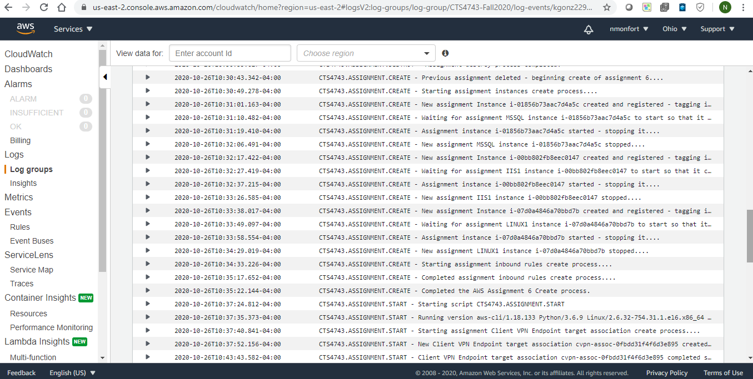
AWSVPCB Logging
Optional logging to AWS cloudwatch is built into the AWSVPCB system. This allows you to rack the progress of students and whether they made a mistake when running the scripts. AWS account with IAM user that has access to cloudwatch must be created outside of tool.

