Slide 1
DevOps – Self-Study -v2
Objectives:
Self-Motivated
Training PoC infrastructure based on individual trainee's personal account
Bottlenecks with previous trainings addressed ,especially with the challenge in running the CICD softwares on trainee personal desktops
Initial pilot with Open-source/Java based app DevOps
Expand the platform to cover additional application technologies

Slide 2
Training PoC infrastructure based on individual trainee's personal account
Trainee Personal Accounts (not associated to TXX /Ci** and non-commercial usage) for two free cloud IaS/PaS
A) Amazon Web Services
12 months free
Linux & Windows VM with Amazon EC2 with sufficient small power
B)Google Cloud App Engine
<<License and subscriptions info>>
Required for softwares (Nexus ) which require higher memory & CPU not available in AWS free tier
Notes:
*Personal accounts require verification through credit cards
*Initial verified on license but need re-verification

Slide 3
Trainee activities and expectations
Create Personal account in AWS and Google Cloud App Engine
( Intros on usage of cloud included in the subs )
( Adhere to the Cloud free tierusage )
Create CI based Virtual Machines
Basic Configuration of tools (based on prior training links and guides)
Checkpoint and test with the basic java webapp
Create CD VMs and basic configuration
Integrate all the features and run and E2E CICD process

Slide 4
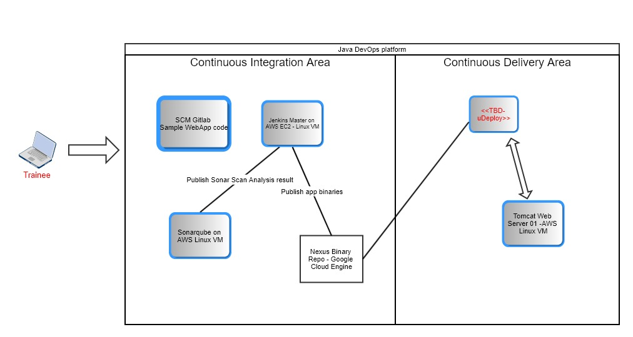
Platform Outline

