Slide 1

What’s in it for you?
What is ITIL?
What is ITSM?
ITSM Key Concepts
ITIL Service Lifecycle

Slide 2
What is ITIL?
ITIL is a list of volumes that describe a framework for the best practices to deliver IT services. These practices are drawn from the private and public sectors worldwide. ITIL has the following benefits:

Slide 3




What is ITIL?
ITIL is a list of volumes that describe a framework for the best practices to deliver IT services. These practices are drawn from the private and public sectors worldwide. ITIL has the following benefits:
Improved IT services
Improved customer satisfaction
Standards and guidance
Reduced IT costs

Slide 4


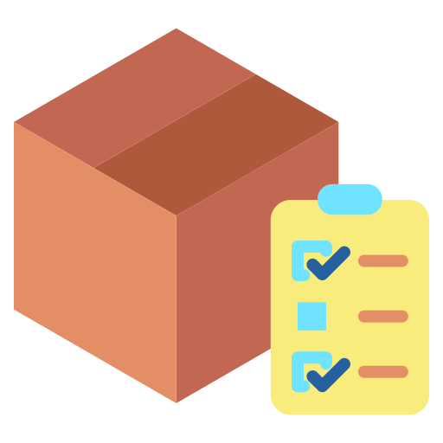
What is ITIL?
ITIL is a list of volumes that describe a framework for the best practices to deliver IT services. These practices are drawn from the private and public sectors worldwide. ITIL has the following benefits:
Improved delivery of 3rd party services
Improved productivity
Improved skills and experience

Slide 5
What is ITIL?
ITIL has gone through several revisions and comprises of five books, focusing on the various processes and stages of the IT service lifecycle

Slide 6
What is ITIL?
ITIL has gone through several revisions and comprises of five books, focusing on the various processes and stages of the IT service lifecycle
Their most recent update, ITIL 4 began to start rolling out in Q1 of 2019, focuses on more agile, flexible and customizable version of ITIL, modified for modern businesses

Slide 7

What is ITSM?
IT Service Management focuses on implementing, managing and delivering IT services to ensure the goals of the organization are met

Slide 8
What is ITSM?
IT Service Management focuses on implementing, managing and delivering IT services to ensure the goals of the organization are met
It uses the appropriate mix of people, processes and technology to ensure they can provide value to the organization

Slide 9


ITSM Key Concepts
To understand ITIL and ITSM, certain keywords need to be understood. Terms like:
Value is the perceived benefits, usefulness and importance of something. Value is subjective in nature with respect to stakeholders, organization and customers
Co-creation of value refers to a strategy that encourages involvement from customers to provide them with a greater experience

Slide 10



ITSM Key Concepts
To understand ITIL and ITSM, certain keywords need to be understood. Terms like:
A service refers to a means of giving value to customers, with favorable outcomes without having to manage specific costs and risks
The service relationship refers to the co-operation between a service provider and a service consumer
The service provider is role performed by an organization that provides services to consumers

Slide 11




ITSM Key Concepts
To understand ITIL and ITSM, certain keywords need to be understood. Terms like:
An organization represents a group of people that have their own functions with responsibilities, authorities and relationship to achieve their objectives
The service relationship management refers to the joint activities performed by service providers and service consumers to ensure co-creation of value
A service consumer could represent the customer, user and sponsor of the service

Slide 12


ITSM Key Concepts
To understand ITIL and ITSM, certain keywords need to be understood. Terms like:
The output refers to the physical or non-physical deliverables created as a result of an activity
The outcome refers to the result for a stakeholders enabled by one or more outputs

Slide 13


ITSM Key Concepts
To understand ITIL and ITSM, certain keywords need to be understood. Terms like:
Utility refers to the functionality offered by a product for service to meet a need of the organization
Warranty refers to the assurance provided that a product or service will meet the agreed requirements discussed

Slide 14
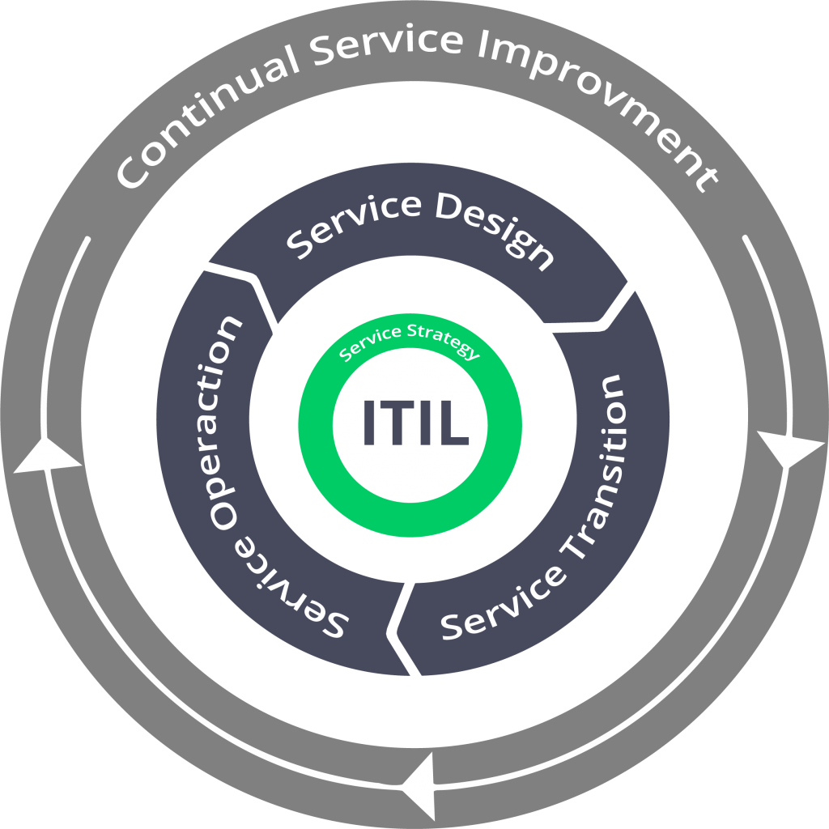
ITIL Service Lifecycle
It is an approach to IT Service Management that organizations of all sizes can be used to manage the full lifecycle of IT and other services. It helps co-ordinate and control across processes, systems and functions

Slide 15
ITIL Service Lifecycle
Strategy Management for IT Service
Service Portfolio Management
Service Strategy
Business Relationship Management
Financial management
Demand Management
Service Design
Service Transition
The Service Strategy stage describes the steps and objectives required to manage IT services. The stage also makes sure that these services are aligned with the goals of the organization. These are the processes under this stage:
Service Operations
Continual Service Improvement

Slide 16
ITIL Service Lifecycle
1/5
Strategy Management for IT Service
Service Portfolio Management
Service Strategy
Business Relationship Management
Financial management
Demand Management
Service Design
Strategy management for IT services is a process to define and maintain the 4Ps of Strategy (i.e. perspective, position, plans, and patterns) and ensures the creation of a strategy for an IT Service & its Management, throughout the service life-cycle
Service Transition
Service Operations
Continual Service Improvement

Slide 17
ITIL Service Lifecycle
1/5
Strategy Management for IT Service
Service Portfolio Management
Service Strategy
Business Relationship Management
Financial management
Demand Management
Service Design
The financial management process helps understand and manage costs and opportunities involved with the service. The different activities under it are:
Accounting: Tracking how money is spent by service providers
Budgeting: Planning how money would be spent by service providers
Charging: Securing payment from customers for the services provided to them
Service Transition
Service Operations
Continual Service Improvement

Slide 18
ITIL Service Lifecycle
1/5
Strategy Management for IT Service
Service Portfolio Management
Service Strategy
Business Relationship Management
Financial management
Demand Management
Service Design
The service portfolio management process represents the entire set of activities that are managed by a service provider. This process organizes the process by which a process is identified, described, evaluated, selected and chartered
Service Transition
Service Operations
Continual Service Improvement

Slide 19
ITIL Service Lifecycle
1/5
Strategy Management for IT Service
Service Portfolio Management
Service Strategy
Business Relationship Management
Financial management
Demand Management
Service Design
The demand management process helps understand and influence customer demand. It uses: User profiles: Characterizes different groups of users for a given service
Patterns of Business Activity: Represents the way users in different user profiles interact with a service over a period of time
Service Transition
Service Operations
Continual Service Improvement

Slide 20
ITIL Service Lifecycle
1/5
Strategy Management for IT Service
Service Portfolio Management
Service Strategy
Business Relationship Management
Financial management
Demand Management
Service Design
Business relationship management aims to maintain a positive relationship with customers. It identifies the requirements of potential and existing customers and ensures the development of appropriate services so that those needs can be met
Service Transition
Service Operations
Continual Service Improvement

Slide 21
ITIL Service Lifecycle
2/5
IT Service Continuity Management
Design Coordination
Availability Management
Service Catalogue Management
Service Design
Service Level Management
Capacity Management
Information Security Management
Supplier Management
Service Transition
Service Operations
This stage focuses on the design of the services and all the other supporting elements that enable the service to be introduced into a live environment. There are 4 areas that need to be taken into consideration when designing a service:
People: HR and organizational structure to support the service
Processes: Service Management process required to support the service
Products: Technology and infrastructure support
Partners: Third parties that can provide additional support
Continual Service Improvement

Slide 22
ITIL Service Lifecycle
2/5
IT Service Continuity Management
Design Coordination
Availability Management
Service Catalogue Management
Service Design
Service Level Management
Capacity Management
Information Security Management
Supplier Management
Service Transition
Design coordination is a process responsible for being the single point of contact for co-ordination and control of all activities related to service design
Service Operations
Continual Service Improvement

Slide 23
ITIL Service Lifecycle
2/5
IT Service Continuity Management
Design Coordination
Availability Management
Service Catalogue Management
Service Design
Service Level Management
Capacity Management
Information Security Management
Supplier Management
Service Transition
The service level management process secures and manages agreements between customers and service providers relating to utility and warranty of specific services. These lead to the creation of Service Level Agreements (SLA) between customers and the provider
Service Operations
Continual Service Improvement

Slide 24
ITIL Service Lifecycle
2/5
IT Service Continuity Management
Design Coordination
Availability Management
Service Catalogue Management
Service Design
Service Level Management
Capacity Management
Information Security Management
Supplier Management
Service Transition
The availability management process handles the management and achievement of the agreed-upon availability requirements that were established in the Service Level Agreements
Service Operations
Continual Service Improvement

Slide 25
ITIL Service Lifecycle
2/5
IT Service Continuity Management
Design Coordination
Availability Management
Service Catalogue Management
Service Design
Service Level Management
Capacity Management
Information Security Management
Supplier Management
Service Transition
The capacity management process ensures that the cost-effective capacity meets or exceeds the needs of the business, as established in the SLAs. It is divided into three categories:
Business Capacity Management
Service Capacity Management
Component Capacity Management
Service Operations
Continual Service Improvement

Slide 26
ITIL Service Lifecycle
2/5
IT Service Continuity Management
Design Coordination
Availability Management
Service Catalogue Management
Service Design
Service Level Management
Capacity Management
Information Security Management
Supplier Management
Service Transition
The process of IT service continuity management ensures that the service provider can provide the minimum agreed upon levels of service. It uses techniques like Business Impact Analysis and Management of Risk to produce an IT Service Continuity Plan
Service Operations
Continual Service Improvement

Slide 27
ITIL Service Lifecycle
2/5
IT Service Continuity Management
Design Coordination
Availability Management
Service Catalogue Management
Service Design
Service Level Management
Capacity Management
Information Security Management
Supplier Management
Service Transition
The process of IT security management aims to protect five basic qualities of information assets:
Confidentiality
Integrity
Availability
Nonrepudiation
Authenticity
Service Operations
Continual Service Improvement

Slide 28
ITIL Service Lifecycle
2/5
IT Service Continuity Management
Design Coordination
Availability Management
Service Catalogue Management
Service Design
Service Level Management
Capacity Management
Information Security Management
Supplier Management
Service Transition
The service catalog management process contains all services available to customers and users. It is usually the only portion of the service portfolio accessible to users
Service Operations
Continual Service Improvement

Slide 29
ITIL Service Lifecycle
2/5
IT Service Continuity Management
Design Coordination
Availability Management
Service Catalogue Management
Service Design
Service Level Management
Capacity Management
Information Security Management
Supplier Management
Service Transition
The process of supplier management deals with obtaining value for money from third party suppliers. It works more with external suppliers than with internal suppliers and consumers
Service Operations
Continual Service Improvement

Slide 30
ITIL Service Lifecycle
3/5
Transition Planning and Support
Release and Deployment Management
Service Transition
Change Evaluation
Knowledge Management
Service Asset and Config Management
Change Management
Service Evaluation and Testing
Service Operations
Continual Service Improvement
The Service Transition stage of service transition enables the building and deploying of IT services, while making sure the changes to the services and service management processes are taking place in a coordinated manner

Slide 31
ITIL Service Lifecycle
3/5
Transition Planning and Support
Release and Deployment Management
Service Transition
Change Evaluation
Knowledge Management
Service Asset and Config Management
Change Management
Service Evaluation and Testing
Service Operations
The transition planning and support process plans and coordinates the use of resources to deploy a major release within the time, time and quality predicted
Continual Service Improvement

Slide 32
ITIL Service Lifecycle
3/5
Transition Planning and Support
Release and Deployment Management
Service Transition
Change Evaluation
Knowledge Management
Service Asset and Config Management
Change Management
Service Evaluation and Testing
Service Operations
The process of asset and configuration management maintains information about the configuration items required to deliver an IT service, including their relationships
Continual Service Improvement

Slide 33
ITIL Service Lifecycle
3/5
Transition Planning and Support
Release and Deployment Management
Service Transition
Change Evaluation
Knowledge Management
Service Asset and Config Management
Change Management
Service Evaluation and Testing
Service Operations
The release and deployment management process plans, schedules and controls the movement of releases to testing and live environments, while ensuring the integrity of the live environment is maintained. It also makes sure the appropriate components are released
Continual Service Improvement

Slide 34
ITIL Service Lifecycle
3/5
Transition Planning and Support
Release and Deployment Management
Service Transition
Change Evaluation
Knowledge Management
Service Asset and Config Management
Change Management
Service Evaluation and Testing
Service Operations
The process of change management controls the lifecycle of all changes with minimal disruption to IT services
Continual Service Improvement

Slide 35
ITIL Service Lifecycle
3/5
Transition Planning and Support
Release and Deployment Management
Service Transition
Change Evaluation
Knowledge Management
Service Asset and Config Management
Change Management
Service Evaluation and Testing
Service Operations
The process of change evaluation assesses major changes before they can proceed to their next phase in their lifecycle
Continual Service Improvement

Slide 36
ITIL Service Lifecycle
3/5
Transition Planning and Support
Release and Deployment Management
Service Transition
Change Evaluation
Knowledge Management
Service Asset and Config Management
Change Management
Service Evaluation and Testing
Service Operations
The process of service validation and testing ensures the deployed releases and resulting services meets the needs of the customer, and verifies the IT operations can support the new services
Continual Service Improvement

Slide 37
ITIL Service Lifecycle
3/5
Transition Planning and Support
Release and Deployment Management
Service Transition
Change Evaluation
Knowledge Management
Service Asset and Config Management
Change Management
Service Evaluation and Testing
Service Operations
The knowledge management process gathers, analyzes, stores and shares knowledge and information within an organization, increasing efficiency by reducing the need to rediscover knowledge
Continual Service Improvement

Slide 38
ITIL Service Lifecycle
4/5
Incident Management
Access Management
Request Management
Technical Management
Service Operations
IT Operations Management
Problem Management
Event Management
Service Desk
Application Management
Continual Service Improvement
In the Service Operations stage, the aim is to meet the expectations of the end-user, while balancing costs and looking for any potential problems. This stage has a combination of processes and functions:

Slide 39
ITIL Service Lifecycle
4/5
Incident Management
Access Management
Request Management
Technical Management
Service Operations
IT Operations Management
Problem Management
Event Management
Service Desk
Application Management
Continual Service Improvement
The incident management process manages the lifecycle of all incidents, ensuring IT service returns to users as soon as possible

Slide 40
ITIL Service Lifecycle
4/5
Incident Management
Access Management
Request Management
Technical Management
Service Operations
IT Operations Management
Problem Management
Event Management
Service Desk
Application Management
Continual Service Improvement
The problem management process manages the lifecycle of all problems, making sure incidents are prevented, or have minimal impact in case they can’t be prevented

Slide 41
ITIL Service Lifecycle
4/5
Incident Management
Access Management
Request Management
Technical Management
Service Operations
IT Operations Management
Problem Management
Event Management
Service Desk
Application Management
Continual Service Improvement
The access management process grants authorized users the right to use a service, while ensuring unauthorized users don’t access it

Slide 42
ITIL Service Lifecycle
4/5
Incident Management
Access Management
Request Management
Technical Management
Service Operations
IT Operations Management
Problem Management
Event Management
Service Desk
Application Management
Continual Service Improvement
The event management process makes sure configuration items and services are continuously monitored, and to filter out and categorize events to decide appropriate actions

Slide 43
ITIL Service Lifecycle
4/5
Incident Management
Access Management
Request Management
Technical Management
Service Operations
IT Operations Management
Problem Management
Event Management
Service Desk
Application Management
Continual Service Improvement
The request management process fulfills service requests (which are usually minor in nature)

Slide 44
ITIL Service Lifecycle
4/5
Incident Management
Access Management
Request Management
Technical Management
Service Operations
IT Operations Management
Problem Management
Event Management
Service Desk
Application Management
Continual Service Improvement
The service desk function is the point of contact between users and service providers. It also handles communication with users, and manages incidents and service requests

Slide 45
ITIL Service Lifecycle
4/5
Incident Management
Access Management
Request Management
Technical Management
Service Operations
IT Operations Management
Problem Management
Event Management
Service Desk
Application Management
Continual Service Improvement
The technical management function provides technical expertise and support for the management of the IT infrastructure

Slide 46
ITIL Service Lifecycle
4/5
Incident Management
Access Management
Request Management
Technical Management
Service Operations
IT Operations Management
Problem Management
Event Management
Service Desk
Application Management
Continual Service Improvement
The application management function manages applications throughout their lifecycle

Slide 47
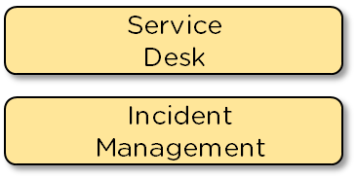
ITIL Service Lifecycle
4/5
Access Management
Request Management
Technical Management
Service Operations
IT Operations Management
Event Management
Service Desk
Application Management
Continual Service Improvement
The IT operations management function that monitors and controls IT services and their underlying infrastructure. It involves activities like job scheduling, backing up and restoring, print and output management and regular maintenance

Slide 48
ITIL Service Lifecycle
5/5
Continuous Service Improvement
7 Step Process Improvement
The Continual Service Improvement stage of the lifecycle uses methods from quality management to learn from bygone successes and failures. It focuses on improving the effectiveness and efficiency of IT processes and services keeping in line with ISO 200

Slide 49
ITIL Service Lifecycle
5/5
Continuous Service Improvement
7 Step Process Improvement
There are 7 steps within this process:
Identifying improvement strategies
Defining what will be measured
Gathering data
Processing data
Analyzing data
Presenting and using information obtained from the data
Using the information for improvement

