Slide 1

Introduction to Linux
“Linux at the Command Line”
Notes:
Tux source: http://upload.wikimedia.org/wikipedia/commons/thumb/a/af/Tux.png/220px-Tux.png

Slide 2
About the class…
We’ll start with a sign in sheet that include questions about your Linux experience and goals.
We’ll end with a class evaluation.
We’ll cover as much as we can in the time allowed, starting with the easiest and most important material. Don’t feel rushed; if we don’t cover everything, you’ll pick it up as you continue working with Linux.
This is a hands-on, lab class; ask questions at any time.
Commands for you to type are in BOLD
We’ll take a break at the half-way point.

Slide 3
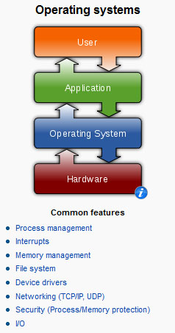
What is Linux?
It’s an Operating System
Notes:
Operating systems graphic source: http://en.wikipedia.org/wiki/Operating_system

Slide 4

What is Linux?
The Most Common O/S Used By BU Researchers When Working on a Server or Computer Cluster
Notes:
Einstein at computer source: http://www.freakingnews.com/Pictures/1/IBM-PC-turns-25.jpg
BU Rhett logo source: http://content.sportslogos.net/logos/30/619/full/71v3tk2fyob03vry9halsekcg.gif

Slide 5
What is Linux?
Linux is a Unix clone written from scratch by Linus Torvalds with assistance from a loosely-knit team of hackers across the Net.
Unix is a multitasking, multi-user computer operating system originally developed in 1969 by a group of AT&T employees at Bell Labs.
Linux and Unix strive to be POSIX compliant.
64% of the world’s servers run some variant of Unix or Linux. The Android phone and the Kindle run Linux.
Notes:
What is Linux? source: http://www.kernel.org/pub/linux/kernel/README and http://en.wikipedia.org/wiki/Linux and http://en.wikipedia.org/wiki/Unix
POSIX an acronym for "Portable Operating System Interface", is a family of standards specified by the IEEE for maintaining compatibility between operating systems. POSIX defines the application programming interface (API), along with command line shells and utility interfaces, for software compatibility with variants of Unix and other operating systems (source: http://en.wikipedia.org/wiki/POSIX).

Slide 6
The Linux Philosophy
The *Nix Philosophy of Doug McIlroy
(i) Make each program do one thing well. To do a new job, build afresh rather than complicate old programs by adding new features.
(ii) Expect the output of every program to become the input to another, as yet unknown, program. Don't clutter output with extraneous information. Avoid stringently columnar or binary input formats. Don't insist on interactive input.
(iii) Use tools in preference to unskilled help to lighten a programming task, even if you have to detour to build the tools and expect to throw some of them out after you've finished using them.
Notes:
Source: http://www.faqs.org/docs/artu/ch01s06.html

Slide 7
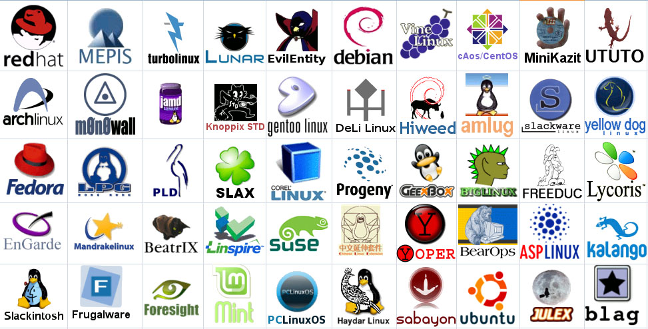
Linux Has Many Distributions
Notes:
Logos source: http://www.muylinux.com/wp-content/uploads/2009/04/logos-distros.jpg

Slide 8

Linux Has Many Distributions
BU uses CentOS in its Linux cluster which is a free version of RedHat Enterprise Linux with the trademarks removed
Notes:
Logo source: http://uk2host.com/i/centos.gif

Slide 9
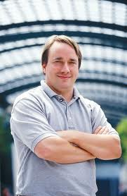
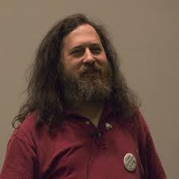
What is Linux? Linux + GNU Utilities = Free Unix
a set of small programs written by Richard Stallman and others. They are the GNU utilities.
http://www.gnu.org/
Linux is an O/S core written by Linus Torvalds and others AND
Notes:
Richard Stallman source: http://www.stuffyouwillhate.com/wp-content/uploads/richard-stallman.jpg
Linux Torvalds source: https://netfiles.uiuc.edu/rhasan/linux/Linus_Torvalds.jpg

Slide 10
What is Linux? “Small programs that do one thing well” (see unix-reference.pdf)
Network: ssh, scp, ping, telnet, nslookup, wget
Shells: BASH, TCSH, alias, watch, clear, history, chsh, echo, set, setenv, xargs
System Information: w, whoami, man, info, which, free, echo, date, cal, df, free
Command Information: man, info
Symbols: |, >, >>, <, &, >&, 2>&1, ;, ~, ., .., $!, !:<n>, !<n>
Filters: grep, egrep, more, less, head, tail
Hotkeys: <ctrl><c>, <ctrl><d>
File System: ls, mkdir, cd, pwd, mv, ln, touch, cat, file, find, diff, cmp, /net/<hostname>/<path>, mount, du, df, chmod, find
Line Editors: awk, sed
File Editors: vim, gvim, emacs –nw, emacs

Slide 11
What is Linux? “Small programs that do one thing well”
We will not cover the commands below in this class, but you need to know them. See the man pages for the process commands and the “sge” folder inside of the “cheat sheets and tutorials” folder for the SGE (Sun Grid Engine) command tutorials: qsh-interactive.pdf, qsh-interactive-matlab.pdf, qsub-batch.pdf, qsub-batch-matlab.pdf, and qstat-qhost.pdf.
Process Management: ps, top, kill, killall, fg, bg
SGE Cluster: qsh, qstat, qsub, qhost

Slide 12
Connecting to a Linux Host
You need a “xterm or xshell” emulator: software that emulates an “X” terminal and connects using the “SSH” secure shell protocol.
You are sitting at the “client,” either a Windows, Macintosh or even possibly a Linux machine.
You are connecting to a “server,” typically the “head” or “gateway” node of a cluster of computers. You will be working on the head node or submitting jobs to execution nodes, all of them, Linux machines.
You can also connect to a Linux machine by using VNC to get a whole desktop if it’s supported by the server.

Slide 13

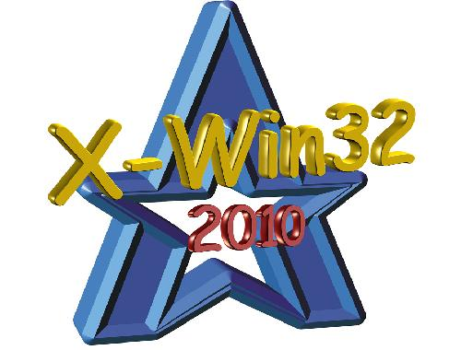
Connecting to a Linux Host – Windows Client Software
You need a “xterm and xshell” emulation – software that emulates an “X” terminal and that connects using the “SSH” Secure Shell protocol.
Windows
If you don’t need windowing, “putty” is good: http://www.chiark.greenend.org.uk/~sgtatham/putty/download.html
If you need windowing, use StarNet “X-Win32:” http://www.bu.edu/tech/desktop/site-licensed-software/xwindows/xwin32/
Notes:
Windows logo source: http://www.whatthetech.com/blog/wp-content/uploads/2012/03/windows-logo.jpg
X-Win32 logo source: http://m.ts.vcu.edu/kb/images/software-images/X-Win32-12-Splash.JPG

Slide 14


Connecting to a Linux Host – Mac OS X Client Software
Mac OS X
“Terminal” is already installed
Why? Darwin, the system on which Apple's Mac OS X is built, is a derivative of 4.4BSD-Lite2 and FreeBSD. In other words, the Mac is a Unix system!
Notes:
Steve Jobs image source: http://blogs.computerworld.com/sites/computerworld.com/files/u23/steve-jobs.jpg
Apple logo source: http://coreldrawtips.com/images/applebig.jpg

Slide 15

Connecting to a Linux Host - Windows Client
X-Win32/X-Config
Wizard
Name: katana
Type: ssh
Host: katana.bu.edu (Off-campus, must include domain “bu.edu” )
Login: <userID>
Password: <password>
Command: Linux
Click “katana” then “Launch”
Accept the host server public key (first time only)

Slide 16
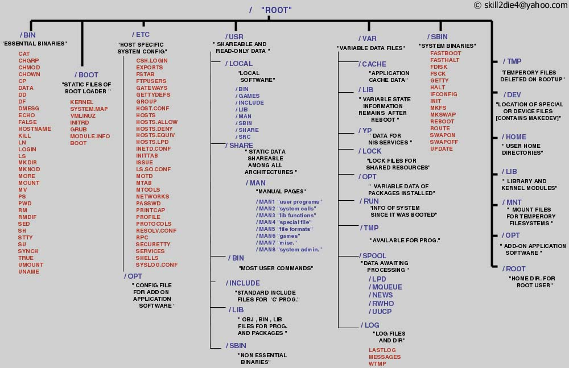
The Linux File System
A Typical Linux File System
Notes:
Source: http://www.tuxmachines.org/images/linux_file_structure.jpg

Slide 17
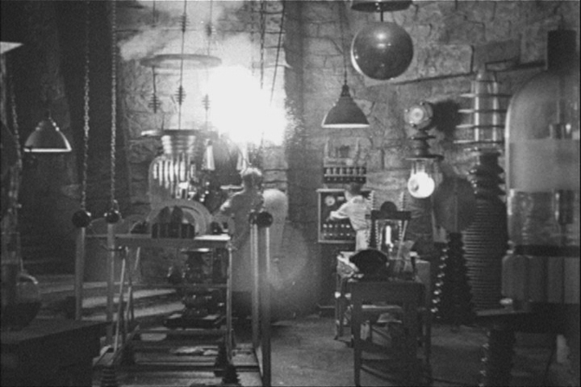

Let the Linux Lab Begin!
Your Instructor Today
The Ideal Lab Facility
Notes:
Lab image source: http://www.sidekickcomicsuk.com/blogs/media/blogs/sidekick//frankenstein_lab.jpg
Frankenstein image source: http://4.bp.blogspot.com/_OcNNOGpvVSI/RyZDUhUpE2I/AAAAAAAAAEU/e-i67sz7_8U/s1600/2007_7young-frankenstein.jpg

Slide 18
The List Command
Useful options for the “ls” command:
ls -a List all file including hidden file beginning with a period “.”
ls -ld * List details about a directory and not its contents
ls -F Put an indicator character at the end of each name
ls –l Simple long listing
ls –lh Give human readable file sizes
ls –lS Sort files by file size
ls –lt Sort files by modification time

Slide 19
File System Ownership and Permissions
All files and directories have a individual and a group ownership.
All files and directories have read (r), write (w), and execute (x) permissions assigned as octets to the individual owner (u), the group (g) owner and all others (o) that are logged into the system.
You can change permissions if you are the individual owner or a member of the group.
Only root can change ownership.

Slide 20

root
The root user is the master
Notes:
Tux image source: https://artsec.com/wp-content/uploads/2011/12/linux-root-account-security.png

