Slide 1
Cloud CPRS improving efficiency, user satisfaction, and veteran access to care via cloud streaming of CPRS
Kathleen Kendle, MD FACP
Clinical Informaticist
Valley Coastal Bend VAMC

Slide 2
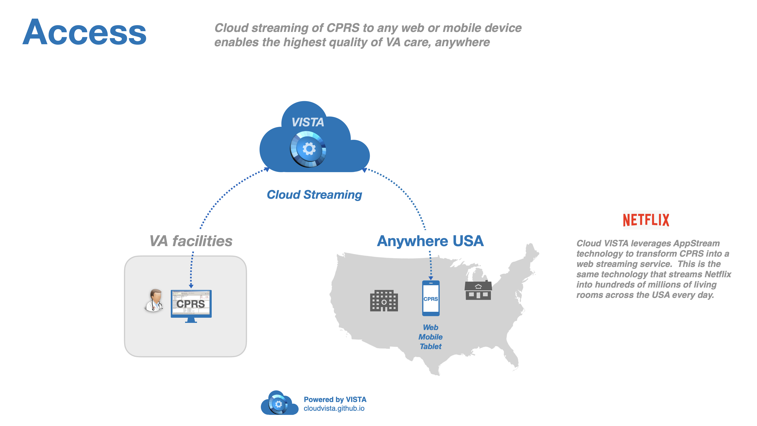
Cloud CPRS: Overview

Slide 3
Cloud CPRS: Texas VAMC experience
Valley Coastal Bend VAMC experience with Cloud CPRS
Efficiency improvement
Improved access to veteran care
Cost reduction
Improvement on Clinicians and Patient experience

Slide 4
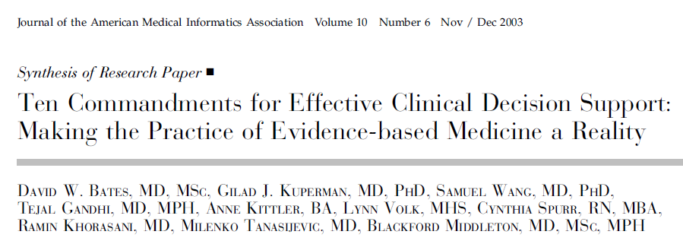
Clinical Decision Support (CDS)

Slide 5
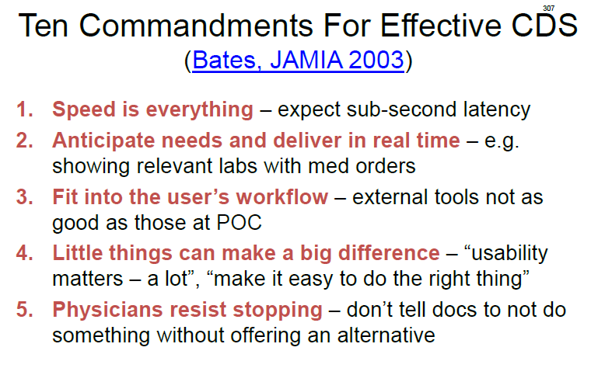
Clinical Decision Support (CDS)
Rule #1: Speed

Slide 6
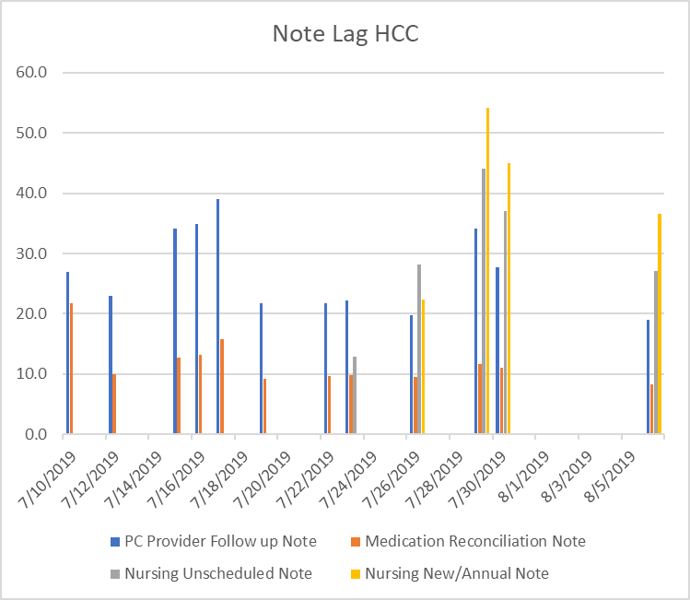
CPRS: VA’s main clinical decision support tool
CPRS note loading time
Average note loading time
27 seconds

Slide 7
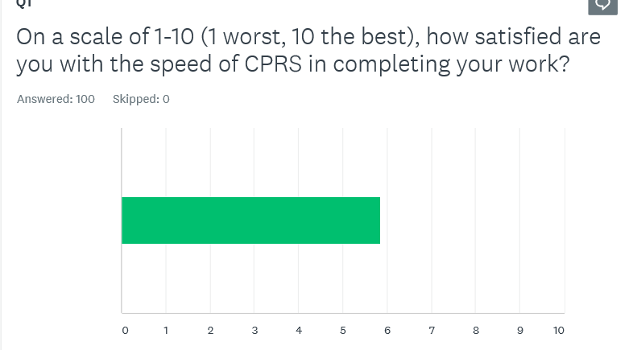
CPRS: Survey on speed

Slide 8
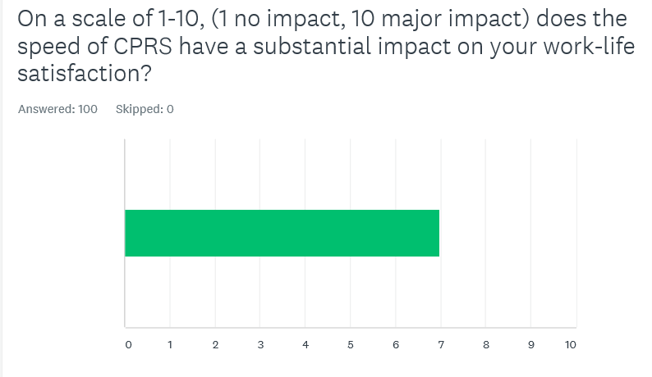
CPRS: Survey on speed

Slide 9
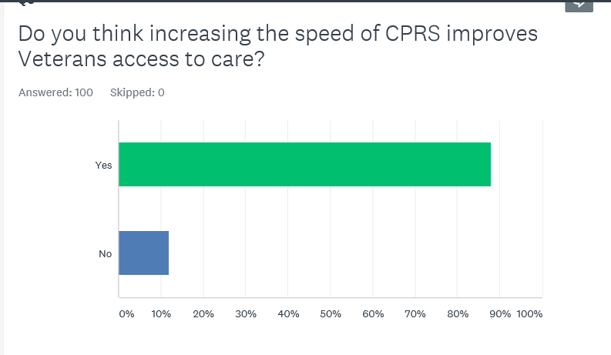
CPRS: Survey on speed

Slide 10
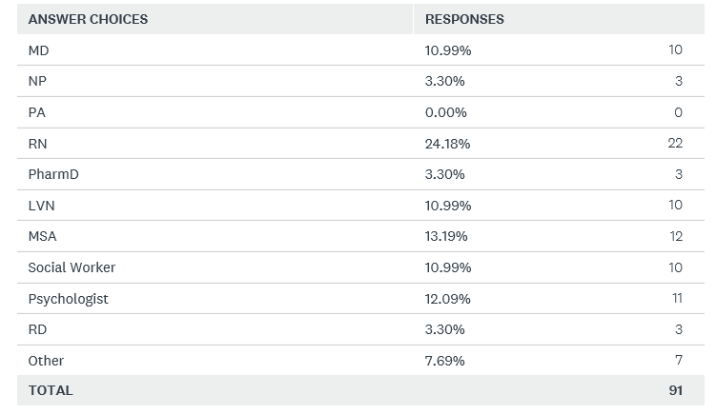
CPRS: Survey on speed

Slide 11
Cloud CPRS: 10X speed improvement
Cloud CPRS note loading time
Average note loading time is
2 seconds
10X speed improvement!
2.0

Slide 12
Cloud Streaming CPRS: 10X speed improvement
Cloud Streaming CPRS improves efficiency, lowers costs, and improves veteran access to care

