Slide 1


DATA PLAYBOOK
U.S DEPARTMENT OF VETERANS AFFAIRS
Veterans Health Administration
Office of Discovery, Education, and Affiliate Networks
Office of Healthcare Innovation and Learning
Notes:
Photo by fabio on Unsplash

Slide 2
TABLE OF CONTENTS
3 | Introduction
4 | Platform Overview
7 | ARCHES
8 | Emerging Technology Innovation Lab (ETIL)
9 | Summit Data Platform (SDP)
10 | VA Common Operating Platform (COP)
11 | VA Informatics Computing Infrastructure (VINCI)
12 | VA Platform One (VAPO)
13 | Data Sources From Within the VA Firewall
17 | Resources

Slide 3
Which VA Data Analytics Solution is Best for Me?
INTRODUCTION
This Data Playbook will guide you toward the VA product or service offering that best suits your needs. Currently, the following products/service offerings are described in this Data Playbook:
We are delighted you are interested in learning how to use data to support your VA Data Analytics Innovations efforts. This Data Playbook is divided into several sections to allow you to navigate easily to the parts that are of interest to you. We will continue to update this document as more resources become available.
ARCHES
EMERGING TECHNOLOGIES INNOVATION LAB (ETIL)
SUMMIT DATA PLATFORM (SDP) (HDAP, CxDW, CDWNG)
VA COMMON OPERATING PLATFORM (COP)
VA INFORMATICS AND COMPUTING INFRASTRUCTURE (VINCI)
VA PLATFORM ONE (VAPO)

Slide 4
PLATFORM OVERVIEW
VA PRODUCT | QUICK DESCRIPTION | USES
ARCHES | PII/PHI data analytics development and production platform within VA network | High-Risk Score EHR Flagging Natural Language Processing Heart Disease Prediction Chronic Kidney Disease Detection
EMERGING TECHNOLOGIES INNOVATION LAB (ETIL) | Innovation lab outside of VA network (No PII/PHI allowed) | Medical Imaging Device Connectivity Testing AI-backed Kidney Biomarker Indication Screening Mission Daybreak
SUMMIT DATA PLATFORM (SDP) (HDAP, CxDW, CDWNG) | Internal tool for analytics, AI/ML, and visualization | Cancer Care Management Protocol Enterprise Data Governance Tooling Self-Service Research
VA COMMON OPERATING PLATFORM (COP) | Leveraging enterprise wide-VA data and customized analytics for informed decision-making platform | ADDS UP Integrated Care Workspace Population Analytics
VA INFORMATICS & COMPUTING INFRASTRUCTURE (VINCI) | Data access, analytic tools, and consultation services for medical research projects | Health Services / Epidemiology Decision Support Business Intelligence
VA PLATFORM ONE (VAPO) (Hosting Platform) | Packaging software code into a single executable bundle | eScreening Item Master Syndicate Source Veteran Identification Card

Slide 5










VA ENVIRONMENT DIAGRAM | COMPONENTS
Illustrative
USER (internal & external)
DEVELOPMENT PLATFORMS
DELIVERY
PRODUCTION
CONSUMER (internal & external)
VA ENTERPISE CLOUD
NON-CLOUD
Data Scientist |Data Analyst
Veterans
VA INTERNAL ENVS Project specific workspaces
Veterans Health Information Systems and Technology Architecture (VistA)
VA Medical Employees
Software
Developer
Devices
Developer
Clinical Decision Support
MLDS (est. 2024) Machine Learning Decision Support Production Platform
SDP Unifying VA Data
HDAP VHA’s Big Data Platform
CxDW Customer Experience Platform
CDWNG Next Generation Cloud Platform
CDW REPLICA
CDW VHA Data Lake
VAEC
RASP (est. 2024) VINCI’s Cloud Platform
eScreening
VINCI Research Platform
VA Data Centers
VA Platform One (VAPO)
Portable Application Packaging
ETIL Innovation Platform
SDP
DAVINCI DoD Data Lake
PALANTIR SaaS Analytics Platform
MLDS
External Data
ARCHES Development and Production Innovation Platform
...
Digital Data Transformation Services
NOTE: Ongoing data sharing expected to occur by 2024
KEY:
Azure
 | Data Source |  | Governing Framework |  | Hosting Platform |  | Platform Product |  | Third Party Accessible |  |  |  | Public Cloud |  | NDS Permissions Required |  | Elevated Privileges Required |  | Ongoing Data Sharing |  | One-time communication
AWS

Slide 6
CATEGORICAL USE
VA PRODUCT | QUICK DESCRIPTION | SAMPLE BUSINESS NEEDS
 |  | ONBOARDING <~30 DAYS | ADDITIONAL SECURITY APPROVALS | BYO DATA | SYNTHETIC DATA | MEDICAL RESEARCH | 3rd PARTY ACCESSIBILITY (NON-VA) | VIRTUAL DESKTOP W/ OS | VIRTUAL WORKSPACE | CONTAINERIZATION | RESEARCH TRANSLATION TO MED. CARE
ARCHES | PII/PHI data analytics development and production platform within VA network |  | ✓ | ✓ | ✓ | ✓ |  | ✓ | ✓ | ✓ | ✓
EMERGING TECHNOLOGIES INNOVATION LAB (ETIL) | Innovation lab outside of VA network (No PII/PHI allowed) | ✓ |  | ✓ | PLANNED | ✓ | ✓ | ✓ | ✓ | ✓ | ✓
SUMMIT DATA PLATFORM (SDP) (HDAP, CxDW, CDWNG) | Internal tool for analytics, AI/ML, and visualization | ✓ |  | ✓ | PLANNED | ✓ |  | ✓ | ✓ | ✓ | ✓
VA COMMON OPERATING PLATFORM (COP) | Leveraging enterprise-wide-VA data and customized analytics to inform decision making | ✓ | ✓ | ✓ | ✓ | ✓ |  |  | ✓ | ✓ | ✓
VA INFORMATICS & COMPUTING INFRASTRUCTURE (VINCI) | Data access, analytic tools, and consultation services for medical research projects | ✓ | ✓ | ✓ |  | ✓ | ✓ | ✓ | ✓ | ✓ | ✓
VA PLATFORM ONE (VAPO) – (Hosting Platform) | Packaging software code into a single executable bundle | ✓ |  | ✓ |  |  |  |  | ✓ | ✓
PROJECT MATURITY
Early-Stage
Enterprise Use
6
Notes:
VINCI>Obeservational Medical Outcomes Partnership OMOP is a Common Data Model (CDM)>100 Health Data Systems worldwide use it
Joint Interagency Funded Iniatitive to use VA CDW, DOD, and VA data – it’s Data Format that uses Best Practice Transfromation Logic - OMOP Synthetic Data is used to train end-users of using the Common Data Model format for SQL queries.
Re: https://towardsdatascience.com/synthetic-data-at-the-vha-8124989c7183
What is Synthetic Data?
Briefly, synthetic data is data that mimics realistic patterns but does not correspond to real data records. If data can be generated that reflects the patterns in clinical EHR data without any identifiable correlation to the actual data records used in their generation, this would have significant benefits for data privacy in the research and clinical contexts.
Synthetic data has the potential to address the two seemingly conflicting challenges of realism and privacy. It must reflect the feature frequency and correlations in the underlying real data used to generate the data set and function with comparable efficiency at training models and predictive algorithms as using the real data set. It must also ensure that probability for privacy risk is minimized or ideally zero. Thus, the ability to predict the actual sample used to train a synthetic data set should remain as low as possible.
Applications for synthetic health data relevant to this audience would include
· Access to hitherto unavailable data for research groups and clinicians.
· Ability to augment training data sets to balance under-represented groups and outcomes in the set.
· Ability to study clinical data from the perspective of time and date to identify clusters and patterns.

Slide 7




ARCHES |
A data platform where users can readily access usable data to improve care for Veterans
The cloud-native development and production platform, complete with a rich set of computational tools, harnesses the power of collaboration and innovation to provide a one-stop data workshop for VA employees. Data in ARCHES is automated, and code based – so users can build, test, deploy, monitor, and review data with ease, all within their workstations.
HIGHLIGHTS
Use Agile MD
Making risk scores more specific and integrating into VistA to flag patients that are the highest risk
USE
CASES
Reduce Administrative Burden Using NLP
Extracting document types and patient identifiers from fax and email documents to import into VistA
COLLABORATIVE
Users can build models and share resources with security and protection
Apply ML and AI Techniques to Predict Heart Disease
Prediction of clinical trajectories of HF in Veterans and recommendation of timely interventions using synthetic data
Compare Primary Care Preventative CKD
Using Synthetic data to compare algorithms for CKD, AKI, and eGFR
INNOVATIVE
Modern practices and faster IT infrastructure create an agile environment for innovation
TOOLS & CAPABILITIES
ONBOARDING | ~45 BUSINESS DAYS
STEP 2
SUBMIT
SERVICE
DESK TICKET
AI
Development
General Development
Security
Features
STEP 4
RESOURCE
PROVISIONING
Model Training
Interactive Notebooks
ML Applications
Orchestration
Integrated Development Environment
Use for Research Reportable Conclusions
Identity and Role-Based Access Control
Project Isolation for Data and Networks
STEP 1
SUBMIT
PROJECT
& REVIEW
STEP 3
ATTEND
TECHNICAL
INTAKE MEETING
STEP 5
COMPLETE
DATA & ANALYTICS
REGISTRY FORM
IMPACTFUL
Our network of innovators can use ARCHES to create data-driven solutions that improve patient care and treatments
DID YOU KNOW
Data Capabilities
Synthetic data increases access and enhances Veteran privacy
LEARN MORE
Access to Patient-Level and Synthetic Data | Data Mgmt. | BYO Data
Notes:
(Possible Entry Points: Diffusion Marketplace, Future OHIL Innvation Platform SP, Data and Analytics Innovations, ETIL and ARCHES Channel)

Slide 8







A separate OHIL computing environment allowing access to non-VA patient-level data
EMERGING TECHNOLOGIES INNOVATION LAB (ETIL) |
This separate OHIL computing environment that allows users to work with non-VA patient level data (aggregate, de-identified, or synthetic data; all of which contain Personally-Identifiable Information (PII) and Personal Health Information (PHI) ) with the AWS cloud infrastructure. ETIL provides an AWS lab where customers need a dedicated lab requiring elevated privileges. PII and PHI is not to be used in ETIL.
HIGHLIGHTS
VistA Medical Imaging Device Connectivity Validation
650+ models of digital imaging and communications devices send images to VistA. ‘Fake” VistA data to test imaging device reading accuracy from VistA
USE
CASES
AI-Powered Biomarker Indicators
Using AI to suggest the diagnosis of kidney disease, suggest screening, and identify stigmatizing language
FAST TO ONBOARD
Users have fewer onboarding procedural steps and no elevated access required
Mission Daybreak
A $20 million grand challenge calling for innovators to develop suicide-prevention solutions that meet the diverse needs of Veterans
TOOLS & CAPABILITIES
ONBOARDING | ~14 BUSINESS DAYS
Research
Platform & Tools
VistA Instances
STEP 2
SUBMIT
SERVICE
DESK TICKET
ACCESSIBLE
Users can access multiple non-VA Patient Level Data: Aggregate, De-identified, and Synthetic
STEP 4
RESOURCE
PROVISIONING
Linux Instance with VistA and Cache with Synthetic Data
Customer Admin Access to Assigned Instance
Windows Instance with CPRS
Big Data (AWS EMR)
AWS SageMaker
Hadoop and Spark
AWS Deep Learning (AWS EC2 GPU)
STEP 5
COMPLETE
DATA & ANALYTICS
REGISTRY FORM
STEP 1
PROJECT
SUMISSION
& REVIEW
STEP 3
ATTEND
TECHNICAL
INTAKE MEETING
DEVELOPMENT & TESTING
SANDBOX RESOURCES
Windows & Linux Virtual Machines
Kubernetes & Containers
Databases
Storage
Serverless
DID YOU KNOW
ETIL artificial data use can only be used to vet proof of concepts for algorithms
LEARN
MORE
AWS Aurora
ETIL will not allow data imports for any production level analysis or scientific conclusions
Notes:
(Possible Entry Points: Diffusion Marketplace, Future OHIL Innvation Platform SP, Data and Analytics Innovations, ETIL and ARCHES Channel)

Slide 9



SUMMIT DATA PLATFORM (SDP) |
Enables the Veteran Experience Office (VEO) to gain insights into Veteran Affairs (VA) customers that drive service improvement and customer satisfaction
Business data is ingested raw and unmodified into the SDP Data Lake. The data is refactored using domain knowledge from the data product owners to provide a common data model and enable actionable, targeted, rapid outreach to veterans, caregivers, and beneficiaries.
HIGHLIGHTS
TOOLS
Coordinated Cancer Tracking
A management portal for VA Cancer Tracking Care Management Protocols
USE
CASES
CDW NextGen (CDWNG) |
VA Business Intelligence Services
Lung Cancer Screening
The Promise to Address Comprehensive Toxics (PACT) Act
Health Data
Analytics Platform (HDAP) |
Cloud-based Health Data Curation and Analytics
UNIFIED
Ecosystem of tools, data, and ops are in one place
Self-Service Research
Pipeline for research, Patient-generated Data from FitBit, Data Analytics, and Patient Dashboard
Customer Experience Data | Warehouse (CxDW)
Veteran Experience Data
ONBOARDING | ~30 BUSINESS DAYS
CAPABILITIES
STEP 2
BEGIN
DATA NEEDS
ASSESSMENT
STEP 4
OPTIONAL
WHITE GLOVE SERVICE
ACCESSIBLE
Researchers can access tools, data, and ops
STEP 1
SUBMIT
PROJECT
& REVIEW
STEP 3
PROVISION
SOP
STEP 5
OFF-BOARD
Centralized Data Sharing
Support for Reporting and Analytics Products
Data Conditioning, including data aggregation and refinement
Azure and AWS Cloud Storage
Oracle Goldengate Data Replication
Oracle Goldengate Big Data Adapter
Databricks Workspace Support
Data Ingestion Patterns for Salesforce, MS Dynamics CRM, MS SQL/Synapse, MS ADF, SSIS, and Oracle platforms
Palantir Connector
Near Real-time Data Ingestion (depending on the platform)
Raw Data Ingestion and Storage
Data Engineering
Synapse Services and Portal
PRIMARY IT SYSTEMS
SECURE
SDP uses Collibra for security and catalogue features and has an advanced analysis White Glove Service
MS Azure
AWS Cloud
Databricks
MS Synapse
RH Linux
Oracle DB
Oracle Goldengate
Oracle Big Data Adapter
Cockroach DB
CONTACT FOR MORE INFO
DID YOU KNOW
Notes:
(Possible Entry Points: Diffusion Marketplace, Future OHIL Innvation Platform SP, Data and Analytics Innovations, ETIL and ARCHES Channel)

Slide 10



VA COMMON OPERATING PLATFORM (COP) – PALANTIR |
Provides a unified data integration, analytics, and operational system for the VA Enterprise
Palantir allows authorized users to import, transform, analyze, and operationalize a wide variety of data types. It enables rapid creation of a reusable Enterprise Information Model (EIM) based on cross-VA data. The EIM integrates seamlessly into analytic and operational decision-making applications using out-of-the-box tooling.
HIGHLIGHTS
ADDS UP (Analytics, Data & Decision Support Platform) A data-driven ecosystem of products supporting acquisition workforce and executives, category managers, and heads of contracting
USE
CASES
Integrated Care Workspace VHA healthcare professionals quickly analyze and explore trends in consulted care, identify problematic and outlier consults
PRODUCTION READY
Available for research and reportable conclusions
Population Analytics A 360-view of the total Veteran Population, including those who do not use VA for services and benefits
FEATURED TOOL
ONBOARDING | ~30 BUSINESS DAYS
STEP 2
SUBMIT
SERVICE DESK
TICKET
Enterprise Information Model (EIM)
STEP 4
COMPLETE
RESOURCE PROVISIONING
BYOD
Bring your own data
Builds a reusable EIM centered on authoritative Veteran data
Enables rapid workflow and application configuration based on out-of-the-box COP tooling
Facilitates decision and data writeback to a VA data asset that compounds in value
Powers operational decisions and organizational learning
STEP 1
SUBMIT
PROJECT
& REVIEW
STEP 3
ATTEND
TECHNICAL
INTAKE MEETING
STEP 5
COMPLETE
DATA
REGISTRY FORM
MAIN CAPABILITIES
COMPREHENSIVE
Access to patient-level data
BUILD PIPELINES | CREATE DATA OBJECTS
OPERATIONALIZE DATA | ANALYZE DATA
CONTACT FOR MORE INFO
DID YOU KNOW
Notes:
(Possible Entry Points: Diffusion Marketplace, Future OHIL Innvation Platform SP, Data and Analytics Innovations, ETIL and ARCHES Channel)

Slide 11



VA INFORMATICS AND COMPUTING | INFRASTRUCTURE (VINCI)
Delivers a suite of analytical tools, services, and a platform for achieving health data insights
VINCI provides a secure, centralized platform supported by on-premises infrastructure, which allows investigators to access data, applications, and services they need to reduce the time and effort required to appropriately access, properly understand and effectively use VA data.
HIGHLIGHTS
Health/Services Epidemiology VINCI provides high value data sources, advanced analytical capabilities, and workspaces in service to the study of diseases and their treatment
USE
CASES
Decision Support VINCI provides broad access to data in the performance of official duties under the treatment, payment, and healthcare operations
UNIVERSAL
Nationwide VA/DOD Patient Data such as CDW, OMOP, DaVINCI
Business Intelligence VINCI provides computing power and advanced analytical capabilities to expose trends, information, and insight into VHA healthcare
TOOLS & CAPABILITIES
ONBOARDING | ~21 BUSINESS DAYS
Applications
Services
STEP 2
OBTAIN
IRB APPROVALS
STEP 4
SUBMIT
DATA ACCESS REQUEST
ROBUST
Comprehensive training materials: VINCI University
Data Access Request Tracker (DART)
Meta Data Viewer
VINCI File Upload
VINCI File Download
Dim Data Viewer
Let’s Collaborate VA!
Voogle Notes
Concierge Services
System Administration
Database Administration
Data Provisioning
Standard Workspace
Application Development Workspace
SharePoint Sites
STEP 1
CREATE
PROJECT
PROTOCOL
STEP 3
MEMO
RESEARCH
REQUEST
STEP 5
COMPLETE
VINCI
WORKSPACE PROVISIONING
INFORMATIONAL
Free feasibility needs assessment before project start and free data needs assessment after IRB approval
MY VINCI Dashboard
VINCI UNIVERSITY
A One-stop-shop for all VINCI training & educational needs, providing instructor-led classes in person and remotely. VINCI Stream provides videos on VINCI data, workspaces, admin processes, and technical procedures.
LEARN MORE
SharePoint Sites
Online Requests
File Shares
Virtual Machines
Directory Groups
DART Requests
Databases
Projects
DID YOU KNOW
Notes:
(Possible Entry Points: Diffusion Marketplace, Future OHIL Innvation Platform SP, Data and Analytics Innovations, ETIL and ARCHES Channel)

Slide 12




VA PLATFORM ONE (VAPO) |
Allows for ready-to-use functionality for hybrid and multi-cloud application development
VAPO is a hosting platform with Containerization Technology allowing developers to spend more time solving business problems instead of wasting time on cross-cloud issues.
eScreening
Web application accelerating the process of documenting healthcare assessments forms before medical appointments
HIGHLIGHTS
USE
CASES
Item Master Source Syndicate Source
Provides a single, enterprise view for all medical logistics functions
EASY
Less system resource overhead
Veteran ID Card
Veterans request a general-purpose identification card that validates military status and replaces the need to carry discharge papers
TOOLS & CAPABILITIES
ONBOARDING | ~30 BUSINESS DAYS
CONSISTENT
Consistent application operations
Application Migration Assessment
Platform Provisioning Environment
Application Transformation Lifecycle (ATL)
STEP 1 : SUBMIT INTEREST FORM
STEP 2: DETERMINE APPLICATION SUITABILITY
Reusable Readiness Assessments
On-premises Workload Analysis
Determine Complexity of Applications
Estimate Development Costs
Automated Deployment
Automated Security Testing
Live Environment Patching and Upgrades
Providing Repeatable Innovation and Development Modernization Practices
STEP 3: DEFINE FUNCTIONAL & TECHNICAL REQS.
STEP 4: ASSESS TECHNICAL CONTAINERIZATION
DEPLOYABLE
Easy deployment to multiple systems/ platforms
STEP 5: DETERMINE VAPO SERVICES NEEDED
STEP 6: SUBMIT APPLICATION FOR REVIEW
STEP 7: MEET WITH VAPO TEAM
Basic Services
STEP 8: PROVISION
Consistent Visibility
Governance
Automation from On-prem to the Edge
Multi-cluster Management
Event Management
Application Management
Infrastructure Management
Integration Tools and Process
REPEATABLE
Repeatable rapid
deployment cycles
VAPO OFFERS
LEARN MORE
A Repeatable Process with Containerization
4S: SPEED STABILITY SCALE SECURITY
Notes:
(Possible Entry Points: Diffusion Marketplace, Future OHIL Innvation Platform SP, Data and Analytics Innovations, ETIL and ARCHES Channel)

Slide 13
DATA SOURCES FROM WITHIN THE VA FIREWALL
Notes:
Photo by Dim Hou on Unsplash

Slide 14
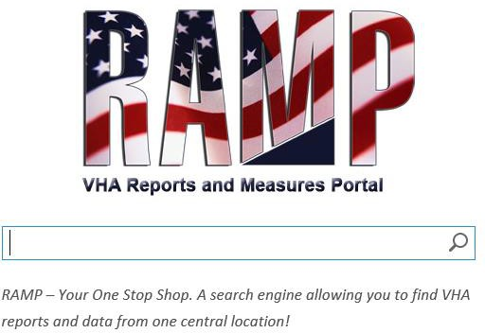
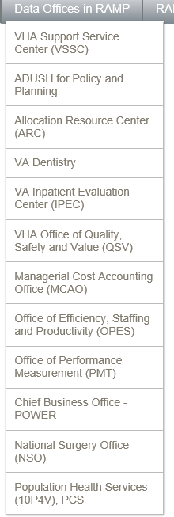
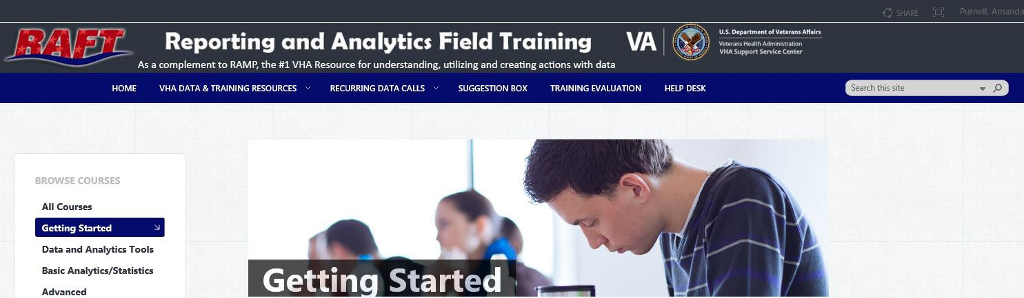
VHA REPORTS AND MEASURES PORTAL (RAMP)
Want to remember one place to go for reports and analytic tools that have already been developed?
VHA RAMP is your place. It is a searchable database. If you aren’t sure what report might have the information you need, you can type in keywords related to your area of interest to see what reports and measures might be helpful to you. Depending on your position, you may need to request access to specific tools.
Click on the image to the left to see what you can find in VHA RAMP.
What’s in VHA RAMP? Pretty much everything!
Are you curious about how different VA Medical centers compare in terms of quality or how your medical center ranks of various quality metrics?
Do you want to know more about productivity and business models for various hospital units?
Is patient or employee satisfaction part of your project?
Do you want to know more about VA inpatient and surgical care?
Is VHA Community Care the topic of your curiosity?
Are you trying to understand VHA nursing practice?
Do you want to know more about specific patient care outcomes at the PHI level, and how to better care for your assigned panel of patients?
Is telehealth utilization the area you want to address?
As you can see, VHA RAMP is a great first place to start on your data journey. Click on the image to the right to learn more.
Reporting and Analytics Field Training (RAFT)
Want to learn more about how to use all of those data tools in VHA RAMP? VHA
RAFT is your place. You can find training in basic and advanced analytics, statistics, and applied work.
We know that learning how to use data tools can be intimidating for new users. We want to assure you that you can learn how to make use of VHA data, and this site has a variety of resources for different kinds of users! Click on the image below to learn more about how you can develop your data skills to
support the VHA mission.
Notes:
Photo by Christopher Burns on Unsplash

Slide 15

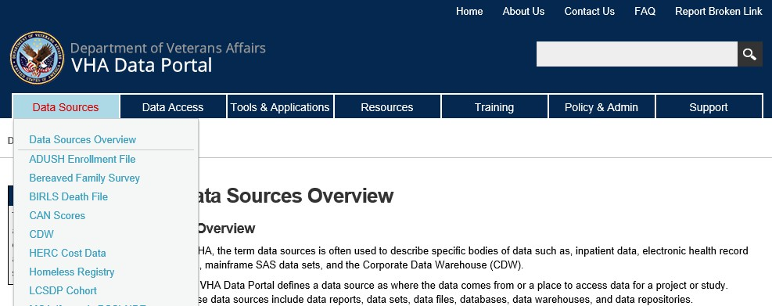
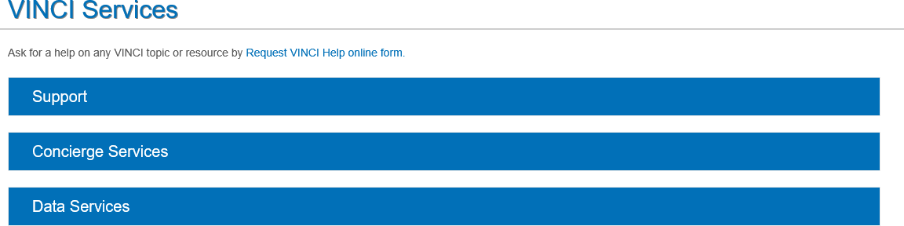
VHA DATA PORTAL
What if the information you want isn’t available in VHA RAMP? What if the data you need is not a report or measure (yet)?
Want to remember one place and obtain accurate, high-quality data about the VHA? VHA Data Portal is your place. Click on the image to explore what’s available at the VHA Data Portal.
VHA Data Portal Sources
Want to know what data is included in the VHA Data Portal? You can find out by clicking on the image below to learn more about all the data elements that are housed in the portal. There is a wide variety of data sources available. Click on the image below on the left to learn more.
VHA Data Portal Support (VINCI)
It’s ok if you need more help to access and understand the information you want to get from the VHA Data Portal! There is a variety of support set up to help you navigate the VHA Data Portal from self- service forms and FAQs to 1:1 data concierge support.
Notes:
Photo by Christopher Burns on Unsplash

Slide 16
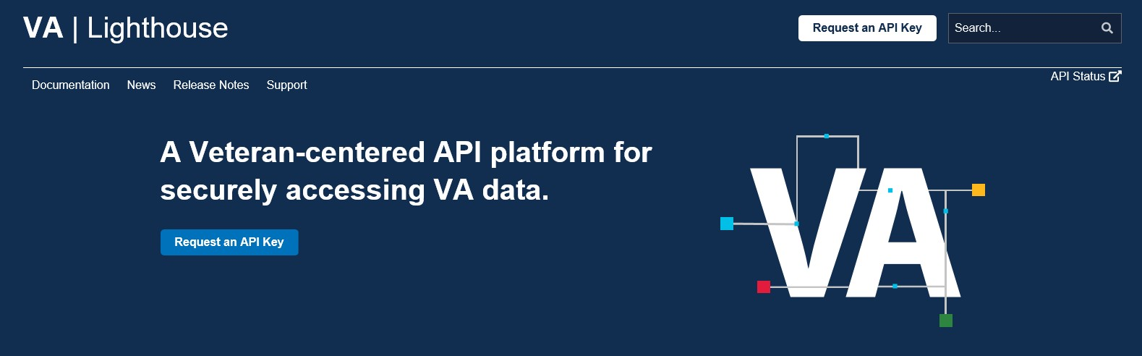

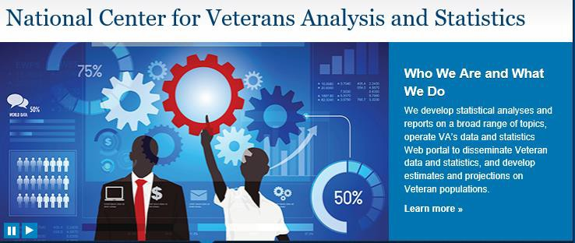
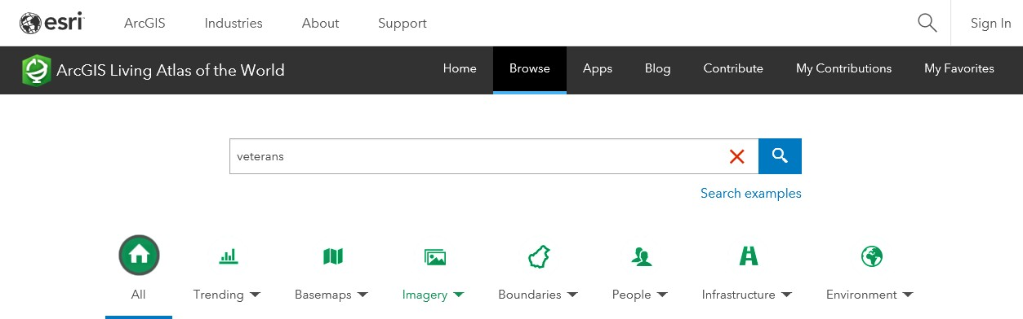
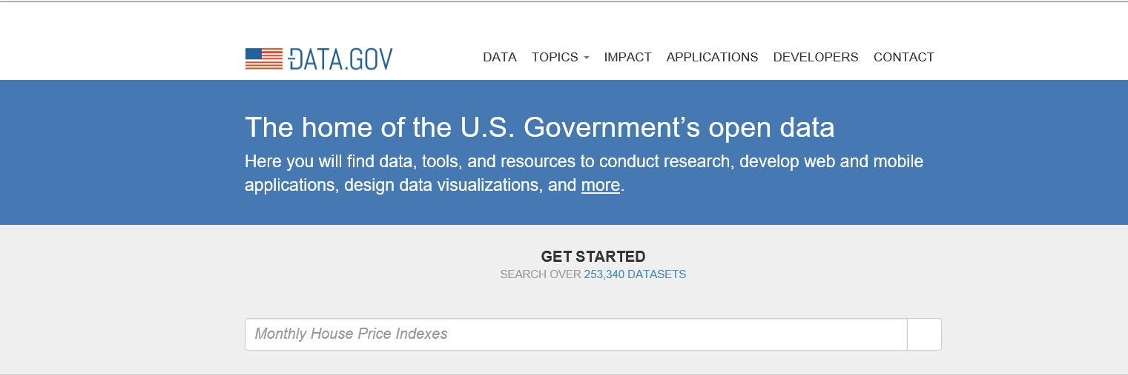

OPEN ACCESS DATA TOOL
The VHA is currently seeking out partnerships with academic institutions, researchers, and industry. We know that for those partnerships to have impact, access to meaningful data is essential. We want to highlight the data sources we believe might be the most useful and impactful to external and internal users.
Application Programming Interface (API)
Want an API for EHR, Benefits, Facilities, Forms, and Veteran Verification (synthetic data) to safely and securely test out ideas and learn? We are always looking for how we can provide even better service and support. If you’d like to work on any of these areas and want to test your idea before getting access to PHI, Lighthouse API is your place.
Quality and Access Data – INTERNAL VA
Want to learn more about access and quality metrics at various VA facilities, being able to compare VA facilities to other VA and non-VA facilities? On this site you can compare VA to non-VA care and within VA care. You can learn more about access data across the nation and for your local facility and Veteran Satisfaction data.
Population Level Statistics
Want to learn generally about the Veteran population including where Veterans live, population changes, demographic shifts, use of VA services? The National Center for Veterans Analysis and Statistics is a great resource for current data about the Veteran population as well as projections for the future.
Open Data Sets
Want access to open data sets across the government and that include challenges that government agencies are trying to solve for now? If you are comfortable with data and have a sense of the kind of information you might want to use, this source might be for you. Type a keyword to see what kinds of datasets might be available to answer your questions and understanding.
Maps and Visualizations
Urban Observatory
Want to be able to see the change in quality ratings over time? Curious about access to care at a variety of VA sites and prefer to see rather than read? This site visualizes information to help you understand the state of VA care and where there are opportunities to improve care.
Living Atlas of the World
Want to see even more maps? This site includes maps of facilities, Veteran demographic data including education, income, age and sex; and population level data on where Veterans are living.
16
Notes:
Photo by Christopher Burns on Unsplash

Slide 17
DATA REGISTRY
Below is an overview of VA data resources to assist the VA CCPI Data Team with onboarding and education of pilot teams:
VA Data Source
Content
Typical Users
Platforms
Corporate Data Warehouse
(CDW)
CDW is a collection of essential Department of Veteran Affairs clinical, enrollment, financial, administrative, utilization and Veterans benefits data that has been architected and standardized from multiple source systems.
Data analysts, operational analysts, VA data scientists, researchers, report and software developers
Arches (Replica), HDAP, SDP, VINCI
CORPORATE DATABASE
CRP/Corp DB
CRP serves as a central, one-stop repository for definitive Veterans records, personal information, history, and benefits-related information (such as claims, awards, and payments).
Data analysts, operational analysts, researchers, report and software developers.
Accessible through PRODTEST SQL access
Customer Experience Data Warehouse (CxDW)
The CxDW provides a single source of Veteran experience data by collecting data from the Customer Relationship Management systems within VA, including telephone systems and Veteran interaction data (which includes the data from Veteran interaction surveys).
VA data scientists, data analysts, and system owners
SDP, CxDW
DAVINCI
DoD-VA Health Data
DaVINCI is a data warehouse and analytic platform that combines DoD Military Health System and VHA healthcare data. DaVINCI is the most comprehensive consolidation of health data sources from each departments’ Electronic Health Records (Composite Health Care System, Armed Forces Health Longitudinal Technology Application, VistA, and MHS GENESIS).
VA researchers and operational analysts
VINCI
Individual Longitudinal Exposure Record (ILER)
ILER is a collaborative effort between the DoD and VA to create a complete record of every Service members’ occupational and environmental health exposures over the course of his or her career. ILER is designed to collate, present, and/or provide service-related exposure information for individuals,: Incident reports, Exposure pathways, Health assessments, Industrial hygiene, Individual monitoring, and Individual deployment history.
Medical providers, epidemiologists, and researchers
CxDW
17
Notes:
Photo by Christopher Burns on Unsplash

Slide 18
DATA REGISTRY
Below is an overview of VA data resources to assist the VA CCPI Data Team with onboarding and education of pilot teams:
VA Data Source
Content
Typical Users
Platforms
VBA DATA WAREHOUSE
VD2 (formerly EDW)
VD2 maintains centralized storage with a common view of all VBA activities. It is comprised of two parts: the Enterprise Data Warehouse, which is the common central repository for all VBA data, as well as data from several other agencies, and Performance Analysis and Integrity for VBA.
Data analysts, operational analysts, researchers, report and software developers
VAEC-Prospect (also known as RASP - Research and Analytics Science Platform)
VA Centers for Medicare and
Medicaid Services
VA/CMS
VA/CMS data includes all CMS and USRDS data used in the VHA. Below are the types of VA/CMS data. These data are available as SAS data sets:
Medicare: Information on Medicare enrollment, demographics, part A (Hospital Insurance), part B (Medical Insurance) fee-for-service claims submitted by providers for reimbursement, managed care encounters, and Part D prescription drug events.
Medicaid: Data on Medicaid enrollment, healthcare utilization, charges, and payments
Patient Assessments (MDS, OASIS, and IRF-PAI): Patient-level socio-demographic, environmental, health, and functional status data on patients in nursing homes or receiving home health care
Medicare Current Beneficiary Summary (MCBS): Survey of Medicare beneficiaries, including information on beneficiary access to medical care and a comprehensive picture of all health services received (including services not covered by Medicare), amounts paid, and source of payment
Healthcare Effectiveness Data and Information Set (HEDIS): Tool used by Medicare Advantage health plans (managed care), to measure quality of care using a standard set of performance measures. These measures can be used to approximate the amount and types of services each Medicare Advantage enrollee receives
United States Renal Data Systems (USRDS): Information about patients with End Stage Renal Disease (ESRD), including demographic, treatment, and transplant data, Medicare claims, and data for USRDS-sponsored Special Studies
Provider Data: Information on institutional (e.g. hospitals, nursing facilities) and non-institutional healthcare providers
Data analysts, operational analysts, and researchers
VINCI, VIReC
Veterans Health Information Systems & Technology Architecture (VistA Imaging System)
Data analysts, operational analysts, VA data scientists, researchers, report and software developers
The VistA Imaging system integrates clinical images, scanned documents, and other non-textual data into the patient’s electronic health record. Captured images are combined with text data to facilitate a clinician’s task of correlating information and making timely and accurate patient care decisions.
SDP
Veteran Signals
VSignals
VSignals is utilized by the VA to collect, analyze, and manage Customer Experience (CX) data and insights to ensure that the Veterans experience with the VA is effective, easy, and emotionally resonant.
All three administrations within VA use Vsignals to measure their customers' experience
VSignals
18
Notes:
Photo by Christopher Burns on Unsplash

Slide 19
CDW Dataset Categories
Each authorization type is categorized by SQL database permissions. One or more dataset authorizations are required to access the data scored within the Corporate Data Warehosue (CDW) SQL databases. CDW datasets are organized in five categories: CDW SQL Datasets, Managerial Cost Accounting (MCA) National Data Extracts (NDEs), CDW SAS Datasets, Non-CDW Data, and Local Data Access. The National Data Systems (NDS) authorization process grants access to these datasets and uses the VHA NDS Access Form for Health Operations.
CATEGORY: CDW SQL DATASET
CATEGORY: LOCAL ACCESS DATA
Security Group:
CDW_FULL
Name: Basic Read Access
Granted by NDS and provides access to all CDW operations data including basic demographic data and the Patient ICN.
Security Group:
CDW_SPatient
Name: Privileged Read Patient Access
Granted by NDS and provides access to patient Personally Identifiable Information (PII) and patient Protected Health Information (PHI).
Security Group:
CDW_SSTAFF
Name: Staff Real SSN Access
Granted by NDS and provides access to data pertaining to VA employees and practitioners (past or present). This type of Sensitive Personal Information (SPI) includes the individual's name, social security number, educational data, and other employee data as recorded in VistA.
Security Group:
AllLSVUsers
Name: Local Data Access
Provides access to the CDW operations data, but is restricted to the local station or approved local stations specific to the end user.
CATEGORY: NON-CDW DATA (SPECIAL PROJECTS)
CATEGORY: CDW SAS DATASET
Security Group:
CDW_nonCDWPHI
Name: Non-CDW, PHI
Granted by NDS and provides access, in addition to the basic operations data sets (i.e., CDWWork database data) to the VHACDWRB01, VHACDWRB02, VHACDWRB03 VINCI databases that stores: Inpatient Acute Care, Inpatient Extended Care, Inpatient Observation Care, Inpatient Non-VA Care, Inpatient Encounters, Outpatient Event.
Security Group:
CDW_nonCDWNonPHI
Name: Non-CDW, NonPHI
Is granted by NDS and provides access to VHACDWRB01, VHACDWRB02, VHACDWRB03 databases that store VSF data in SQL format.
Security Group:
CDW_SASDATA
Name: Med SAS
Granted by NDS and provides access, in addition to the basic operations data sets (i.e., CDWWork database data) to the VHACDWRB01, VHACDWRB02, VHACDWRB03 VINCI databases that stores: Inpatient Acute Care, Inpatient Extended Care, Inpatient Observation Care, Inpatient Non-VA Care, Inpatient Encounters, Outpatient Event.
Security Group:
CDW_VitalStatus
Name: Vital Status Files
Is granted by NDS and provides access to VHACDWRB01, VHACDWRB02, VHACDWRB03 databases that store VSF data in SQL format.
19

Slide 20

VA Community Care Data in CDW
There are several domains within the Corporate Data Warehouse (CDW) containing data on care delivered in the community and paid for by VA: CDW Raw Domain and CDW Production Domain. This sheet provides an overview of the contents within each domain.
CDW RAW DOMAIN
CDW-Raw refers to the test and evaluation database. CDW-RAW data are extracted directly from the data source (e.g., VistA). These data are not modeled, standardized, or indexed and include MCA (formerly DSS) NDEs in SQL table and other SAS-to-SQL tables. When the domain is developed for production, it is removed from Raw. Requests for CDW Raw data require additional time to create data extracts as it is more difficult for studies to use.
CDW PRODUCTION DOMAIN
Data on the CDW-prod servers are mostly uploaded from VistA with no filtering of records, editing, or business rules applied. These data are modeled and indexed to promote efficient querying.
Community Care Reimbursement System (CCRS)
CCRS is used to process claims for care provided via the Community Care Network contracts. The CCRS schema contains 29 tables that are updated daily, a subset of the tables in the Preview_CCRS schema.
Electronic Claims Adjudication Management System (eCAM)
Domain contains reimbursement data for VA Community Care.
Community Care Referral and Authorization (CCRA)
Contains extracts from the HealthShare Referral Manager (HSRM) system. The HSRM system is used to authorize and refer care to community providers.
Fee Basis Claims System (FBCS)
Contains authorizations, claims, and cost data for care Veterans receive at non-VA facilities and entered into the Fee Basis Claim System.
Veteran Access, Accountability and Choice Act (VACAA)
Contains information about Choice authorizations found in the Office of Community Care's Choice Monthly Contractors' Reports
Purchased Care (FEE) – Authorized
Purchased Care (FEE) – Unauthorized
Purchased Care (FEE) – Service
Purchased Care (FEE) – Repair
Program Integrity Tool
Integrated Billing
Includes claims, cost and payment for office visits, outpatient diagnosis and treatment, and elective inpatient admission provided in non-VA facilities.
Includes claims, cost and payment for emergency care, and hospital admission connected to ER care provided in non-VA facilities.
Includes information about the vendor, staff/provider, dates of service, and links to CPT codes. Also includes claim and payment details, fee schedules, and a flag for service-connected conditions.
Contains similar information as purchased care service domain, but with corrected invoice/payment information.
PIT Domain contains claims previously found in the VistA Fee Basis Package, with the exception of dental claims and contract nursing claims. The PIT system is the primary source for Choice, and Patient Centered Community Care (PC3) claims. Some authorizations and claims in the FBCS and the VistA Fee Basis Package will also be included in the PIT system.
Contains extracts of the VistA Integrated Billing/Accounts Receivable (IB) module. The IB module is used to track bills submitted to third party payers on behalf of patients to obtain payment for care provided by or paid for by the Veterans Health Administration (VHA).
PII/PHI =
PII/PHI =
PII/PHI =
PII/PHI =
PII/PHI =
PII/PHI =
PII/PHI =
PII/PHI =
PII/PHI =
20

Slide 21
RESOURCES
21

Slide 22
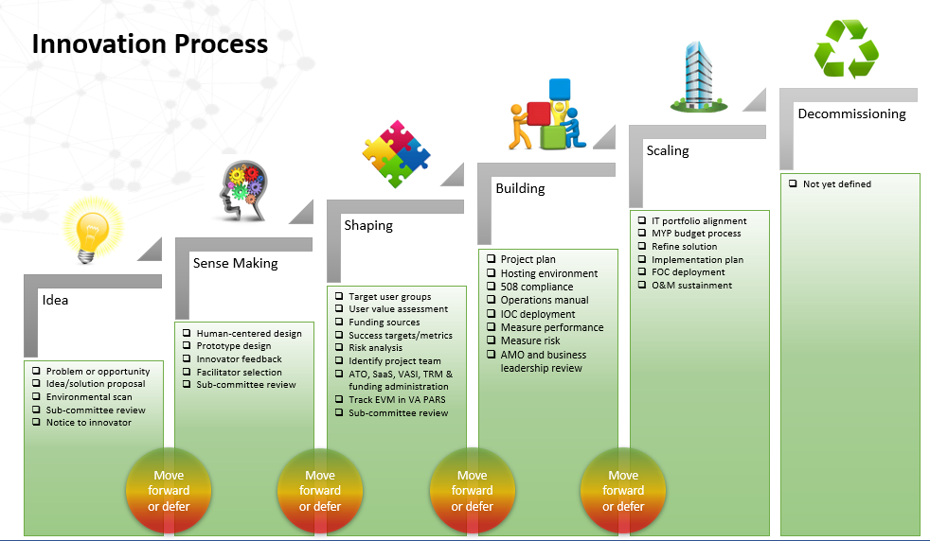
VA INNOVATION UNIT (VAIU)
VA Innovation Unit is a central hub where innovation experts can transform your ideas into real-world solutions. The VAIU exists to facilitate, coordinate, and drive innovation by using technology to deliver IT breakthroughs in three focus areas: enhancing service delivery to Veterans, increasing operational efficiency, and improving Veteran and employee experiences.
SERVICES
Helping you define, shape, and launch your idea through stakeholder research, journey mapping, user experience design, engineering and testing, and contractual negotiations
1
We give you a test environment to host your idea, and engineering and testing support to build and release it
2
We provide enabling software and tools
3
For more information about how to get started, visit VA Pathfinder at pathfinder.va.gov
22
Notes:
“VAIU will serve as an orchestrator of innovation investments
by identifying and integrating
innovative solutions and operationalizing how innovators can connect their solutions with our community of technology professionals.”
-ANGELA GANT-CURTIS,
PROGRAM MANAGER, VA INNOVATION
PROGRAM – VHA State of Innovation Report 2022
VAIU exists to facilitate, coordinate, and drive innovation by using technolo- gy to deliver IT breakthroughs in three focus areas: enhancing service delivery to Veterans, increasing operational efficiency, and improving Veteran and employee experiences

Slide 23
LEARN MORE
The following serves as additional resources when looking to learn about data within the VHA Innovation Ecosystem:
DATA SOURCES IN DATA PORTAL
Assistant Deputy Under Secretary for Health (ADUSH) Enrollment Files
Beneficiary Identification & Records Locator System (BIRLS) Death File
Bereaved Family Survey (BFS) Database
Care Assessment Need (CAN) Scores
Corporate Data Warehouse (CDW)
Death Ascertainment File (DAF)
Health Economics Resource Center (HERC) Cost Data
Homeless Registry
Lung Cancer Screening Demonstration Project (LCSDP) Cohort
Managerial Cost Accounting National Data Extracts (MCA NDEs)
Managerial Cost Accounting (MCA) Web Reports
Medical SAS Inpatient & Outpatient Data Sets
National Patient Care Database (NPCD)
National Prosthetics Patient Database (NPPD)
Patient Aligned Care Team (PACT) Implementation Index (Pi2)
Patient Treatment File (PTF)
Pharmacy Benefits Management (PBM) Database
Planning Systems Support Group (PSSG) Geocoded Enrollee Files
Resident Assessment Instrument/ Minimum Data Set (RAI/MDS)
Traumatic Brain Injury (TBI) Screening and Evaluation Data
VA/CMS Data
VA Surgical Quality Improvement Program (VASQIP) Data
Veterans Services Network Corporate Mini Master (VETSNET) File
VHA Support Service Center (VSSC) Self Service Web Reports
VA GOVERNANCE GROUP
Cybersecurity Awareness Portal
Data Governance Council (DGC)
Data Management & Governance
How to Obtain Access Corporate Data Warehouse (CDW)
OEI Data Governance & Analytics
OIT Process Asset Library
VA Enterprise Data Strategy
VHA IT Governance Management
OTHER
CxDW: Customer Experience Data Warehouse
FY23 Privacy Threshold Analysis Template
Analytics Training (sharepoint.com) (NOLA University)
VA Identity and Access Management Services (IAM)
DATA SETS in VHA RAMP
Allocation Resource Center
Managerial Cost Accounting (MCA) Reports
National Surgery Office
Office of Community Care
Office of Performance Measurement (PM)
Strategic Analytics for Improvement and Learning (SAIL)
VA Dentistry
VA Inpatient Evaluation Center
VHA Office of Productivity, Efficiency & Staffing (OPES)
VHA Office of Quality & Patient Safety (QPS)
VHA Support Service Center (VSSC)

Slide 24
ABBREVIATIONS
Term | acronym
Analytics, Data & Decision Support Platform | ADDS UP
Artificial Intelligence | AI
Acute Kidney Injury | AKI
Application Programming Interface | API
Application Transformation Lifecycle | ATL
Amazon Web Services | AWS
Bring Your Own | BYO
Common Data Model | CDM
Corporate Data Warehouse | CDW
Corporate Data Warehouse NextGen | CDWNG
Chronic Kidney Disease | CKD
VA Common Operating Platform | COP - Palantir
Computerized Patient Record System | CPRS
Customer Relationship Management | CRM
Customer Experience Data Warehouse | CxDW
Data Access Request Tracker | DART
DoD and VA Infrastructure for Clinical Intelligence | DaVINCI
Database | DB
Department of Defense | DoD
Estimated Glomerular Filtration Rate | eGFR
Term | acronym
Electronic Health Record | EHR
Enterprise Information Management | EIM
Electronic medical record | EMR
Emerging Technologies Innovations Lab | ETIL
Graphics Processing Unit | GPU
Health Data And Analytics Platform | HDAP
Heart Failure | HF
Institutional Review Board | IRB
Information Technology | IT
Machine Learning | ML
Microsoft | MS
National Data Systems | NDS
Natural Language Processing | NLP
Office of Healthcare Innovations and Learning | OHIL
Office of Information and Technology | OIT
Observational Medical Outcomes Partnership | OMOP
VHA Office of Productivity, Efficiency & Staffing | OPES
Office of Research and Development | ORD
Promise to Address Comprehensive Toxins Act | PACT
Personal Health Information | PHI
Term | acronym
Personally Identifiable Information | PII
VHA Office of Quality Safety & Value | QSV
Report and Analytics Field Training | RAFT
Reports and Measures Portal | RAMP
Strategic Analytics for Improvement and Learning | SAIL
Summit Data Platform | SDP
SQL Server Integration Services | SSIS
Veterans Affairs | VA
VA Enterprise Cloud | VAEC
VA Innovation Unit | VAIU
VA Platform One | VAPO
Veteran’s Experience Office | VEO
Veterans Health Administration | VHA
VA Informatics and Computing Infrastructure | VINCI
Veterans Health Information Systems and Technology Architecture | VistA

