Slide 1
VAA – Year 1 to Year 2
Traffic to Recommendations Proven from Year One
Limited Resources and Choices for Year Two
9/5/25

Slide 2
Year One End – Traffic to Recommendations
PWS Track | Title | Details
5.2.1 | Traffic Capture | 2 Centers (VCB, Omaha), Extensive 2nd run for VCB, Know not every VistA can be monitored (Omaha can’t be monitored again), S3 pipeline from VistA VPC to DAS (with Cognosante)
5.2.2 | Traffic Statistics | “Traffic Dashboard", Tangential to Analytics – did not QA traffic for analytics
5.2.3 | Workflow Analytics | Scoped (Surprising) Extent of Information, Index/Reduction Framework, Changed from Application to Functional Analysis (Order …), Emulation and Reports of Representative Workflows from Traffic, Detailed "Metric" Reports
5.2.4 | Reports and Presentations | Detailed Recommendations, one each for Notes and Orders, based on Analytics
Notes:
Gits checked in

Slide 3
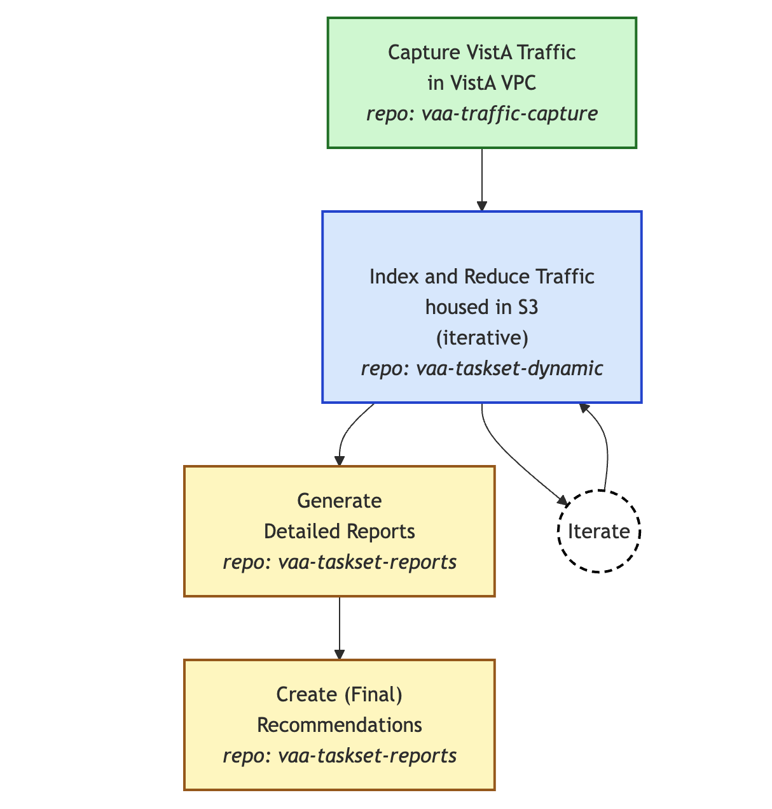
Established Framework in VAEC

Slide 4
Momentum from Year 1 ...
Track | Title | In Place
5.3.1 | Traffic Capture | • Cognosante configuration for traffic capture in VistA VPCs • S3 Pipeline from VistA to DAS S3 • Know only some VistAs are monitorable (which?)
5.3.2 | Workflow Analytics | • Indexing/Reduction Framework (vaa-tasksets-dynamic) of S3-based traffic • Detailed reports established new areas for fuller analysis (how + areas to examine)
5.3.3 | Reports & Presentations | • Tooling from detailed reports to Word/PDF • How to make detailed analysis presentable
* Do not continue "Traffic Statistics" – Tangential Effort, effectively another project
But now much more limited Resources
Notes:
Plumbing done, framework in place all the way to Reports

Slide 5
Year 2 – Suggestions
Track | Title | Details
5.3.1 | Traffic Capture | Establish which VistAs are monitorable Monitor one or more new VistAs for 30 days Transfer from VistA to DAS S3 (Tables?)
5.3.2 | Workflow Analytics | Choose from partly analyzed and new: Add to Notes Analysis, Analyze Reports, Analyze Reminder-driven workflow … iterate to fully analyze/emulate
5.3.3 | Reports and Presentation | Refine Existing Reports based on Feedback, New Reports, Use of improving AI/Copilot etc.
Balance Goals with available Personnel –
Administrators, Analysts, Coders, Writer/Graphics …?
Hours available
Notes:
Example: Administrator – then organize VistA monitoring; Analyst(s) – more analysis for reports; Presentation people for Report improvement/review; Coders for infrastructure (ex/ S3 tables) … unlikely so work with the infrastructure we have

Slide 6
5.3.1 Traffic Capture Option
Reuse Cognosante Setup/S3 Transfer
Swap out inert Omaha for a new large system
[Swap out VCB for a smaller system]
Data year 2 current; Fuller large system
Administration and Coordination
Establish which VistAs in VAEC are monitorable
Gain permission to monitor 2 appropriate instances
Liaise with Cognosante to change their monitoring
Coordinate transfer of new data to DAS S3
Notes:
Reuse infrastructure

Slide 7
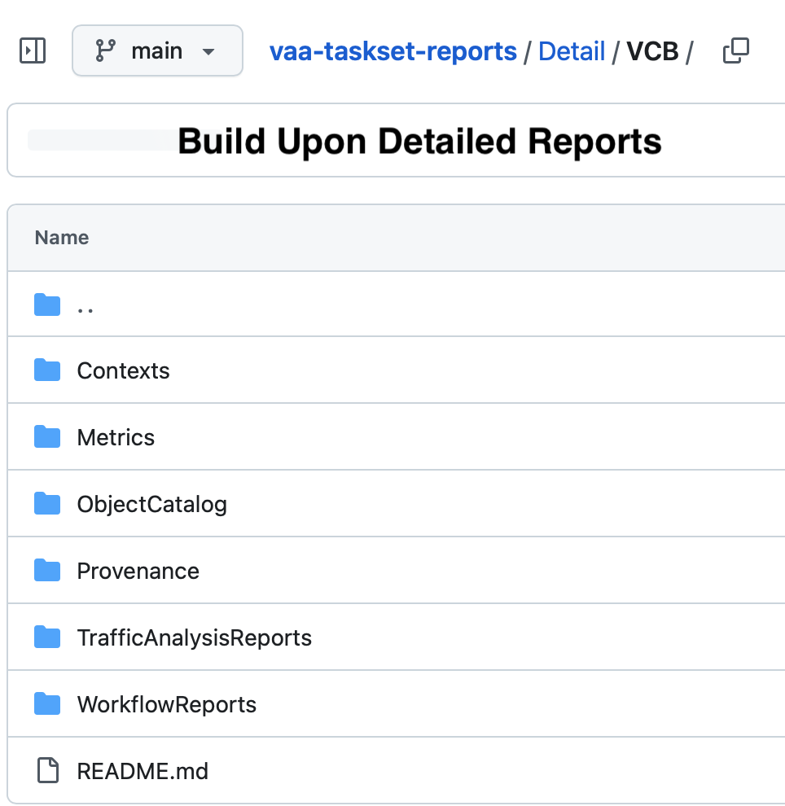
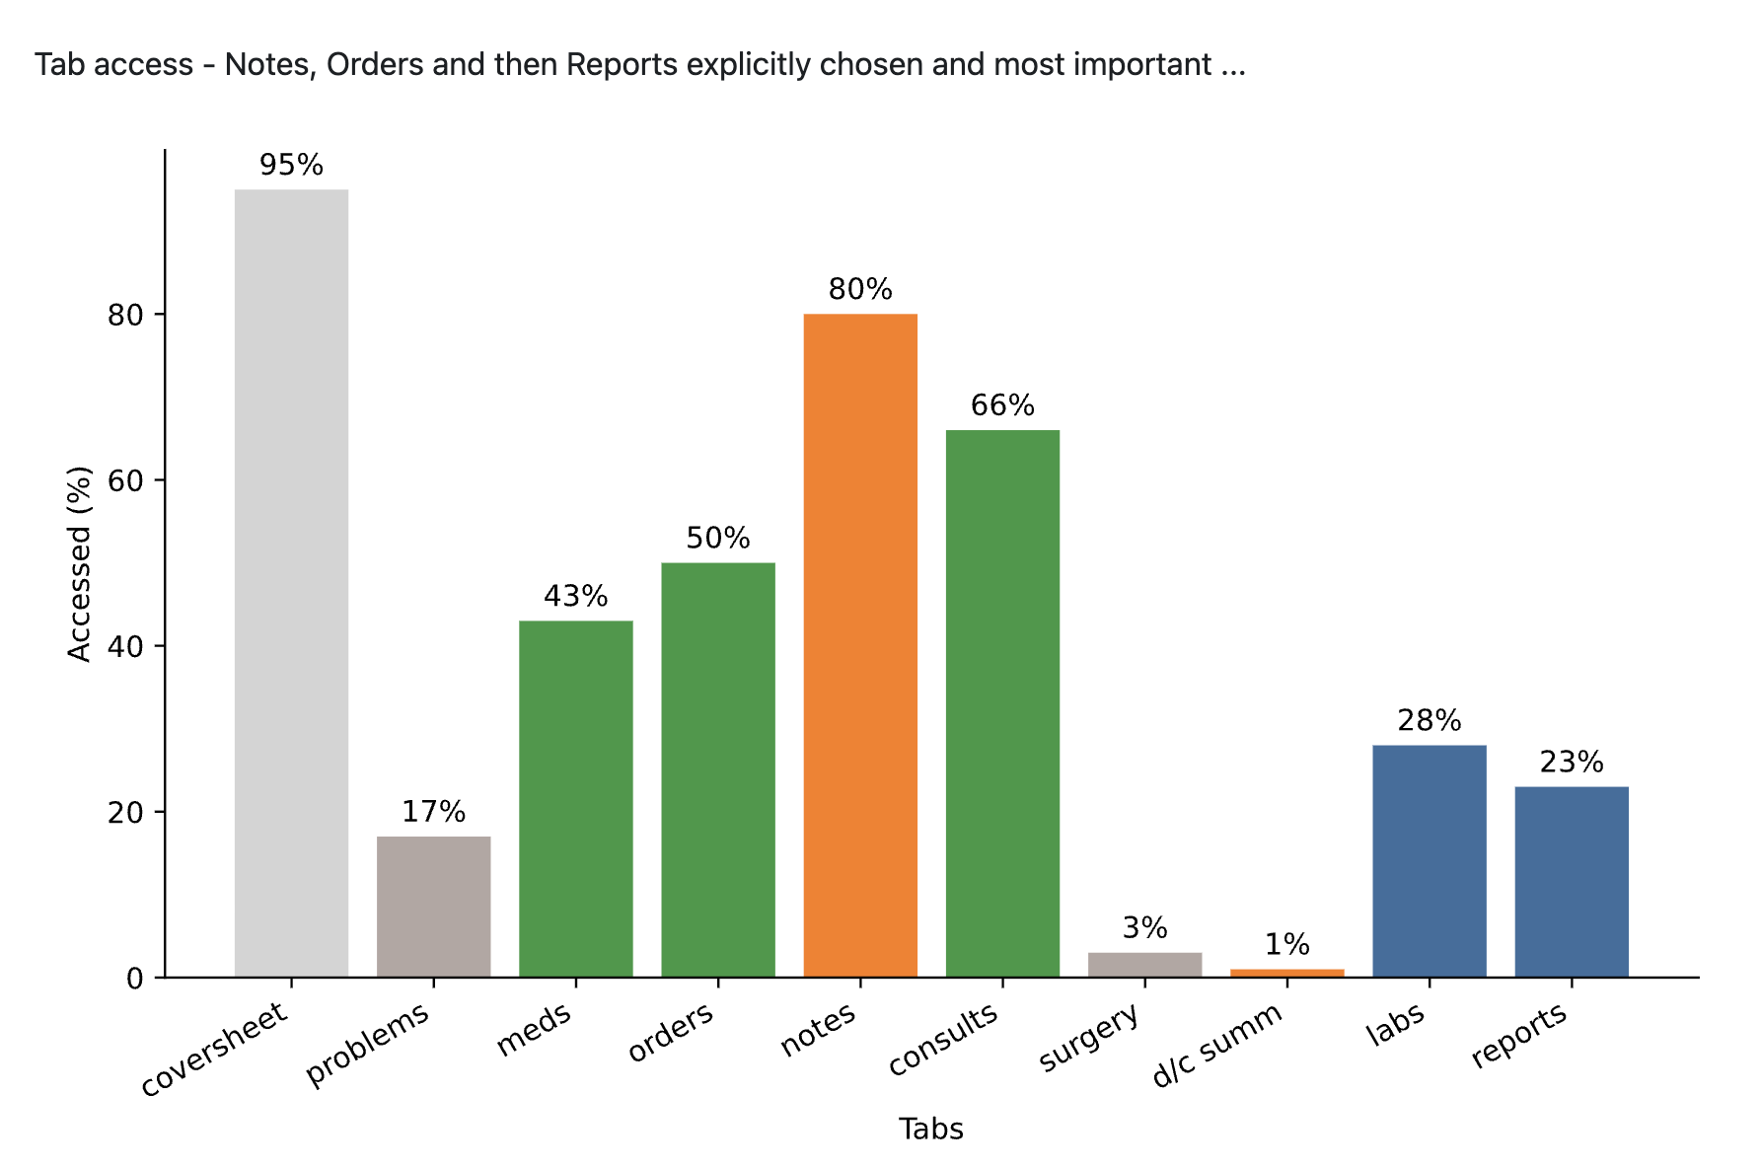
5.3.2 Workflow Analytics Options
Some Suggestions | Report New or Enhanced
Pointer Notes (cross client) | New Note Report
Template % of Notes | End Year 1 Note Report Addition
Reminders drive Workflow | New Workflow Trigger Report
Reports Breakdown (Lab, Report) | New “Improved Report” Report

Slide 8
Year 2 – 9/9/25 on
Year One:
Proved Traffic Analysis Delivers Recommendations for Workflow Improvement
Framework for more in Year 2 in place
But Limited Resources
Choices to make – more VistAs? What analysis?

Slide 9
Extras

Slide 10
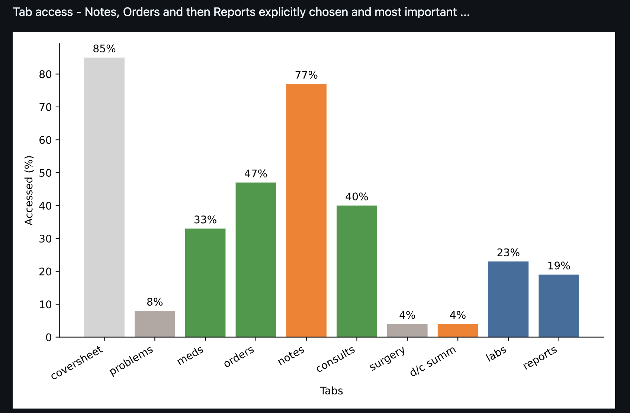
Omaha CPRS Tabs

