Slide 1
VAA Status and Targets:
Portable, Objective Baseline of VA Medical Center Workflow
5/20/25
VA Application Analytics (VAA)
Office of Clinical Informatics
Digital Health Office
Veterans Health Administration
U.S. Department of Veterans Affairs

Slide 2
VAA
Baseline the Clinical Workflow of any VA Medical Center
Objective: automatically report on the complete clinical workflow of any medical center in an objective, portable form to [a] recommend workflow improvements [b] aid workflow migration of the same workflow to new systems (configurations, training
Approach:
Non-invasive Capture and Reduction of the clinical application traffic generated by all users of an entire medical center for a 30-day period
Replay every class of center-specific workflow to ensure reduction is complete
Generate Medical Center Clinical Workflow Reports and Configurations
This approach could be taken with any system or EHR (“Portable”, “Objective”)
Use for migration: Focused Training (what’s changed?); Configurations to migrate Workflows

Slide 3
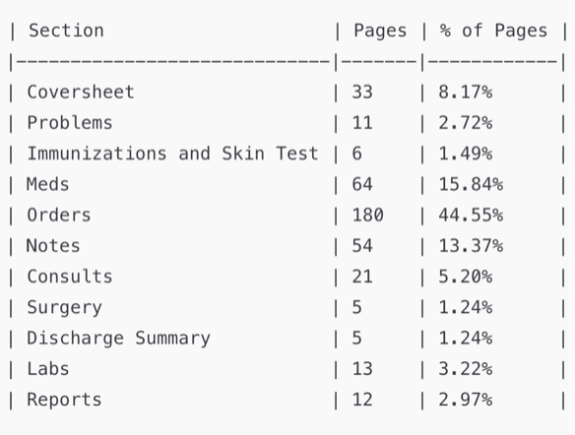
VA Clinical Workflow
Centered around Orders and Templated Notes (“Smart Forms”)
CPRS User Guide content (620 pages) reflects Workflow types and importance
The “Orders" sections (Meds, Orders, Consults, Labs) represent 68.81% of the pages.
The "Notes" sections (Notes, Surgery, Discharge Summary) represent 15.85% of the pages.
Other data entry (Problem, Vital …) is simple and not at all custom
Summaries in Coversheet and elsewhere leverage ordered items and note types

Slide 4
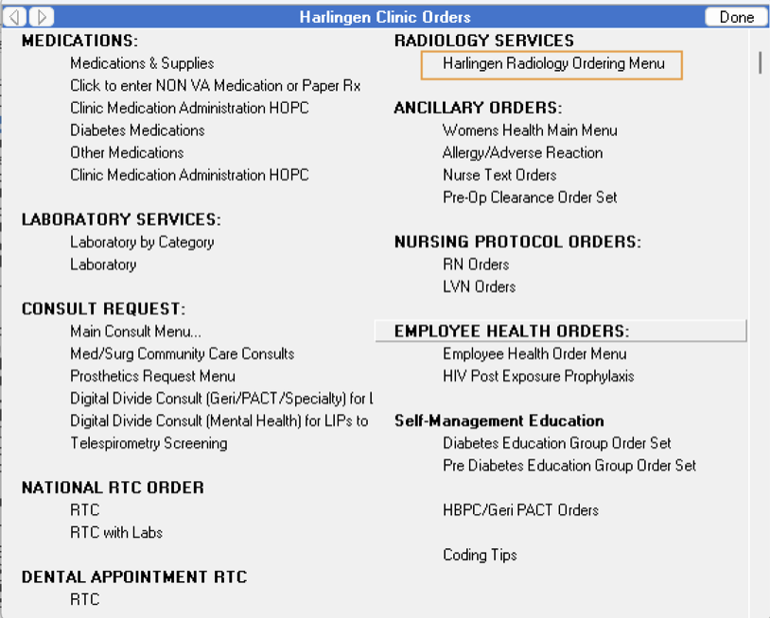
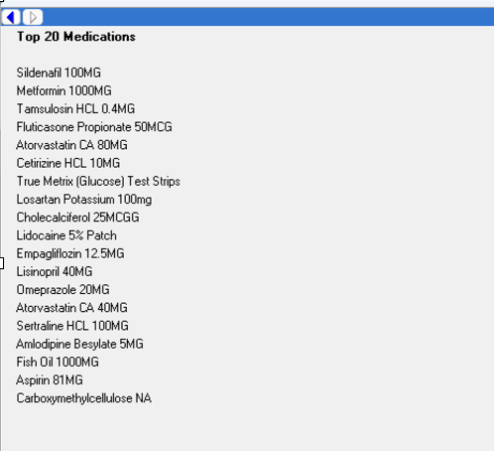
Workflow: Navigation that leads to Actions
Navigation: Root Menus + series of Nested Menus
Root Menus
(Vertical side bar)
Nested Menus
Reflect the important location and groupings for care
Doctors are used to these site-specific organizations
Entry point for other menus or popular actions
Specialized for Medical Discipline, Division, …
+
VCB: 523 (max nesting 12)
Omaha: 5,392 (max nesting 17)
VCB: 13
Omaha: 1,595
(100x difference)
(10x difference)
Notes:
This is what the doctors of a specific site are used to - no two sites are the same
A migration will need to retrain doctors to do equivalent work in a new system
These organizations should have equivalents in the new system

Slide 5
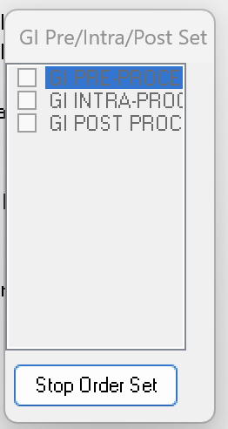
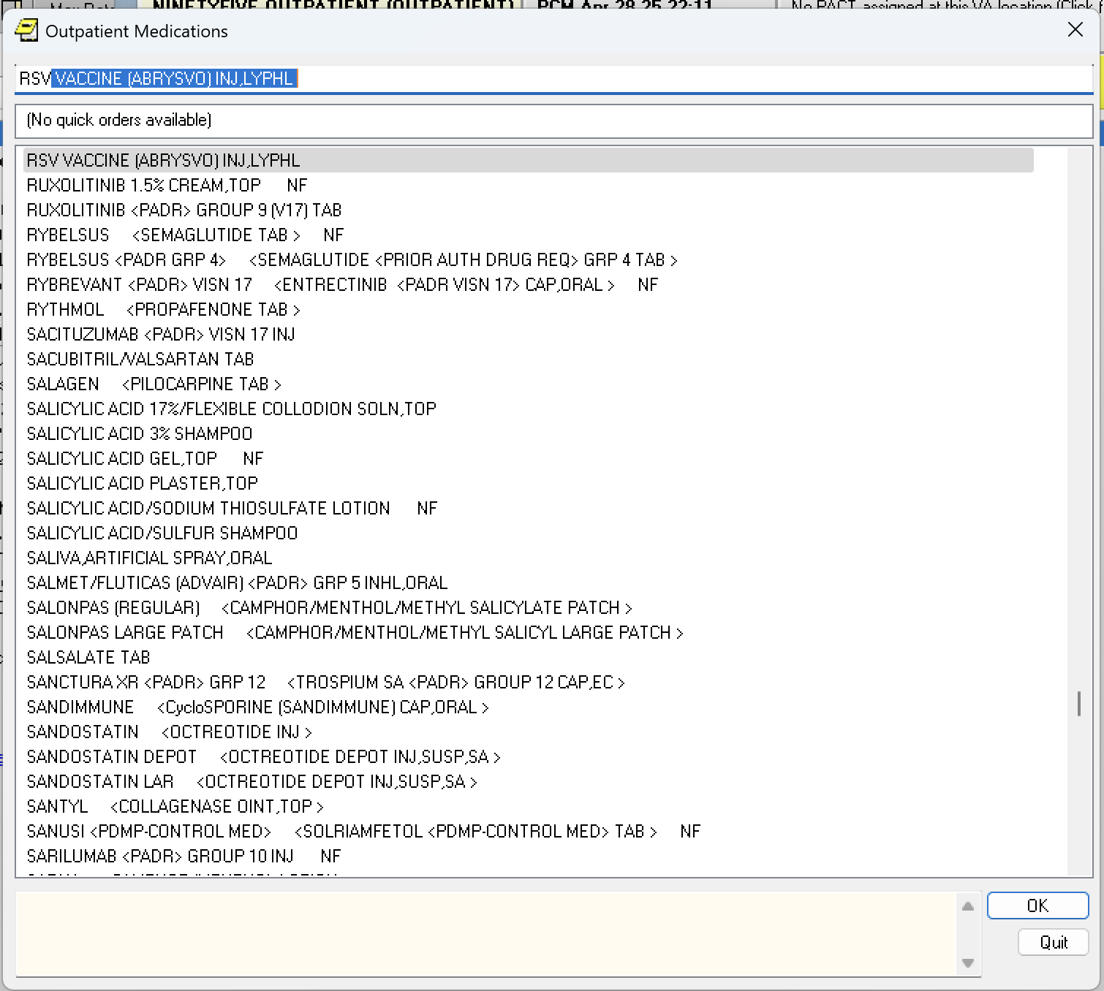
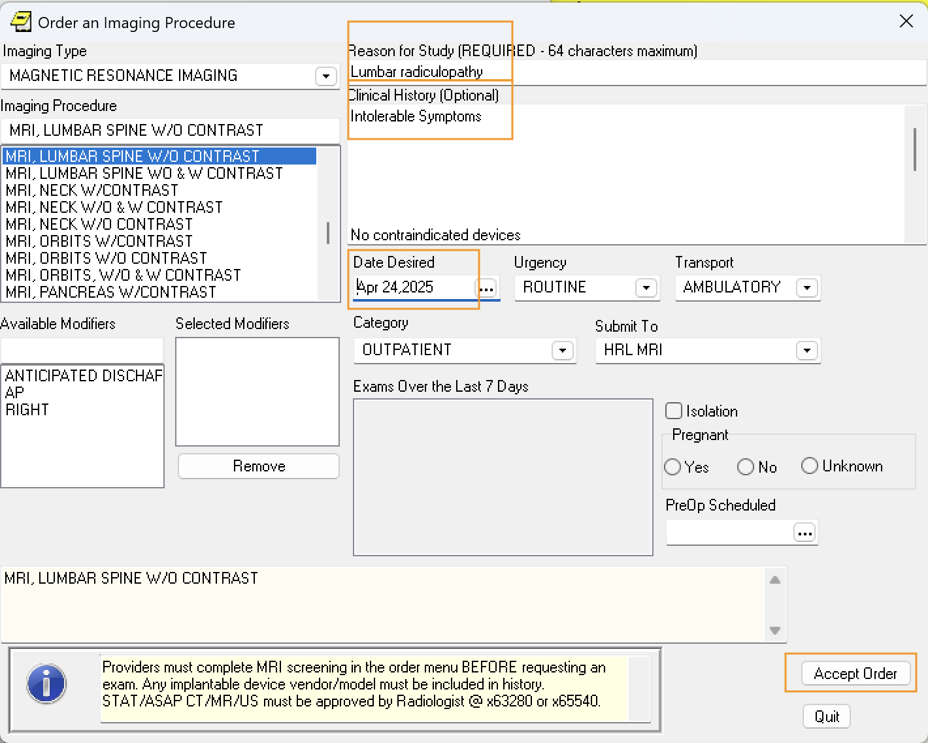
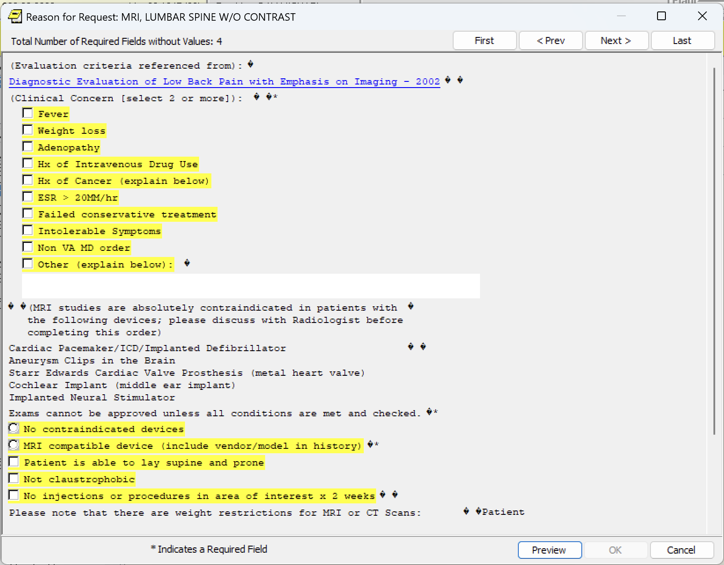
Workflow: Navigation that leads to Actions
Actions: Order Sets, Lookups, Templates, Dialogs, Quick Orders
Order Sets
Lookup Orderables
Dialog - populate prompts
Templates
Notes:
Navigation to Action which may be a set of orders, popup templates, search boxes for a more precise order and a dialog for specifics. In quick orders, many prompts - maybe ALL prompts are prefilled.

Slide 6
Example: Simple Order - Navigation x 3
Root Menu + 2 Nested Menus
Corpus Christi Orders Side Menu (Root)
→ Corpus Christi (Primary Care/Behvioral) [15831] (1)
→ Medications & Supplies [24371] (2)
→ All other medications [147] (ACTION)
1
2
3

Slide 7
Example: Simple Order - Actions x 4
One Search and then Three Details to fill in
1
2
3
4

Slide 8
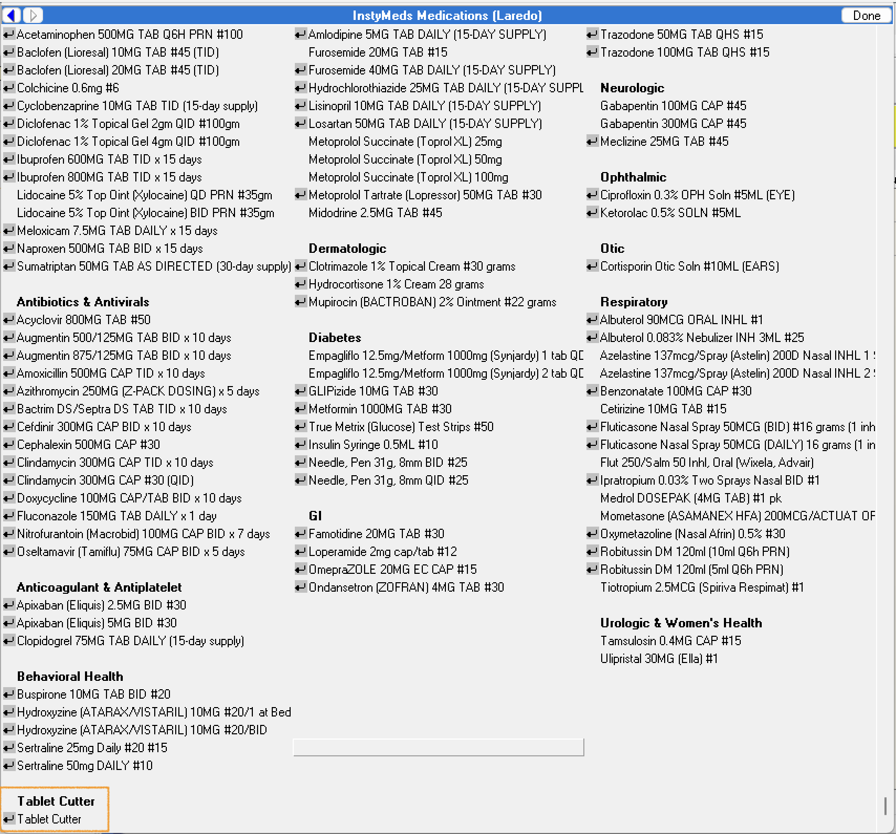
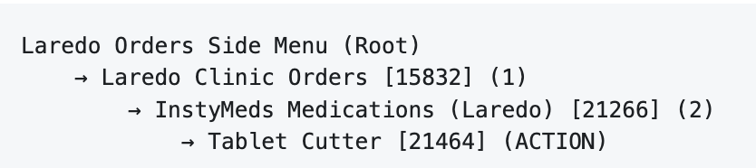
Example: Quick Order - Click and done
One click in the Menu and Done
See all these Quick Orders you can navigate to in Laredo
One click makes an order execute and complete
Example Significance: Labs ordered at Omaha: 83% are Quick Orders
1

Slide 9
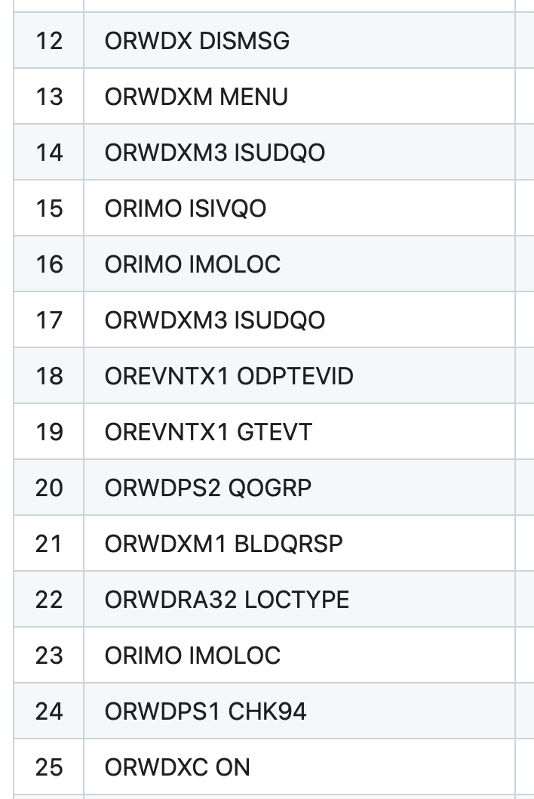
VAA Methodology
Five Steps
Example sequence of RPCs to Reduce
Non Invasive Capture of VistA RPC traffic for a 30-day period of a VA Medical Center: Focus is on CPRS traffic
Workflow Extraction: Sequences of extracted RPCs represent workflow
Workflow Categorization
Example: 7 types of Radiology Study, Quick Orders, Explicit Orders, Order Sets, Verify only Orders within these types
Workflow Validation: Use Emulator to reproduce examples of all types to validate completeness
Example screens seen earlier in this slide deck are from the Emulator
Generate Reports/Configurations from Categorizations

Slide 10
VAA Year One
Current Status (5/25)
Rounding out Order Workflow Representation
Establishing Note Workflow Representation
Reduce two more 30-day periods of data as final representative VAMC workflow - both Omaha and Valley Coastal Bend (VCB)
Deliver Medical Center Workflow Reports in browsable and document form, including configuration file samples (CSV)

Slide 11
VAA Year Two Proposed (Full)
9/25 to 8/26
Extend Workflow Modeling to include Community Care and Interfacility Consults (clinical workflow between VA Medical Centers and in the Community)
Baseline Workflow Reports and Configurations for three to-be-migrated Medical Centers to enable EHRM migration and training
Deliver VAA in Packaged form for use by third parties on any VA Medical Center

