Slide 1

In-store Animations

Slide 2
Table of Contents:
Overview
Components and Process
  External Cascade (Project Overview and Details)
  Internal Cascade (Project Overview and Details)
  Turnover of Permits
  Preparation of Manpower
  Turnover of Schedule and Checklists
  Briefing, Training and Simulation
  Actual Implementation
  Reporting
Glossary
Important Protocols

Slide 3
In-store Animations
Overview

Slide 4
What is In-store Animation?
In-store Animations are promotional efforts to:
  To make shoppers be aware of a certain Brand
  To introduce the Brand and its variant/product range
  To push for sales and avail the free prizes / services
In-store Animations can be any of the ff:
  Push Girl Deployment (W/o booth set-up)
  In-store Animation (With booth set-up)

Slide 5
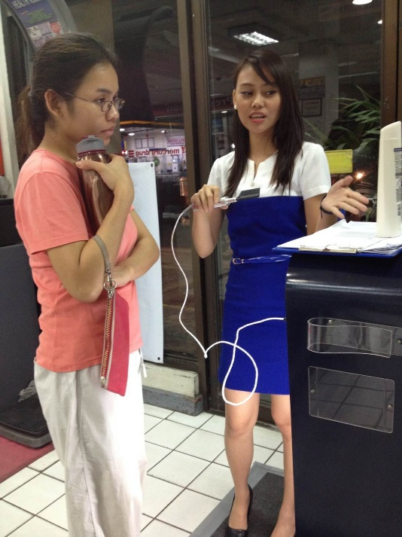
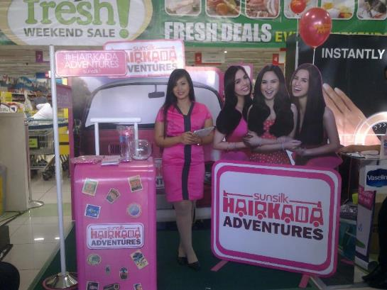
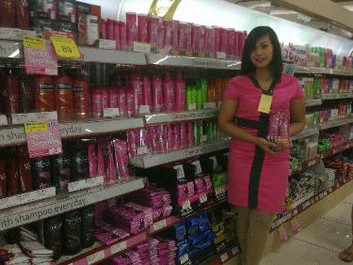
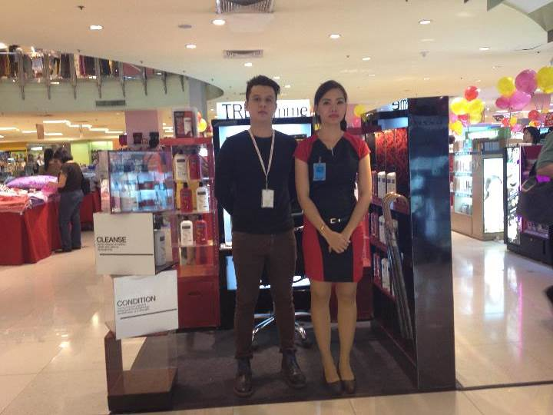
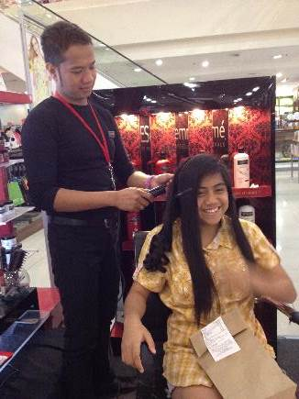
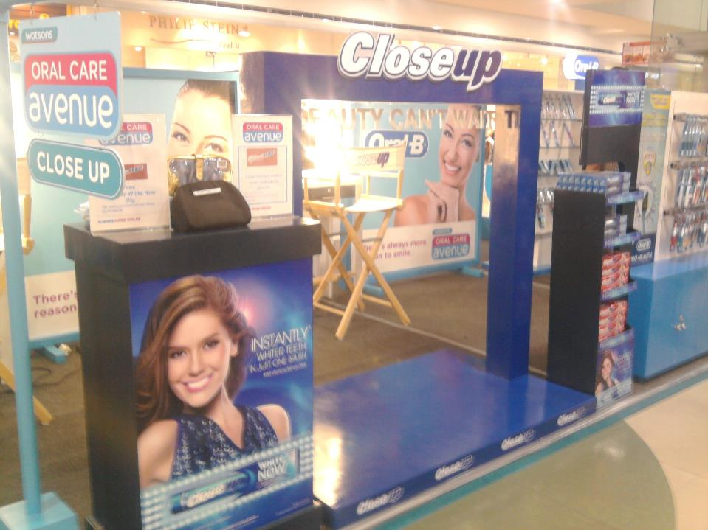
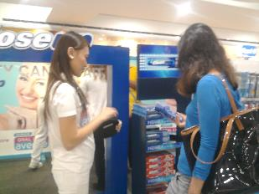
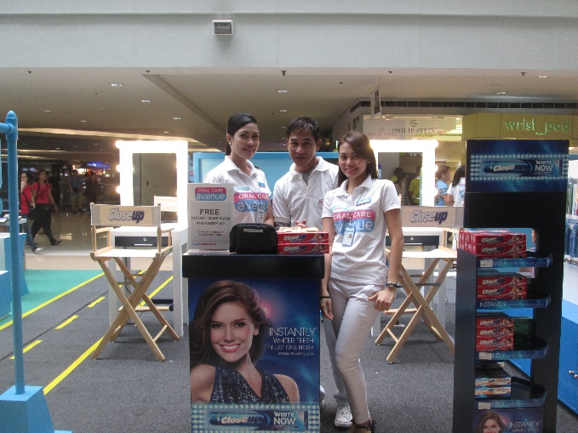

Slide 6
PG Deployment / In-store Animations
Components and Process

Slide 7
Components and Process
External Cascade
(Project Overview and Details)
Internal Cascade
(Project Overview and Details)
Turnover of Trade Letters / Permits
Preparation of Manpower
Turnover of Schedule and Checklists
Actual Implementation
Reporting

Slide 8
Components and Process
External Cascade
(Project Overview and Details)
Client to schedule a project briefing to discuss project overview and details
(Project Name, Highlighted Brand, Promo Scheme/Mechanics, Requirements, Schedule, etc.)
Internal Cascade
(Project Overview and Details)
Turnover of Trade Letters / Permits
Preparation of Manpower
Turnover of Schedule and Checklists
Actual Implementation
Reporting

Slide 9
Components and Process
External Cascade
(Project Overview and Details)
Internal Cascade
(Project Overview and Details)
AE to prepare the CE and submit to Client for approval and DO issuance.
AE to prepare internal JO and request for an internal cascade for the details of the project
Important points for discussion are the ff:
  - Project Name
  - Highlighted Brand
  - Promo Scheme/Mechanics
  - Manpower Requirements (Pooling, Briefing and Training, Intro Sched, etc.)
  - Set-up and Production Requirements (Booth/Structure, Merch, etc.)
  - Materials Needed (Uniforms, Premiums, Supplies, etc.)
  - Schedule of Deployment
Turnover of Trade Letters / Permits
Preparation of Manpower
Turnover of Schedule and Checklists
Actual Implementation
Reporting

Slide 10
Components and Process
External Cascade
(Project Overview and Details)
Internal Cascade
(Project Overview and Details)
Turnover of Trade Letters / Permits
AE to request for the trade letters / permits from Client
AE to turnover the trade letters / permits to the OPM for distribution and attachment purposes
There are 2 types of permits:
  - Manpower Permit: For HR’s perusal
  - Ingress/Egress Permit: For Set-up’s perusal
*In cases that there are no trade letters provided, an intro letter and other manpower requirements will do
(This usually occurs in Watsons-initiated in-store animations)
Preparation of Manpower
Turnover of Schedule and Checklists
Actual Implementation
Reporting

Slide 11
Components and Process
External Cascade
(Project Overview and Details)
Internal Cascade
(Project Overview and Details)
Turnover of Trade Letters / Permits
Preparation of Manpower
HR to prepare and submit the ff:
- Pooling and Screening (based on the agreed requirements)
- Manpower Shoplist
- Schedule Intro to Store/s
HR to ensure manpower has complete requirements and issuance of necessary attachments – Permit, Intro Letter, etc.
HR to ensure that Intro is done ahead of target schedule to avoid any delays in implementation
*Schedule of Intro varies per store/account
*Manpower requirement varies per store/account
Turnover of Schedule and Checklists
Actual Implementation
Reporting

Slide 12
Components and Process
External Cascade
(Project Overview and Details)
Internal Cascade
(Project Overview and Details)
Turnover of Trade Letters / Permits
Preparation of Manpower
After successful manpower intro, submission of requirements and orientation to store/s, HR to schedule briefing and training
AE to provide briefing materials (Promo Deck, Product Deck, etc.)
AE and OPM to facilitate briefing and training so that the manpower will be well aware of the Project, Brand/Product Range, Protocols, Scope of Work, and AAI Rules and Regulations
Turnover of Schedule and Checklists
Actual Implementation
Reporting

Slide 13
Components and Process
External Cascade
(Project Overview and Details)
Internal Cascade
(Project Overview and Details)
Turnover of Trade Letters / Permits
Preparation of Manpower
AE to prepare an excel file consisting of all the upcoming / on-going in-store animations
Excel file should have the ff details
- Project Name
- Assigned Overall Project Manager
- Photo of the Set-up
- Schedule (Date, Branch, No. of Days, Manpower Needed and Scope – Daily/Weekender, Notes, Location)
AE to prepare project checklist of all the upcoming / on-going in-store animations
*OPM to print and distribute the schedule and project checklist on a weekly basis
Turnover of Schedule and Checklists
Actual Implementation
Reporting

Slide 14
Components and Process
External Cascade
(Project Overview and Details)
Internal Cascade
(Project Overview and Details)
Turnover of Trade Letters / Permits
Preparation of Manpower
Turnover of Schedule and Checklists
Actual Implementation
Before a project’s breakdate, OPM to ensure that all schedule and materials are aligned with the team
During the actual date/s of deployment, OPM to do actual in-store visits and gives regular update and monitoring reports
  - Check status of deployment (Manpower, Set-up, Promo Scheme, Sales, Other Concerns)
Reporting

Slide 15
Components and Process
External Cascade
(Project Overview and Details)
Internal Cascade
(Project Overview and Details)
Turnover of Trade Letters / Permits
Preparation of Manpower
Turnover of Schedule and Checklists
Actual Implementation
OPM to collate and submit comprehensive report to AE
  Qualitative (Observations, Trends)
  Quantitative (Experiential Hits, Total Transactions, Total Premiums Depleted, Total Sales)
  Photos (Set-up, Manpower, Actual Deployment)
  Inventory
  Attendance
OPM to store all reports (in both hard and soft copies for database purposes)
Reporting

Slide 16
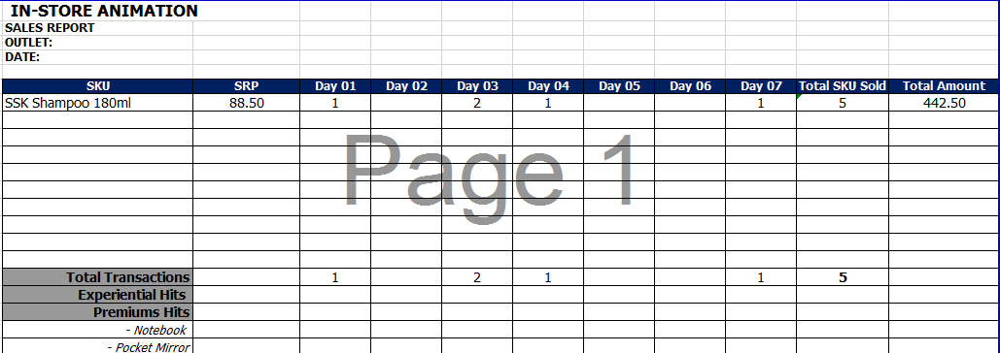
Quantitative Report Template

Slide 17
Qualitative Report Template
Project Name
Branch
Booth Area/Location
Common Questions
Brand Feedback
Product Feedback
Learnings & Highlights (What Worked?)
Challenges Encountered (What Didn’t Work?)
Adjustments In-between Runs
Recommendations/OFIs

Slide 18
PG Deployment / In-store Animations
Glossary

Slide 19
Glossary
SKU
Stock Keeping Unit – Used to identify the product, product size/type and manufacturer
SRP
Standard Retail Price – Indicated product selling price in-stores
*Selling price may vary per store
Hits
Unit of measurement used to determine specific count of an item and/or activity
Experiential Hits
Measurement of actual consumers who underwent product experience
Total Transactions / Total Selling Hits
Measurement of actual selling transactions or successful purchase per day

Slide 20
PG Deployment / In-store Animations
Important Protocols

Slide 21
Important Protocols
All manpower are required to report to AAI’s HO after every in-store run (1 day after) to accomplish the ff:
  Submit all reports
  Turnover uniforms and other materials issued
  Clearance
Necessary sanctions will be applied for those who fail to comply with the rules

Slide 22
Thank You Very Much!!!

