Slide 1
How it Works
Kuma acts as service mesh
Loki log collection
Opentelemtry collector as gateway to Tempo
Tempo trace storage
Grafana correlation and visualization tool
Kong as ingress

Slide 2
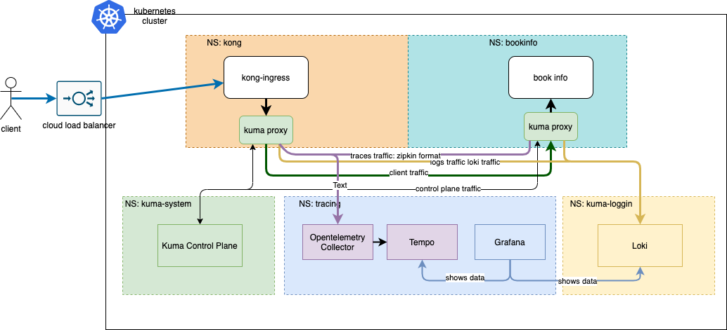
Diagram

Slide 3
Pros and Cons To Kuma Service Mesh
Pros: - Serious company behind Kuma: Kong, they know industry pains - Much simpler setup and operations then other Service Meshes - Easy to setup centralized logging and tracing - Works with virtual machines Cons: - Relatively new solution - Traffic policies can become tricky to manage - Not so many features if comparing to istio (maybe it’s pro)

