Slide 1

MASTER TERRAFORM ·
Project Structure & terraform.tfvars
Topic 1 Project Structure Best Practices
Topic 2 terraform.tfvars

Slide 2
TOPIC 1 · PROJECT STRUCTURE
You've already been following this convention
providers.tf
terraform {} block, required_providers, provider blocks
variables.tf
Every variable declaration
locals.tf
Every locals {} block
main.tf
The actual resource/data blocks
outputs.tf
Every output declaration
2

Slide 3




TOPIC 1 · PROJECT STRUCTURE
Naming conventions
Resource local names
Variable names
Real AWS resource names
Tags
snake_case(lowercase with underscores), descriptive, never repeat the resource type.
snake_case, matches what it configures.
Built from a shared prefix — never hardcoded literally.
One shared map, applied to every resource.
aws_s3_bucket.app_data
project_prefix, environment
local.name_prefix
local.common_tags
aws_s3_bucket.aws_s3_bucket_app_data
3

Slide 4

TOPIC 1 · PROJECT STRUCTURE
Growing beyond one flat folder
modules/
environments/
Reusable building blocks — code you write once and call multiple times with different inputs (a VPC shape, a compute tier). Not deployed directly.
One deployable root config per environment, each calling those modules with environment-specific values — and its own state file, so a mistake in dev can never touch prod.
vpc/
compute/
dev/
qa/
prod/
Called by environments with environment-specific inputs.
5

Slide 5

TOPIC 1 · PROJECT STRUCTURE
Documentation & repo hygiene
.gitignore — block secrets
README per module/project
Block .terraform/, *.tfstate*, *.tfvars , .terraformrc, credentials.
Explain what it builds, its inputs, its outputs. terraform-docs can generate this automatically from your variables.tf / outputs.tf descriptions.
6

Slide 6
TOPIC 2 · TERRAFORM.TFVARS
From -var flags to real .tfvars files
The actual mechanism a team uses to run the same code against dev / qa / prod — without editing .tf files or retyping flags.
How Terraform loads variable values from files
terraform.tfvars
Automatically, if present in the working directory
terraform.tfvars.json
Same as above — JSON instead of HCL syntax
*.auto.tfvars / *.auto.tfvars.json
Automatically, any matching file, loaded in alphabetical order
Anything else — e.g. dev.tfvars
Only if passed explicitly: -var-file="dev.tfvars"
7

Slide 7
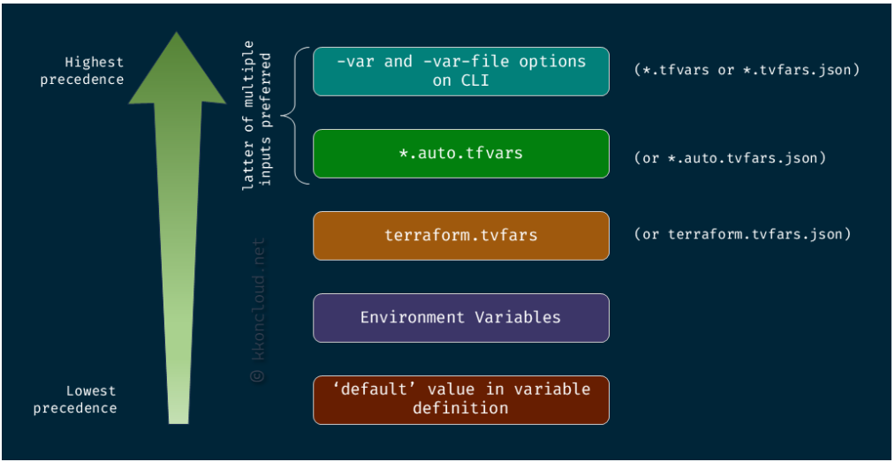

Slide 8


TOPIC 2 · TERRAFORM.TFVARS
The syntax — and naming per environment
dev.tfvars
Name per-environment files explicitly
# dev.tfvars
environment = "dev"
project_prefix = "master-terraform-day05"
owner_tag = "your-name-here"
dev.tfvars qa.tfvars prod.tfvars
Select one explicitly per run with -var-file. Never used automatically, so you can't run the wrong environment by accident.
Run it with:
Don't name it terraform.tfvars
terraform plan -var-file="dev.tfvars"
That exact filename loads automatically on every plan/apply — including runs meant for a different environment. Reserve it for values that should truly always apply, or avoid it in a multi-environment setup.
Every variable still needs a variable block in your .tf code — a .tfvars file only supplies values, it never declares new variables.
8

Slide 9

TOPIC 2 · TERRAFORM.TFVARS
The .tfvars.example pattern
The general pattern most real teams use for per-environment secrets and config.
.gitignore
Day 5's own lab does it differently
*.tfvars
*.tfvars.json
!*.tfvars.example
It keeps dev.tfvars / qa.tfvars as real, gitignored files directly — no .example template this time. Read lab/lab.md for how that's handled here.
1
2
3
Commit the template
Each person copies it
Run against it
dev.tfvars.example — safe placeholder values, no real secrets — goes to git.
cp dev.tfvars.example dev.tfvars, then fills in anything real. That copy stays local and gitignored.
-var-file="dev.tfvars" picks up the real, local file at plan/apply time.
9

Slide 10


TOPIC 2 · TERRAFORM.TFVARS
Validation still applies — and common mistakes
Nothing changes about validation when values come from a file. A dev.tfvars with environment = "developement" fails the exact same validation block, at the exact same point (before touching AWS), as typing it wrong on the command line.
Three ways this goes wrong
terraform.tfvars for one environment
It loads automatically on every plan/apply — including ones meant for a different environment.
Committing a real .tfvars with secrets
The #1 reason this repo's .gitignore blocks *.tfvars by default.
Forgetting -var-file
dev.tfvars / qa.tfvars aren't *.auto.tfvars — a plan with no flag silently falls back to only variable defaults.
10

