Slide 1

An Android Based IoT System for Garbage Monitoring
DATE: 12 December, 2018
SUPERVISED BY-
Shakila Mahjabin Tonni
Lecturer, Department of CSE
East West University
PRESENTED BY-
Syed Shafaet Hossain
ID: 2014-1-60-087
Md Tanvir Ahmed
ID: 2014-2-60-032
Md Rasel Miah
2014-2-60-013

Slide 2
CONTENTS
Introduction
Project Background
What we have to offer?
Application UI
Methodology(Hardware/software)
Conclusions
Notes:
45817c90-de3c-4cab-9120-bfafa748d387

Slide 3
Economist Intelligence Unit annual global survey
Notes:
45817c90-de3c-4cab-9120-bfafa748d387

Slide 4
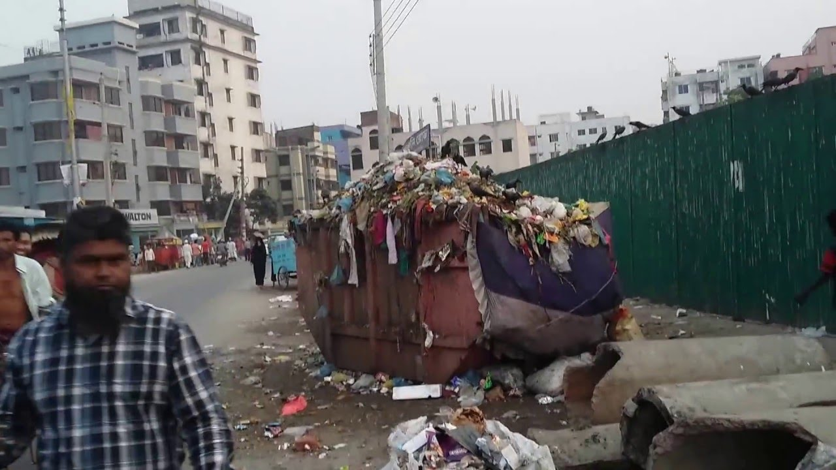
Project Background
Environment is highly polluted by untreated waste
More human effort, time and cost which can easily be avoided with our present technologies.
No smart system is present in developing countries.
Smart waste management systems are present in developed countries.
Notes:
1c4c040a-0192-4701-894e-d950c83b7e8c

Slide 5
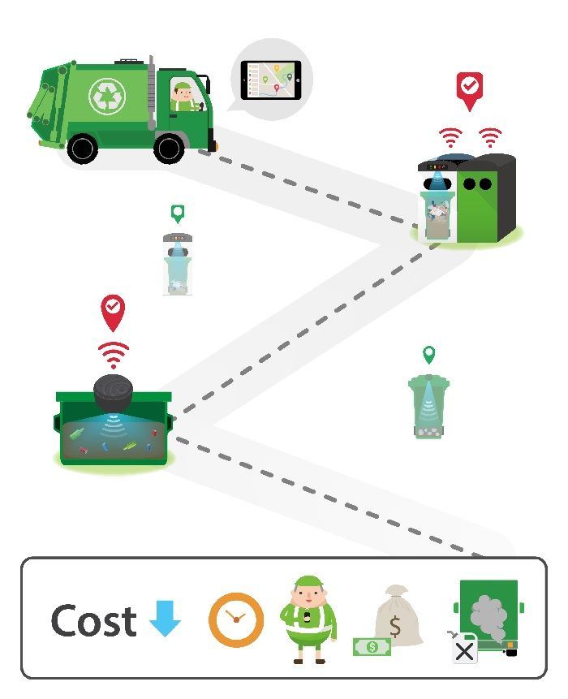
What we have to offer?
Automated waste-bin management.
Real time indicator of waste level.
Google API based waste collection routes.
Android Waste bin monitoring with SMS based notification.

Slide 6
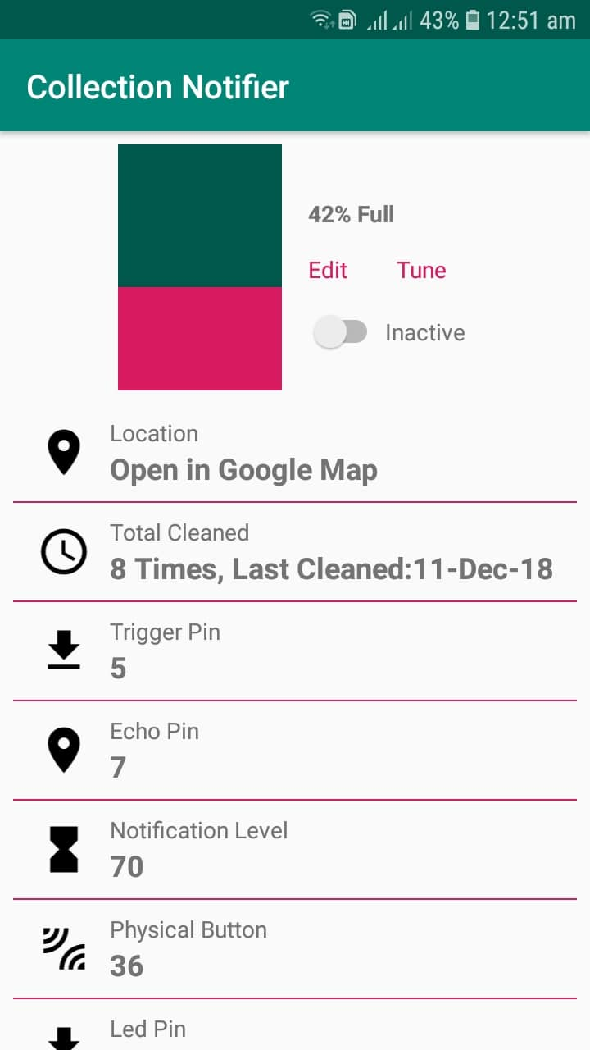
Features
Notification if bin is 70% (adjustable)
Tune
Location of the bin
Last time cleaning date
Total cleaned

Slide 7
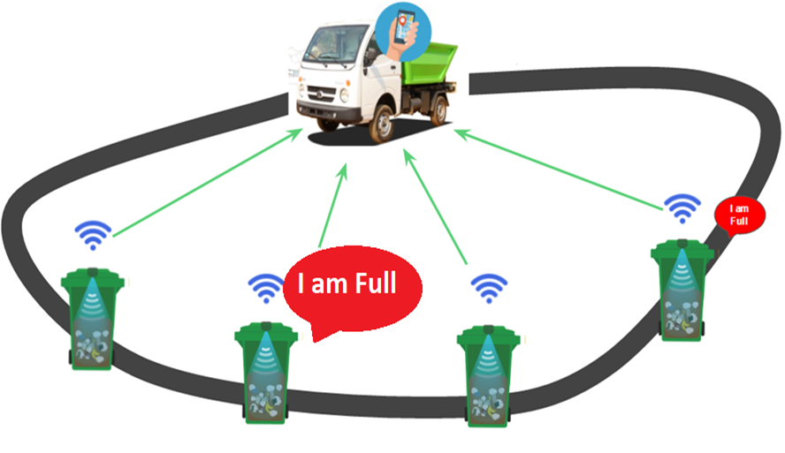
Overview of System
I am on the way

Slide 8
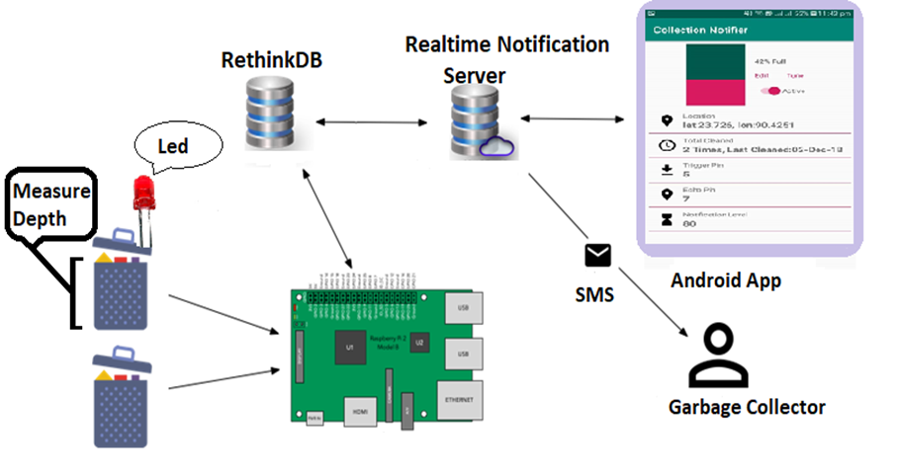
Methodology

Slide 9
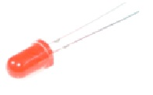
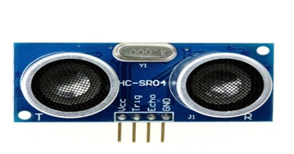
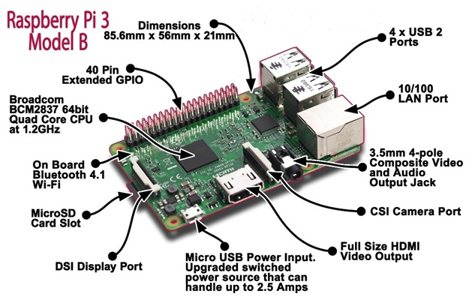
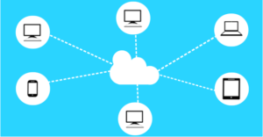
Hardware/Software
Led
Ultrasonic Sensor
Raspberry Pi3
Cloud Database

Slide 10
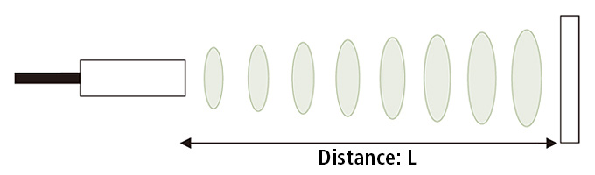

Working Principle of Ultrasonic Sensor
Ultrasonic sensors generate high frequency sound waves and evaluate the echo which is received back by the sensor.
Here,
L = distance,
T = time between the emission and reception
C = sonic speed
The value is multiplied by 1/2 because T is the time for go-and-return distance

Slide 11
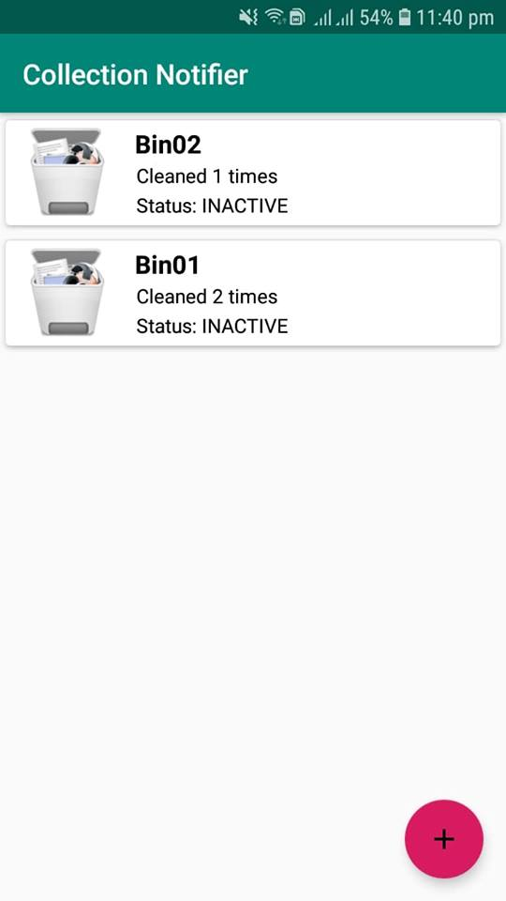
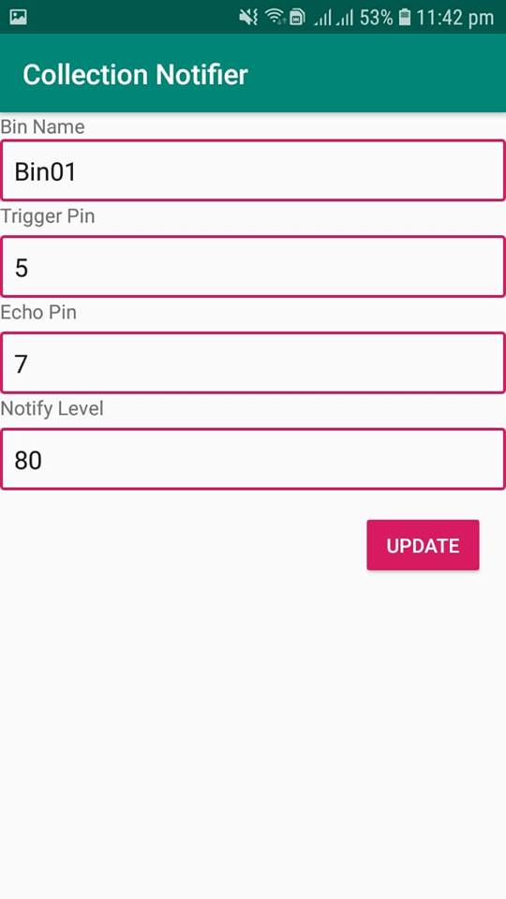
Application UI
Home Layout
Bin Details Layout
Bin Update

Slide 12
Conclusion
The developed system provides garbage collection time and
quantity of garbage collection at each location.
Implementing this project we will avoid over flowing of garbage from the container.
System is develop for city administrations, municipal staff.

Slide 13
References
[1]"Global Liveability Ranking", Eiu.com, 2018. [Online]. Available: http://www.eiu.com/topic/liveability. [Accessed: 12- Dec- 2018].
[2]"Waste management in Bangladesh", En.wikipedia.org, 2018. [Online]. Available: https://en.wikipedia.org/wiki/Waste_management_in_Bangladesh. [Accessed: 12- Dec- 2018].
[3]"Raspberry Pi 3 Model B - RoboGearsBD", RoboGearsBD, 2018. [Online]. Available: https://robogearsbd.com/shop/raspberry-pi-3-model-b/. [Accessed: 12- Dec- 2018].
[4]Lazada.com.ph, 2018. [Online]. Available: https://www.lazada.com.ph/products/ultrasonic-sensor-hc-sr04-i102973276-s103282735.html. [Accessed: 12- Dec- 2018].

Slide 14
THANK YOU

