Slide 1
Smart Dustbin Monitoring System Using IOT Devices

Slide 2
Course Title: Microprocessors and Microcontrollers
Course Code: CSE 442
Course Instructor: Dr. Md. Nawab Yousuf Ali
Sec: 02
Group: 10
Group Members | ID’s
Md. Tanvir Ahmed | 2014-2-60-032
Md. Sakib Hasan | 2014-2-60-077
Farhan Tanvir | 2014-2-60-124
Sikder Rakin | 2014-2-60-108

Slide 3
INTRODUCTION
A major environmental concern of our society today is proper management and disposal of solid waste, which is crucial to the cleanliness and overall health of our society . Traditional monitoring and disposal of waste is highly inefficient as it requires a lot of time and human effort. Using the power of IoT, we are therefore coming up with the idea of Smart Bin for efficient and smart waste monitoring.

Slide 4
Problems
1. Wastage of Resources Since the garbage collectors don't get to know exactly when the dustbins are to be cleaned, they need to regularly monitor them. This consumes a lot of time, effort and fuel.
2. Unhygienic environment Over usage of some dustbins results into wastes getting littered all around. This causes extremely unhygienic situation.

Slide 5
Components Used
• Arduino UNO2500 Board
• Ultrasonic Sensor- HC-SR04
• ESP8266 (ESP-01) Wi-Fi module
• Breadboard • Jumper wires

Slide 6
SOCIETAL IMPACT
• Our system can be used on a larger scale to keep our cities clean by monitoring the garbage in dustbins located in different corners of the city. This would solve to a great extent the sanitary and resource wastage problems mentioned earlier. • Besides, a cleaner city would result in curbing a lot of diseases leading to much better health conditions.

Slide 7
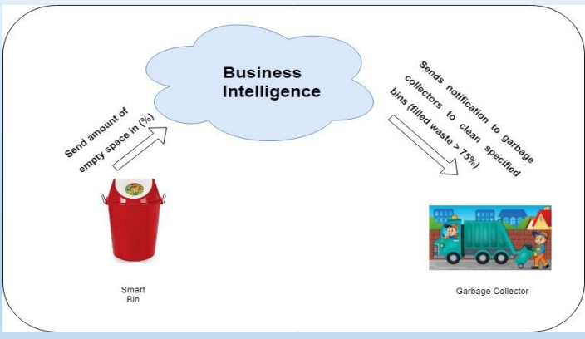
DATA FLOW

Slide 8
Conclusion
Clean and Healthy City Less Effort
Digital monitoring
More Value

