Slide 1
Detecting and surviving data races using complementary schedules
Kaushik Veeraraghavan
Peter Chen, Jason Flinn, Satish Narayanasamy
University of Michigan
Revised by 贺天行

Slide 2




Multicores/multiprocessors are ubiquitous
Most desktops, laptops & cellphones use multiprocessors
Multithreading is a common way to exploit hardware parallelism
Problem: it is hard to write correct multithreaded programs!
Kaushik Veeraraghavan

Slide 3
Data races are a serious problem
Data race: Two instructions (at least one of which is a write) that access the same shared data without being ordered by synchronization
Data races can cause catastrophic failures
  Therac-25 radiation overdose
  2003 Northeast US power blackout
If (proc_info) {
fputs (proc_info, f);
}
proc_info = 0;
crash
MySQL bug #3596
Kaushik Veeraraghavan

Slide 4
Related work
Data race survival:
Primary-backup replicas(retrying)
Intentionally diverse replicas(changint layout of memory, instruction set, etc.)
(Mostly related to Frost)change the events(signals or priority)
Kaushik Veeraraghavan

Slide 5
Related work
Data race detection:
Happens-before analysis(slow)
Lockset analysis(slow)
Random sampling
They are slow because they are real-time
Frost is outcome-based
Kaushik Veeraraghavan

Slide 6
First goal: efficient data race detection
Data race detection
  High coverage (find harmful data races)
  Accurate (no false positives)
  Low overhead
 | High coverage | Sampling
Native (C/C++) | ThreadSanitizer (30X) Frost (3X) | DataCollider (1.1x with 4 watchpoints) Frost (1.18x @ 3.5% coverage)
Managed (Java/C#) | FastTrack (8.5X) | PACER (1.6-2.1x @ 3% coverage)
Kaushik Veeraraghavan

Slide 7
Second goal: data race survival
Unknown data race might manifest at runtime
Mask harmful effect so system stays running
Kaushik Veeraraghavan

Slide 8
Outline
Motivation
Design
  Outcome-based race detection
  Complementary schedules
Implementation: Frost
  New, fast method to detect the effect of a data race
  Masks effect of harmful data race bug
Evaluation
Kaushik Veeraraghavan

Slide 9
State is what matters
All prior data race detectors analyze events
  Shared memory accesses are very frequent
New idea: run multiple replicas and analyze state
And outcome
Goal: replicas diverge if and only if harmful data race
If (proc_info) {
fputs (proc_info, f);
}
If (proc_info) {
fputs (proc_info, f);
}
proc_info = 0;
proc_info = 0;
✔
crash
Kaushik Veeraraghavan

Slide 10
Our solution
First slice the execution in to time-slices called epoches.
Use three replicas to run each epoches via complementary schedules.
Use the outcomes to detect and survive data races.
Kaushik Veeraraghavan

Slide 11
Why Complementary schedules?
unlock (*fifo);
fifo = NULL;
unlock (*fifo);
fifo = NULL;
✔
crash
We do not know a priori that a race exists
Replicas schedule unordered instructions in opposite orders
  Race detection: replicas diverge in output
  Race survival: use surviving replica to continue program
Kaushik Veeraraghavan

Slide 12
How to construct complementary schedules?
First record total ordering of instructions in one thread-parallel execution
Then make two epoch-parallel schedule non-preemptively(that means it have to be run in one core), in reverse order. E.g T1T2T3 and T3T2T1
That is, each thread runs in the order we assigned until it is blocks by the synchronization recorded by the first replica
T1
T3
T2
T2
T3
T1
Kaushik Veeraraghavan

Slide 13
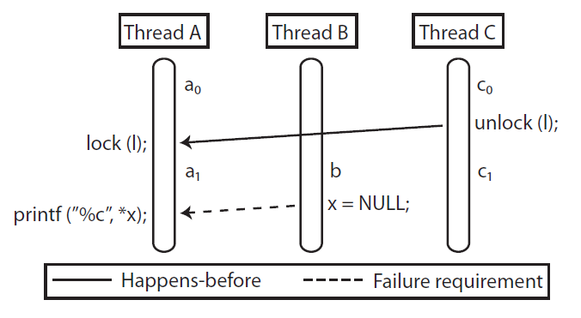
An example for complementary schedule
ABC:{ a0, b, c0, a1, c1 }
CBA:{ c0, c1, b, a0, a1 }
Kaushik Veeraraghavan

Slide 14
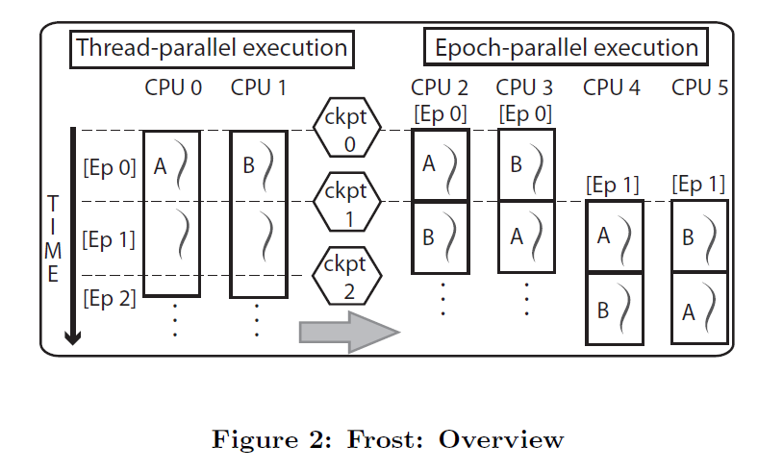
Now we can get a overview
Kaushik Veeraraghavan

Slide 15


Leverage uniparallelism to scale performance
CPU 0
CPU 1
CPU 2
CPU 3
CPU 4
CPU 5
T1
T2
T1
T2
ckpt
T2
T1
T1
T2
T2
T1
Each epoch has three replicas
Frost executes three replicas of each epoch
  Leading replica provides checkpoint and non-deterministic event log
  Trailing replicas run complementary schedules
Upto 3X overhead, but still cheaper than traditional race detectors
Kaushik Veeraraghavan

Slide 16
Type I data race bug
Replica 1
Replica 2
fifo = NULL;
fifo = NULL;
unlock (*fifo);
unlock (*fifo);
fifo = NULL;
unlock (*fifo);
crash
✔
crash
Failure requirement: order of instructions that leads to failure
  E.g.: if “fifo = NULL;” is ordered first, program crashes
Type I bug: all failure requirements point in same direction
Guarantee race detection for synchronization-free region as replicas diverge
Survival if we can identify correct replica
Kaushik Veeraraghavan

Slide 17
Type II data race bug
Replica 1
Replica 2
If (proc_info) {
fputs (proc_info, f);
}
proc_info = 0;
proc_info = 0;
If(proc_info) {
fputs(proc_info, f);
}
crash
If(proc_info) {
fputs(proc_info, f);
}
proc_info = 0;
✔
✔
Type II bug: failure requirements point in opposite directions
Guarantee data race survival for synchronization-free region
  Both replicas avoid the failure
Kaushik Veeraraghavan

Slide 18
Analyzing epoch outcomes for race detection
CPU 0
CPU 1
CPU 2
CPU 3
CPU 4
CPU 5
T1
T2
T1
T2
T2
T1
T1
T2
T2
T1
Each epoch has three replicas
Do replica states match?
Race detected if replicas diverge
  Self-evident failure? Output or memory difference?
Frost guarantees replay for offline debugging
Kaushik Veeraraghavan

Slide 19
Analyzing epoch outcomes for survival
Outcomes | Likely bug | Survival strategy
A-AA | None | Commit A
F-FF | Non-race bug | Rollback
A-AB/A-BA | Type I | Rollback
A-AF/A-FA | Type I | Commit A
F-FA/F-AF | Type I | Commit A
A-BB | Type II | Commit B
A-BC | Type II | Commit B or C
F-AA | Type II | Commit A
F-AB | Type II | Commit A or B
A-BF/A-FB | Multiple | Rollback
A-FF | Multiple | Rollback
It claims F using a time-out
Kaushik Veeraraghavan

Slide 20
Analyzing epoch outcomes for survival
Outcomes | Likely bug | Survival strategy
A-AA | None | Commit A
F-FF | Non-race bug | Rollback
A-AB/A-BA | Type I | Rollback
A-AF/A-FA | Type I | Commit A
F-FA/F-AF | Type I | Commit A
A-BB | Type II | Commit B
A-BC | Type II | Commit B or C
F-AA | Type II | Commit A
F-AB | Type II | Commit A or B
A-BF/A-FB | Multiple | Rollback
A-FF | Multiple | Rollback
All replicas agree
Kaushik Veeraraghavan

Slide 21
Analyzing epoch outcomes for survival
Outcomes | Likely bug | Survival strategy
A-AA | None | Commit A
F-FF | Non-race bug | Rollback
A-AB/A-BA | Type I | Rollback
A-AF/A-FA | Type I | Commit A
F-FA/F-AF | Type I | Commit A
A-BB | Type II | Commit B
A-BC | Type II | Commit B or C
F-AA | Type II | Commit A
F-AB | Type II | Commit A or B
A-BF/A-FB | Multiple | Rollback
A-FF | Multiple | Rollback
Two outcomes/trailing replicas differ
Single
Type I bug
Kaushik Veeraraghavan

Slide 22
Analyzing epoch outcomes for survival
Outcomes | Likely bug | Survival strategy
A-AA | None | Commit A
F-FF | Non-race bug | Rollback
A-AB/A-BA | Type I | Rollback
A-AF/A-FA | Type I | Commit A
F-FA/F-AF | Type I | Commit A
A-BB | Type II | Commit B
A-BC | Type II | Commit B or C
F-AA | Type II | Commit A
F-AB | Type II | Commit A or B
A-BF/A-FB | Multiple | Rollback
A-FF | Multiple | Rollback
Single
Type II bug
Trailing replicas do not fail
Kaushik Veeraraghavan

Slide 23
Analyzing epoch outcomes for survival
Outcomes | Likely bug | Survival strategy
A-AA | None | Commit A
F-FF | Non-race bug | Rollback
A-AB/A-BA | Type I | Rollback
A-AF/A-FA | Type I | Commit A
F-FA/F-AF | Type I | Commit A
A-BB | Type II | Commit B
A-BC | Type II | Commit B or C
F-AA | Type II | Commit A
F-AB | Type II | Commit A or B
A-BF/A-FB | Multiple | Rollback
A-FF | Multiple | Rollback
Kaushik Veeraraghavan

Slide 24
Limitations
Multiple type I bugs in an epoch
  Rollback and reduce epoch length to separate bugs
Priority-inversion
  If >2 threads involved in race, 2 replicas insufficient to flip races
  Heuristic: threads with frequent constraints are adjacent in order
Epoch boundaries(epoch is a constraint that does not exist, this is not good for a Type I bug)
  Insert epochs only on system calls.
Detection of Type II bugs
  Usually some difference in program state or output
Kaushik Veeraraghavan

Slide 25
An example for priority-inversion
ABC:{ a0, b, c0, a1, c1 }
CBA:{ c0, c1, b, a0, a1 }
B is always before a1!!
Kaushik Veeraraghavan

Slide 26
Frost detects and survives all harmful races
Application | Bug manifestation | Outcome | % survived | % detected | Recovery time (sec)
pbzip2 | crash | F-AA | 100% | 100% | 0.01
Apache #21287 | double free | A-BB/A-AB | 100% | 100% | 0.00
Apache #25520 | corrupted out. | A-BC | 100% | 100% | 0.00
Apache #45605 | assertion | A-AB | 100% | 100% | 0.00
MySQL #644 | crash | A-BC | 100% | 100% | 0.02
MySQL #791 | missing output | A-BC | 100% | 100% | 0.00
MySQL #2011 | corrupted out. | A-BC | 100% | 100% | 0.22
MySQL #3596 | crash | F-BC | 100% | 100% | 0.00
MySQL #12848 | crash | F-FA | 100% | 100% | 0.29
pfscan | infinite loop | F-FA | 100% | 100% | 0.00
Glibc #12486 | assertion | F-AA | 100% | 100% | 0.01
Kaushik Veeraraghavan

Slide 27
Frost detects all harmful races as traditional detector
Application | Harmful race detected |  | Benign races
 | Traditional | Frost | Traditional | Frost
pbzip2 | 5 | 5 | 3 | 1
Apache: #21287 | 0 | 0 | 55 | 2
Apache: #25520 | 3 | 3 | 61 | 2
Apache: #45605 | 3 | 3 | 65 | 2
MySQL: #644 | 4 | 4 | 2899 | 2
MySQL: #791 | 3 | 3 | 808 | 1
MySQL: #2011 | 0 | 0 | 1414 | 1
MySQL: #3596 | 0 | 0 | 658 | 2
MySQL: #12848 | 0 | 0 | 1449 | 2
pfscan | 5 | 5 | 0 | 0
Glibc: #12486 | 6 | 6 | 9 | 3
Kaushik Veeraraghavan

Slide 28
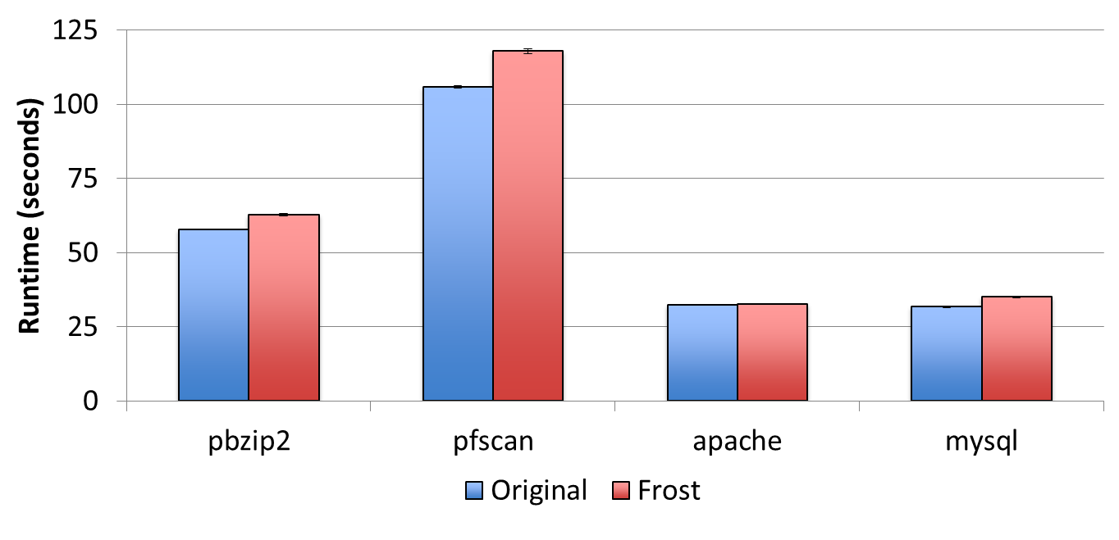
Frost: performance given spare cores
12%
8%
3%
11%
Overhead 3% to 12% given spare cores
Kaushik Veeraraghavan

Slide 29
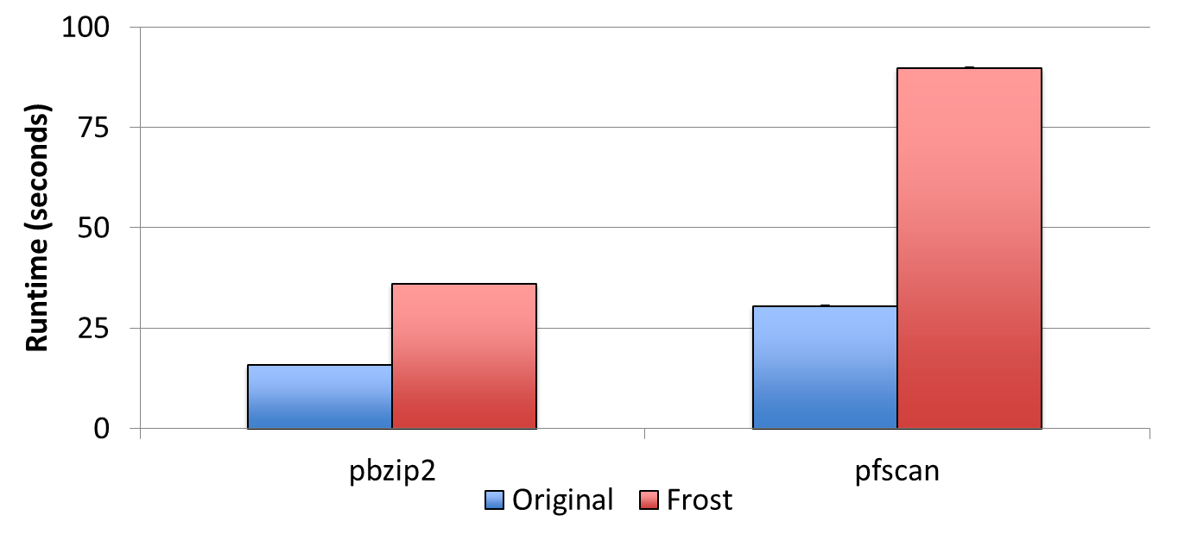
Frost: performance without spare cores
194%
127%
Overhead ≈200% for cpu-bound apps without spare cores
Kaushik Veeraraghavan

Slide 30
Frost summary
Two new ideas
  Outcome-based race detection
  Complementary schedules
Fast data race detection with high coverage
  3%—12% overhead, given spare cores
  ≈200% overhead, without spare cores
Survives all harmful data race bugs in our tests
Uses existing work, like DoublePlay and Speculator
Could be modified to use sampling for accerlating
Kaushik Veeraraghavan

Slide 31
however
Don’t guarantee theoretically all coverage
Will skip harmless datarace
Kaushik Veeraraghavan

Slide 32
Questions?
Kaushik Veeraraghavan

Slide 33
Thanks
Kaushik Veeraraghavan

