Slide 1

TinyOS 2.1
WenChao Jiang
Shanghai Jiaotong University-September 2011

Slide 2
What is TinyOS, NesC, Telosb
TinyOS is an operating system for low power, embedded, wireless device
  Provide multiple components for user
  Only install necessary components to chip
NesC is a programming language used in TinyOS
  Define components
  Wire components
Telosb is a typical device we used
  Provide radio, leds, sensors etc on chip

Slide 3
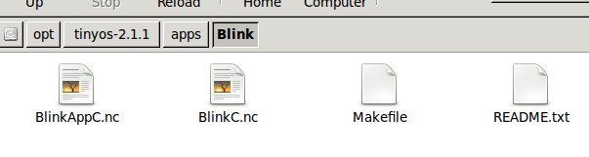
Apps/Blink
Blink is composed of two components: a module, called "BlinkC.nc", and a configuration, called "BlinkAppC.nc".
Convention used in the TinyOS source tree
File Name | File Type
Foo.nc | Interface
Foo.h | Header File
FooC.nc | Public Module
FooP.nc | Private Module
FooAppC.nc | Configuration

Slide 4
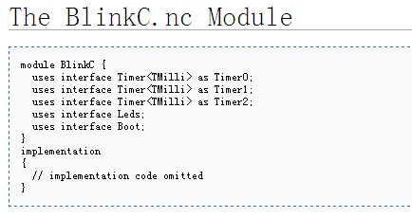
BlinkC.nc: a module
Run Blink demo
  Check mote : motelist
  Install program: make telosb install /dev/ttyUSB0
What do we need to let a led light bink several times?
  Led light
  Timer
  Program entrance

Slide 5
Component : Module
Modules are components that have variables and executable code
  Modules use interfaces
  Modules provide interfaces (not shown in the example)
Use interface
rename
Excutable code

Slide 6
BlinkAppC.nc: a configuration
Configurations are components that wire (->) other components together
  Some components system defined, some user defined
  A.B->C.B means: component A uses interface B, component C provides interface B
  Component A can call command of interface B, but must implement event of B
  Interface B implement its commands, provide event (like interrupt) for component who use it
  A.B->C.B is equivalent to: A.B->C, A->C.B, C<-A.B, C.B<-A
  B.B is a terrible but correct format. Remember former B is component, latter B is interface

Slide 7
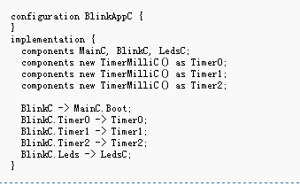
Component : configuration
User defined component
Configuration wires BlinkC with other components (TimerMilliC, MainC, LedsC)
BlinkC.Timer0->Timer0.Timer0 is correct but confusing
Terrible rename
A.B->C.B
provides
uses
Timer0
TimerMilliC (Timer0)m
Timer0
BlinkC
Leds
Leds
LedsCm
Boot
Boot
MainC

Slide 8
Singletons and Generics
Singleton components are unique: they exist in a global namespace
Generics are instantiated: each instantiation is a new, independent copy
configuration BlinkC { … }
implementation {
components new TimerC();
components BlinkC;
BlinkC.Timer -> TimerC;
}

Slide 9
Interfaces details
Collections of related functions
Define how components connect
Interfaces are bi-directional: for A->B
  Commands are from A to B (implemented by B)
  Events are from B to A (implemented by A)
Can have parameters (types)
interface Timer<tag> {
command void startOneShot(uint32_t period);
command void startPeriodic(uint32_t period);
event void fired();
}

Slide 10
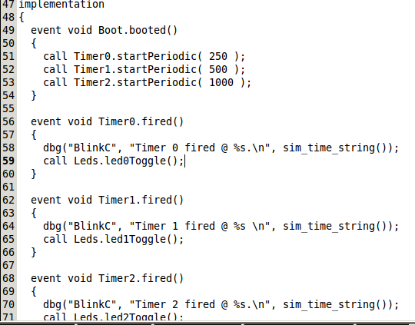
Implementation of BlinkC.nc
Use Boot
  Implement event booted
Use Timer
  Call command startPeriodic
  Implement event fired
  Use Leds
    Call command led0Toggle()

Slide 11
Exercise
Change all the leds to 1 blink/second
One led light blink 10 times then stop
  Hint: define a counter in implement {..}
  Parameter definition: int, bool….
  NesC can still use “for ”,”if” like C

Slide 12
Sender & Receiver
Sender and Receiver are two simple examples to show how radio communication, serial communication and sensor works
  Run the program by: make telosb install /dev/ttyUSB0
  One person runs Sender, another runs Receiver
  The Sender will broadcast temperature message
  The person runs Receiver can see received message by: java net.tinyos.tools.Listen –comm serial@/dev/ttyUSB0:telosb
  The received message is raw message, need further analysis

Slide 13
Sender
Use some new interfaces
  SplitControl, start a device if power on time is unnegligible compared with “Stdcontrol”
  AMSend, send message
  Packet, analysis packet
  Read, read sensor
module SenderC{
uses{
interface SplitControl as Control;
interface Leds;
interface Boot;
interface Timer<TMilli>;
interface AMSend;
interface Packet;
interface Read<uint16_t>;
}
}

Slide 14
Configuration of Sender
The interfaces are provided by ActiveMessageC and SensirionSht11C(temperature sensor)
configuration SenderAppC{
}
implementation{
.......
components SenderC as AppC;
components ActiveMessageC as AM;
components new SensirionSht11C() as Sht;
.......
AppC.Control -> AM.SplitControl;
AppC.AMSend ->AM.AMSend[AM_TEMPERATURE_MSG];
AppC.Packet -> AM.Packet;
AppC.Read -> Sht.Temperature;
}

Slide 15
Detail of SenderC.nc
Procedure of getting sensor message
  Call Read.read()
  Implement Read.readDone, put your own logic (eg. Check read success? Put message in a packet and send)
  Procedure of Sending a message
  Start device Control.start()
  Check if start success
  Define a packet, get the pointer of its PayLoad Packet.getPayload(&packet, user_message_size)
  Fill the payload
  Send the packet AMSend.send(destination, &packet, size)

Slide 16
Receiver
A receiver will receive the packet and transmit it to a PC through serial port, uses some new interface:
  Receive
  SplitControl as SerialControl
module ReceiverC {
uses {
interface Boot;
interface Leds;
interface AMSend;
interface Receive;
interface Packet;
interface SplitControl as RadioControl;
interface SplitControl as SerialControl;
}
}

Slide 17
Configuration of Receiver
The receive function comes from ActiveMessageC, serial transportation is supported by SerialActiveMessageC
configuration ReceiverAppC {}
implementation {
components ReceiverC as App;
components ActiveMessageC as Radio;
components SerialActiveMessageC as Serial;
.......
App.Packet -> Serial.Packet;
App.AMSend -> Serial.AMSend[AM_TEMPERATURE_MSG];
App.Receive -> Radio.Receive[AM_TEMPERATURE_MSG];
App.RadioControl -> Radio.SplitControl;
App.SerialControl -> Serial.SplitControl;
.......
}

Slide 18
Detail of ReceiveC.nc
An event Receive.receive appear after receiving a message.
  A message_t type variable will be filled with received packet
  Get the payload and analysis
  In this example, broadcast the received message to serial
event message_t* Receive.receive(message_t* msg, void* pl, uint8_t len) {
.......
temperature_msg_t* payload2 =
(temperature_msg_t *)call Packet.getPayload(&packet,
sizeof(temperature_msg_t));
.........
call AMSend.send
(AM_BROADCAST_ADDR, &packet, sizeof(temperature_msg_t))
........
}
Send in serial not radio

Slide 19
Exercise
Change broadcast of radio to a definite chip
  Hint1: change AM_BROADCAST_ADDR to a definite number (eg 2)
  Hint2: When install a program, give the chip an ID by:
  make telosb,2 install /dev/ttyUSB0
  Define a new message type, add a variable ux_uint16_t counter, will +1 each time after read a temperature. transmit both counter and temperature value
  Hint1: user message is defined in TempRadio.h
  Hint2: fill the counter just like temperature in Sender after getPayload, do the same in Receiver

Slide 20
Further Reading
Go through the website and its wiki:
  http://www.tinyos.net
“TinyOS Tutorial”, Chien-Liang Fok
  http://www.princeton.edu/~wolf/EECS579/imotes/tos_tutorial.pdf
“Programming TinyOS”, David Culler, Phil Levis
  University of California, Berkeley
NesC language reference manual
  http://www.tinyos.net/tinyos-2.x/doc/nesc/ref.pdf
Hardware manual:
  http://www.xbow.com/Support/Support_pdf_files/MPR-MIB_Series_Users_Manual.pdf

Slide 21
THE END

