Slide 2
Beginner to Maintainer: Journey of a student
Debabrata Panigrahi
NIT Rourkela
d.panigrahi.nitrkl@gmail.com

Slide 3

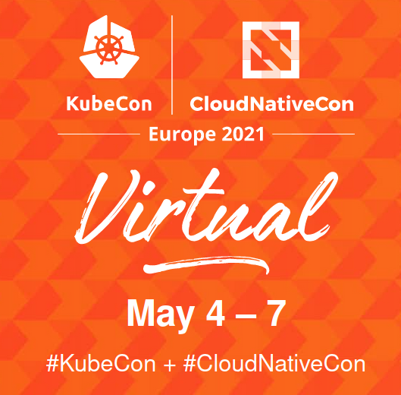
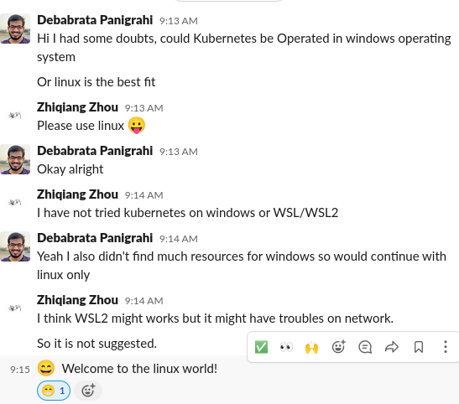

How it Started

Slide 4
Key Elements for a beginner:
Mentoring
Perseverance
Courage to ask the right questions in the community and get your doubts cleared

Slide 5
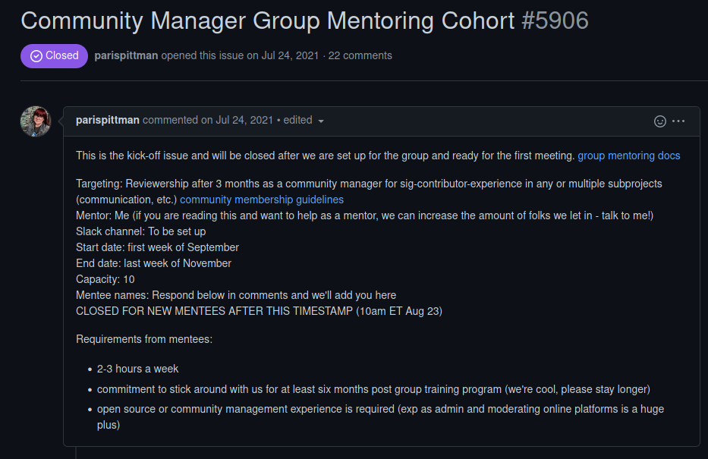
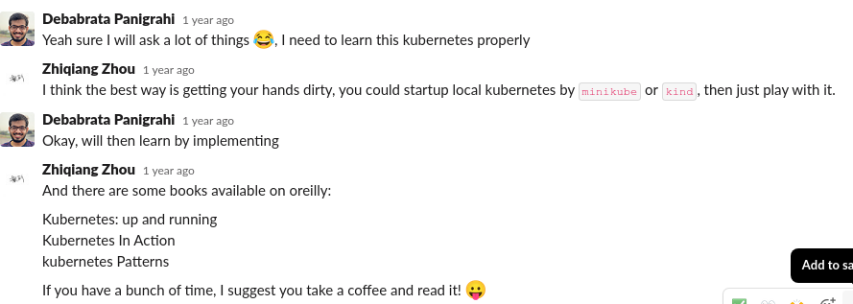
Mentoring Programs that I was part of:
LFX MENTORSHIP
Group Mentoring under SIG-Contribex

Slide 6
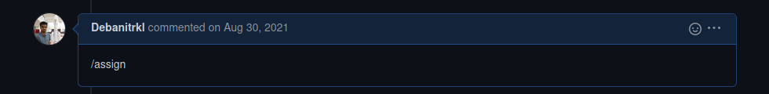
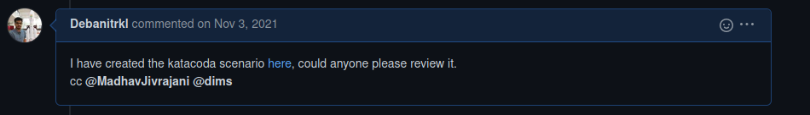
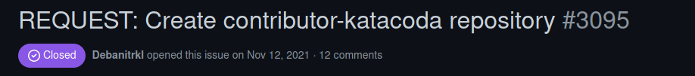
How Perseverance Helped me to become a approver

Slide 7
Things I learnt during this journey
Before assigning any issue try to understand the subject of the issue and look for the cues to help solve the issue, once confident then only assign it to yourself
Whenever stuck, do ask for help
Communication is the key
Don’t burnout
Be regular

Slide 8
The Community and people are important for any open source project to sustain, in this small period of contribution I have met a lot of co contributors who have inspired me to contribute more also made me a responsible contributor which is key to rise the contributor ladder.

Slide 9
No longer is open source the alternative. It is the mainstream.
Thank You

