Slide 1
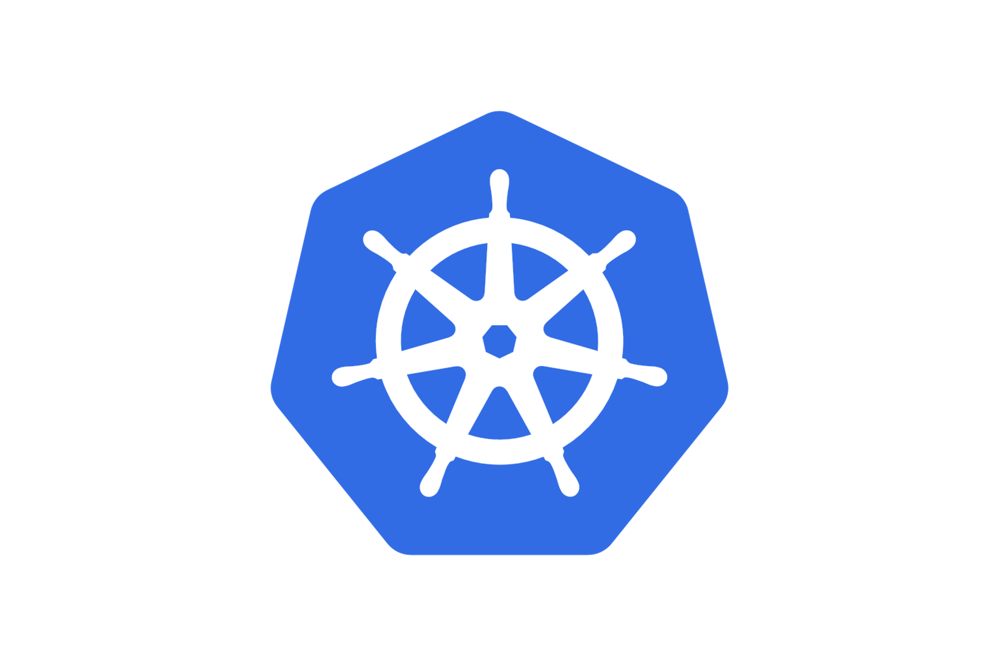


Secure Multi User HPC jobs in Kubernetes with Kyverno
Trey Dockendorf
Ohio Supercomputer Center

Slide 2
Kubernetes HPC Workload
Lightweight interactive workloads
Minimal CPU requirements compared to traditional HPC workloads
Exclusively Jupyter and Rstudio (so far)
Serving numerous classrooms used with distance learning as well as general OSC user community

Slide 3
Overview of Technologies
Open OnDemand
Web interface to make HPC access easier
Provides a way for sites to make things like interactive jobs easy to deploy and use
Web processes run as logged in HPC user
Supports multiple resource manages: SLURM, Torque, Kubernetes
Kyverno
Kubernetes policy engine
Deploy policies using Kubernetes resources, ie standard Kubernetes YAML resources

Slide 4
Challenges
Treat Kubernetes "jobs" similar to traditional HPC jobs and allow usage of SLURM or Kubernetes from same OnDemand app code
Kubernetes pods can run as root and on systems with shared filesystems like GPFS, this can be very dangerous.
How to ensure a user running a pod is doing so using their UID/GIDs that ensures operations like filesystem access are taking place as that user

Slide 5
Kubernetes Design Patterns
All user pods run in user specific namespace of pattern user-$USER which is bootstrapped by OnDemand at login
RBAC for user-$USER namespaces limits user operations to just the things needed to run OnDemand jobs
Kubernetes authenticates with Keycloak OIDC IDP and the OIDC tokens for OnDemand are allowed to be used for Kubernetes via OAuth2 audience
k8-ldap-configmap – Map LDAP data to ConfigMaps for use by Kyverno

Slide 6
Solution to security - Kyverno
Policies to ensure UID/GID and supplemental groups match user’s LDAP record
Restrict hostPath mount locations to the paths they need such as NFS $HOME, GPFS and Slurm configurations and sockets
Disallow any form of privilege escalation or elevated privileges
Enforce max resource requests and max runtime of pods

Slide 7
Kyverno selecting resources
Select user namespaces
match:
any:
- resources:
kinds:
- Pod
namespaces:
- "user-?*"
Restrict to CREATE/UPDATE to avoid LDAP data changing and unable to delete
preconditions:
- key: "{{ request.operation }}"
operator: In
value: ["CREATE","UPDATE"]

Slide 8
Kyverno LDAP data
Pull ConfigMap data into context of policy
context:
- name: uidMap
configMap:
name: user-uid-map
namespace: k8-ldap-configmap

Slide 9
Kyverno Validate UID/GID
anyPattern:
- spec:
securityContext:
runAsUser: "{{ uidMap.data.\"{{ request.object.metadata.namespace }}\" }}"
=(initContainers):
- =(securityContext):
=(runAsUser): "{{ uidMap.data.\"{{ request.object.metadata.namespace }}\" }}"
containers:
- =(securityContext):
=(runAsUser): "{{ uidMap.data.\"{{ request.object.metadata.namespace }}\" }}"
- spec:
=(initContainers):
- securityContext:
runAsUser: "{{ uidMap.data.\"{{ request.object.metadata.namespace }}\" }}"
containers:
- securityContext:
runAsUser: "{{ uidMap.data.\"{{ request.object.metadata.namespace }}\" }}"
ConfigMap data
user-tdockendorf: "20821"

Slide 10
Kyverno Validate Supplemental Groups
deny:
conditions:
- key: "{{ request.object.spec.securityContext.supplementalGroups[*].to_string(@) }}"
operator: NotIn
value: "{{ userGIDMap.data.\"{{ request.object.metadata.namespace }}\" }}"
ConfigMap data
user-tdockendorf: '["1021","2399","3241","3285","3309","4391","4496","4547","4548","5087","5301","5325"]'

Slide 11
Additional Kyverno security
Ensure pods cannot escalate privileges or access host filesystems outside of filesystems needed for OnDemand
Most policies came from kyverno-policies Helm chart
Example restrict host paths
pattern:
spec:
=(volumes):
- =(hostPath):
path: "/etc/slurm | /var/run/munge/munge.socket.2 | /users/?* | /fs/?*"

Slide 12
Resources
Upstream:
https://github.com/kyverno/policies/
https://github.com/kyverno/kyverno/tree/main/charts/kyverno-policies
OSC Policies
https://github.com/OSC/osc-helm-charts/tree/main/charts/kyverno-policies
k8-ldap-configmap
https://github.com/OSC/k8-ldap-configmap

