Slide 1

Trimaran: Real Load Aware Scheduling in Kubernetes
Abdul Qadeer (Software Engineer, PayPal)
Chen Wang (Research Scientist, IBM)
Notes:
Greeting: Good afternoon
Self-introduction followed by introducing Chen
We are going to present about load aware scheduling in Kubernetes

Slide 2
Agenda
Background & Problem
Trimaran Design
TargetLoadPacking Plugin
Trimaran at PayPal
LoadVariationRiskBalancing Plugin
Demo
Trimaran Challenges
Lessons
Future Work
Acknowledgements
Notes:
This is the agenda for today, we will go over the motivation and problem, followed by Trimaran architecture design along with the plugins it provides. Then we have a demo, the challenges Trimaran faces and how we solve them, followed by good practices. Let's get started without further ado.

Slide 3
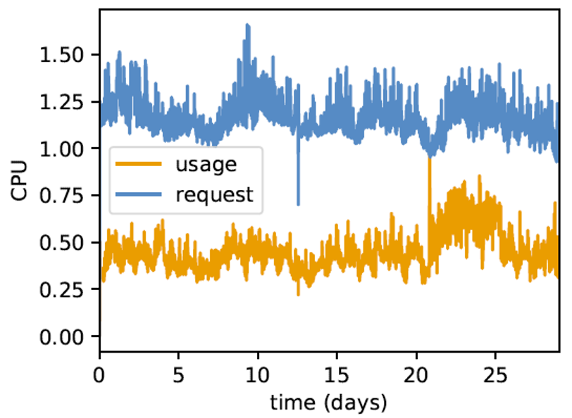
Background & Problem
Kubernetes
Default scheduler schedules pods based on their requests and what is available on nodes.
Developers
They are known to grossly over-provision resources for their containers to avoid under-provisioning risks (pod evictions due to OOM and performance issues, etc.)
Benchmarking to get accurate requests?
Cumbersome
May not be feasible: estimating real load is hard.
Allocation based scheduling can lead to underutilized nodes (CPU, Memory…) and fragmentation of cores.
29 day Google trace
Source: [TN Le, Z Liu] Flex: Closing the Gaps between Usage and Allocation
Notes:
Kubernetes provides a declarative resource model for pods. What I mean by declarative resource model is that resource usage need to be defined in container spec before you run it. The core components (scheduler and kubelet) honor this to behave consistently and satisfy QoS guarantees.
Developers tend to over provision the resources with this model to avoid penalties of evictions or CPU throttling. One way to solve this problem of declarative model is to benchmark applications with real production load to find out usage, however it is cumbersome and estimating real load is a hard problem.
With that bg, the main problem we are trying to solve in Kubernetes is that the default allocation based scheduling can.....cores. The graph you see is a trace from a Google cluster showing the gap between resource allocation and actual usage, which is about 40% of requests implying large underprovisioning.

Slide 4
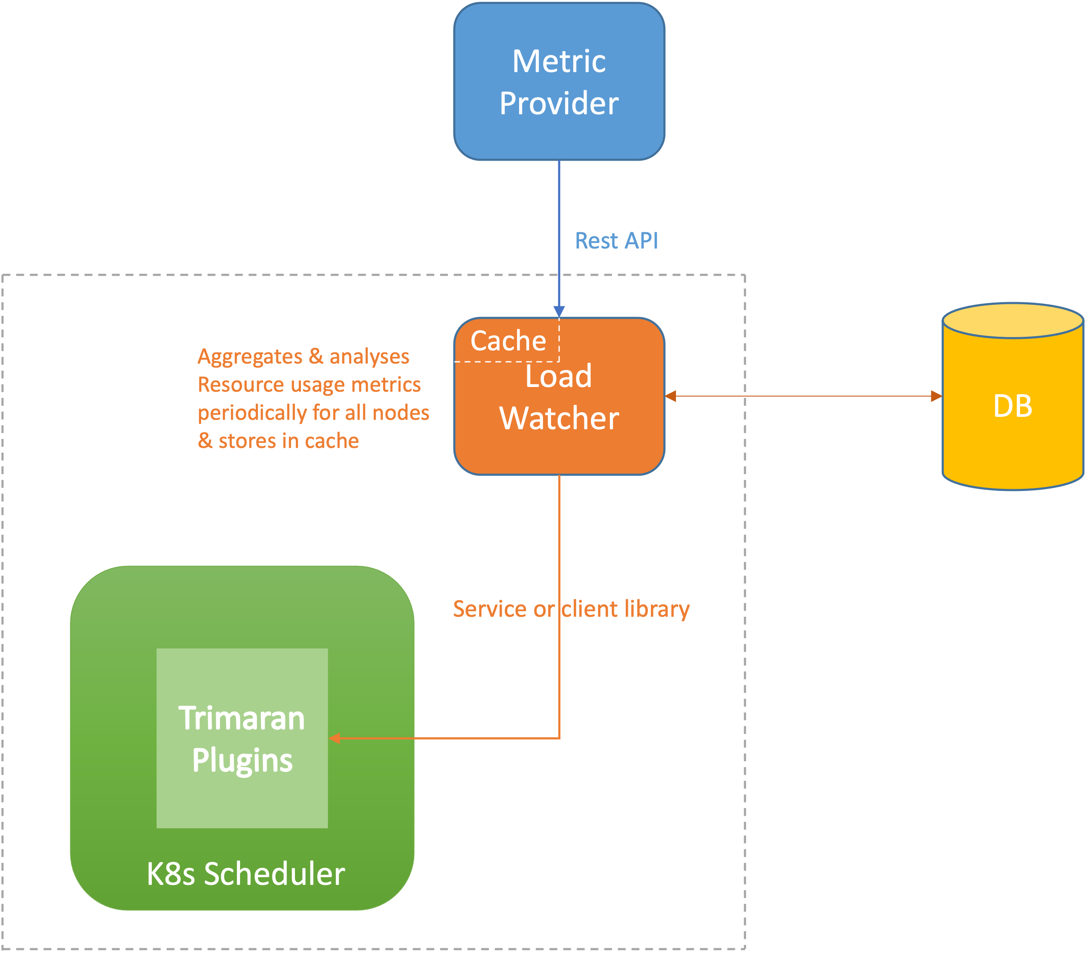
Trimaran Design - Architecture
Leverage Kubernetes scheduler framework
Plug in Score extension point
In: Set of nodes
Out: Set of node scores
Load watcher:
Retrieve real load metrics from various metric providers, e.g., metric server, Splunk, Prometheus.
Aggregate & analyze resource usage metrics periodically for all nodes and store in cache.
Can be used as a library or service.
Notes:
Around the time we started working on this problem, Kubernetes scheduler framework was in beta and was moving towards becoming stable, so we decided to leverage it. It provides flexibility to extend the scheduler in different phases of scheduling cycle; Trimaran plugins do so in Score extension point.
There is an upcoming talk by sig-scheduling folks with a deep dive in scheduling if you are interested. For a scoring plugin, you have a set of nodes as input to the plugin, and output is a set of corresponding node scores based on algorithm. In the diagram, you can see that the Trimaran plugins run as part of the K8s scheduler process.
The next major component in Trimaran design is the load watcher, which is a clusterwide aggregator of metrics, backed by a metric provider. The watcher maintains a cache for fast metric lookups by Trimaran plugins in scheduling cycle. The load watcher also stores its cache in a DB for fault tolerance and fast recovery. More on the load watcher in the next slide.

Slide 5
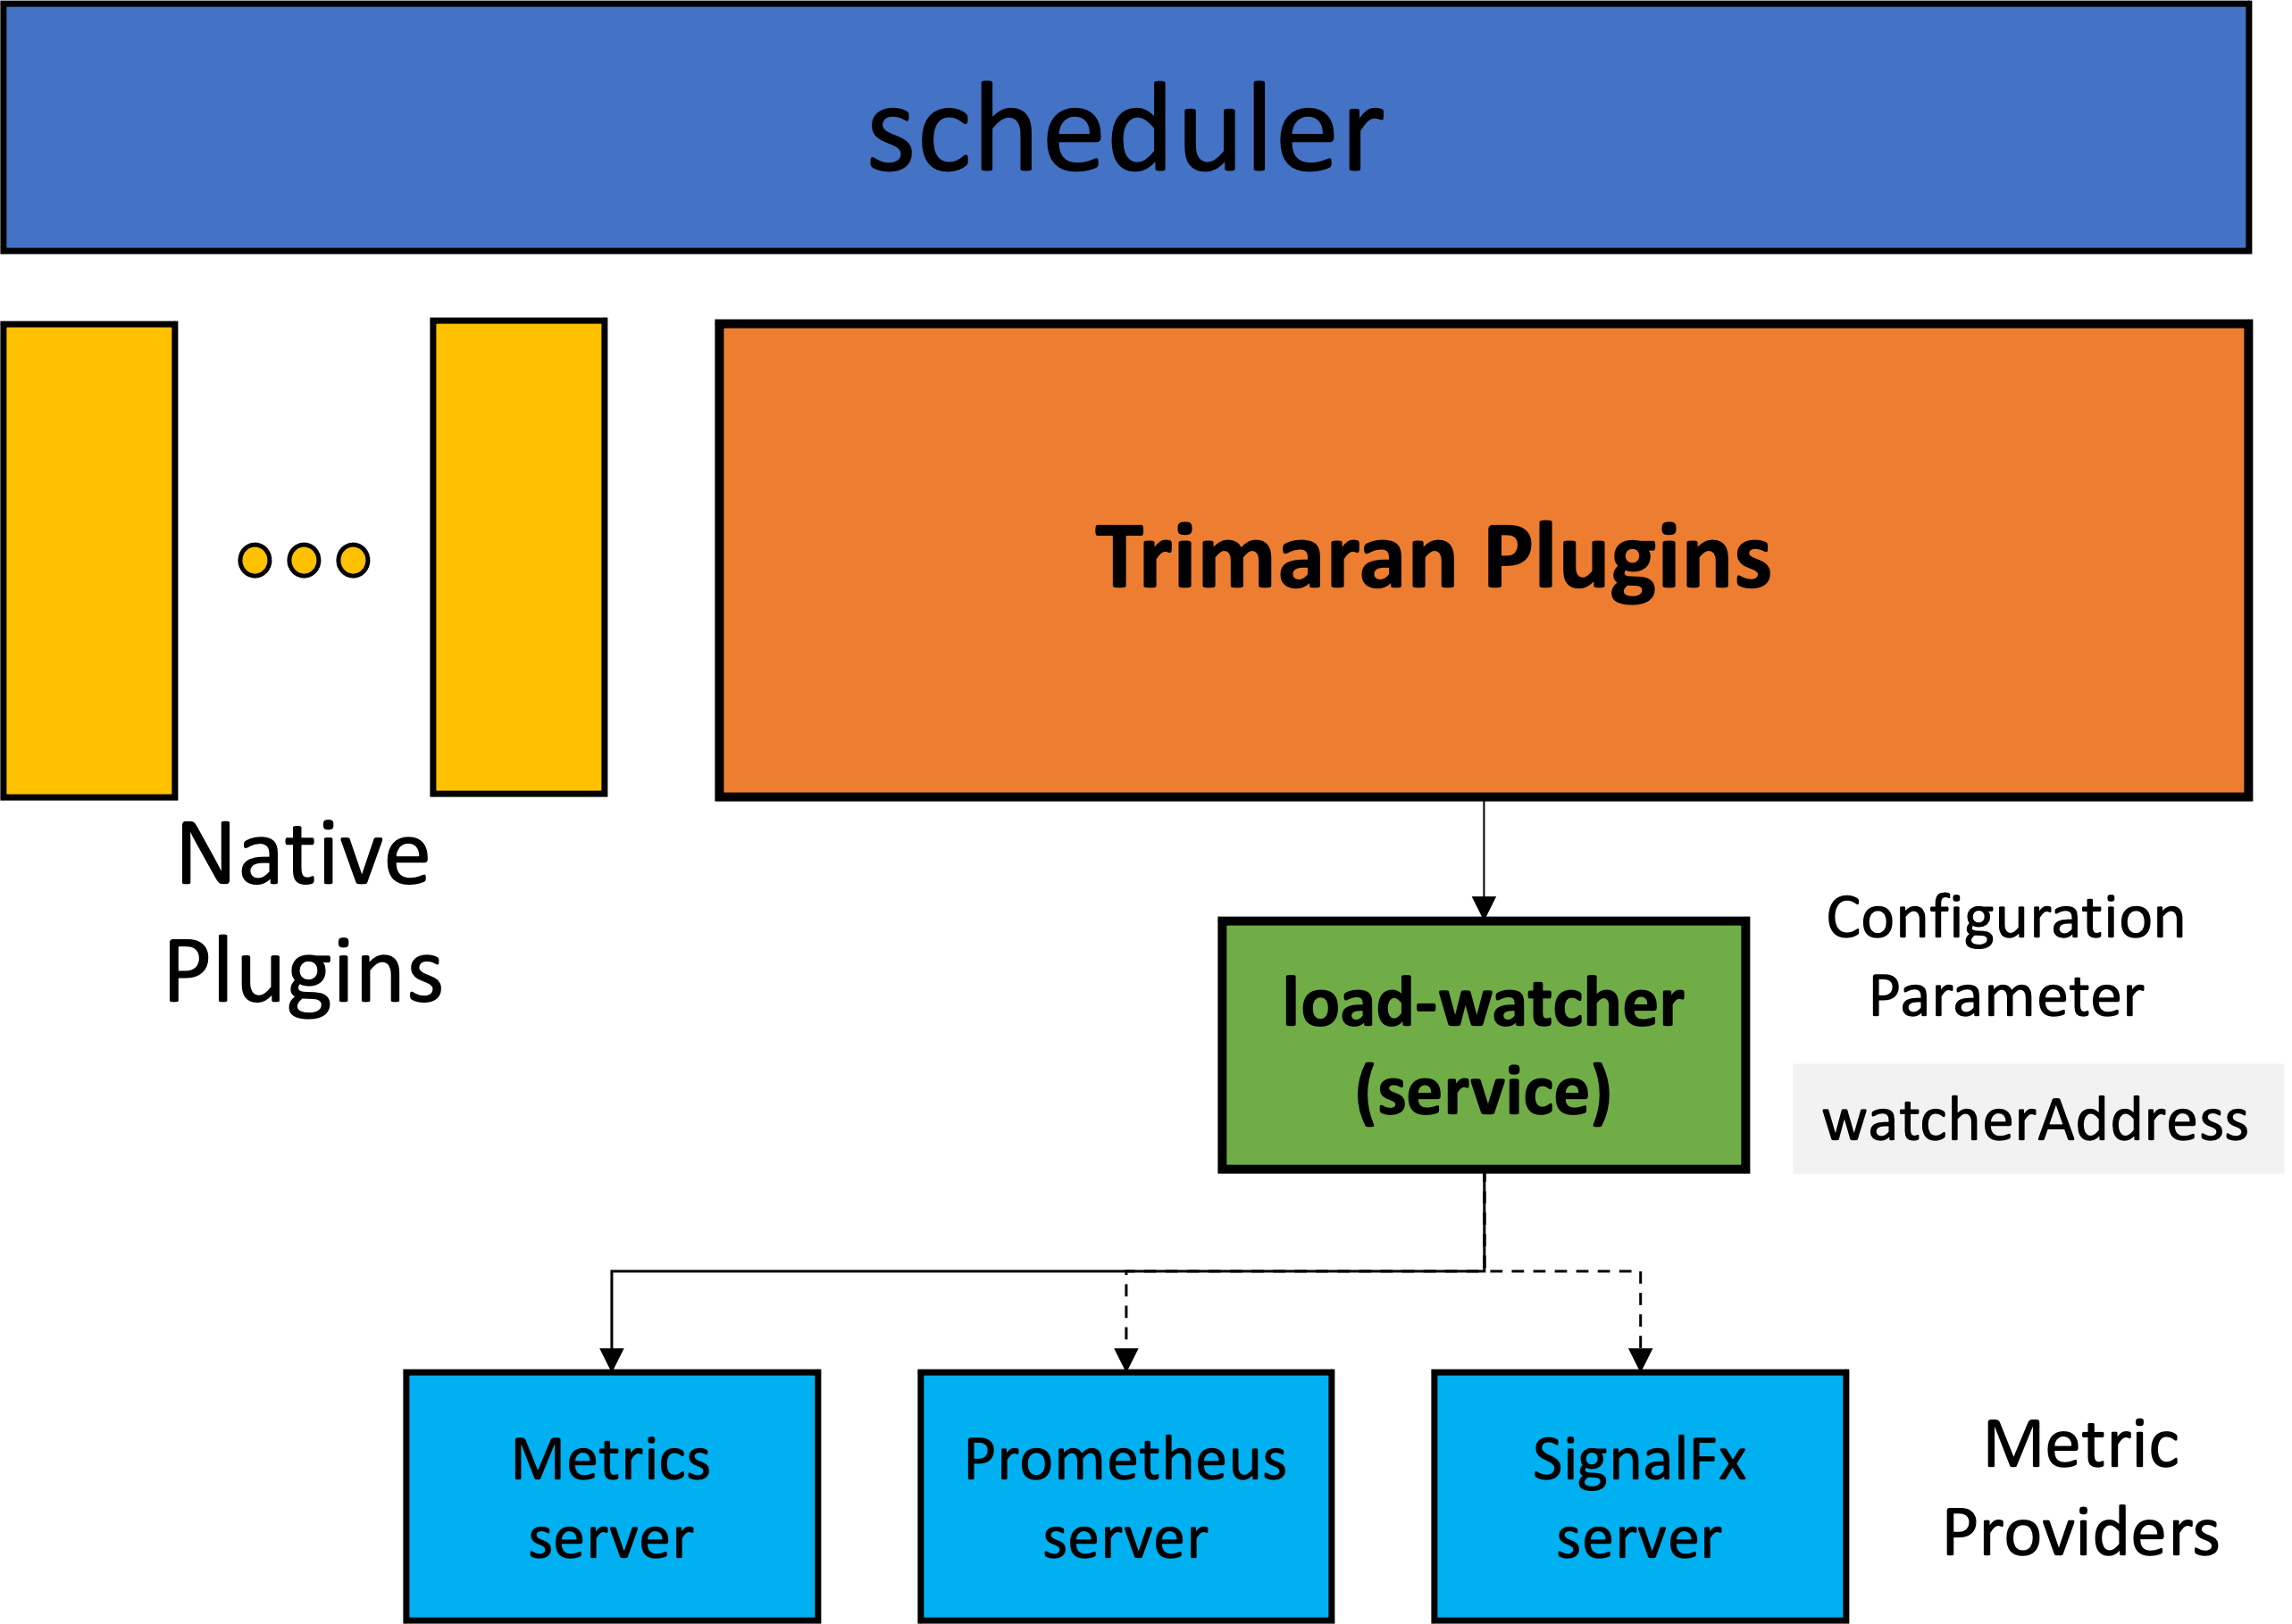
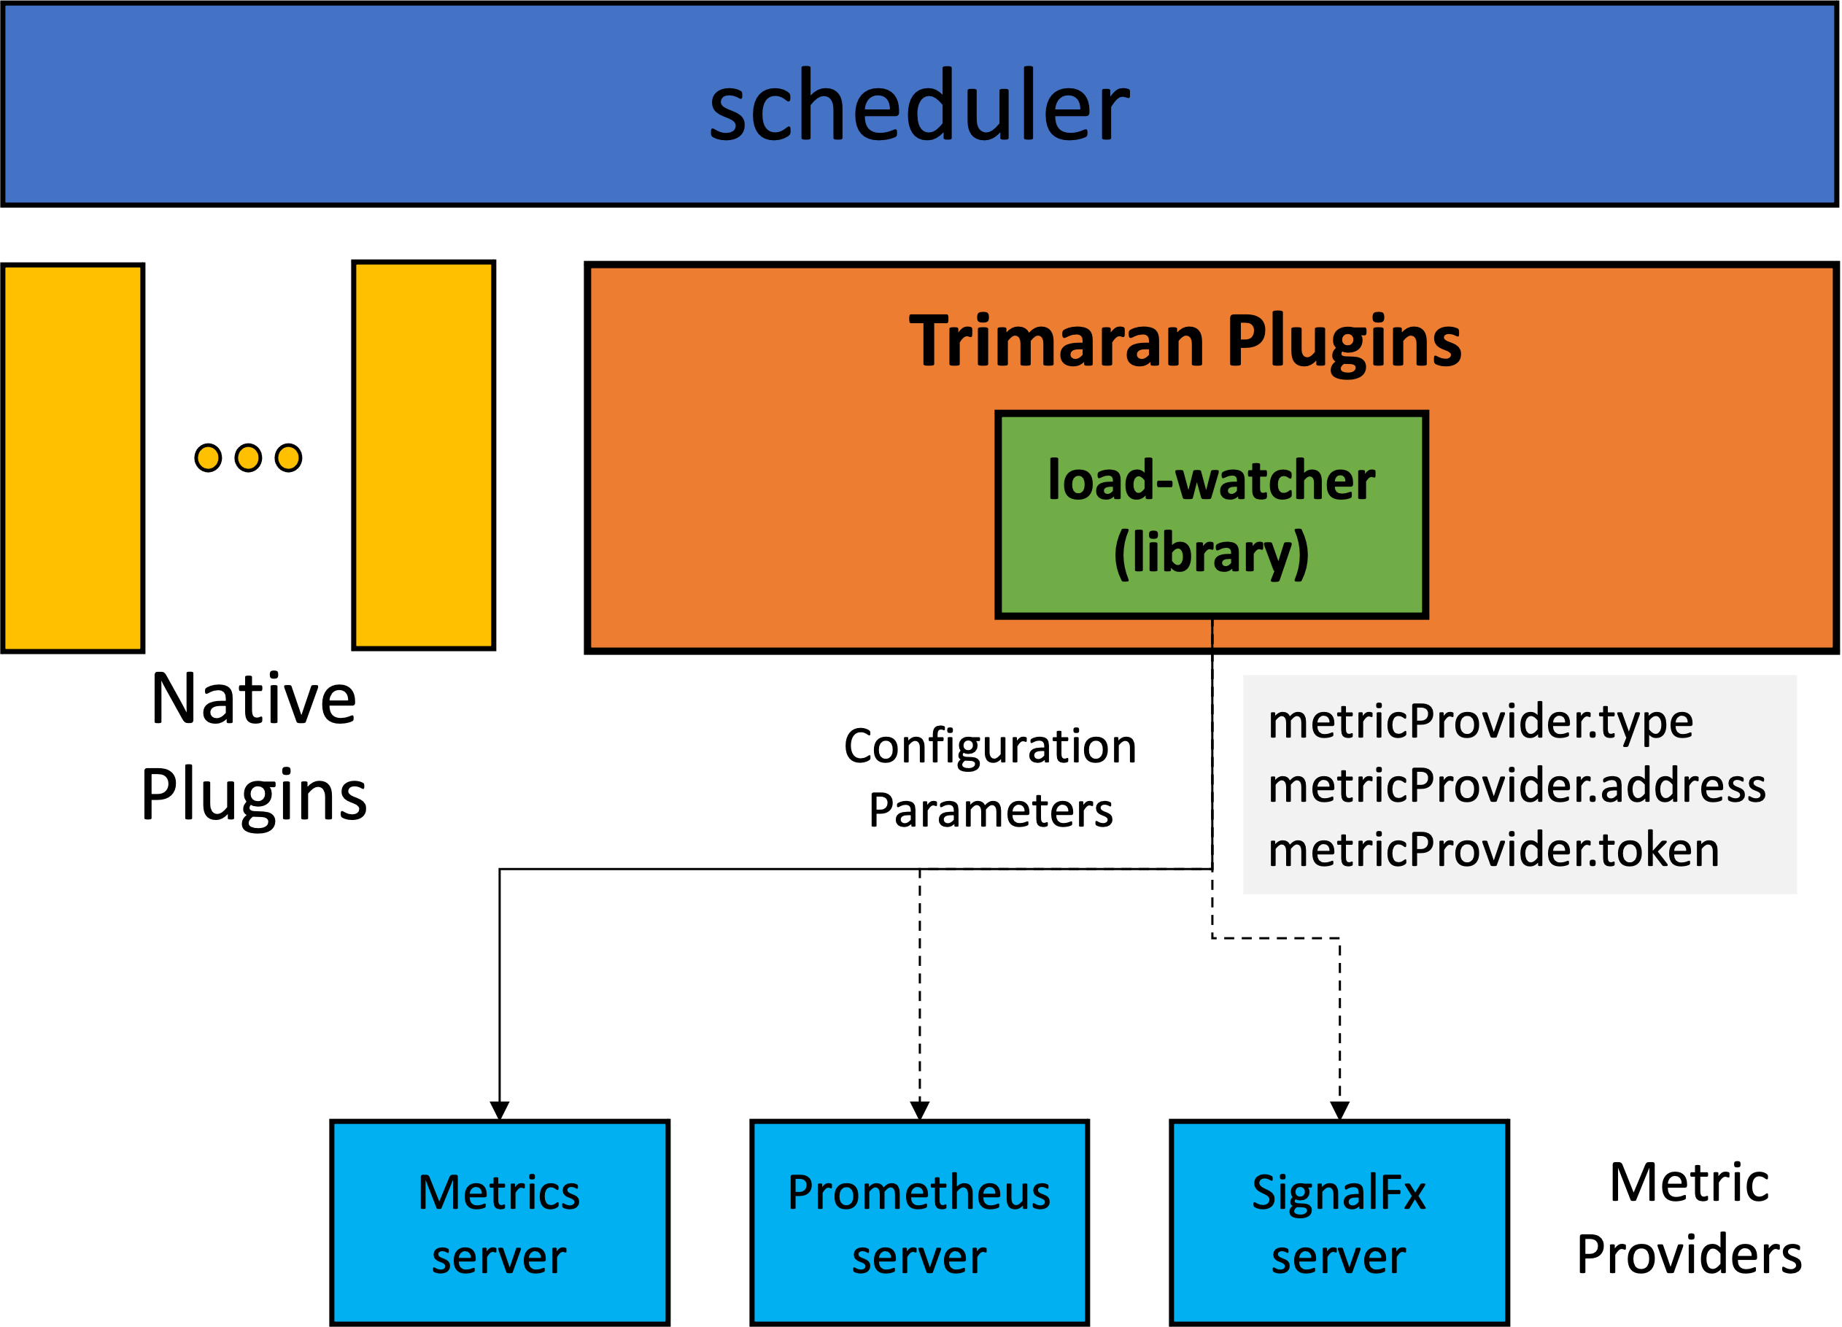
Trimaran Design - LoadWatcher
Data stored in Watcher Cache:
{
"window": {
"duration": "15m",
"start": 1556984522,
"end": 1556985422
},
“name” : “cpu.utilization”,
“type” : “CPU”,
“operator” : “AVG”,
“provider” : “InfluxDB” ….
}
Separation of failure component
API call latency can be minimized with local load-watcher container
Scales separately from k8s scheduler for resources
No API call over network
Simple deployment
Notes:
Load watcher can thought of as a wrapper unifying metrics from various providers into a common format, recognized by the Trimaran plugins. Currently supported ones are Prometheus, SignalFx by Splunk and native K8s metrics provider. It can be extended to support any other metrics provider. Load watcher has an option to be used as a service or a library. Each has their pros and cons, it is up to users to choose what works best for them.
For example if you use it as a service, you have separation of failure components.....
We use it as a service in PayPal, RedHat has it integrated as a client library in their product offering open shift with Kubernetes.
On the right hand side you see a sample payload of data in watcher cache. We define windows of metrics ranging from 15m to 5m, and use them in different scenarios. Also some added metadata to enrich it.

Slide 6
TargetLoadPacking Plugin
Objectives:
High utilization on all running nodes
All running nodes have around X% utilization.
Maintain safe margin
No nodes exceed X% utilization when there are nodes with < X%.
Implication
Bin Packing
When running nodes have < X% CPU.
Nodes with 0% utilization can be powered off
Spreading
When all nodes have >= X% (hot nodes) CPU.
Notes:
Coming to the meat of the design, there are two main objectives we had in mind when we designed TargetLoadPacking plugin.
The first one is that we want to avoid under provisioning of nodes and have high utilization on all running nodes. which implies we keep packing pods on nodes when they have less than X% utilization.
The second objective is to maintain a safe margin for usage spikes on packed nodes and spread the new pods to nodes which result in higher safety.

Slide 7
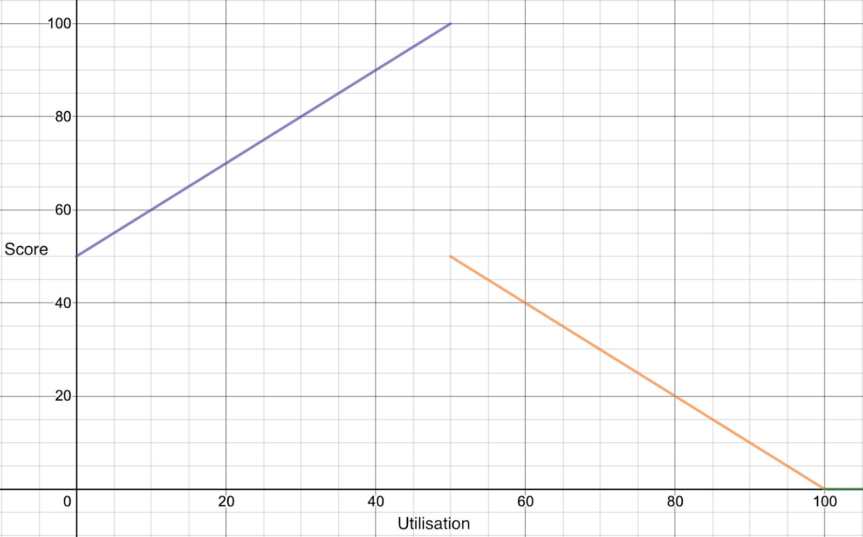
TargetLoadPacking Plugin
Algorithm
Let X be the target utilization %. Get the utilization of the current node to be scored. Call it A.
Calculate the current pod's total CPU requests and overhead. Call it B.
Calculate the expected utilization if the pod is scheduled under this node by adding i.e. U = A + B.
If U <= X, return (100 - X)U/X + X as the score
If X < U <= 100%, return 50(100 - U)/(100 - X) as the score
If U > 100%, return 0
X = 50
Notes:
Here's a slightly technical slide, I will try simplifying it.
What you see on the right is a graph of expected scores with given utilization values, when your target utilization is 50% on each node. The range of score as required by scheduler framework is between 0-100, favors nodes whose scores are high.
As the utilization increases from 0->50, we favor the nodes by scoring them high. At 50%, you see a discontinuous function and a drop, signifying penalties for hot nodes.
Another way to put it is that the algorithm switches from best fit variant of bin packing to least fit variant as the utilization increases.

Slide 8
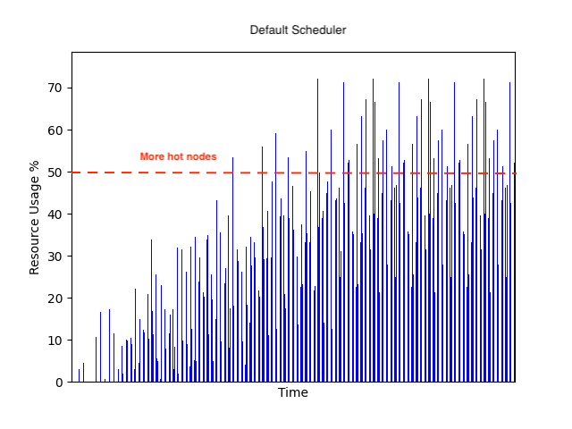
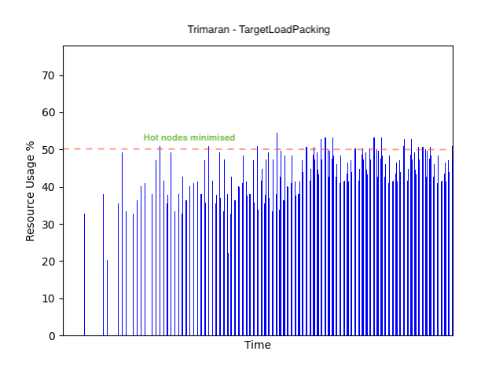
TargetLoadPacking Plugin
Area under threshold mark is higher for TargetLoadPacking, implying better capacity utilization across cluster
Lesser hot nodes over time with TargetLoadPacking
Lesser number of fragmented cores with TargetLoadPacking
Notes:
This is an experiment done with 100 nodes and 400 pods with burstable QoS I.e. limits larger than requests and varied utilizations.
The graph on the left is for native scheduler and the on one the right is for Trimaran.
There are multiple results you can understand from comparing these graphs.

Slide 9
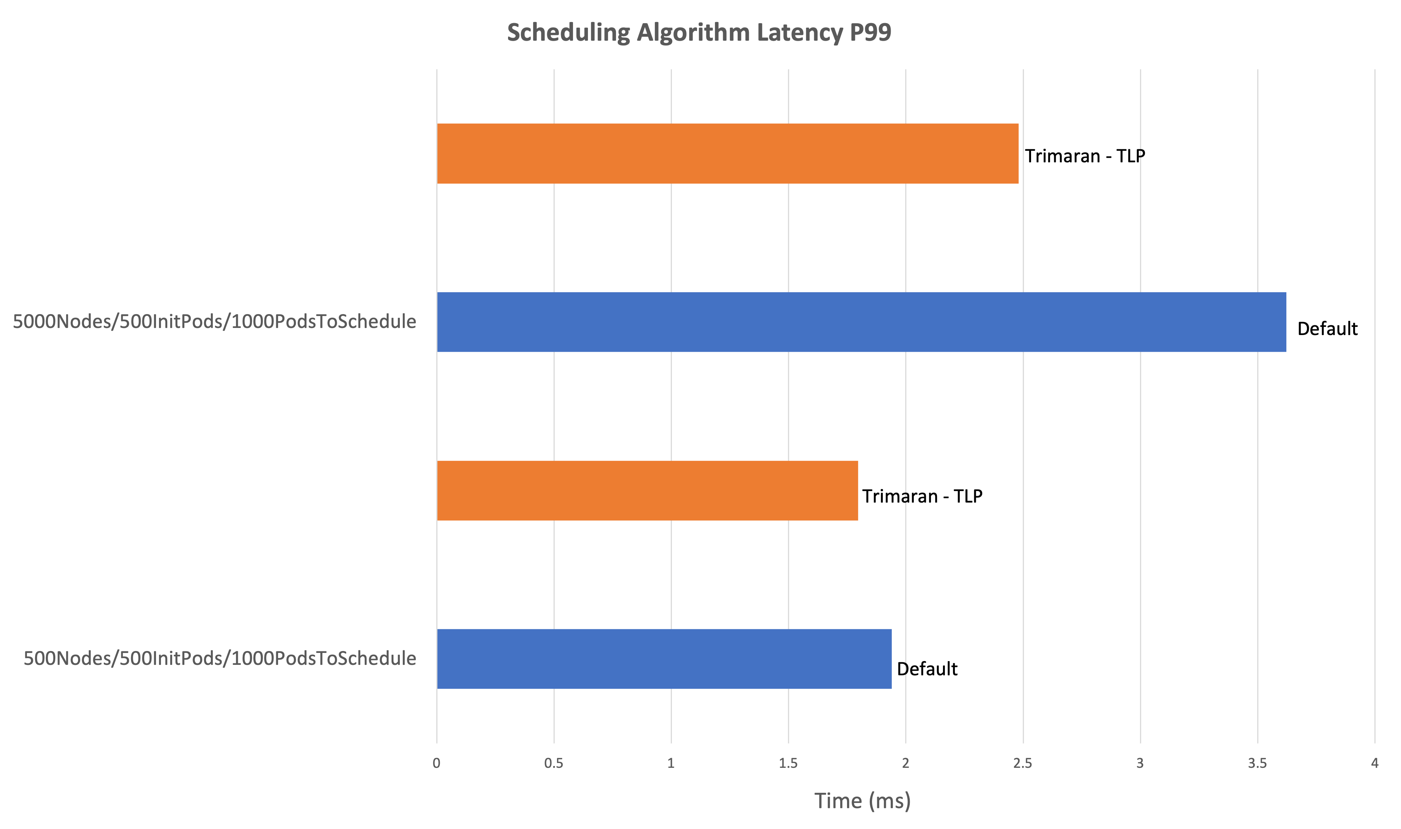
TargetLoadPacking Performance
Notes:
The next important question for production, how well does Trimaran perform?
These tests were done in forked scheduler-perf tests from main K8s repo, with some modifications to include out of tree plugins. scheduler-perf tests is what Kubernetes uses for publishing its scheduler metrics with each build to check and verify SLOs.
We did two experiments, one with 5000 nodes 1000 pods and other with ….You can see that Trimaran beats default scheduler in P99 algorithm latency in both of them.
Before I explain why Trimaran performs better, I would like to mention that the default scheduler comes with a set of plugins. Trimaran replaces two of those plugins with one, so you essentially have one less plugin. So faster scoring overall. Secondly, It also has some optimizations to use fast json encoder/decoders, and background caching of load watcher metrics.

Slide 10
Trimaran at PayPal
Infrastructure team has to assure the efficiency of the fleet while keeping safety in mind
Requirements:
Utilization of any node should not exceed a threshold.
Replicas of an application should be spread across topologies.
Flex down nodes when utilization is 0%
TargetLoadPacking + PodTopologySpread
Actively tested for deployment in QA environment, followed by prod for PayPal’s core infrastructure.
Notes:
The main business use case for us, working in infrastructure team is to assure efficiency of the fleet. PayPal relying on cloud, we also want to make sure we minimize costs. Technically, this translates to the objectives I explained about target load packing. One other rquirement we didn't talk about is spreading replicas of an application across failure zones which could be nodes, pools zones etc.
We utilize both TLP and PTS to achieve thos re

Slide 11
LoadVariationRiskBalancing Plugin
Objectives:
Account usage variations on nodes when scheduling pods
Balancing the risk from bursty load
​
Implication:
The scheduler can balance the risk of having pod evictions or performance issues on all nodes.​
Some nodes have on average low utilization but will evict pods or have performance issues due to CPU throttling at peak usage.
Notes:
Hi, next, I will introduce the LoadVariationRiskBalancing Plugin that is designed to solve the issue we observed in our production clusters.
We observe that nodes will have different load variations though their average usage are similar.
And it is important to account usage variations on nodes when scheduling pods.
Namely the higher variation of workload you have on a node, the higher risk you will have to have pod evictions or performance issues.
So, this plugin is designed to balance such a risk.
(40s)

Slide 12
LoadVariationRiskBalancing Plugin
Variations of utilization on nodes matter!
Resource Amount (RAM, CPU, …)
Resource Amount (RAM, CPU, …)
Can fit on both nodes
Total Capacity
Total Capacity
Free for scheduling
New Workload
Total Requested
Total Requested
Max Actual Utilization
Max Actual Utilization
Average Actual Utilization
Average Actual Utilization
Min Actual Utilization
Min Actual Utilization
Time
Time
Cluster Node 1
Cluster Node 2
On which node do we schedule this workload?
Same capacity, Same requested resources
=> no preference for the default K8s scheduler
Notes:
Now let’s look at an example.
Suppose we have two nodes, and each has a capacity of 8 CPUs, and only 5 are requested.
And the new pod’s request is less than 3 CPUs.
In that case, the two nodes will be deemed equivalent (assuming everything else is identical) by the default scheduler.
And, then we would like to see their actual resource utilization.
And if you look at the actual average utilization, you will find out that they are also equally favorable.
The scoring algorithm that only considers the average utilization cannot differentiate these two nodes and may randomly select one of those, as shown in the above figure.
But from the variations, we know that the peak usage on node 2 is apparently higher than the peak usage on node 1.
So if a pod can fit in both nodes, in order to minimize the risk of over committing or throttling, it is safer to choose node 1.
(1m5s)

Slide 13
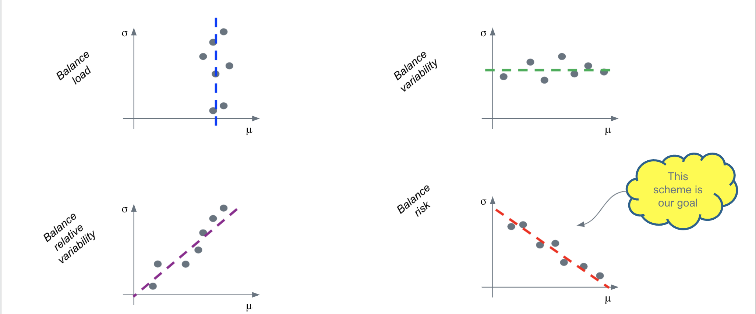
LoadVariationRiskBalancing Plugin
What to balance in a cluster?
A point represents the loading of a node
Collection of points represents all nodes in the cluster
Notes:
To better understand how to balance based on average, denoted as mu
And the standard deviation, denoted as sigma.
Let’s draw all nodes’ mu and sigma in a mu-sigma plot, where the x-axis is mu and y-axis is sigma.
So when your scheduler tries to balance the average utilization on all nodes, the plot will look like the upper left one, which is a vertical line.
Then, if you would like to make sure all nodes have the same variability regardless of their average load, then the plot looks like the upper right, which is a horizontal line.
For the lower left one, we balance the relative variability between average and standard deviation.
This may not have a good practical use case but help us understand the last one.
Namely the lower right plot, that shows when we higher average load, we hope the node’s variation would be low so the risk of exceeding the total capacity can be managed.
That is to say, the higher variation we have, the lower usage we want on a node, and the higher average usage we have, the lower variation we want.
(1m10s)

Slide 14
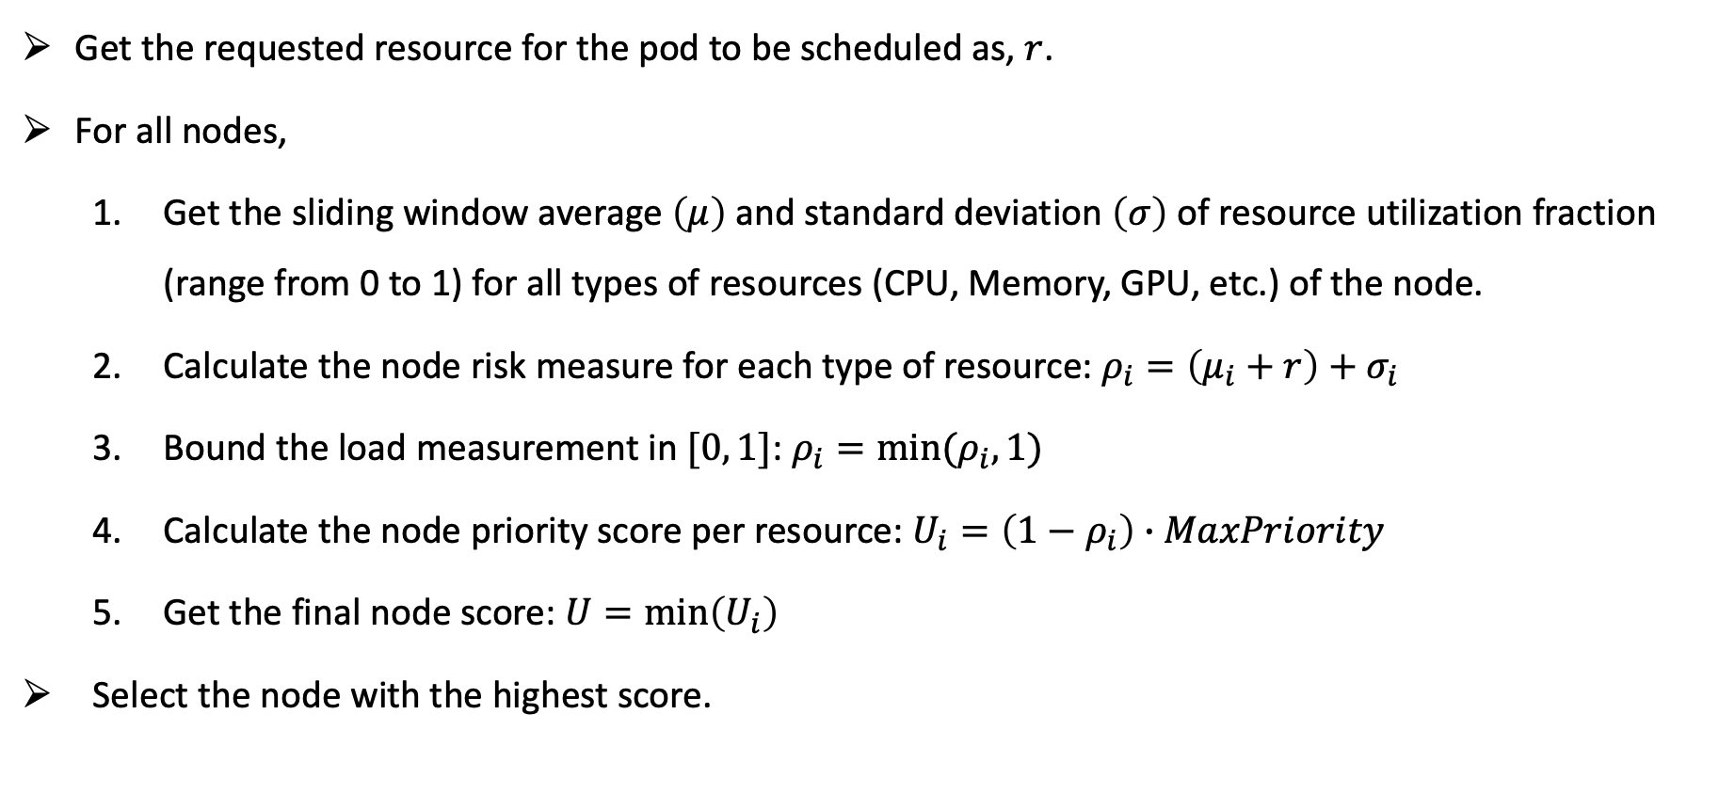
LoadVariationRiskBalancing Plugin
Get the requested resource for the pod to be scheduled as, $r$.
For all nodes,
Get the sliding window average $\left(μ\right)$ and standard deviation $\left(σ\right)$ of resource utilization fraction (range from 0 to 1) for all types of resources (CPU, Memory, GPU, etc.) of the node.
Calculate the node risk measure for each type of resource: $ρ_{i}=\left(μ_{i}+r\right)+σ_{i}$
Bound the load measurement in $[0, 1]$: $ρ_{i}=min(ρ_{i}, 1)$
Calculate the node priority score per resource: $U_{i}=\left(1−ρ_{i}\right)∙MaxPriority$
Get the final node score: $U=min\left(U_{i}\right)$
Select the node with the highest score.
Notes:
Here we show the details of the algorithm.
We first get the requested resource for the pod to be scheduled, denoted as r
Then, we run our scoring plugin to score all nodes.
For each node, we first get the sliding window average and standard deviation for all types of resources.
We use the average node utilization + the pod request to estimate the future average usage in the node, and use the standard deviation observed before as the future prediction.
Thus, we can estimate the risk of overloading a node. Of course, we need a way to normalize all mu + r and sigma separately into the scale of [0, 1].
And then we make sure the risk that combined both the average and standard deviation is also bounded within [0, 1]
Then we can use the risk to score nodes, the higher risk you have, the lower score you would get.
And lastly, to always consider the bottleneck resource, we will compute score for each type of resources independently and then get the minimum score across resource types as the node score.
The scheduler running the plugin will then choose a node with the highest score to schedule the pods.

Slide 15
Trimaran Challenges
Metrics/load-watcher a major dependency for proper functioning of plugins
Unavailability of metrics:
Incorrect metrics:
Misconfiguration
Bugs
Anomalies
Type | Solution
Short inter-arrival times of pods | Predict utilization based on QoS
Failure of metric reporting agent | Last good utilization window + Prediction
Metric provider failure | Fall back to metric server/allocation-based scheduling (not yet implemented)
Addition of new nodes | Easy with no pods, predict otherwise
Notes:
If we have a bursty arrival of pods, we do not have those pods’ utilization metrics.
In this case the metrics would be missing for a duration of time.
We can use previous utilization window (not older than 5 minutes) with the predicted utilization of recent scheduled pods to predict the actual utilization on a node.
The prediction is simple,
For pods with requests and limits, we count with limits
For pods with only requests, we use a multiplier to add a safe margin for the limit, the multiplier is configurable.
For pods with best efforts, we assume a threshold of minimum usage which is configurable.
Both the multiplier and the threshold can be configured in the plugin.
If one metric provider is not accessible, we fall back to the metric server.
If a new node is just started and we do not have metrics to the node, we assume the utilization is 0 when no pods are running. And if pods are scheduled to the node, we do prediction.
Because metrics are critical to our service, you might misconfigure the provider and get the incorrect metrics.
In the future, we plan to use multiple metric sources and do cross validation in load-watcher.

Slide 16
Lessons
Do not overload your metric providers.
Always have a fallback solution
Trimaran falls back to the allocation-based scheduling (not yet implemented) when metrics are not available.
Do not use conflicted plugins together
TargetLoadPacking may conflict with LoadVariationRiskBalancing.
Trimaran plugins may conflict with NodeResourcesLeastAllocated & NodeResourcesBalancedAllocation
Choose an appropriate interval to retrieve data so the load on metric providers are acceptable and the metrics are also updated.
Notes:
From development and testing of this plugin, we learn several lessons through our way.
First, we should be careful about how frequently we should retrieve metric data so the load on metric providers are acceptable and also updated.
This is exactly why we we introduce load watcher library, which only fetch data from providers periodically and cache it in the scheduler plugin to be ready to use upon pod arrivals.
Second, we should always have a fallback solution for the metrics, as you may lose connections to the metric provider.
Third, it is important to not use conflicted plugins together.
So, for example, targetloadpacking is targeting the average load on node, so it might be conflicted with LoadVariationRiskBalancing plugin.
And targetLoadPacking is apparently conflicted with the existing NodeResourceLeastAllocated plugin and the NodeResourcesBalancedAllocation plugin.

Slide 17
Future Work
Contribute to K8s descheduler
Solve issue#225@descheduler: Use actual node resource utilization in the strategy “LowNodeUtilization”
Include multiple resources like Memory, Disk, Network BW, etc. for scheduling decisions.
Network aware Scheduler Proposal
Step 1: Includes Network Bandwidths Allocation as extended resources.
Step 2: Include Network Bandwidth Usage in Trimaran Plugins.
Step 3: Consider service dependencies and latency requirements in scheduling.
ML models to predict utilization with more plugins.
Notes:
But, even with Trimaran Plugins, you can not predict the load variation 100% accurately.
You can always end up with over-loading a node if a pod usage climes up.
So, here we have some future work to do.
First, we plan to integrate load-watcher with descheduler to deschedule pods based on their actual usage
To solve a reported issue in descehduler.
Second, we plan to include additional resources such as network bandwidth, etc. in trimaran schedulers.
Recently, we have a presentation in the sig-scheduling group about network aware scheduler that include network bandwidth allocation as extended resources.
Its next step is also to consider the network bandwidth usage in trimaran plugins.
The proposal also includes some latency considerations for service dependencies. We welcome your comments on this and welcome any types of contributions in this new proposal.
Lastly, our predictions of usage now is purely based on history observations and estimations based on arriving pod requests,
we may want to explore more advanced ml models for predictions in the future.

Slide 18
Further Reading
Trimaran KEP
Load Watcher GitHub
Deployment Tutorial
Network-aware Scheduling KEP
Issue#225@descheduler
Notes:
Here are some references if you would like more details about Trimaran.

Slide 19



Acknowledgements
Nhat Tan Le @ PayPal
Asser Tantawi @ IBM Research
Renan Del Valle @ PayPal
SIG Scheduling
Notes:
Lastly, we would like to send our appreciations to those who can not attend the conference in person
Including, Tan and Renan from PayPal, Dr. Asser Tantawi from IBM Rsearch.

Slide 20
Questions?
Abdul Qadeer
aqadeer@paypal.com
zorro786@github
aq__93@twitter
https://www.linkedin.com/in/abdul-qadeer-9182786a/
Chen Wang
chen.wang1@ibm.com
wangchen615@github
wangchen615@twitter
https://www.linkedin.com/in/chenw615/

