Slide 1
Simplify Application Deployment at the Edge with Harbor

Slide 2
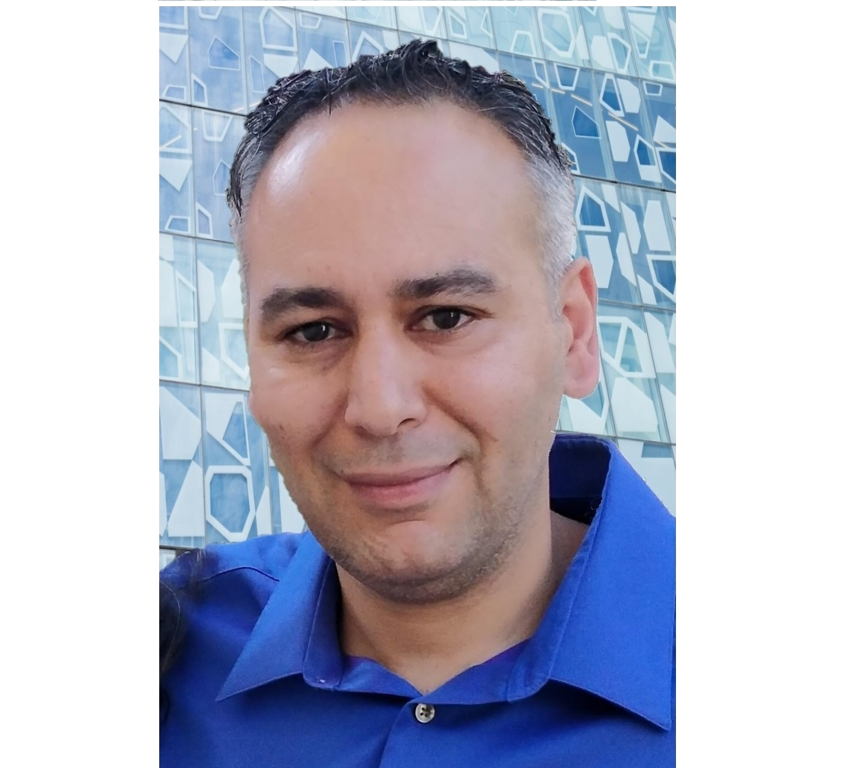
Who Am I?
Michael Michael
Harbor Maintainer
Director of PM, VMware
@m2 on Slack

Slide 3


A CNCF Graduated project
Our mission is to be the trusted cloud native repository for Kubernetes
@project_harbor
http://goharbor.io

Slide 4
Harbor is an open source registry that secures artifacts with policies and role-based access control, ensures images are scanned and free from vulnerabilities, and signs images as trusted.
Harbor delivers compliance, performance, and interoperability to help you consistently and securely manage artifacts

Slide 5
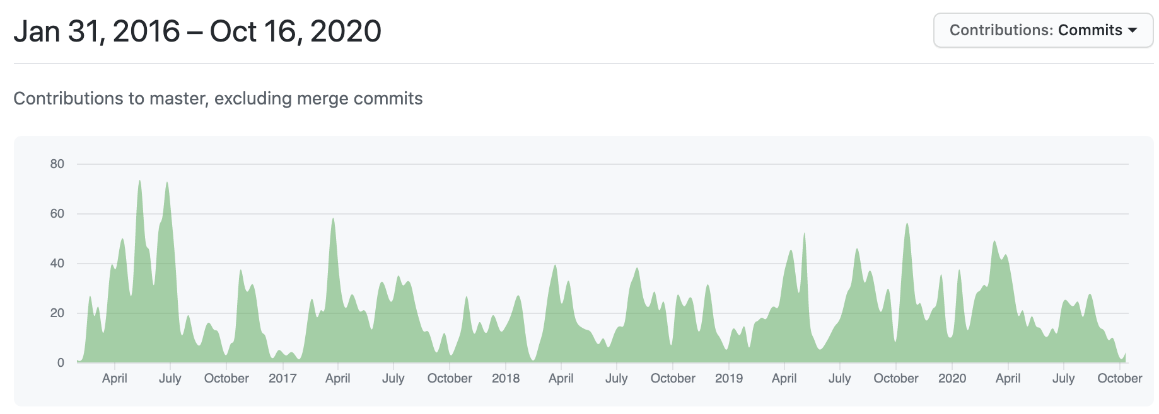
GitHub Stars
Committers
Contributing Companies
Contributors
Forks
13K+
200+
250+
3000+
4000+
14 Maintainers across 5 companies
Harbor Community
data source: https://harbor.devstats.cncf.io/ & https://github.com/goharbor/harbor/graphs/traffic (till 2020/10/16)

Slide 6
Kubernetes is the standard for container orchestration

Slide 7
We are seeing tremendous interest from users that want to deploy Kubernetes clusters at the edge
Focus is simplicity, reliability, and security

Slide 8
You can’t operate Kubernetes without a registry

Slide 9
Users are asking for an easy way to describe how to deliver images where they need to run
Users are asking for the ability to deliver images next to the compute that’s running their applications

Slide 10
Harbor v2.1 improves image distribution with new features on Proxy Cache and P2P support

Slide 11
Harbor makes it possible to distribute your cloud native artifacts and images, co-locating these artifacts with your applications running on Kubernetes

Slide 12
Harbor Core Tenets
Ownership & Deployment
Multitenancy
RBAC, Project Isolation
Policy
Quotas, Retention, Immutability, Signing, Vulnerability
Security & Compliance
I&AM, Scanning, CVE Exceptions
Extensibility
Webhooks, Replication, Pluggable Scanners, REST API, Robot Accounts, CLI Secrets
Notes:
What are our core tenets for delivering a consistent image management for Kubernetes

Slide 13


DEMO TIME
Proxy Cache
P2P w/ Dragonfly
Notes:
So now I will turn it over to Daniel for a quick Demo we have prepared

