Slide 1

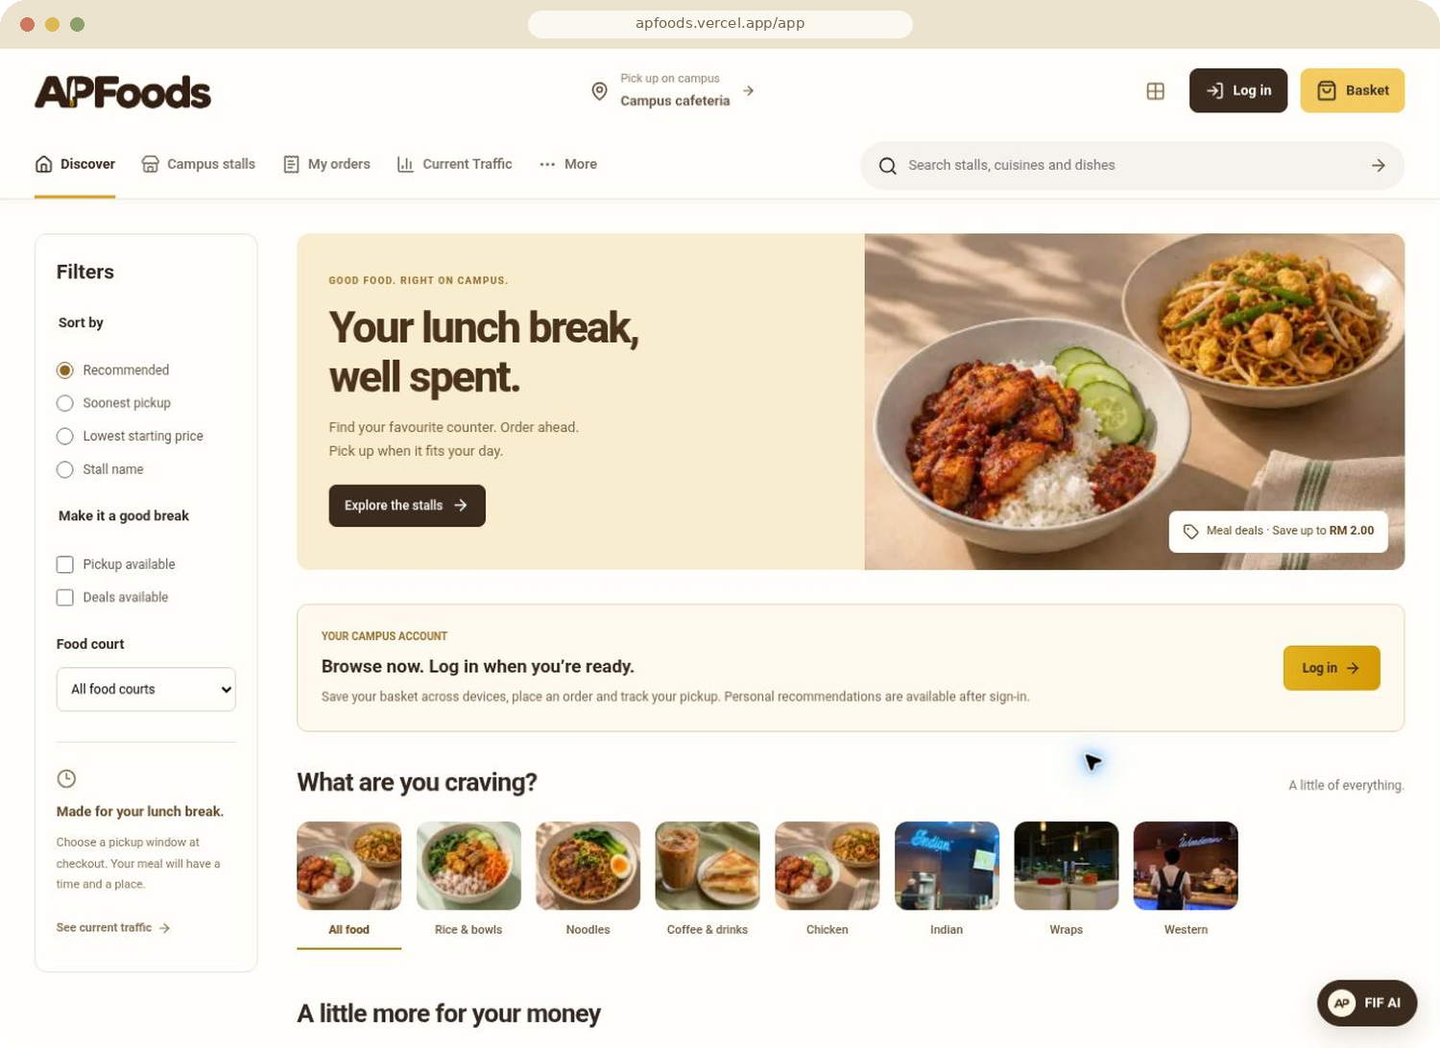
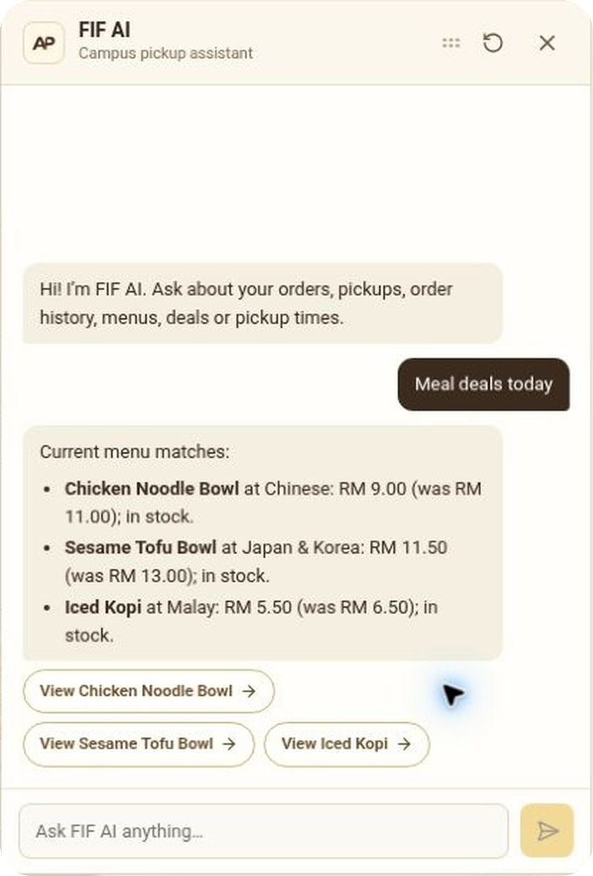
Campus food,
on your time.
FOOD INTELLIGENCE FRAMEWORK
Order between classes.
Pick up with a plan.
POWERED BY FIF AI
apfoods.vercel.app
Notes:
A short campus break should leave time to eat. APFoods connects students with campus stalls, while FIF, our Food Intelligence Framework, helps each side make informed decisions. We have built the student, vendor and management workspaces in one deployed application.
Sources: https://apfoods.vercel.app/app; https://github.com/cloudywalnut/APFood/tree/Keyaan. Live public marketplace screenshot captured 13 November 2026.

Slide 2
A short break has little room
for an unpredictable queue.
THE CAMPUS OPPORTUNITY
13,000+
students in APU’s published campus community
130+ countries
Each dot represents 100 students
APU 2025 computing brochure. Campus population is context, not APFoods adoption.
Notes:
APU’s 2025 computing brochure describes a community of 13,000 students from more than 130 countries. That is the campus context, not our user count. Our problem is practical: students have gaps between classes, while ordering, preparation and collection compete for that limited time. We have not conducted a campus queue-time study, so we make no measured waiting-time claim.
Sources: https://publicwebsite-media.apu.edu.my/assets/2025-02/2025Jan_Computing-min.pdf?VersionId=ETvrGvJxZU_QDjjaFS1Ppmla2dC_OEhi ; repository docs/MVP.md.

Slide 3
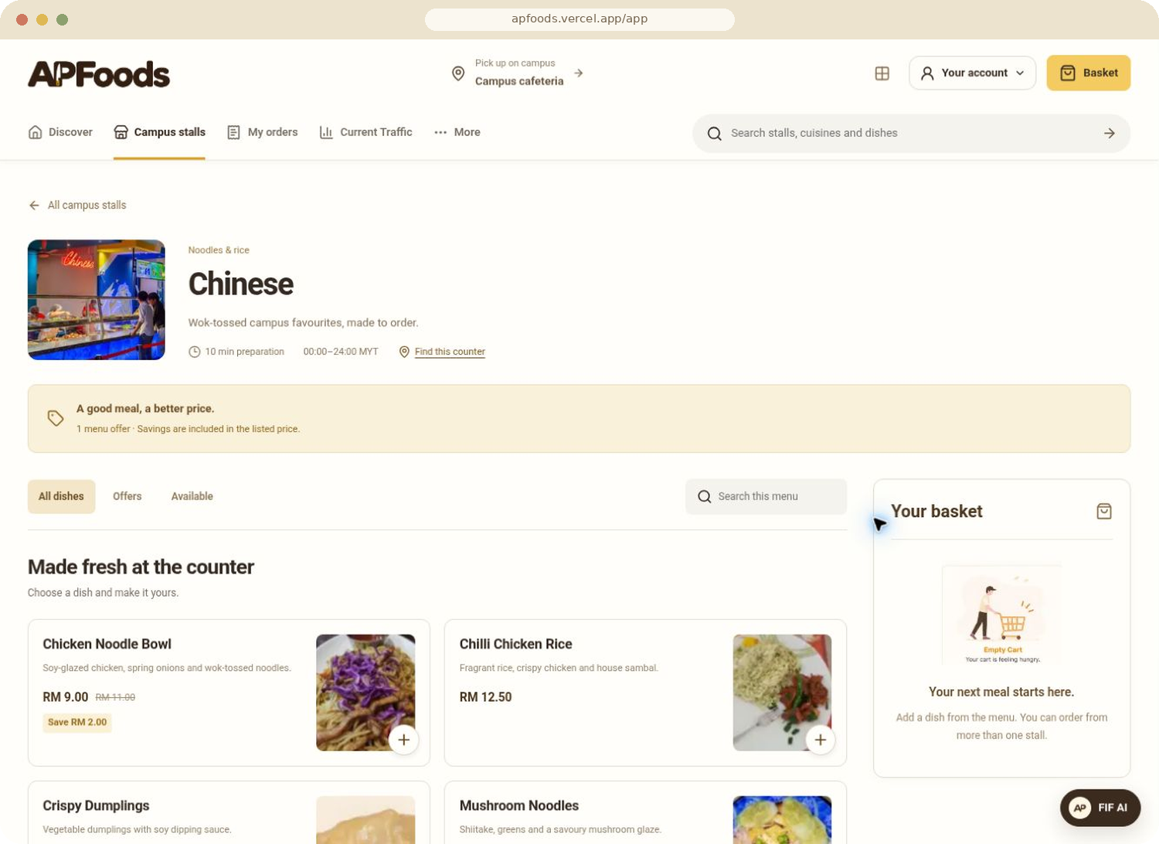
Food that fits the gap between classes
STUDENT EXPERIENCE
Browse. Order. Choose a pickup.
15-minute
capacity-aware pickup windows
01
One basket across stalls
02
Live order tracking
03
8-digit pickup verification
Notes:
Students can order directly from the menu, build a basket across stalls and choose a shared 15-minute pickup window. The backend checks capacity and stock. Order tracking continues through preparation and pickup, with a one-time verification code at handoff. The ten stalls and payment records belong to the demonstration environment.
Sources: Live student session at https://apfoods.vercel.app/app/vendors/campus-noodle-bar, captured 13 November 2026; Keyaan docs/MVP.md and docs/HANDOFF.md.

Slide 4
A clearer picture before the walk
PICKUP INTELLIGENCE
30 minute
APP PICKUP LOAD · NEXT 30 MINUTES
Low
Medium
High
Campus Cafeteria
Next 15 min
15–30 min
look-ahead
Local cuisine
Shawarma
See booked pickup demand by counter and food court.
Local corner
Japan & Korea
App pickup load.
Physical queues are not measured.
Western
Illustrative layout. Colours show booked capacity, not measured queues.
Notes:
Students can inspect current booked pickup load before walking to a counter. The map looks ahead thirty minutes and uses booked capacity. It does not measure a physical queue or infer the number of people standing in the cafeteria. This gives the product a concrete operational signal without claiming sensors that we have not connected.
Sources: Live https://apfoods.vercel.app/app/traffic captured 13 November 2026; Keyaan docs/MVP.md and lib/traffic-load.ts.

Slide 5
“Find me food under RM10”
FIF FOR STUDENTS
A request becomes a meal choice.
01
Search by budget or dish.
02
Compare current deals and pickup options.
03
Prepare basket additions for confirmation.
The student confirms the basket and completes checkout.
Notes:
Students can use the normal ordering interface or ask FIF for a meal, such as food under RM10. Supported budget requests preserve the price limit and use authorised menu data. FIF can prepare basket additions, which the student confirms before checkout. The screenshot shows a live current-deals answer with exact prices and dish links. Budget filtering is supported by the implementation and repository regression coverage; this screenshot does not depict a budget-query test.
Sources: Live student FIF current-deals response captured 13 November 2026; Keyaan lib/backend/student-fif-chat.ts, student-fif-answers.ts, student-fif-cart.ts and docs/FIF_CART_ACTIONS.md.

Slide 6
How FIF turns live data into a useful next action
FOOD INTELLIGENCE FRAMEWORK
01
02
03
04
Read context
Apply rules
Reason with AI
Validate output
Menus, stock, prices, booked pickups and role-specific order data.
Filter by budget and availability. Build eligible operational actions.
Gemini uses authorised tools and evidence to explain recommendations.
Check IDs, evidence, numerical claims and allowed changes.
Routine lookups can use rules directly. Users confirm basket or vendor edits.
Administrator guidance stays read-only.
Notes:
FIF combines deterministic business rules with an AI layer. It does not send an unrestricted model straight to the database. Student tools retrieve the signed-in student's own orders, current menus, prices, stock and pickup availability. Common supported requests, including simple budget searches, can use direct data shortcuts without a model call. More complex requests use the shared Gemini tool-calling runtime. Vendor and admin insights start from authorised candidate actions and evidence. Gemini chooses and explains useful recommendations, then the server validates candidate IDs, evidence references and numerical claims. The simple shift-priority ranker only lets Gemini break ties between actions with equal rule priority. Student cart tools prepare an addition for confirmation and never check out. Vendor Copilot proposes bounded menu or stall-setting changes, with confirmation and state checks before application. Admin AI remains read-only. Scenario projections are assumptions, not observed gains.
Sources, Keyaan branch inspected 13 November 2026:
https://github.com/cloudywalnut/APFood/blob/Keyaan/lib/backend/student-fif-chat.ts
https://github.com/cloudywalnut/APFood/blob/Keyaan/lib/backend/fif-ranking.ts
https://github.com/cloudywalnut/APFood/blob/Keyaan/lib/backend/vendor-recommendation-writer.ts
https://github.com/cloudywalnut/APFood/blob/Keyaan/lib/backend/vendor-copilot-core.ts
https://github.com/cloudywalnut/APFood/blob/Keyaan/lib/backend/admin-intelligence-writer.ts

Slide 7
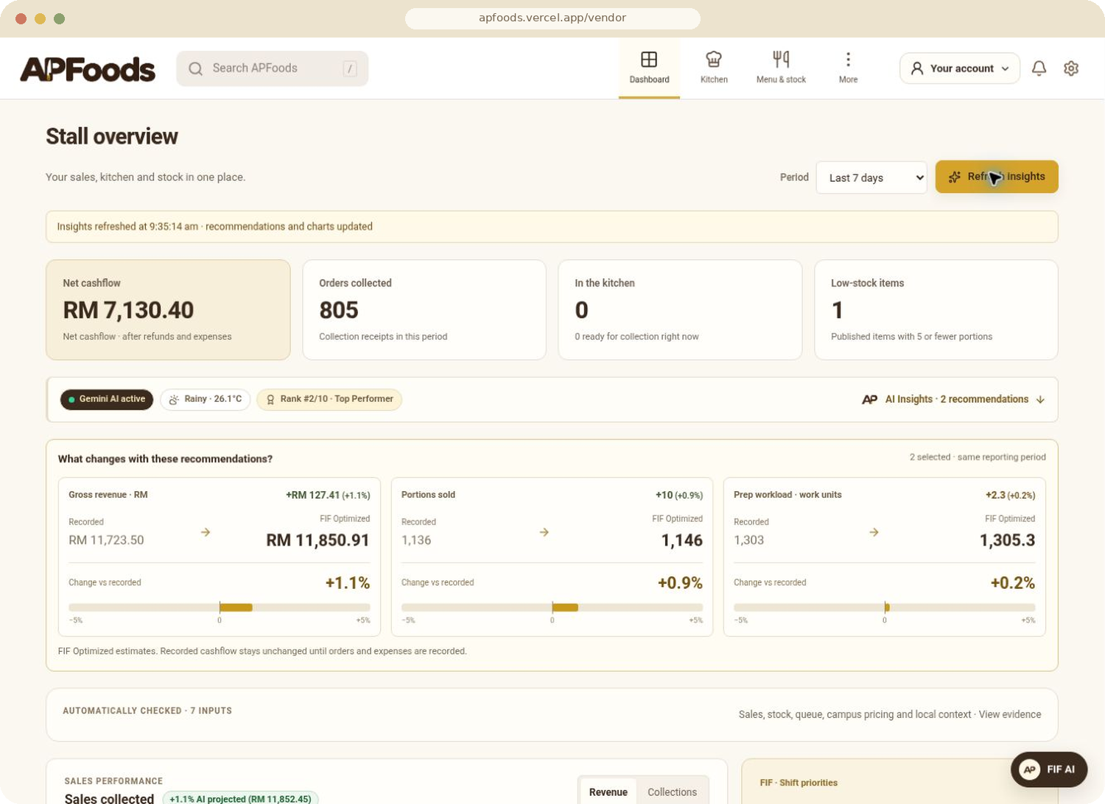
Kitchen decisions backed by evidence
FIF FOR VENDORS
7
operational
inputs
Sales and stock
Kitchen queue and campus prices
Timing, day patterns and local weather
Recommendations inform decisions.
Vendors confirm operational changes.
Notes:
We clicked Generate insights in the deployed vendor dashboard. Gemini returned two recommendations: replenish Mushroom Noodles carefully and pre-stage Hot Curry Laksa for the rush. The page showed Gemini AI active and seven checked inputs. It also updated revenue and workload scenarios. These are what-if estimates over fictional demo records, not measured commercial improvement. Operational changes require vendor confirmation.
Sources: https://apfoods.vercel.app/vendor, live generation captured 13 November 2026 at 09:35 MYT; Keyaan lib/backend/vendor-copilot.ts and docs/HANDOFF.md.

Slide 8
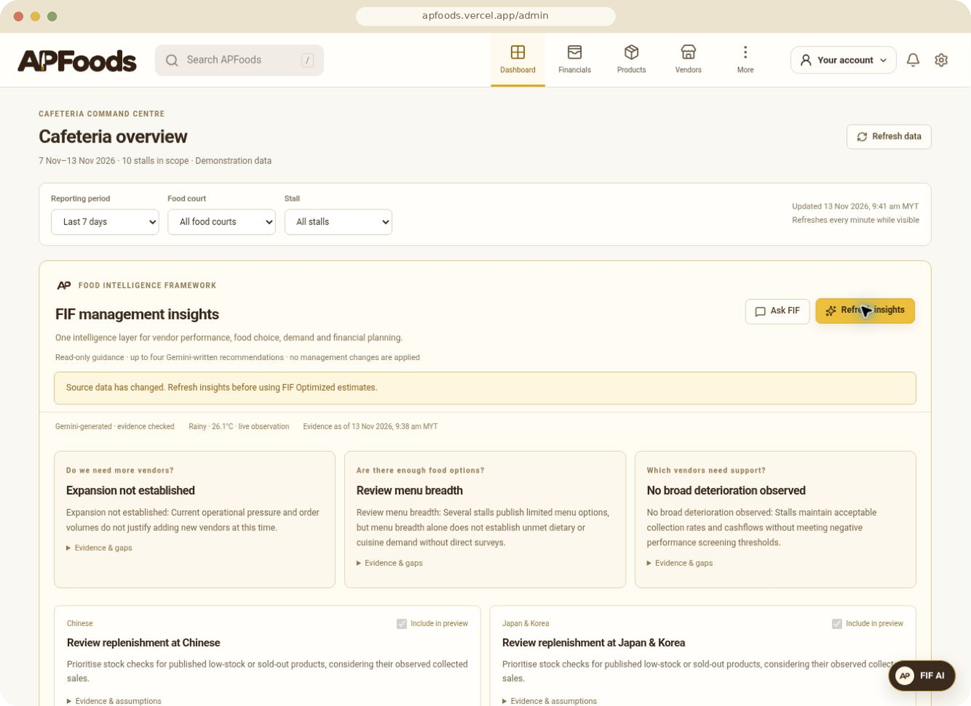
One view of the whole cafeteria
FIF FOR CAFETERIA MANAGEMENT
10
stalls
in the deployed demonstration
Compare vendor performance.
Investigate stock and fulfilment risks.
Review cashflow and audit history.
Evidence-backed AI guidance.
Management retains authority.
Notes:
Managers get a cross-vendor command centre with reporting filters, financial records, vendor review and an audit trail. We generated management insights in the deployed application. FIF assesses vendor performance, menu breadth and potential operational improvements, with evidence and limitations attached. It does not infer unmet cuisine demand or a need for expansion when the evidence does not establish it. The dashboard’s orders and sales remain demonstration data.
Sources: https://apfoods.vercel.app/admin, live session captured 13 November 2026; Keyaan docs/ADMIN_COMMAND_CENTRE.md.

Slide 9
If 20% of a 13,000-student community
saves 10 minutes per day
ILLUSTRATIVE CAMPUS IMPACT
433
Campus community
13,000
Students using APFoods (20%)
2,600
Minutes saved each day
10
student-hours per day
Student-hours per day
433
2,600 students × 10 minutes ÷ 60 = 433 hours
Scenario only. Adoption and time saved are assumptions
to test in a pilot.
Notes:
Here is the scale of the opportunity, not an achieved result. If 20 percent of a 13,000-student community uses the service and saves ten minutes per day, that would return roughly 433 student-hours each day. Neither assumption has been measured. A pilot should compare actual waiting time, pickup punctuality and kitchen workload before and after adoption.
Sources: Population context: APU 2025 computing brochure, cited on slide 2. Scenario arithmetic: 13,000 × 0.20 × 10 / 60 = 433.33. All adoption and saving assumptions are illustrative.

Slide 10
A campus pilot.
A measurable result.
MEASURED AGAINST A BASELINE
Waiting time
On-time pickups
One food court, with participating stalls
Vendor workload
NEXT
1
Verified payment integration
2
Wider campus rollout
apfoods.vercel.app
Notes:
The deployed prototype connects the complete operating model. The next step we propose is a supervised pilot in one food court with participating vendors. We would establish a baseline and measure actual student waiting time, on-time collection and vendor workload. Verified money movement, timetable integration and physical crowd sensing are future work. APFoods is an independent project and this deck does not claim university endorsement.
Sources: Live app and Keyaan docs/MVP.md. Pilot, integrations and rollout are proposed future work.

Slide 11
Platform architecture
TECHNICAL APPENDIX
Student
Vendor
Administrator
Next.js / TypeScript API
Auth, validation and FIF tools
Supabase
Auth, Postgres, RLS, Realtime
Gemini
Tool calling and insights
Notes:
Vercel hosts the Next.js and React application. Server-side API handlers validate requests and expose role-scoped tools to FIF. Supabase supplies authentication, Postgres, row-level security and realtime order updates. Gemini supports conversational and insight generation. Deterministic data paths handle common requests and operational constraints. OpenAI transport exists in the source, but we do not claim verified live OpenAI operation. Stock, capacity and order transitions remain server and database responsibilities.
Sources: Keyaan package.json; lib/backend/fif-agent.ts; fif-chat-runtime.ts; vendor-copilot.ts; supabase/migrations; docs/HANDOFF.md. Simplified architecture, not every integration shown.

