Slide 1
FA 7: Campus-Related Statistical Analysis
Part 2 – Applying Normal Distribution on Campus
Variable: Weight of Students' Backpacks

Slide 2
Objective
To analyze 50 backpack-weight observations and apply the normal distribution using the sample mean and standard deviation.

Slide 3
Data Collection
• 50 responses collected through Google Forms
• Variable measured: backpack weight in kilograms
• Data summarized using a frequency distribution and graphs

Slide 4
Descriptive Statistics
Sample size: 50
Mean (μ): 3.17 kg
Sample SD (σ): 0.98 kg
Minimum: 1.0 kg
Maximum: 5.2 kg

Slide 5
Distribution
The highest observed frequency is 3.0 kg (12 responses, 24%).
The data are centered around roughly 3 kg but are not perfectly normal.

Slide 6
Mean ± Standard Deviation
Within 1σ: 66.00% of observations
Within 2σ: 94.00%
Within 3σ: 100.00%
These are observed sample percentages, not assumed 68–95–99.7% values.

Slide 7
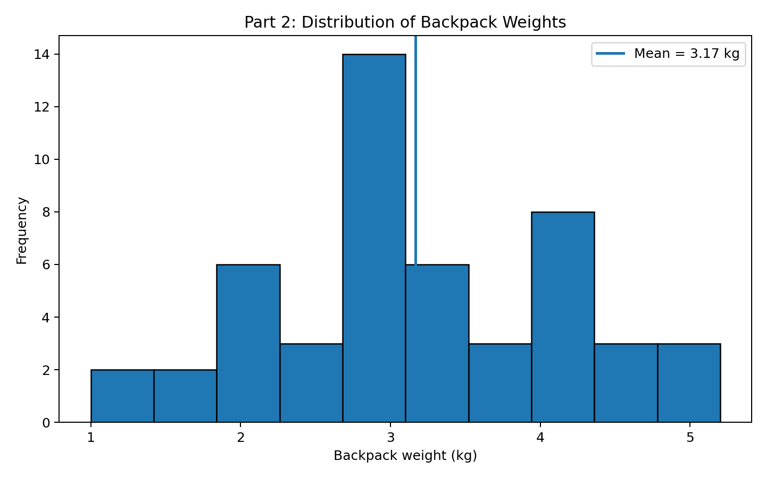
Graph

Slide 8
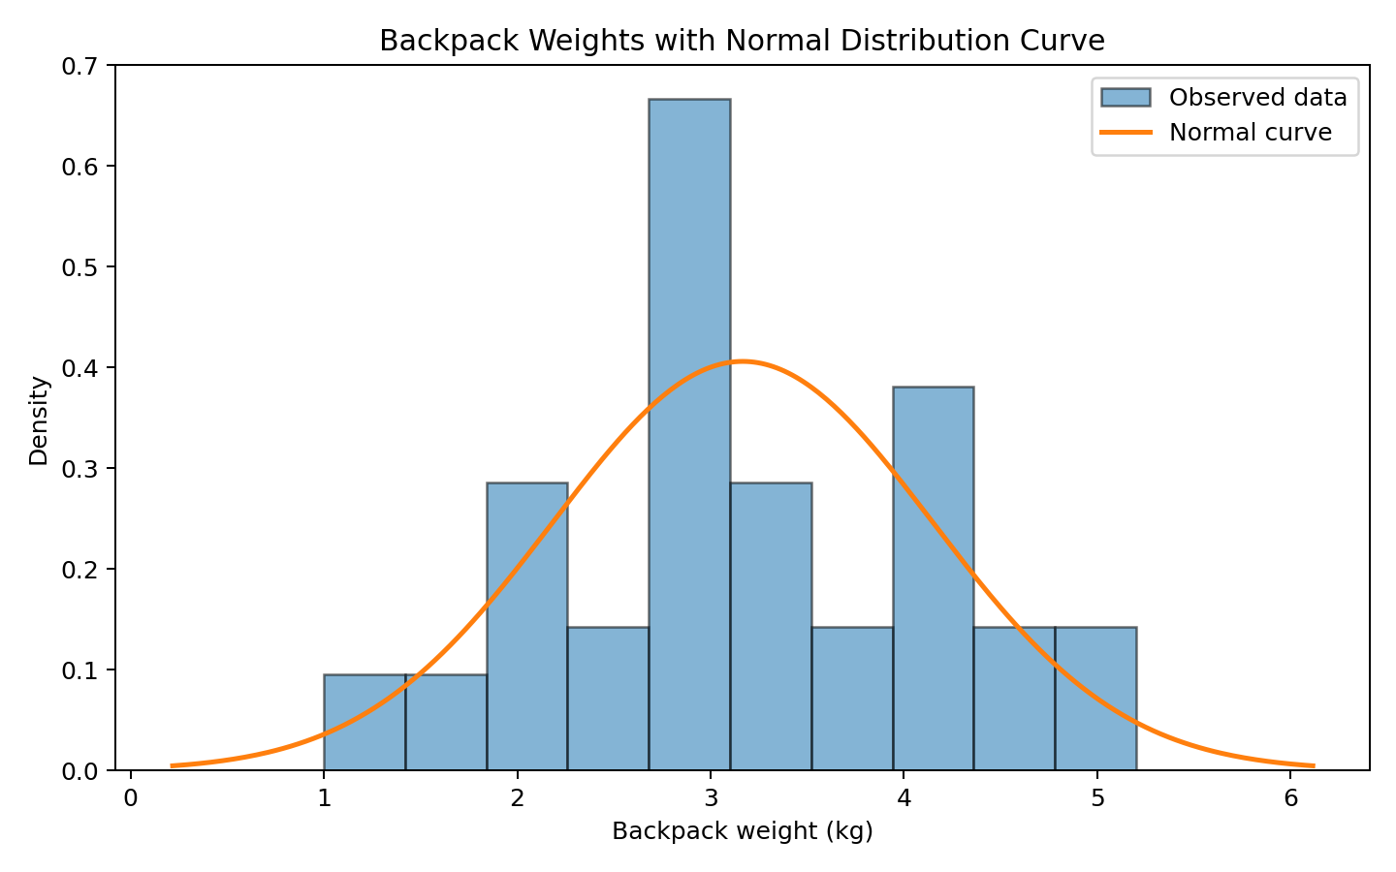

Slide 9
Real-Life Implications
• Encourage students to bring only necessary materials.
• Consider digital materials or storage options when appropriate.
• Use the results as a basis for discussing backpack load and student comfort.

Slide 10
Conclusion
The sample shows that backpack weights vary, with many observations around 3 kg. A normal curve provides a useful reference, but the actual data are not perfectly normal.

Slide 11
Thank You
Questions?

