Slide 1



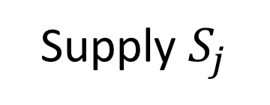
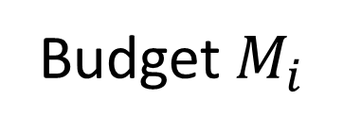
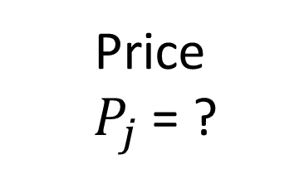
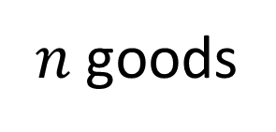
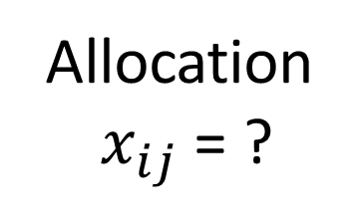
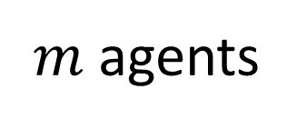
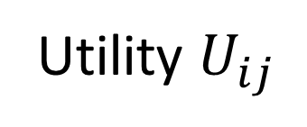
$m$ agents
Allocation
$x_{ij}$ = ?
Budget$M_{i}$
Utility $U_{ij}$
Price
$P_{j}$ = ?
Supply $S_{j}$
$n$ goods

Slide 2




$$y_{1}≥0$$
$$y_{1}+2y_{2}≤3$$
$${2y}_{1}{−y}_{2}≤2$$
(2,2’)
(1,2)
$$y_{2}≥0$$
(1’,2’)
(1’,1)

Slide 3


$$y_{1}+2y_{2}−z≤0$$
$${2y}_{1}{−y}_{2}−z≤−1$$

Slide 4










$$\overset{⃑}{y}$$
$$n=6$$
$$(1^{′},2 , 3 ,4^{′},5 ,5′,6′)$$
$$(0, 1 , 2 ,3 ,4^{′},5 , 6′)$$
$$({1 ,1}^{′},2 ,3 ,4^{′},5 ,6′)$$
$$(1^{′},2 , 3 ,3′,4′,5′,6′)$$
$$(1^{′},2^{′},2 , 3′,4′,5′,6′)$$
$$0$$
$$−q_{2}$$
$$z$$

