Slide 1

Orange
김범석.김영우.박소연

Slide 2
목차 ( 참고용 )
우리가 구현한 내용.
전체 프로그램 구조
역할 분담
BigFile 설명
Class Hierarchy
알고리즘
[최적화]Append Acc
[최적화]RecordCache
Sort & Merge 구조 설명
Mutli Disk 고려
[최적화] Priority Queue
네트워크
데모

Slide 3
Unsorted Block 0
Unsorted Block 1
Unsorted Block 2
Unsorted Block 3
Step 1 : Sort
sorted Block 0
sorted Block 1
Step 2 : Shuffle
sorted Block 0
sorted Block 1
Step 3 : Merge
sorted Block 0

Slide 4
We need to do
Read
Sort
Shuffle

Slide 5
Project Architecture
Network
Sort & Merge
Netty
BigFile
Application Code
Library Code
Java network
Java File Library

Slide 6
Basic Role Assignment
Network
Sort & Merge
김영우
박소연
Netty
BigFile
김범석
Application Code
Library Code
Java network
Java File Library

Slide 7
Call Hierarchy
BigFile
ChunkMerger
SlaveSorter
ChunkSorter
ResourceChecker
Sender
NetworkInterface
SlaveShuffler
Reciever

Slide 8
BigFile?
Handle to file
Delegate pattern
Give all file related issue to other class
BigFile class handles all file I/O related issue
Network/Sorting Component does not handle I/O
getRecord() : Record
getRecords() : Vector[Record]
numOfRecords : Int
IBigFile

Slide 9
BigFile?
Cons
Don’t need to care about file path & name
Easy to switch implementation
Make several alternate designs
Can test even before BigFile is implemented
Use ConstFile / NullOutputFile
Can be used with ‘Future‘

Slide 10
trait
real class in use
BigFile Subclasses
tester class
IBigFile
IBigFileWithCache
SingleFile
MultiFile
PartialFile
ConstFile
SingleFilePrefetch

Slide 11
TODO : 이 슬라이드는 3초만에 지나가는 슬라이드 입니다.
MultiFile
User
Sorter Component
Virtual View
IBigFile
Physical View
File1
File2
File3
FileN
……

Slide 12
TODO : 이 슬라이드는 3초만에 지나가는 슬라이드 입니다.
SingleFile
User
Merge Component
Virtual View
IBigFile
Physical View
File 1

Slide 13
TODO : 이 슬라이드는 3초만에 지나가는 슬라이드 입니다.
PartialFile
User
Shuffler
IBigFile
IBigFile
IBigFile
Virtual View
Physical View
Real File (single)

Slide 14
TODO : 이 슬라이드는 3초만에 지나가는 슬라이드 입니다.
ConstFile ( for test )
User
Merge Component
Virtual View
IBigFile
Physical View
(No File)
Numerically Generated

Slide 15
BigFile usage
File 1
File 2
File 3
File 4
File N
File I/O Read for sorting
(Virtual) BigFile from many MultiFiles
Sorting and File I/O Write
Sorted Large File
Good
File Handler!
File I/O Read for shuffling
(Virtual)N BigFiles from Large SingleFile

Slide 16
BigFile Operations
MultiFile
1.
Get Records from multi-files
IBigFile
SingleFile
3.
Get Records from single-files
RecordCache
Record cache for reading efficiency
IOutputFile
BigOutFile
2.
Set Records to file
Notes:
레코드 캐시는 멀티파일이랑 싱글파일에서 쓰인다.
우리 프로그램이 실행됨에 따라 쓰이는 클래스 순서는 보라색화살표와 같다

Slide 17
File I/O
- java.io.RandomAccessFile
- Read : using offset
->seek , readfully(buf : Array[Byte])
ex) record offset = 100, key offset = 10
- Write : append records
->put(buf : ByteBuffer)
Notes:
준수한 속도와 임의의 구간에 쓰고 읽기가 가능한 자바 io RandomAccessFile을 씀
오프셋을 이용하여 읽었음
좀더 구체적으로, 쓰인 메소드는 seek readfully정도 (뒤 자세히 설명, seek에 걸리는 오버헤드 문제 해결위해 레코드캐시사용)
어차피 한파일에 쓰기때문에 레코드들을 append하는 형식으로 write구현 (하지만 쓰는 량이 엄청나기 때문에 느리다. 그래서, Optimization – 1 자세히 설명해줌~)
좀더 구체적으로, 쓰인 메소드는 블라블라

Slide 18
RecordsNumEachBlock -> constant 32MB
BigFile Index = 10000
File Index = 10000/RecordsNumEachBlock Record Index = 10000%RecordsNumEachBlock
ex) GetRecord(i)
i =10000
Big File
File index and Record index
* 100
Block 0
Block 1
Block 2
Block 3
Block n
Each has 3000 Records
File Index : Int= 10000/3000 = 3
Record Index = 10000%3000 = 1000

Slide 19
Performance
Network I/O > File I/O >> CPU Time
We aim at minimizing File & Networks I/O

Slide 20
Sorter – Primitive Approach
Unsorted Block 0
Unsorted Block 1
Unsorted Block 2
Unsorted Block 3
sort
sort
sort
sort
sorted Block 0
sorted Block 1
sorted Block 2
sorted Block 3

Slide 21
Sorter – Sorting more than one file
Raw File
Unsorted Block 0
Unsorted Block 1
Unsorted Block 2
Unsorted Block 3
BigFile
sort
sort
sorted Block 0
sorted Block 1

Slide 22

Sorter – Multithreading with future
Each single file object represents the set files in each disk
Split BigFile into several task
Split BigFile into several task

Slide 23
Sorter – Multithreading with future
Returns Future
Do not wait the sorting process

Slide 24

Optimization 1 (Append Record)
Memory Mapped File
MappedByteBuffer
Memory Region
Direct
Byte Buffer
File Region

Slide 25
Optimization 1 (Append Record)
Append Accumulating
Append Record N
If (queue is full
Or
Close File)
Write
Append Record 3
Append Record 2
Append Record 1
Write Queue
File

Slide 26
Optimization 2 (Read Record)
Record Cache ( to avoid frequent disk seek )
File
Each block = record
Cache Entry
…EOF
Seek Point for each record
record cache 1
record cache 2
File
…EOF
Seek Point for each record cache

Slide 27
Optimization 2 (Read Record)
Record Cache ( to avoid too much disk seek )
2,467,919 Times
21.71 sec
 | No Cache | Cache
I/O count | 2,457,919 | 706,681
Read bytes | 238MB | 243MB
Merge Time | 21.751 s | 12.393 s
12.39 sec
706,681 Times

Slide 28
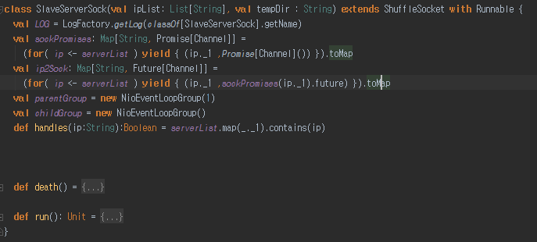
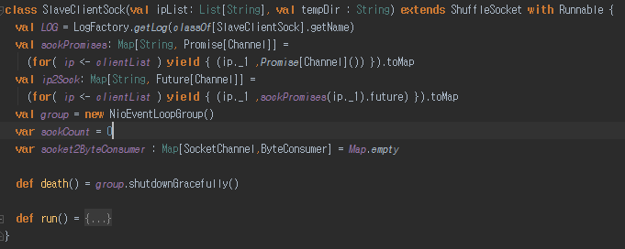
Network interface
Partitions myIp
Server
Client
S
S
S

Slide 29
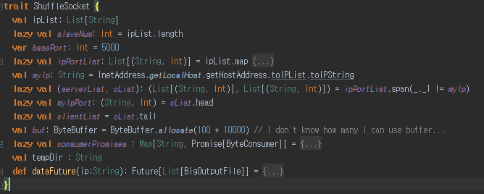
Network interface
ShuffleSocket
SlaveServerSock
SlaveClientSock

Slide 30
Network protocol
Total size
size
SortedData
size
SortedData
size
SortedData

Slide 31
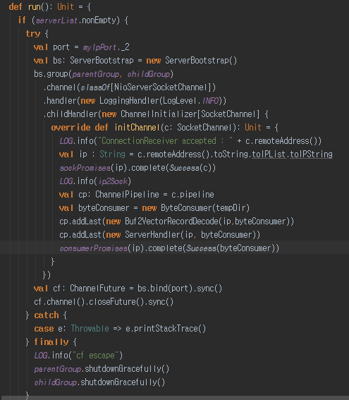
Asynchronous recieve with natty
Total size
size
SortedData
size
SortedData
size
SortedData
Buf2VectorRecordDecode
Vector[Record]
ServerHandler
BigOutputFile

Slide 32
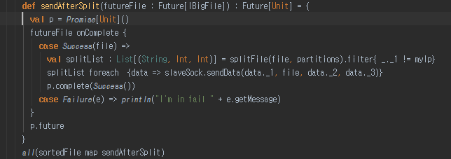
Asynchronous send data
After one IBigFile sort, directly send without wait all IBigFile sort process
sort/partition
merge
shuffle
network idle
network busy

Slide 33
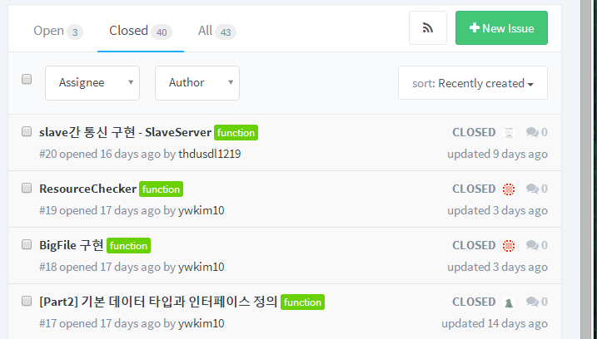
Initial Issue Assignment

Slide 34
Initial Issue Assignment

Slide 35
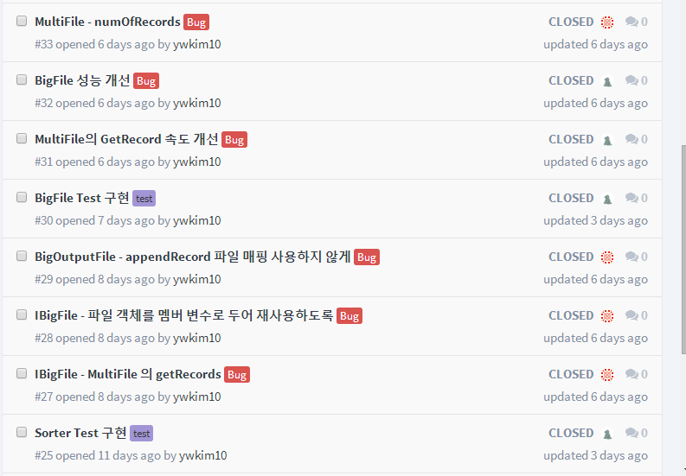
Additional Issue Tracking

Slide 36
결과를 동영상으로 만들어서 넣어보자.

Slide 37
THANK
YOU
Q&A

Slide 38
Optimization 3
N-Way merge with Priority Queue
이론 설명 그림

Slide 39
Optimization 3
N-Way merge with Priority Queue
결과 분석 그림
http://141.223.82.189/git/beomseok0203/orange/issues/36
표 하나 막대그래프 하나

Slide 40
Optimization 3
N-Way Merge sort is slow
Sorted Run #1
Sorted Run #2
select min
Sorted Run #3
Merged Run
Sorted Run #4
Sorted Run #5
List of min values
File Pointer

