Slide 1

Orange
File Index
김범석.김영우.박소연

Slide 2
목차 ( 참고용 )
우리가 구현한 내용.
핵심 알고리즘 ( 소팅, BigFile 의 존재 이유, 네트워크 통신)
전체 프로그램 구조
역할 분담
BigFile 설명
Class Hierarchy
알고리즘
[최적화]Append Acc
[최적화]RecordCache
Sort & Merge 구조 설명
Mutli Disk 고려
[최적화] Priority Queue
네트워크
데모

Slide 3
Goal
Read
Sort
Shuffle

Slide 4
Algorithm 설명
Sort를 어떻게 하는지.

Slide 5
Project Architecture
Network
Sort & Merge
Netty
BigFile
Application Code
Library Code
Java network
Java File Library

Slide 6
BigFile?
Delegate pattern
Give all file related issue to other class
BigFile class handles all file I/O related issue
Network/Sorting Component does not handle I/O
Cons
Easy to switch implementation
Can test even before BigFile is implemented
getRecord() : Record
getRecords() : Vector[Record]
numOfRecords : Int
IBigFile

Slide 7
trait
real class in use
BigFile Subclasses
tester class
IBigFile
IBigFileWithCache
SingleFile
MultiFile
PartialFile
ConstFile
SingleFilePrefetch

Slide 8
TODO : 이 슬라이드는 3초만에 지나가는 슬라이드 입니다.
MultiFile
User
Sorter Component
Virtual View
IBigFile
Physical View
File1
File2
File3
FileN
……

Slide 9
TODO : 이 슬라이드는 3초만에 지나가는 슬라이드 입니다.
SingleFile
User
Merge Component
Virtual View
IBigFile
Physical View
File 1

Slide 10
TODO : 이 슬라이드는 3초만에 지나가는 슬라이드 입니다.
PartialFile
User
Shuffler
IBigFile
IBigFile
IBigFile
Virtual View
Physical View
Real File (single)

Slide 11
TODO : 이 슬라이드는 3초만에 지나가는 슬라이드 입니다.
ConstFile ( for test )
User
Merge Component
Virtual View
IBigFile
Physical View
(No File)
Numerically Generated

Slide 12
Call Hierarchy
BigFile
ChunkMerger
SlaveSorter
ChunkSorter
ResourceChecker
Sender
NetworkInterface
SlaveShuffler
Reciever

Slide 13
BigFile usage
File 1
File 2
File 3
File 4
File N
File I/O Read for sorting
(Virtual) BigFile from many MultiFiles
Merge Sorting and File I/O Write
One Sorted Large File
Good
File Handler!
File I/O Read for shuffling
(Virtual)N BigFiles from Large SingleFile

Slide 14
BigFile Operations
MultiFile
1.
Get Records from multi-files
IBigFile
SingleFile
3.
Get Records from single-files
RecordCache
Record cache for reading efficiency
IOutputFile
BigOutFile
2.
Set Records to file
Notes:
레코드 캐시는 멀티파일이랑 싱글파일에서 쓰인다.
우리 프로그램이 실행됨에 따라 쓰이는 클래스 순서는 보라색화살표와 같다

Slide 15
Network
thdusdl1219
Socket communication
beomseok0203
BigFile Implementation
Sort & Merge
ywkim10
BigFile
Sort & Merge Implementation

Slide 16
SingleThreadSorter
Memory Size

Slide 17
File I/O
- java.io.RandomAccessFile
- Read : using offset
->seek , readfully(buf : Array[Byte])
ex) record offset = 100, key offset = 10
- Write : append records
->put(buf : ByteBuffer)
Notes:
준수한 속도와 임의의 구간에 쓰고 읽기가 가능한 자바 io RandomAccessFile을 씀
오프셋을 이용하여 읽었음
좀더 구체적으로, 쓰인 메소드는 seek readfully정도 (뒤 자세히 설명, seek에 걸리는 오버헤드 문제 해결위해 레코드캐시사용)
어차피 한파일에 쓰기때문에 레코드들을 append하는 형식으로 write구현 (하지만 쓰는 량이 엄청나기 때문에 느리다. 그래서, Optimization – 1 자세히 설명해줌~)
좀더 구체적으로, 쓰인 메소드는 블라블라

Slide 18
RecordsNumEachBlock -> constant 32MB
BigFile Index = 10000
File Index = 10000/RecordsNumEachBlock Record Index = 10000%RecordsNumEachBlock
ex) GetRecord(i)
i =10000
Big File
File index and Record index
* 100
Block 0
Block 1
Block 2
Block 3
Block n
Each has 3000 Records
File Index : Int= 10000/3000 = 3
Record Index = 10000%3000 = 1000

Slide 19

Optimization 1 (Append Record)
Memory Mapped File
MappedByteBuffer
Memory Region
Direct
Byte Buffer
File Region

Slide 20
Optimization 1 (Append Record)
Append Accumulating
Append Record N
If ( Cache is full
Or
Close File)
Write
Append Record 3
Append Record 2
Append Record 1
Cache
File

Slide 21
Optimization 2 (Read Record)
Record Cache ( to avoid too much disk seek )
File
Each block = record
Cache Entry
…EOF
Seek Point for each record
record cache 1
record cache 2
File
…EOF
Seek Point for each record cache

Slide 22
Optimization 2 (Read Record)
Record Cache ( to avoid too much disk seek )
2,467,919 Times
21.71 sec
 | No Cache | Cache
I/O count | 2,457,919 | 706,681
Read bytes | 238MB | 243MB
Merge Time | 21.751 s | 12.393 s
12.39 sec
706,681 Times

Slide 23
Optimization 3
N-Way Merge sort is slow
Sorted Run #1
Sorted Run #2
select min
Sorted Run #3
Merged Run
Sorted Run #4
Sorted Run #5
List of min values
File Pointer

Slide 24
Optimization 3
N-Way merge with Priority Queue
이론 설명 그림

Slide 25
Optimization 3
N-Way merge with Priority Queue
결과 분석 그림
http://141.223.82.189/git/beomseok0203/orange/issues/36
표 하나 막대그래프 하나

Slide 26
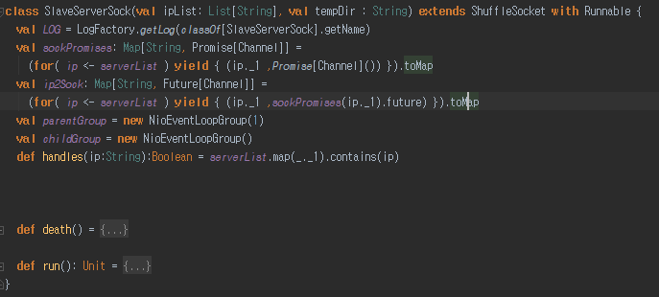
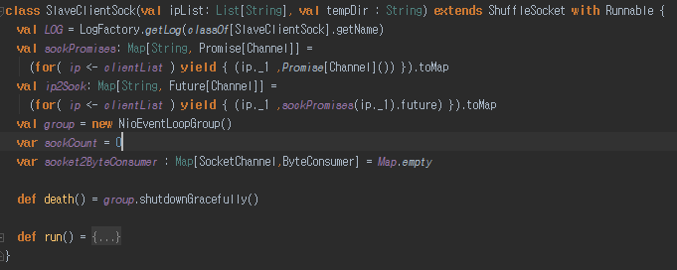
Network interface
Partitions myIp
Server
Client
S
S
S

Slide 27
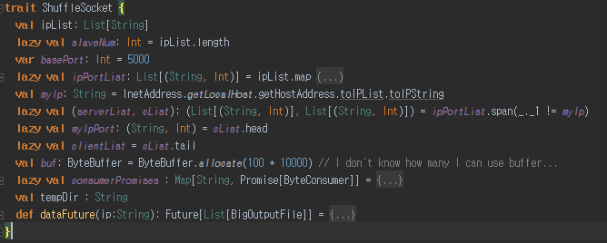
Network interface
ShuffleSocket
SlaveServerSock
SlaveClientSock

Slide 28
Network protocol
Total size
size
SortedData
size
SortedData
size
SortedData

Slide 29
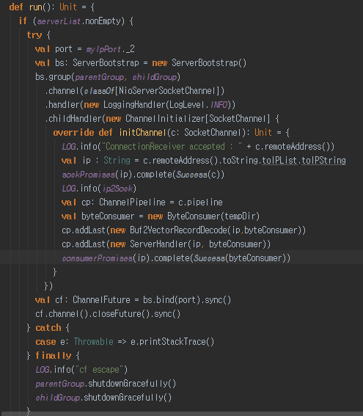
Asynchronous recieve with natty
Total size
size
SortedData
size
SortedData
size
SortedData
Buf2VectorRecordDecode
Vector[Record]
ServerHandler
BigOutputFile

Slide 30
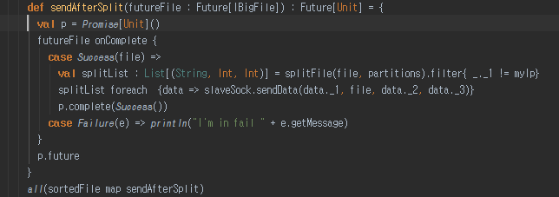
Asynchronous send data
After one IBigFile sort, directly send without wait all IBigFile sort process
sort/partition
merge
shuffle
network idle
network busy

Slide 31
결과를 동영상으로 만들어서 넣어보자.

Slide 32
THANK
YOU
Q&A

