Slide 1
Lesson 2
Can I sit here?

Slide 2
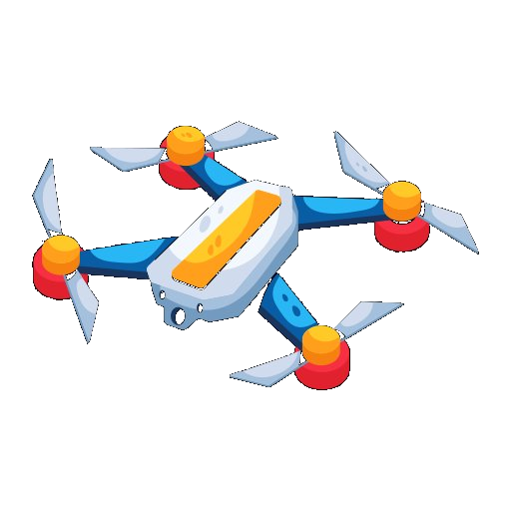
fly a drone

Slide 3
드론을 날리다

Slide 4
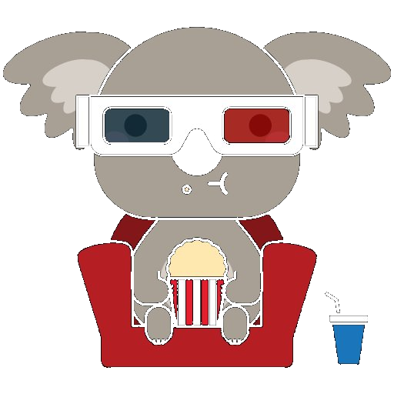
watch a movie

Slide 5
영화를 보다

Slide 6

draw a picture

Slide 7
그림을 그리다

Slide 8
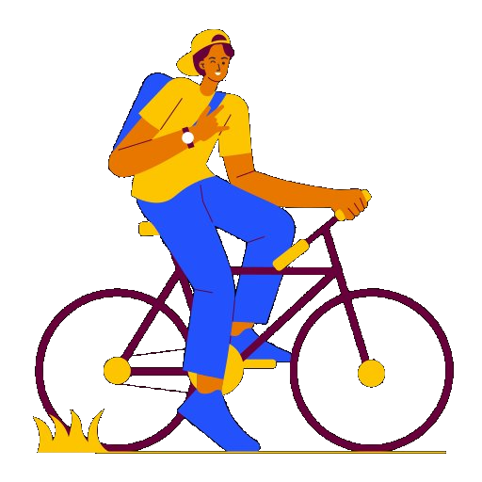
ride a bike

Slide 9
자전거를 타다

Slide 10

sit here

Slide 11
여기에 앉다

Slide 12
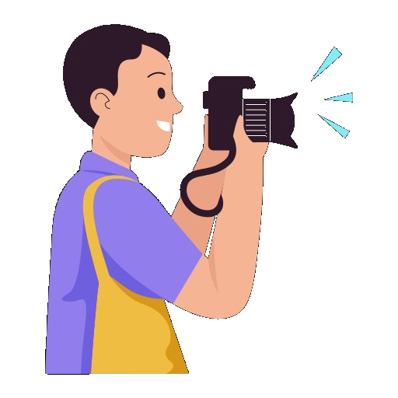
take a picture
Notes:
<a href="https://www.flaticon.com/free-icons/glasses" title="glasses icons">Glasses icons created by Freepik - Flaticon</a>

Slide 13
사진을 찍다

Slide 14

show

Slide 15
공연
Notes:
<a href="https://www.flaticon.com/free-icons/tuesday" title="tuesday icons">Tuesday icons created by Freepik - Flaticon</a>

Slide 16
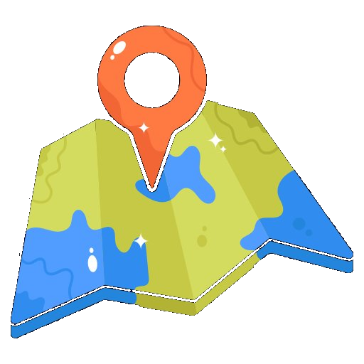
map

Slide 17
지도

Slide 18
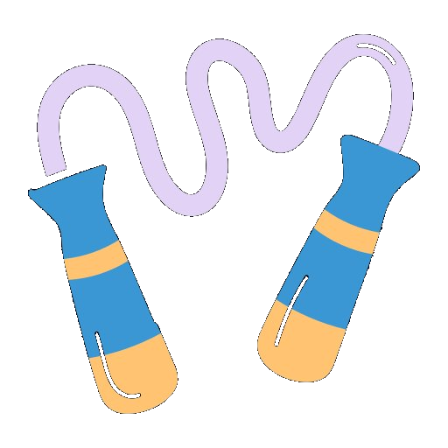
rope

Slide 19
밧줄

Slide 20
Practice 1 -in Korean (한글로)

Slide 21
fly a drone

Slide 22
watch a movie

Slide 23
draw a picture

Slide 24
ride a bike

Slide 25
sit here

Slide 26
take a picture
Notes:
<a href="https://www.flaticon.com/free-icons/glasses" title="glasses icons">Glasses icons created by Freepik - Flaticon</a>

Slide 27
show

Slide 28
map

Slide 29
rope

Slide 30
Practice 2 -in English (영어로)

Slide 31
드론을 날리다

Slide 32
영화를 보다

Slide 33
그림을 그리다

Slide 34
자전거를 타다

Slide 35
여기에 앉다

Slide 36
사진을 찍다

Slide 37
공연
Notes:
<a href="https://www.flaticon.com/free-icons/tuesday" title="tuesday icons">Tuesday icons created by Freepik - Flaticon</a>

Slide 38
지도

Slide 39
밧줄

Slide 40
Practice 3 -in Korean (한글로)

Slide 41
fly a drone

Slide 42
watch a movie

Slide 43
draw a picture

Slide 44
ride a bike

Slide 45
sit here

Slide 46
take a picture
Notes:
<a href="https://www.flaticon.com/free-icons/glasses" title="glasses icons">Glasses icons created by Freepik - Flaticon</a>

Slide 47
show

Slide 48
map

Slide 49
rope

Slide 50
Practice 4 -in English (영어로)

Slide 56
Notes:
<a href="https://www.flaticon.com/free-icons/glasses" title="glasses icons">Glasses icons created by Freepik - Flaticon</a>

