Slide 1

take a picture

Slide 2

sit here

Slide 3
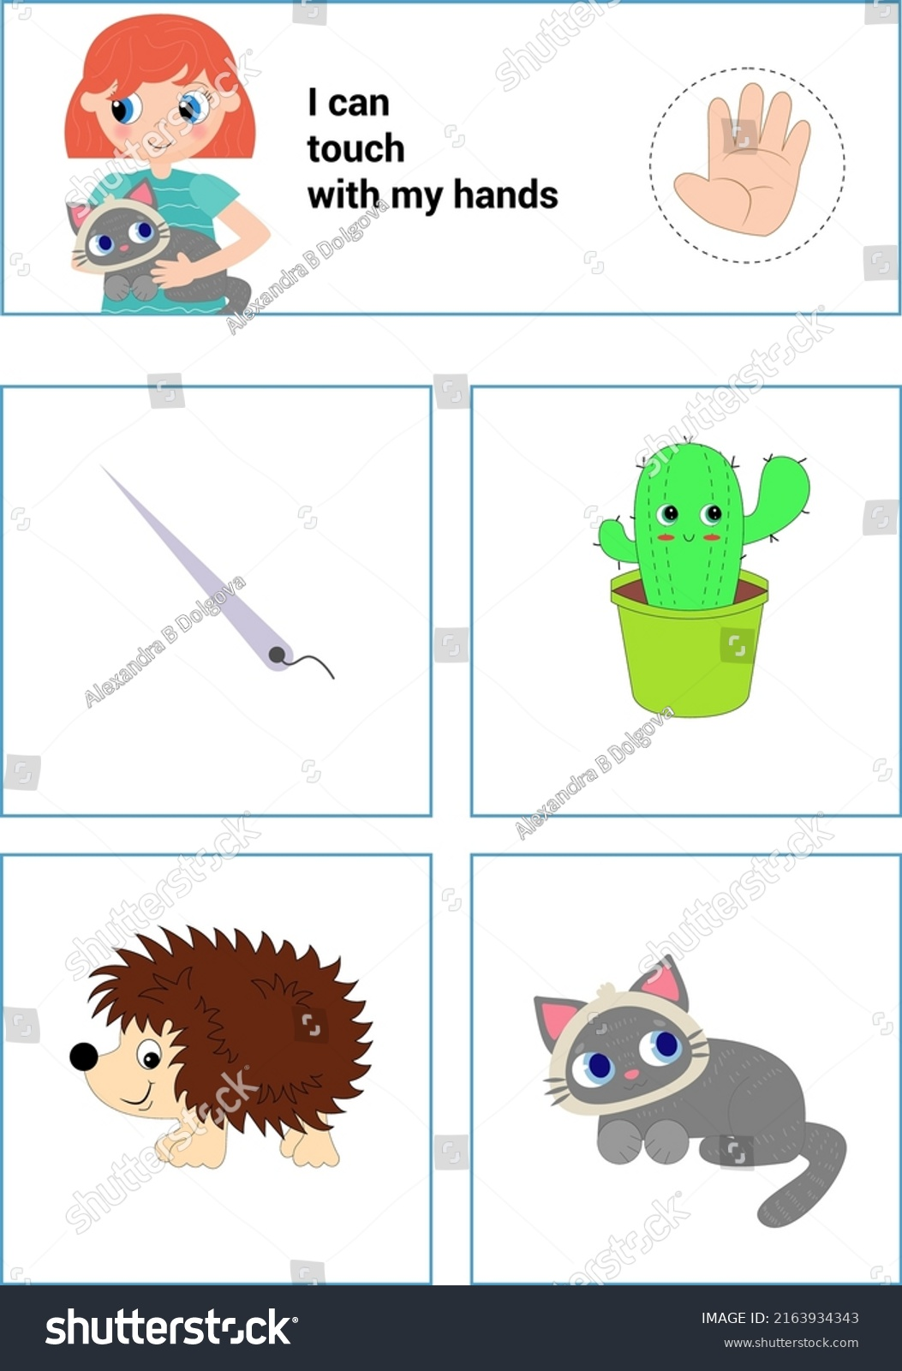
touch that

Slide 4

run

Slide 5

eat snacks

Slide 6

drink water

Slide 7

speak loudly

Slide 8
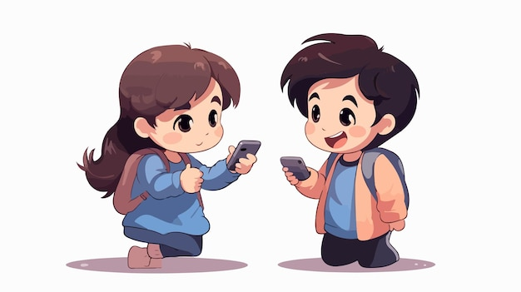
use a phone

Slide 9

ask a question

Slide 10

open the door

Slide 11

write notes

Slide 12
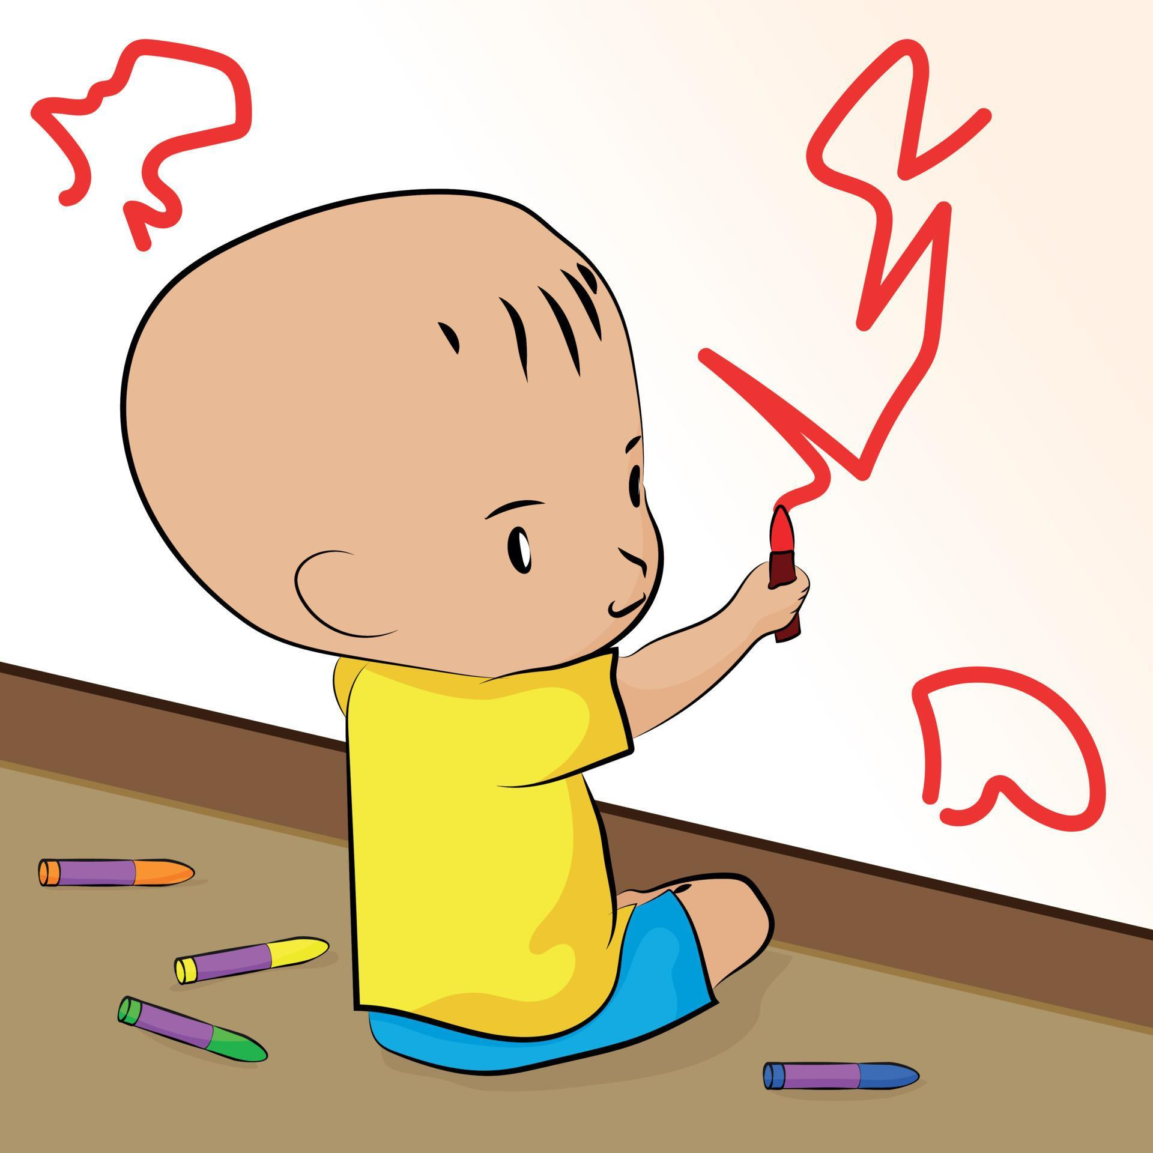
draw on the wall

Slide 13

bring a bag

Slide 14

listen to music

Slide 15
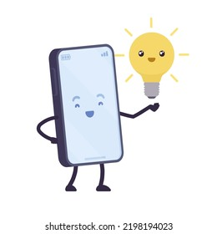
turn on the flash

Slide 16
Permission Phrases
take a picture
sit here
touch that
run
eat snacks
drink water
speak loudly
use a phone
ask a question
open the door
write notes
draw on the wall
bring a bag
listen to music
turn on the flash

