Slide 1



mystery box
Notes:
This template is for educational, non-commercial purposes only. For more free game templates like this one, visit https://www.taysteachingtoolkit.com

Slide 2

The mystery box may be good or bad!
+100 pts
-100 pts

Slide 3


Choose to keep the box or give it to another team!

Slide 4





























Slide 5
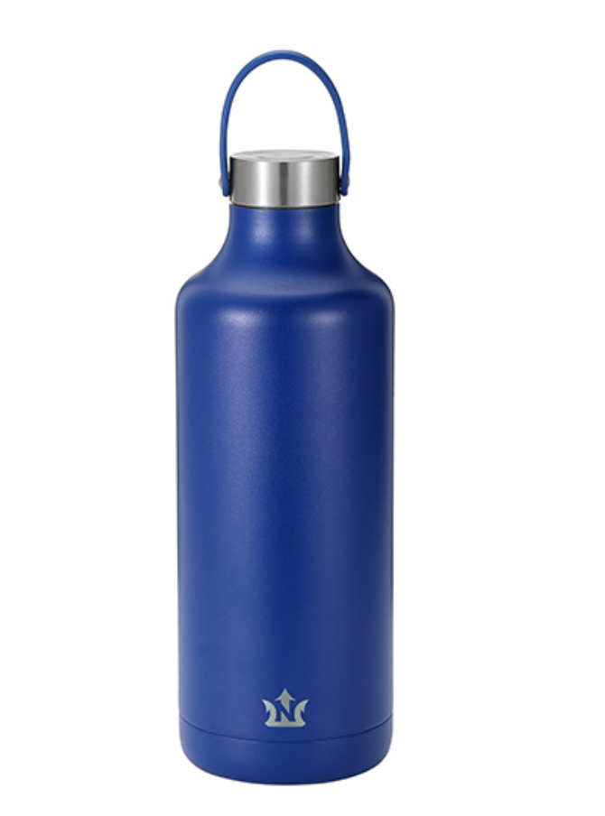

Whose bottle is this?
수호꺼
It's Suho's.
Notes:
Press the spacebar or down arrow to reveal the answer.
Press the X to go back to the letter slide (wrong answer), press the question box to go the reward slide (correct answer).

Slide 6

Whose phone is this?
It’s mine.
Notes:
Press the spacebar or down arrow to reveal the answer.
Press the X to go back to the letter slide (wrong answer), press the question box to go the reward slide (correct answer).

Slide 7

다음 물건의 주인을 물으세요.
Whose umbrella is this?
Notes:
Press the spacebar or down arrow to reveal the answer.
Press the X to go back to the letter slide (wrong answer), press the question box to go the reward slide (correct answer).

Slide 8
다음 문장을 영어로 말하세요.
"이것은 누구의 신발이니?"
Whose shoe is this?
Notes:
Press the spacebar or down arrow to reveal the answer.
Press the X to go back to the letter slide (wrong answer), press the question box to go the reward slide (correct answer).

Slide 9
다음 문장을 영어로 말하세요.
"그녀를 찾아보자."
Let's find her.
Notes:
Press the spacebar or down arrow to reveal the answer.
Press the X to go back to the letter slide (wrong answer), press the question box to go the reward slide (correct answer).

Slide 10
그냥 통과
^^*
다음 페이지로
Notes:
Press the spacebar or down arrow to reveal the answer.
Press the X to go back to the letter slide (wrong answer), press the question box to go the reward slide (correct answer).

Slide 11
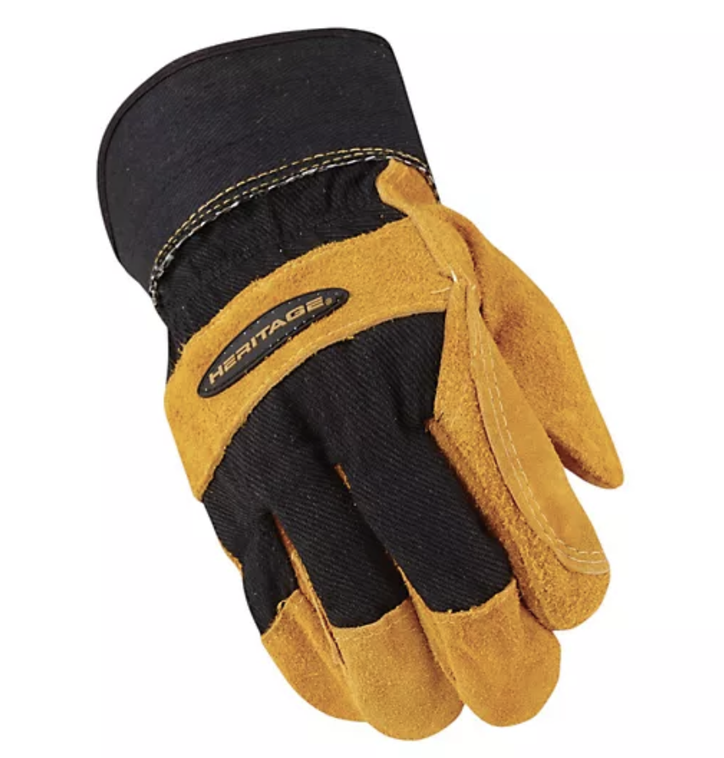
다음 그림을 뜻하는 단어는?
glove 장갑
Notes:
Press the spacebar or down arrow to reveal the answer.
Press the X to go back to the letter slide (wrong answer), press the question box to go the reward slide (correct answer).

Slide 12
Julia가 잃어버린 물건은?
umbrella (우산)
Notes:
Press the spacebar or down arrow to reveal the answer.
Press the X to go back to the letter slide (wrong answer), press the question box to go the reward slide (correct answer).

Slide 13
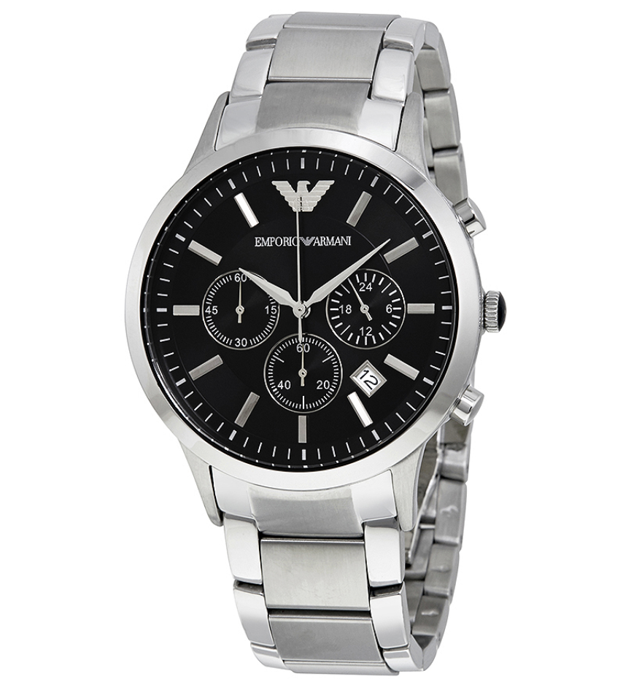
다음 그림을 뜻하는 단어는?
watch 손목시계
Notes:
Press the spacebar or down arrow to reveal the answer.
Press the X to go back to the letter slide (wrong answer), press the question box to go the reward slide (correct answer).

Slide 14
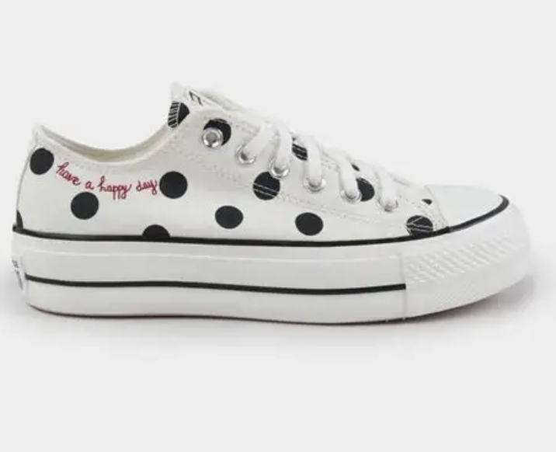
이 신발을 영어로 묘사해 보세요.
It's white. /
It has black dots.
Notes:
Press the spacebar or down arrow to reveal the answer.
Press the X to go back to the letter slide (wrong answer), press the question box to go the reward slide (correct answer).

Slide 15
다음 문장을 영어로 말하세요.
"아니요, 제 것이 아니에요.
제 건 초록색이에요."
No, it's not. Mine is green.
Notes:
Press the spacebar or down arrow to reveal the answer.
Press the X to go back to the letter slide (wrong answer), press the question box to go the reward slide (correct answer).

Slide 16
다음 물건의 주인을 물으세요.
Whose watch is this?
Notes:
Press the spacebar or down arrow to reveal the answer.
Press the X to go back to the letter slide (wrong answer), press the question box to go the reward slide (correct answer).

Slide 17
다음 문장이 틀린 이유는?
It have pink hearts.
주어가 it이므로 have(x) has(o) → It has pink hearts.
Notes:
Press the spacebar or down arrow to reveal the answer.
Press the X to go back to the letter slide (wrong answer), press the question box to go the reward slide (correct answer).

Slide 18
그냥
통과
^^
Notes:
Press the spacebar or down arrow to reveal the answer.
Press the X to go back to the letter slide (wrong answer), press the question box to go the reward slide (correct answer).

Slide 19
알파벳을 배열하여 단어를 만드세요.
a, l, e, r, l, m, b, u, r
umbrella
Notes:
Press the spacebar or down arrow to reveal the answer.
Press the X to go back to the letter slide (wrong answer), press the question box to go the reward slide (correct answer).

Slide 20


다음 그림을 나타내는 단어는?
c _ _ _ _ _
circle
Notes:
Press the spacebar or down arrow to reveal the answer.
Press the X to go back to the letter slide (wrong answer), press the question box to go the reward slide (correct answer).

Slide 21
알파벳을 배열하여 단어를 만드세요
t, l, b, t, o, e
bottle
Notes:
Press the spacebar or down arrow to reveal the answer.
Press the X to go back to the letter slide (wrong answer), press the question box to go the reward slide (correct answer).

Slide 22
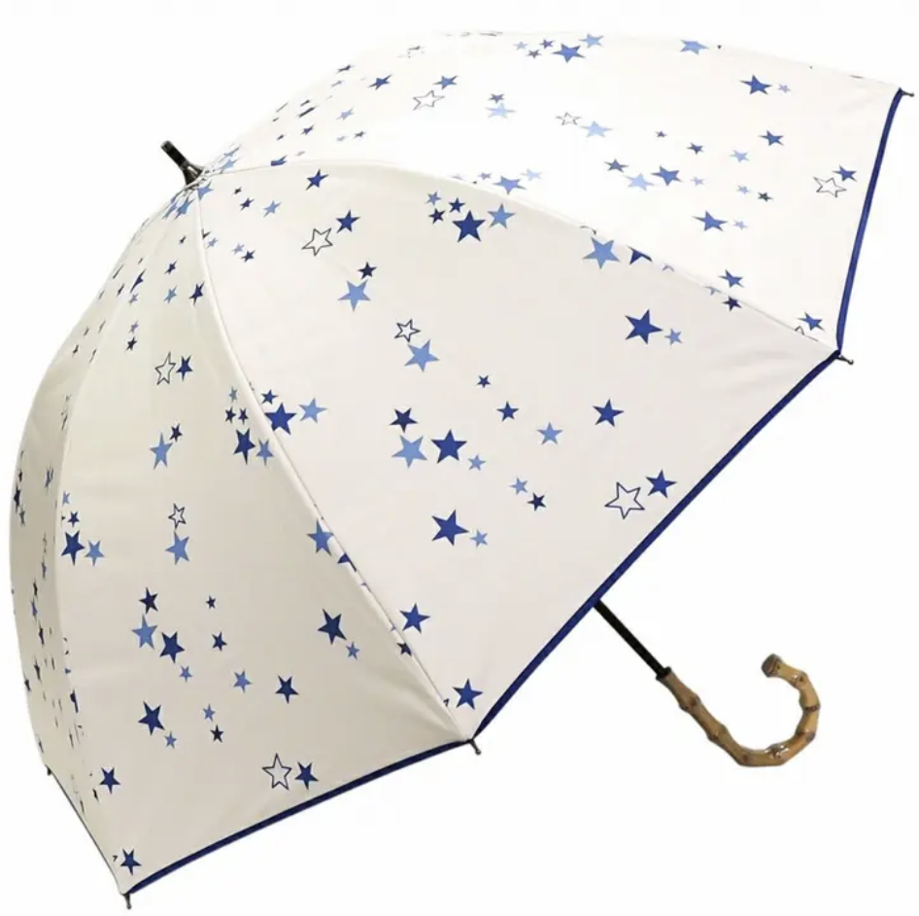
이 우산을 영어로 묘사해 보자
It has blue stars.
Notes:
Press the spacebar or down arrow to reveal the answer.
Press the X to go back to the letter slide (wrong answer), press the question box to go the reward slide (correct answer).

Slide 23
알파벳을 배열하여 단어를 만드세요
t, h, e, r, a
heart
Notes:
Press the spacebar or down arrow to reveal the answer.
Press the X to go back to the letter slide (wrong answer), press the question box to go the reward slide (correct answer).

Slide 24

이 모자를 영어로 묘사해 보세요.
It is pink/red.
It has a heart.
Notes:
Press the spacebar or down arrow to reveal the answer.
Press the X to go back to the letter slide (wrong answer), press the question box to go the reward slide (correct answer).

Slide 25
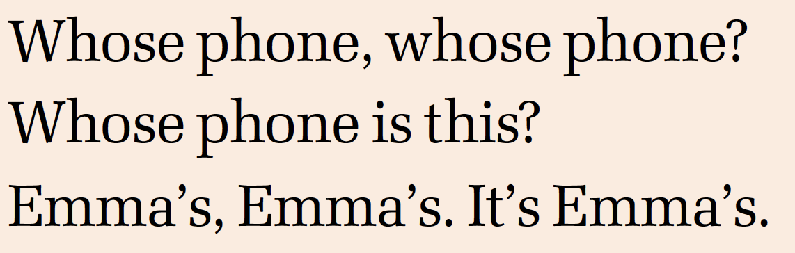
빈칸에 들어갈 노래 가사는?
phone, phone / is this
Notes:
Press the spacebar or down arrow to reveal the answer.
Press the X to go back to the letter slide (wrong answer), press the question box to go the reward slide (correct answer).

Slide 26
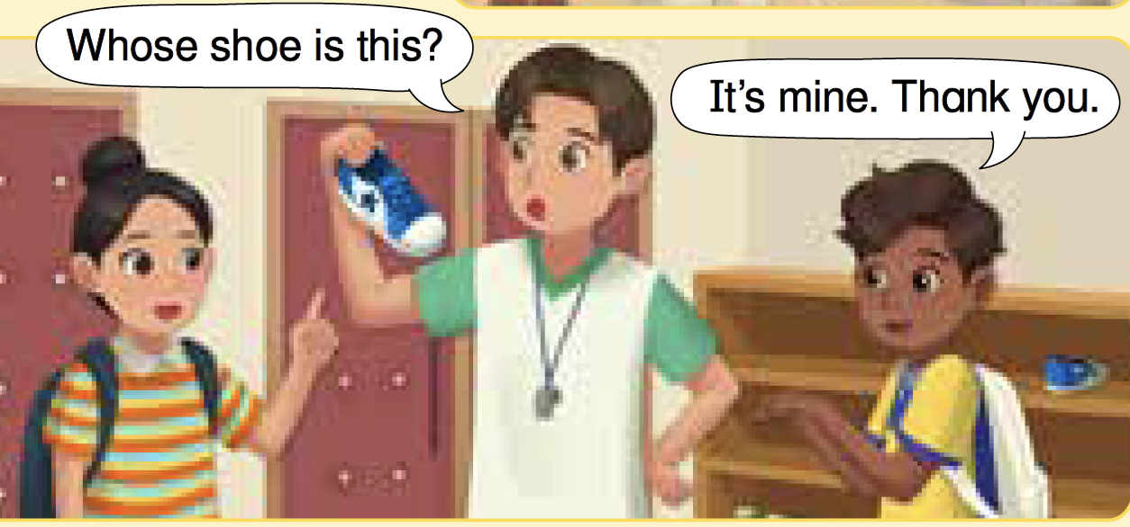
다음 대화의 빈칸에 들어갈 말은?
Whose shoe is this?
It’s mine. Thank you.
Notes:
Press the spacebar or down arrow to reveal the answer.
Press the X to go back to the letter slide (wrong answer), press the question box to go the reward slide (correct answer).

Slide 27
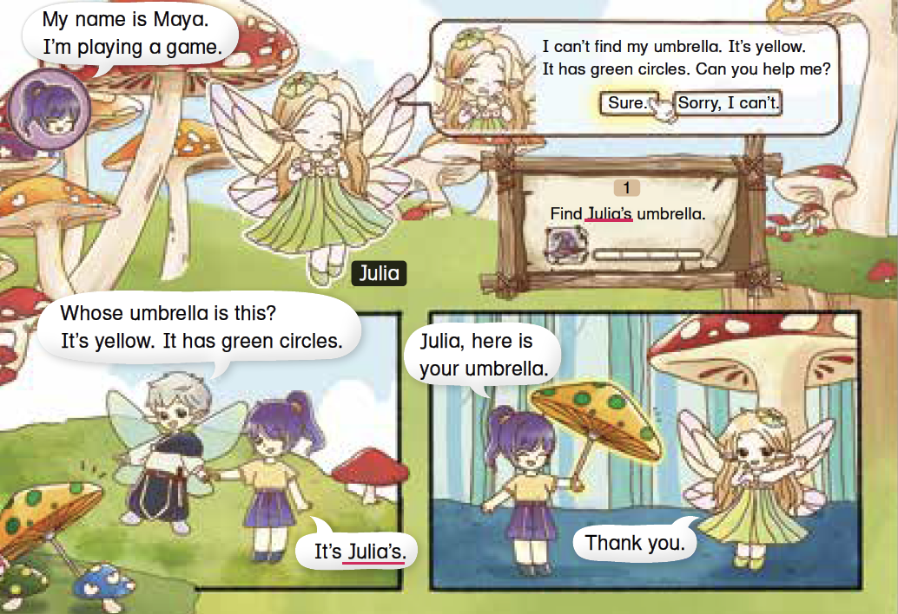
이 글의 제목으로 알맞은 것은?
Find Julia's Umbrella!
Notes:
Press the spacebar or down arrow to reveal the answer.
Press the X to go back to the letter slide (wrong answer), press the question box to go the reward slide (correct answer).

Slide 28
단어를 배열하여 문장을 만드세요.
this, Is, watch, your (+ ?)
Is this your watch?
Notes:
Press the spacebar or down arrow to reveal the answer.
Press the X to go back to the letter slide (wrong answer), press the question box to go the reward slide (correct answer).

Slide 29
다음 문장을 우리말로 말하세요.
"It's blue and white.
It has a big star."
그것은 파란색과 하얀색이야.
큰 별이 하나 있어.
Notes:
Press the spacebar or down arrow to reveal the answer.
Press the X to go back to the letter slide (wrong answer), press the question box to go the reward slide (correct answer).

Slide 30
그냥 통과!
^^
다음 페이지로
Notes:
Press the spacebar or down arrow to reveal the answer.
Press the X to go back to the letter slide (wrong answer), press the question box to go the reward slide (correct answer).

Slide 31
다음 빈칸에 들어갈 알파벳은?
u _ b _ e _ _ a (우산)
m, r, l, l
Notes:
Press the spacebar or down arrow to reveal the answer.
Press the X to go back to the letter slide (wrong answer), press the question box to go the reward slide (correct answer).

Slide 32
다음 대화를 우리말로 말하세요.
A: "Is this yours?"
B: "Yes, it is. Thank you."
A: 이거 네 거니?
B: 응, 맞아. 고마워.
Notes:
Press the spacebar or down arrow to reveal the answer.
Press the X to go back to the letter slide (wrong answer), press the question box to go the reward slide (correct answer).

Slide 33




+100 pts
Keep or give the mystery box?
Notes:
Ask the student(s) if they want to keep the box or give it to another student/team.
Click the question block to reveal the reward/punishment.
Press the Mario icon in the corner to go back to the letter slide.

Slide 34
+100 pts
Keep or give the mystery box?
Notes:
Ask the student(s) if they want to keep the box or give it to another student/team.
Click the question block to reveal the reward/punishment.
Press the Mario icon in the corner to go back to the letter slide.

Slide 35
+200 pts
Keep or give the mystery box?
Notes:
Ask the student(s) if they want to keep the box or give it to another student/team.
Click the question block to reveal the reward/punishment.
Press the Mario icon in the corner to go back to the letter slide.

Slide 36
+200 pts
Keep or give the mystery box?
Notes:
Ask the student(s) if they want to keep the box or give it to another student/team.
Click the question block to reveal the reward/punishment.
Press the Mario icon in the corner to go back to the letter slide.

Slide 37
+300 pts
Keep or give the mystery box?
Notes:
Ask the student(s) if they want to keep the box or give it to another student/team.
Click the question block to reveal the reward/punishment.
Press the Mario icon in the corner to go back to the letter slide.

Slide 38
+300 pts
Keep or give the mystery box?
Notes:
Ask the student(s) if they want to keep the box or give it to another student/team.
Click the question block to reveal the reward/punishment.
Press the Mario icon in the corner to go back to the letter slide.

Slide 39
+400 pts
Keep or give the mystery box?
Notes:
Ask the student(s) if they want to keep the box or give it to another student/team.
Click the question block to reveal the reward/punishment.
Press the Mario icon in the corner to go back to the letter slide.

Slide 40
+500 pts
Keep or give the mystery box?
Notes:
Ask the student(s) if they want to keep the box or give it to another student/team.
Click the question block to reveal the reward/punishment.
Press the Mario icon in the corner to go back to the letter slide.

Slide 41

-100 pts
Keep or give the mystery box?
Notes:
Ask the student(s) if they want to keep the box or give it to another student/team.
Click the question block to reveal the reward/punishment.
Press the Mario icon in the corner to go back to the letter slide.

Slide 42
-100 pts
Keep or give the mystery box?
Notes:
Ask the student(s) if they want to keep the box or give it to another student/team.
Click the question block to reveal the reward/punishment.
Press the Mario icon in the corner to go back to the letter slide.

Slide 43
-200 pts
Keep or give the mystery box?
Notes:
Ask the student(s) if they want to keep the box or give it to another student/team.
Click the question block to reveal the reward/punishment.
Press the Mario icon in the corner to go back to the letter slide.

Slide 44
-200 pts
Keep or give the mystery box?
Notes:
Ask the student(s) if they want to keep the box or give it to another student/team.
Click the question block to reveal the reward/punishment.
Press the Mario icon in the corner to go back to the letter slide.

Slide 45
-300 pts
Keep or give the mystery box?
Notes:
Ask the student(s) if they want to keep the box or give it to another student/team.
Click the question block to reveal the reward/punishment.
Press the Mario icon in the corner to go back to the letter slide.

Slide 46
-300 pts
Keep or give the mystery box?
Notes:
Ask the student(s) if they want to keep the box or give it to another student/team.
Click the question block to reveal the reward/punishment.
Press the Mario icon in the corner to go back to the letter slide.

Slide 47
-400 pts
Keep or give the mystery box?
Notes:
Ask the student(s) if they want to keep the box or give it to another student/team.
Click the question block to reveal the reward/punishment.
Press the Mario icon in the corner to go back to the letter slide.

Slide 48
-500 pts
Keep or give the mystery box?
Notes:
Ask the student(s) if they want to keep the box or give it to another student/team.
Click the question block to reveal the reward/punishment.
Press the Mario icon in the corner to go back to the letter slide.

Slide 49


Change pts!
Keep or give the mystery box?
Notes:
Ask the student(s) if they want to keep the box or give it to another student/team.
Click the question block to reveal the reward/punishment.
Press the Mario icon in the corner to go back to the letter slide.

Slide 50
Change pts!
Keep or give the mystery box?
Notes:
Ask the student(s) if they want to keep the box or give it to another student/team.
Click the question block to reveal the reward/punishment.
Press the Mario icon in the corner to go back to the letter slide.

Slide 51

pts x2!
Keep or give the mystery box?
Notes:
Ask the student(s) if they want to keep the box or give it to another student/team.
Click the question block to reveal the reward/punishment.
Press the Mario icon in the corner to go back to the letter slide.

Slide 52
pts x2!
Keep or give the mystery box?
Notes:
Ask the student(s) if they want to keep the box or give it to another student/team.
Click the question block to reveal the reward/punishment.
Press the Mario icon in the corner to go back to the letter slide.

Slide 53

Steal 200 pts!
Keep or give the mystery box?
Notes:
Ask the student(s) if they want to keep the box or give it to another student/team.
Click the question block to reveal the reward/punishment.
Press the Mario icon in the corner to go back to the letter slide.

Slide 54
Steal 300 pts!
Keep or give the mystery box?
Notes:
Ask the student(s) if they want to keep the box or give it to another student/team.
Click the question block to reveal the reward/punishment.
Press the Mario icon in the corner to go back to the letter slide.

Slide 55
Lose all pts!
Keep or give the mystery box?
Notes:
Ask the student(s) if they want to keep the box or give it to another student/team.
Click the question block to reveal the reward/punishment.
Press the Mario icon in the corner to go back to the letter slide.

Slide 56
Lose all pts!
Keep or give the mystery box?
Notes:
Ask the student(s) if they want to keep the box or give it to another student/team.
Click the question block to reveal the reward/punishment.
Press the Mario icon in the corner to go back to the letter slide.

Slide 57
+1000 pts!
Keep or give the mystery box?
Notes:
Ask the student(s) if they want to keep the box or give it to another student/team.
Click the question block to reveal the reward/punishment.
Press the Mario icon in the corner to go back to the letter slide.

Slide 58
+1000 pts!
Keep or give the mystery box?
Notes:
Ask the student(s) if they want to keep the box or give it to another student/team.
Click the question block to reveal the reward/punishment.
Press the Mario icon in the corner to go back to the letter slide.

Slide 59
pts -x2!
Keep or give the mystery box?
Notes:
Ask the student(s) if they want to keep the box or give it to another student/team.
Click the question block to reveal the reward/punishment.
Press the Mario icon in the corner to go back to the letter slide.

Slide 60
pts -x2!
Keep or give the mystery box?
Notes:
Ask the student(s) if they want to keep the box or give it to another student/team.
Click the question block to reveal the reward/punishment.
Press the Mario icon in the corner to go back to the letter slide.

