Slide 1

SAFECRACKER
Notes:
This template is for educational, non-commercial purposes only. For more free game templates like this one, visit https://www.taysteachingtoolkit.com
-----
HOW TO PLAY: Students can see different pictures on the safe, each with numbers under them. The teacher will read a set of words or sentences. Students will try to match what the teacher says to the pictures on the screen and write down the numbers under them. The numbers they write will make a code to unlock the safe.

Slide 2
HOW TO PLAY
Write the numbers 1-10 in your notebook.

Slide 3
HOW TO PLAY
Listen carefully to the words or sentences I say and match them to the pictures on the safe.

Slide 4
HOW TO PLAY
As you find each matching picture, write the number under it in your notebook.

Slide 5
HOW TO PLAY
The numbers will make a code to unlock the safe.

Slide 6


LEVEL 1
TALKING SPEED
Notes:
Slow talking speed

Slide 7
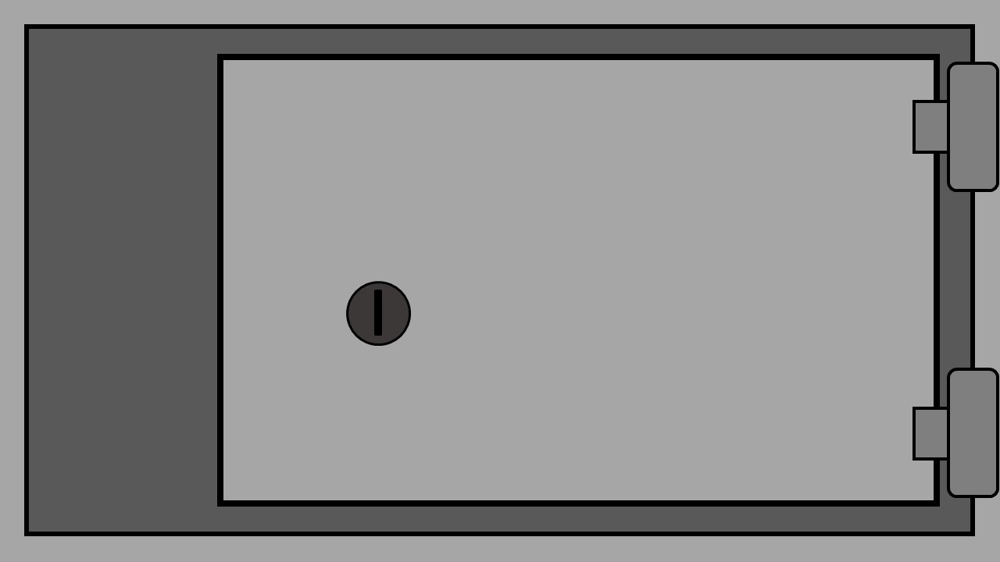



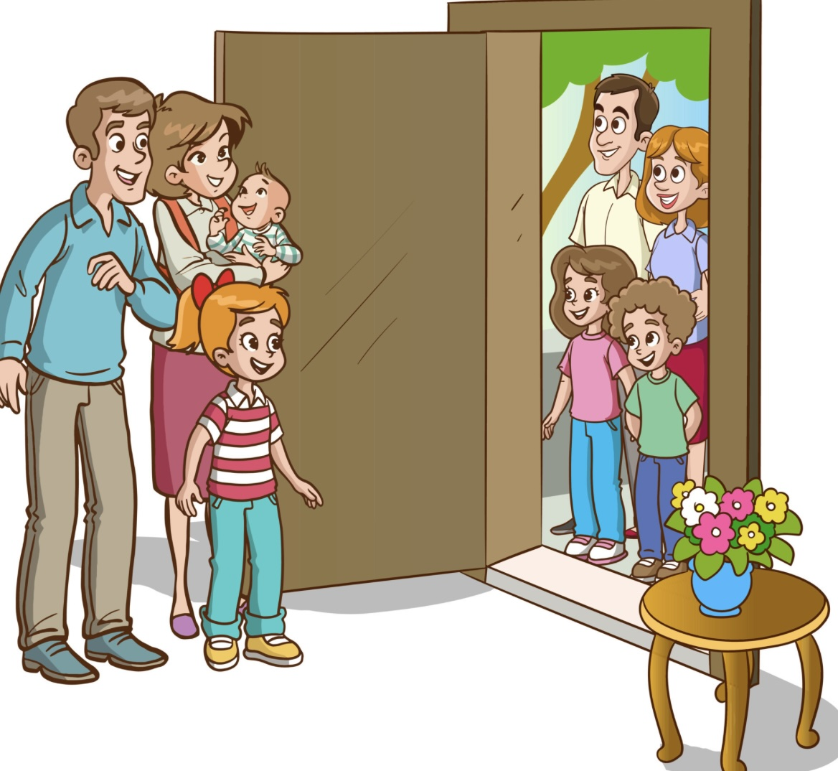

314
#1
1
2
3
4
Notes:
Replace the pictures on the safe by right clicking on the picture icon and press “Change Picture…” Choose the picture you want to replace it with from your files and click “Insert.”
The pound symbols in the green bar are where you put your answer that will show up after students have solved the code. Replace symbols with numbers (as little or as many as you want).

Slide 8


241
#2
1
2
3
4
Notes:
Replace the pictures on the safe by right clicking on the picture icon and press “Change Picture…” Choose the picture you want to replace it with from your files and click “Insert.”
The pound symbols in the green bar are where you put your answer that will show up after students have solved the code. Replace symbols with numbers (as little or as many as you want).

Slide 9
LEVEL 2
TALKING SPEED
Notes:
Slow talking speed

Slide 10
5263
#3
1
2
3
4
5
6
Notes:
Replace the pictures on the safe by right clicking on the picture icon and press “Change Picture…” Choose the picture you want to replace it with from your files and click “Insert.”
The pound symbols in the green bar are where you put your answer that will show up after students have solved the code. Replace symbols with numbers (as little or as many as you want).

Slide 11
3146
#4
1
2
3
4
5
6
Notes:
Replace the pictures on the safe by right clicking on the picture icon and press “Change Picture…” Choose the picture you want to replace it with from your files and click “Insert.”
The pound symbols in the green bar are where you put your answer that will show up after students have solved the code. Replace symbols with numbers (as little or as many as you want).

Slide 12
LEVEL 3
TALKING SPEED
Notes:
Normal talking speed

Slide 13
51624
#5
1
2
3
4
5
6
Notes:
Replace the pictures on the safe by right clicking on the picture icon and press “Change Picture…” Choose the picture you want to replace it with from your files and click “Insert.”
The pound symbols in the green bar are where you put your answer that will show up after students have solved the code. Replace symbols with numbers (as little or as many as you want).

Slide 14
36152
#6
1
2
3
4
5
6
Notes:
Replace the pictures on the safe by right clicking on the picture icon and press “Change Picture…” Choose the picture you want to replace it with from your files and click “Insert.”
The pound symbols in the green bar are where you put your answer that will show up after students have solved the code. Replace symbols with numbers (as little or as many as you want).

Slide 15
LEVEL 4
TALKING SPEED
Notes:
Normal talking speed

Slide 16
35162
#7
1
2
3
4
5
6
Notes:
Replace the pictures on the safe by right clicking on the picture icon and press “Change Picture…” Choose the picture you want to replace it with from your files and click “Insert.”
The pound symbols in the green bar are where you put your answer that will show up after students have solved the code. Replace symbols with numbers (as little or as many as you want).

Slide 17
462513
#8
1
2
3
4
5
6
Notes:
Replace the pictures on the safe by right clicking on the picture icon and press “Change Picture…” Choose the picture you want to replace it with from your files and click “Insert.”
The pound symbols in the green bar are where you put your answer that will show up after students have solved the code. Replace symbols with numbers (as little or as many as you want).

Slide 18
LEVEL 5
TALKING SPEED
Notes:
Fast talking speed

Slide 19
251463
#9
1
2
3
4
5
6
Notes:
Replace the pictures on the safe by right clicking on the picture icon and press “Change Picture…” Choose the picture you want to replace it with from your files and click “Insert.”
The pound symbols in the green bar are where you put your answer that will show up after students have solved the code. Replace symbols with numbers (as little or as many as you want).

Slide 20
615243
#10
1
2
3
4
5
6
Notes:
Replace the pictures on the safe by right clicking on the picture icon and press “Change Picture…” Choose the picture you want to replace it with from your files and click “Insert.”
The pound symbols in the green bar are where you put your answer that will show up after students have solved the code. Replace symbols with numbers (as little or as many as you want).

Slide 21
GOOD JOB!

