Slide 1


From Physical AI Data to Operational Insights
Presentation By Clover Yang
August 2026

Slide 2


Project Overview
Project Scope
Aido Rover telemetry analysis
Fari interaction quality analysis
Multi-platform KPI framework
Executive dashboard prototype
Raw Data
↓
Data Quality
↓
EDA
↓
Feature Engineering
↓
ML Analysis
↓
KPI Pipeline
↓
Dashboard
Built a complete workflow from raw physical AI data to actionable insights.

Slide 3

Different AI Platforms Require Different Data Strategies
Platform
Data
Goal
Aido Rover
Battery, LiDAR, Torque
Robot health monitoring
Fari
Conversation data
Interaction quality
Sentinel Prime AI
Security events
Risk monitoring

Slide 4

Key Findings
GPS
Missing location records required validation
LiDAR
Saturation values affected distance analysis
Wheel Torque
Noise spikes required smoothing
Data validation was necessary before statistical and machine learning analysis.
Data Quality & EDA
Missing value chart
Correlation heatmap
Distribution chart

Slide 5

Statistical Analysis
Mann-Whitney- 1
Purpose: Compare sensor behavior
Mann-Whitney U Test
Chi-Square Test
One Sample t-Test
Kruskal-Wallis Test
Regression Analysis
Chi-square- 2
Purpose: Check status relationship
Regression- 3
Purpose: Understand battery factors

Slide 6

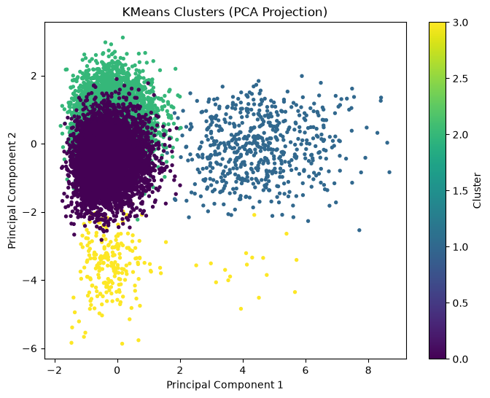
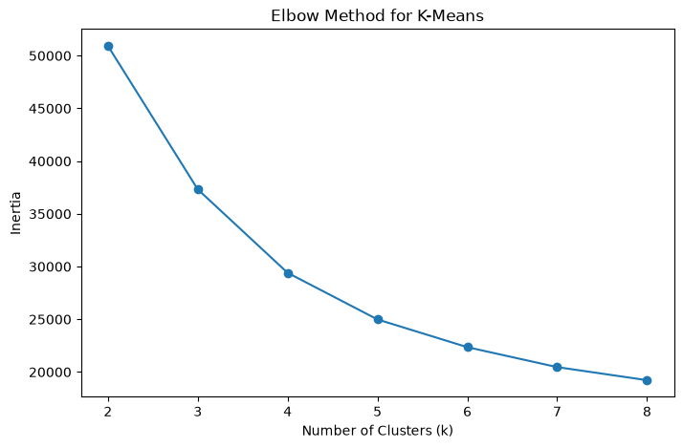
Clustering
Optimal k = 4
Clusters represented different combinations of:
• Battery condition
• Sensor stability
• Torque behavior
Segmentation helps identify different operational states.

Slide 7
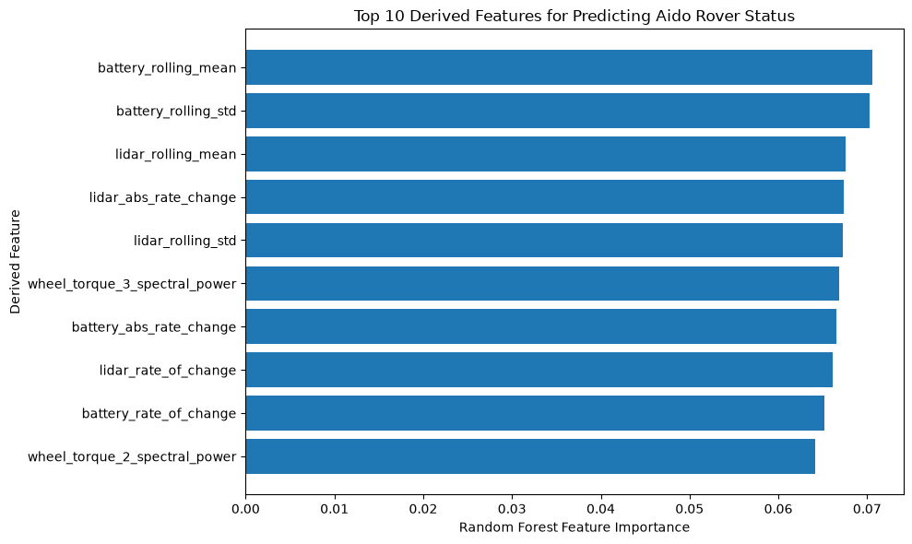
Rover Feature Analysis
Feature | Importance
battery_rolling_mean | 0.0706
battery_rolling_std | 0.0703
lidar_rolling_mean | 0.0676
lidar_abs_rate_change | 0.0674
No single feature dominated Rover health prediction. Multiple sensor patterns contributed together.
www.reallygreatsite.com

Slide 8

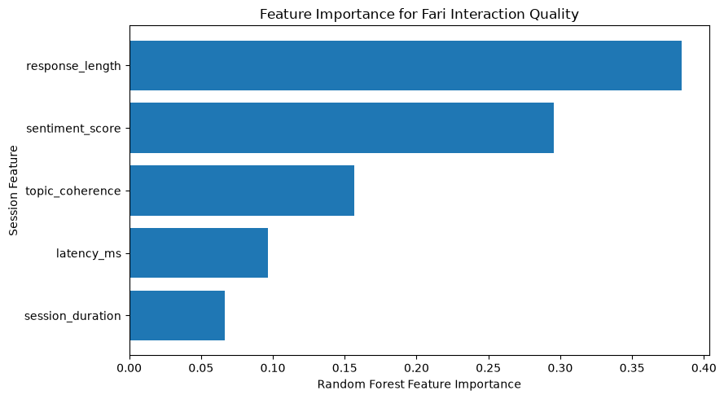
Fari Feature Analysis
Response Length
38.5%
Sentiment Score
29.5%
Combined:
≈68%
Random Forest
Accuracy:
≈88%

Slide 9

Automated Reporting & Dashboard
Battery SOC
59.99%
Fault Rate
0%
High-risk Events
600
LiDAR Distance
8.45
Data
↓
Feature Generation
↓
KPI Calculation
↓
Anomaly Detection
↓
Dashboard
Automated reporting reduced manual analysis effort and improved repeatability.

Slide 10

Limitations & Future Work
Current Limitations
Synthetic datasets
Limited labels
Single rolling window
No production deployment
Dashboard dependency issue
Future Improvements
Real-time telemetry streaming
Cloud dashboard deployment
SHAP explainability
Automated alerts
Database integration

