Slide 1



Seminário:
Orion Context Broker
IN0953-Engenharia de Software
Professores:Silvio Meira / Herbertt
Aluno: Clovis Holanda

Slide 2
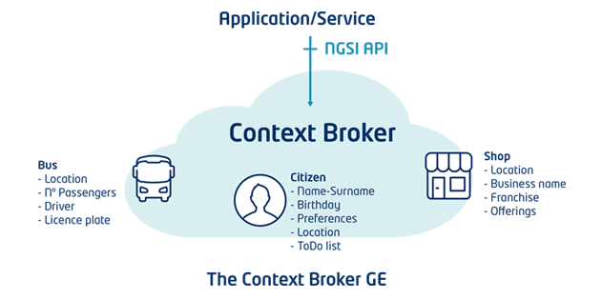
Orion Context Broker
O Orion Context Broker GE é um componente que permite gerir todo ciclo de vida de informações de contexto(Registry, Updates, Queries and others).
Através das interfaces NGSI9 e NGSI10 as operações de contexto são manipuladas.

Slide 3
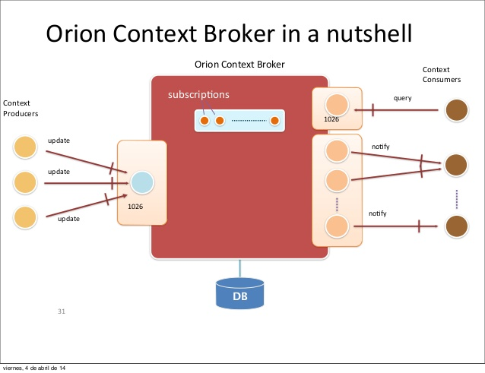
Orion Context Broker

Slide 4
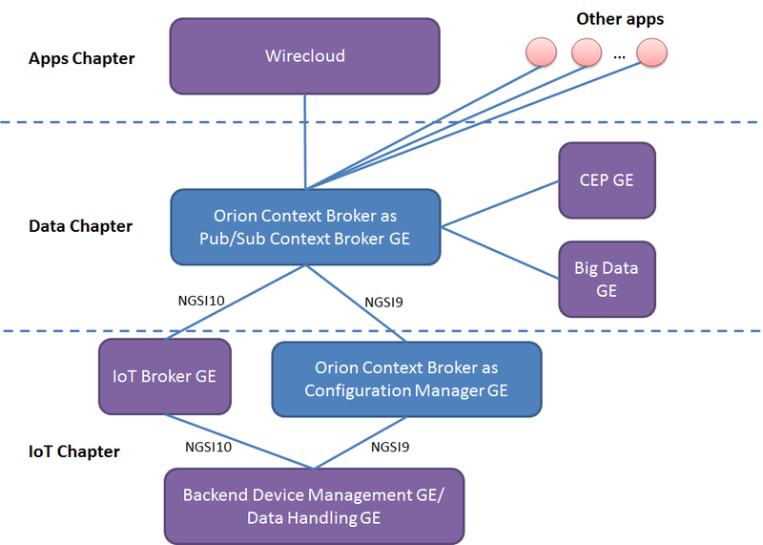

Orion Context Broker
Orion integration

Slide 5

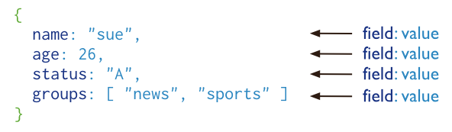
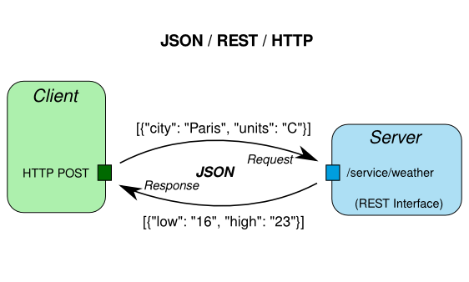

Orion Context Broker

Slide 6
Orion Context Broker
/etc/sysconfig/contextBroker
# BROKER_USER - What user to run orion-broker as
BROKER_USER=orion
# BROKER_PORT - the port/socket where orion-broker will listen for connections
BROKER_PORT=1026
# BROKER_LOG_DIR - Where to log to
BROKER_LOG_DIR=/var/log/contextBroker
# BROKER_PID_FILE - Where to store the pid for orion-broker
BROKER_PID_FILE=/var/log/contextBroker/contextBroker.pid
## Database configuration for orion-broker
BROKER_DATABASE_HOST=localhost
BROKER_DATABASE_NAME=orion
## Replica set configuration. Note that if you set this parameter, the BROKER_DATBASE_HOST
## is interpreted as the list of host (or host:port) separated by commas to use as
## replica set seed list (single element lists are also allowed). If BROKER_DATABASE_RPL_SET
## parameter is unset, Orion CB assumes that the BROKER_DATABASE_HOST is an stand-alone
## mongod instance
#BROKER_DATABASE_RPLSET=orion_rs
# Database authentication (not needed if MongoDB doesn't use --auth)
#BROKER_DATABASE_USER=orion
#BROKER_DATABASE_PASSWORD=orion

Slide 7
Orion Context Broker
 | Functions | Operations
NGSI9 | Register, Search and Subscribe for context sources | registerContext discoverContextAvailability subscribeContextAvailability updateContextAvailabilitySubscription unsubscribeContextAvailability
NGSI10 | Query, Update and Subscribe to context elements | updateContext queryContext subscribeContext updateContextSubscription unsubscribeContextSubscription

Slide 8
Orion Context Broker
Entities
GET /v1/contextEntities/{entityID}
Retrieves an entity
POST /v1/contextEntities/{entityID}
Creates an entity
PUT /v1/contextEntities/{entityID}
Updates an entity
DELETE /v1/contextEntities/{entityID}
Deletes an entity

Slide 9
Orion Context Broker
Attributes
GET /v1/contextEntities/{entityID}/attributes/{attrID}
Retrieves an attribute’s value
POST /v1/contextEntities/{entityID}/attributes/{attrID}
Creates a new attribute for an entity
PUT /v1/contextEntities/{entityID}/attributes/{attrID}
Updates an attribute’s value
DELETE /v1/contextEntities/{entityID}/attributes/{attrID}
Deletes an attribute

Slide 10
Orion Context Broker
Subscriptions
POST /v1/contextSubscriptions
Creates a subscription
PUT /v1/contextSubscriptions/{subID}
Updates a subscription
DELETE /v1/contextSubscriptions/{subID}
Cancel a subscription

Slide 11
Orion Context Broker
Entity Types
GET /v1/contextTypes
Retrieve a list of all entity types currently in Orion, including their corresponding attributes
GET /v1/contextTypes/{typeID}
Retrieve attributes associated to an entity type
PRO TIP
GET /v1/contextTypes?collapse=true
Retrieves a list of all entity types without attribute info

Slide 12
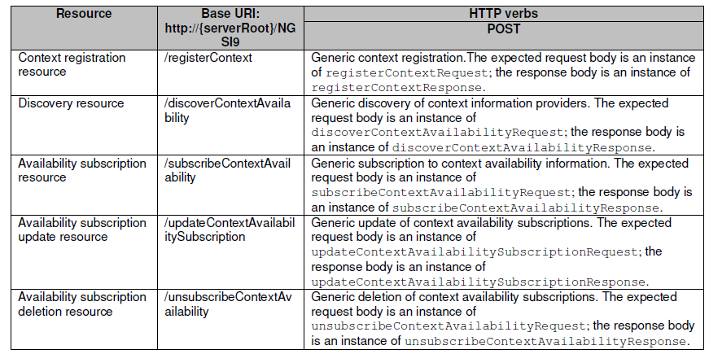
Orion Context Broker
Operações oferecidas por NGSI-9 (disponibilidades).

Slide 13
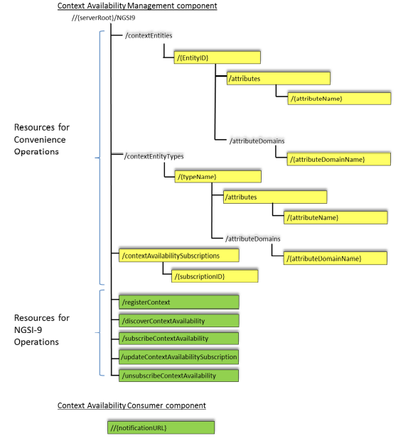
Orion Context Broker

Slide 14
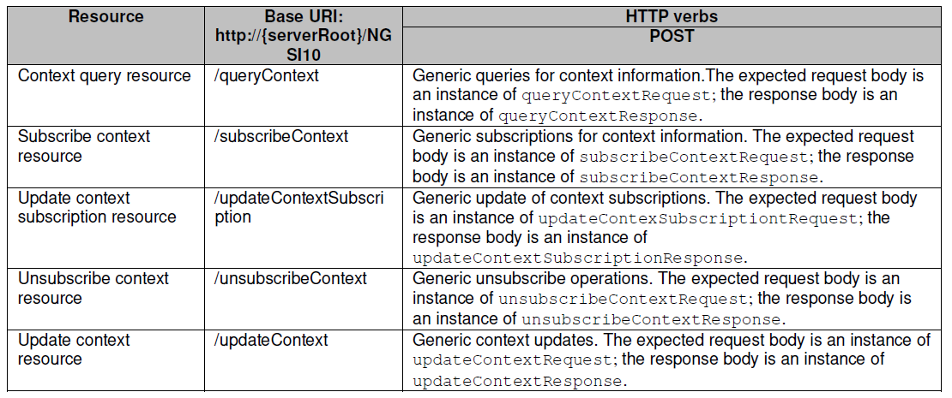
Orion Context Broker
Operações oferecidas por NGSI-10 (informações).

Slide 15
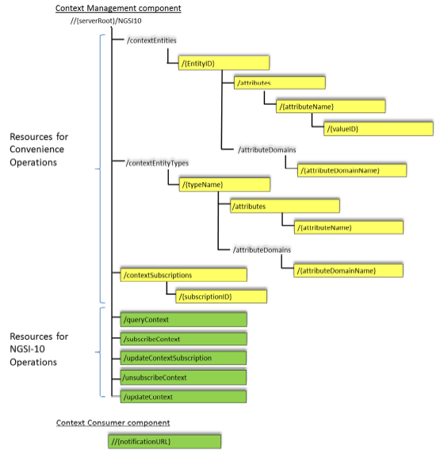
Orion Context Broker

Slide 16
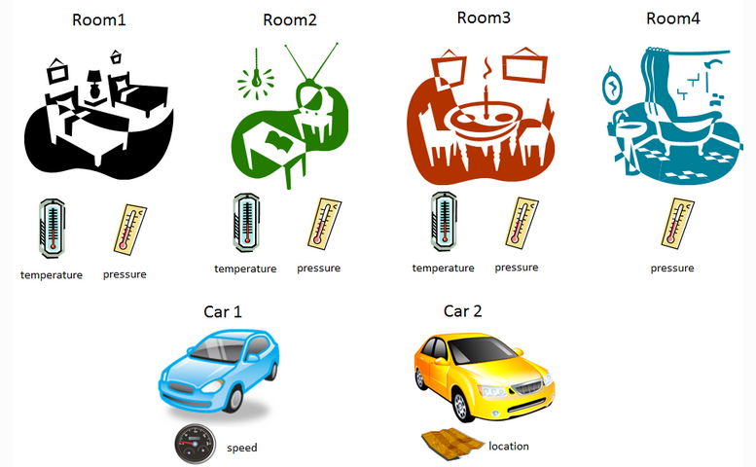
Orion Context Broker

Slide 17
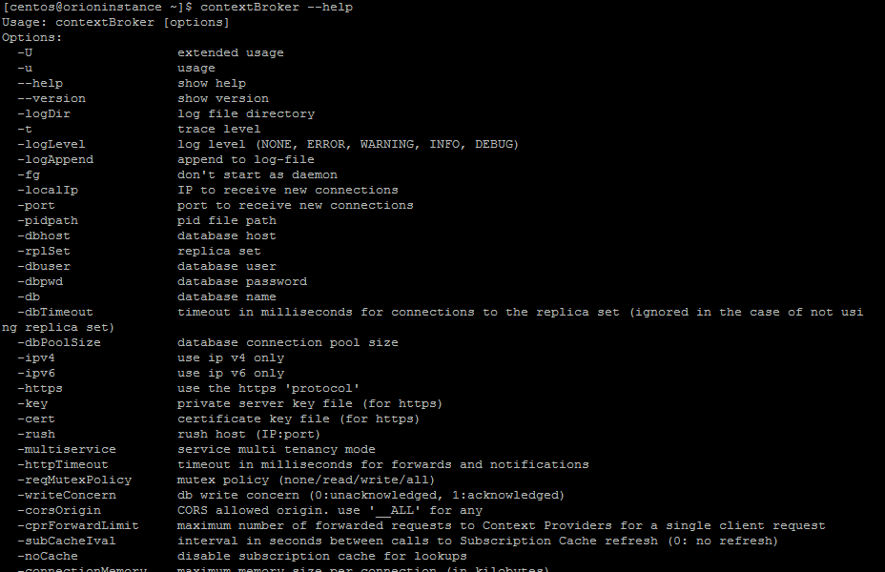
Orion Context Broker

Slide 18
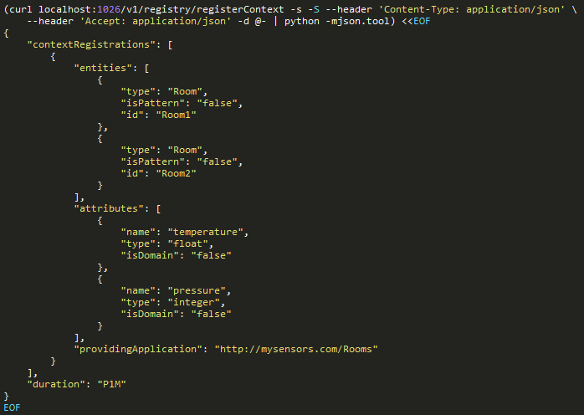
Orion Context Broker
Registrando Room1 e Room2

Slide 19
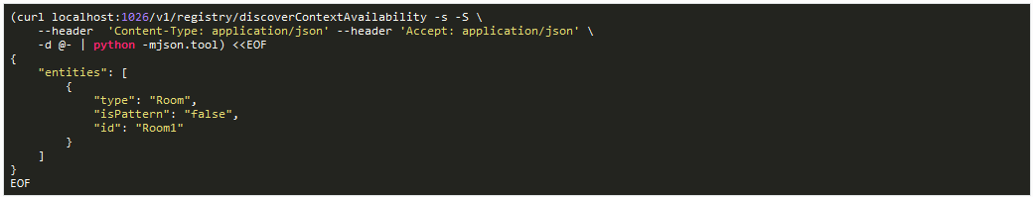
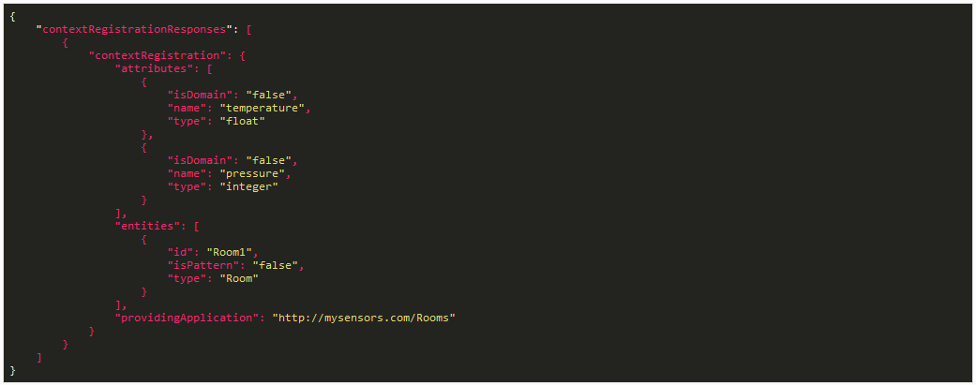
Orion Context Broker
Descobrindo Registro de Room1

Slide 20
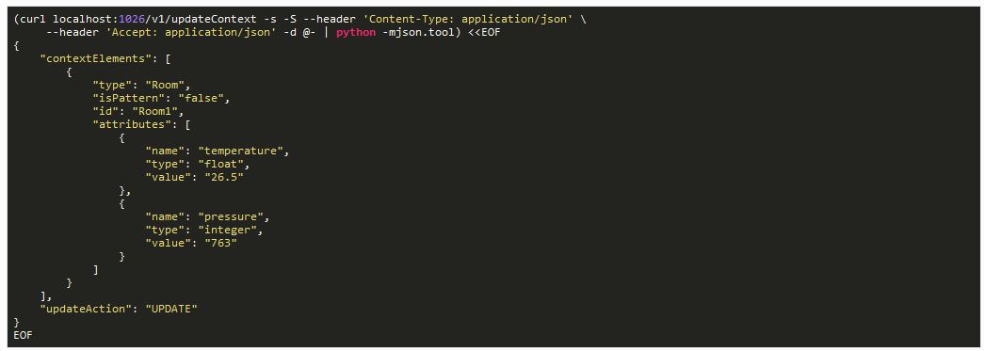
Orion Context Broker
Atualizando dados do Room1

Slide 21
Orion Context Broker
Alternatives products to FIWARE GEs
FIWARE GEs | Alternatives products/services
ORION Context Broker GE | Message Brokers - Distributed publish-subscribe Messaging System [29][30][31] such as: Redis, RabbitMQ, Apache Kafka, Apache ActiveMQ, and Kestrel
Cloud GEs | Cloud services from TELCO and IT companies (e.g. Amazon AWS [20], Google Cloud [21], Microsoft Azure [22])
COSMOS Big Data Analysis GE | Cloudera’s Hadoop dist [23], Hortonworks’s Hadoop dist [24], MapR’s Hadoop dist [25], EMC-spinoff PIVOTAL [26], IBM InfoSphere BigInsights [27]
WIRECLOUD Application Mashup GE | Mashup [28] platforms such as: iMashup, iGoogle, Apache Shindig, Apache Rave
PROTON Complex Event Processing GE | Event Processing Software [32] such as: Oracle Event Processing, Tibco Streambase, Esper, Drools and IBM Infosphere
Fonte:FIWARE Generic Enablers as Building Blocks of a Marketplace for Energy
eChallenges e-2015 Conference Proceedings
Paul Cunningham and Miriam Cunningham (Eds)
IIMC International Information Management Corporation, 2015
ISBN: 978-1-905824-53-3

Slide 22
Orion Context Broker
Referências:
https://fiware-orion.readthedocs.io/en/develop/
http://catalogue.fiware.org/enablers/publishsubscribe-context-broker-orion-context-broker
https://github.com/telefonicaid/fiware-orion/blob/develop/README.md
http://forge.fiware.org/plugins/mediawiki/wiki/fiware/index.php/FI-WARE_NGSI:_publicly_available_documents
https://fiware-orion.readthedocs.io/en/develop/user/walkthrough_apiv1/index.html#update-context-elements

