Slide 1
Extracting Memory Traces of Common Machine Learning Algorithms

Slide 2
Approach:
Build the Arm processor using gem5 by flowing the tutorial on the gem5 site.
Execute the default example programs
Try to compile your own code with the default ARM processor configurations, create their respective binary files and run it
In order to understand where the memory access is taking place, try building your own configuration script rather than using the default one to better understand the flow
The stats.txt file shows parameters like execution cycles, the number of bytes that are read from memory. This gives us a distribution of where the addresses are read and written.
Then implement the machine learning algorithm to use this data and extract the traces.
Note: DO NOT COPY THE COMMANDS FROM THE PPT AND RUN IN THE TERMINAL DIRECTLY, THEY ARE NOT COPIED PROPERLY AND YOU WILL FACE WEIRD UNRELATED ERROS. TYPE ALL COMMANDS MANUALLY.

Slide 3
Creating the configuration script for a simple basic model
Features:
One simple CPU core
One system-wide memory bus
Single DDR3 memory channel, also connected to the memory bus
Parameter | Parameter Value
Clock | 1 Ghz
Memory Mode | Timing
Memory Size | 512 MB
CPU Type | TimingSimpleCPU
Cache | None
Memory Controller Type | DDR3
Timing Simple CPU: executes each instruction in a single clock cycle to execute, except memory requests, which flow through the memory system

Slide 4
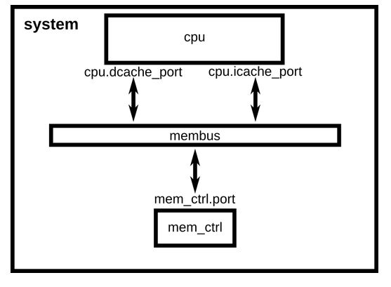
Abstract Diagram of the structure without cache

Slide 5
Results:
Parameter | Parameter Value
Simulation time | 0.000373
Execution Cycles | 373367
Bytes read from I-memory | 20144
Bytes read from D-memory | 4673
Bytes read to D-memory | 3696

Slide 6
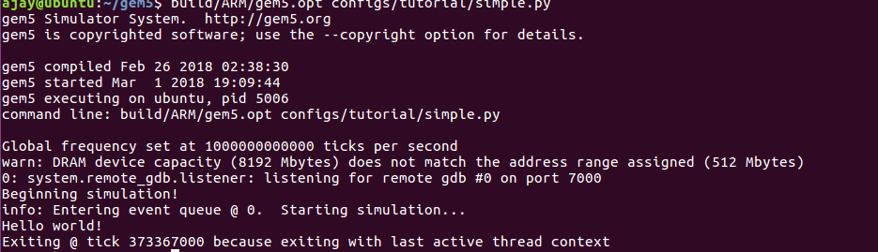
Output:

Slide 7
Creating the configuration script for a simple basic model with Cache
Features:
One simple CPU core
One system-wide memory bus
Single DDR3 memory channel, also connected to the memory bus
Cache included
Parameter | Parameter Value
Clock | 1 Ghz
Memory Mode | Timing
Memory Size | 512 MB
CPU Type | TimingSimpleCPU
Cache | L1: 16 kB, L2: 64 kB
Memory Controller Type | DDR3
Timing Simple CPU: executes each instruction in a single clock cycle to execute, except memory requests, which flow through the memory system

Slide 8
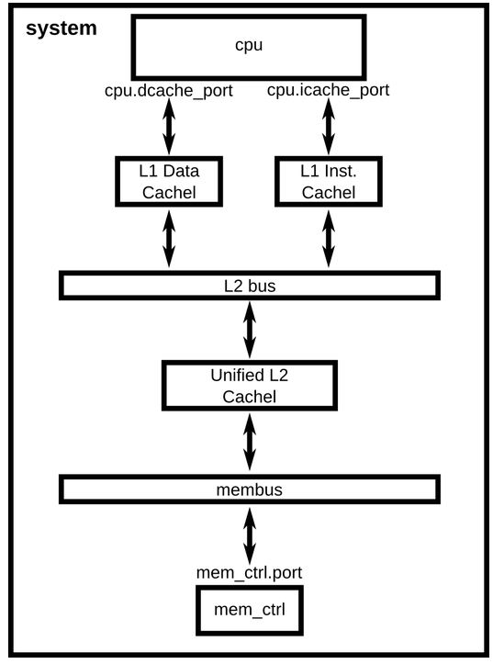
Abstract Diagram of the structure with cache

Slide 9
Results:
Parameter | Parameter Value
Simulation time | 0.000053
Execution Cycles | 52574
Bytes read from I-memory | 14400
Bytes read from D-memory | 8064

Slide 10
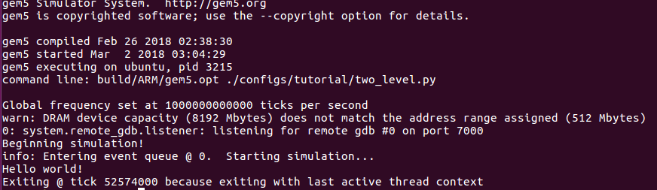
Output with Cache:

Slide 11
Data transfer between CPU and different memory units is done using ports: Master and slave
Functions responsible for utilizing these ports for transport interfaces: sendFunctional(), sendAtomic(), sendTiming()
“port.hh” and “port.cc” files located in: gem5/src/mem/ are the files where the ports are defined.
After observing the files and the structs and functions, it was found that the functions are dealing with the memory addresses that we need for the tracing purposes.
Also, referring the ‘gem5_hipeac.pdf’ manual tells us that there are in-built debub flags that can be activated using appropriate commands.
The debug commands give us an output file which gives the addresses that are accesses by the ports when the benchmark files are run.

Slide 12
Running with the –debug-flags command
Command used: ./build/ARM/gem5.opt --debug-ﬂags=Decode --trace-start=0 --trace-ﬁle=my_trace.out conﬁgs/example/se.py -c tests/test-progs/hello/bin/arm/linux/hello
The benchmark file used was the example ‘hello’ file.
An issue encountered was that the command is outdated and not documented in the pdf.
The modified command was used: ./build/ARM/gem5.opt --debug-ﬂags=Decode --debug=0 --debug=my_trace.out conﬁgs/example/se.py -c tests/test-progs/hello/bin/arm/linux/hello

Slide 13
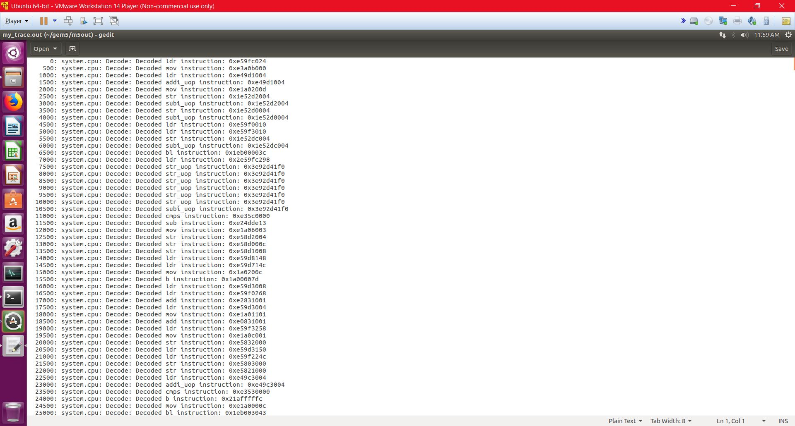
Memory addresses

Slide 14
Future Work:
Now that we have the output file with the required memory addresses and the cross compiler has also been configured to run custom user programs, we can implement the Machine Learning algorithms to create memory traces.
Challenges might be faced again while running user defined programs as the simulator might not support some of the python libraries that are required to run the algorithms.
User may have to define the functionalities that are in the unsupported libraries manually to make them work or code the entire algorithm in C instead of python.

Slide 15
Challenges
Challenges were faced while retrieving memory address file.
Challenges were faced while setting up the ARM processor on so that it can compile any sort of user code.

Slide 16
Unable to retrieve the memory address file using the debug command since the one mentioned was outdated and not documented
Solution:
Use the updated command: ./build/ARM/gem5.opt --debug-ﬂags=Decode --debug-start=0 --debug-ﬁle=my_trace.out conﬁgs/example/se.py -c tests/test-progs/hello/bin/arm/linux/hello

Slide 17
Unable to compile since the native system was x86 and the simulated system was ARM.
Solution:
Install the cross compiler for ARM.
sudo apt-get install gcc-arm-linux-gnueabihf

Slide 18
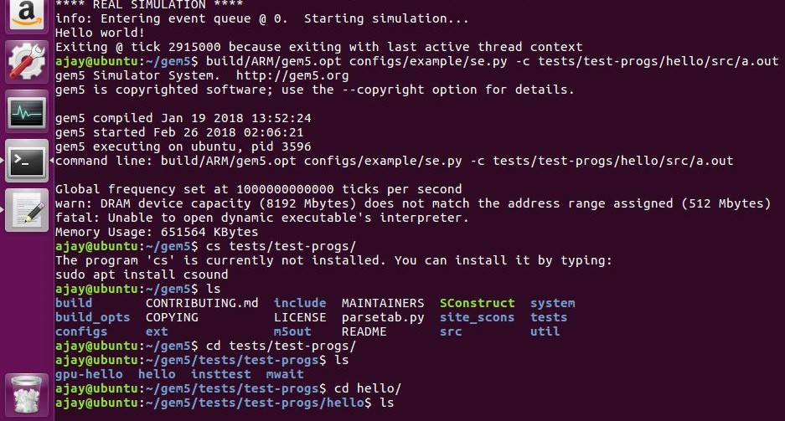
Even after cross compilation, unable to run the ARM binary code for the .c program.
Error:

Slide 19
Solution:
This happens because the output binary file created after running the code is incompatible, use command: arm-linux-gnueabihf-gcc hello.c –o hello
The compilation code needs to be modified by adding the -static option to create the static binary file because the required library codes will be built in the file itself, i.e. the command becomes: arm-linux-gnueabihf-gcc hello.c –o hello –static
The static binary code created is quite bigger than its non-static counterpart.
Note: The command needs to be run in the same directory where the files that needs to be compiled id present or mentioned the directory of the files in the command
Remember, the binary file is generated in the ‘src’ directory and not in the ‘bin’ directory. So be careful in the directories that you mention in the command.
Now run gem5 again using the command: ./build/ARM/gem5.opt conﬁgs/example/se.py -c tests/test-progs/hello/src/hello

Slide 20
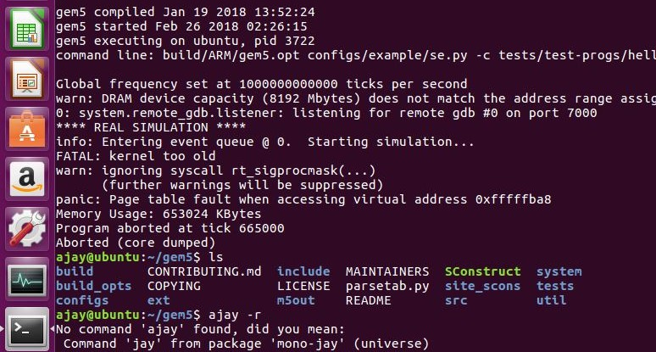
After successfully compiling the code and creating the static binary file, an error occurs stating that the linux kernel of gem5 is too old when compared to the local/native linux kernel.
Error:

Slide 21
Solution:
The solution applied was editing the process.cc file in the directory: ./gem5/src/arch/arm/linux/process.cc
Find “strcpy(name->release, "3.0.0");” and change the release version to the latest that matches your native linux kernel.
To find the version of your native linux kernel, use the command: uname -r
After modifying the process.cc file, rebuild the gem5 and repeat slide-19.
Modify the debug command in slide 16 according to the file that you’ll be using as a benchmark.

Slide 22
References:
http://www.gem5.org/Main_Page
https://www.acmesystems.it/arm9_toolchain
https://www.mail-archive.com/gem5-users@gem5.org/msg05538.html
Gem5 document: ‘gem5_hipeac.pdf’ : http://gem5.org/dist/tutorials/hipeac2012/gem5_hipeac.pdf
Gem5 document: ‘gem5_rsk.pdf’

