Slide 1
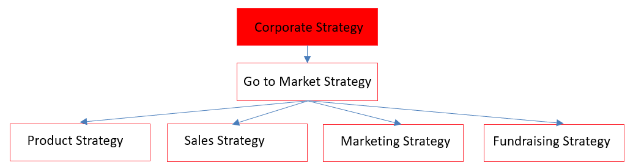

Corporate Strategy - 1
Orbit Positioning:
Be the one stop shop for data, analytics, business process. Next generation of Bloomberg + Aladdin
Addressable market is financial industry (with subsets of asset management, trading, private markets)
Start from London/UK market, with target to expand to EU and US markets
Help clients digest huge volume of (structured and unstructured) data and make complicated decisions, in user friendly way and with affordable price.
Growth target:
We want to reach to GBP 50 Million at next round, GBP 1 Billion valuation in 4 years
Assuming valuation = 20 X revenue, revenue should be 2.5M at next round, and 50M in 4 years

Slide 2
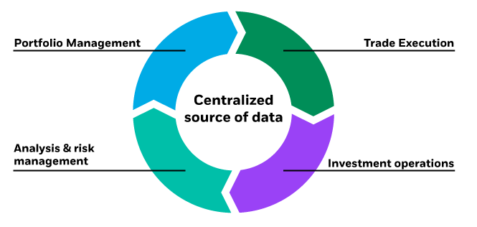
Corporate Strategy - Long Term Plan
Data
Search
Analytics
Business Process – by Sub Industry
Targets:
Clients can operate their end-to-end and core business on our platform
Similar business model to Aladdin
Targets:
Fundamental functionalities ready
Complete datasets ready
Client base ready
Asset Management
Investment Research
Portfolio Management
Risk
Compliance
Hedge fund
Brokerage
Bank
Insurance
PE
Wealth Management
Family Office
Real Estate
Year 1, 2
Year 3,4,5…
Orbit Technology Infrastructure
Ontology| Data Sourcing | Calculation | NLP | Algo | UI | …

Slide 3
Corporate Strategy – How we help with clients
Be Data Driven by Better Handling Unstructured Data
Access to Data
Ability to Digest Data
Easier to Run Analytics
Centralize publicly available data
Integrate your in-house data
Bespoke data sourcing
Data is cleansed and interlinked
NLP and ML models available
Ability to run different analytics for different use cases (with Orbit’s help)
Self service, no-coding analysis
Dashboard
A non technical research analyst can build a pipeline to run certain NLP on selected dataset for research tasks.
Orbit Technology Infrastructure
Ontology| Data Sourcing | Calculation | NLP | Algo | UI | …

Slide 4
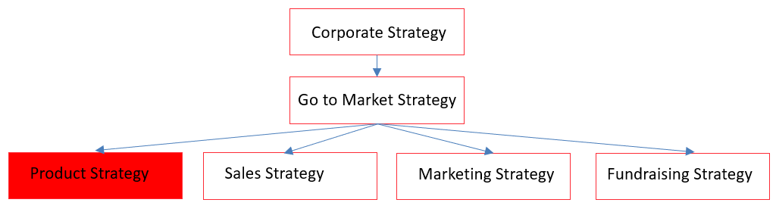
Product Strategy
Institutional Clients
Volume Clients
Orbit Vision –A subscription-based product
Service Layer
Data
Analytics
Orbit Technology Platform
Ontology| Data Sourcing | Calculation | NLP | Algo | UI | …

