Slide 1
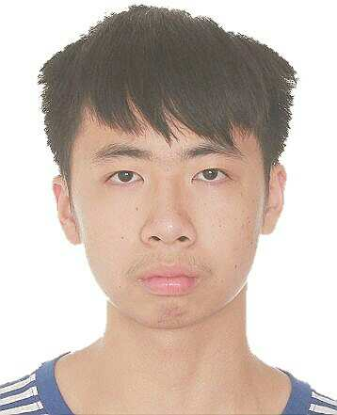
Basic Information
Chinese name: 成泽森
Pinyin: Cheng Ze Sen
English name: akko
Place of Birth: Hunan Yongzhou (湖南永州)
Birth Date: 1999.11.10
Major: Electronic Science and Technology
CET6: 522 (Listen:182 Read:211 Writing:129)
Scores: 91.12 GPA: 3.92 Rank: 1/88
Now, I’m fatter…
I’m an undergraduate student of South China University of Technology (华南理工大学)

Slide 2
Awards
National Scholarship (2017 ~ 2018) [Intellectual education: 1st, Comprehensive assessment: 1st]
The Second Prize Scholarship (2018 ~ 2019) [Intellectual education: 1st, Comprehensive assessment: 3st]
Cstro 16th Conference -- AI and Big Data Part -- ROI Segmentation Challenge -- Head and Neck OAR track -- Champion
National College Students Mathematical Modeling Competition Provincial Third Prize
Taidi Cup 8th Data Mining Challenge

Slide 3
Research Experiences
Multi-media Emotion recognition (SRP project From 2019.6 to 2020.4)
Sun Yat-sen University Cancer Center Research Assistant (From 2019.8 to now)
SCUT-robotlab Memeber of vision group (From 2019.9 to now)
Detailed:
1. Using deep-learning model to extract emotion related feature representation from image, video. Then inputting these feature representation to regression model or classification model to get emotion state.
2. During radiotherapy workflow, tumors and organs at risk contouring are important but time-consuming. Besides, it requires dozens of clinical experience. So, we try to use deep-learning based semantic image segmentation to perform automatic tumors and organs at risk contouring which can save contouring time largely.
3. The robot which I am in charge of is base station. Base station can’t move and just can interact with other robots by referee system. Its usage is using object detection and object track to perform strategy calculation so that it can provide some strategy support for other robots.

Slide 4
Publications
《基于深度学习的医学图像配准综述》
p.s. [rejected]
《AutoSegmentation of Pelvic OARs On MRI Multi-Sequence Using An Fused-Unet》
p.s. [received] (AAPM 2020 oral presentation & BLUE RIBBON ePOSTER)
《A Novel Hybrid Network for H&N Organs At Risk Segmentation》
p.s. [received] (ICBIP 2020 oral presentation) -- Corresponding SCI Under Review
《Attention V-Net: A Residual U-Net with Attention Gate Block for Lung Organ At Risk Segmentation》
p.s. [received] (CSAE 2020) -- Corresponding SCI Under Review
《ZigZag U-Net: Multi-stage medical segmentation network》
p.s. [to be submitted] (inspired by CB-Net)

Slide 5
Research Interest
Because of my past research, I may be interested in medical image segmentation, object detection and object track. Actually, I’m not limited to specific computer vision tasks. I’m interested in computer vision tasks which are meaningful and practical. For instance, the tumors and organs at risk automatic contouring on MRI Multi-sequence. MRI Multi-sequence tumors and organs at risk manual contouring is really time consuming and clinical knowledge intensive. So, we use Multi-modality model to perform MRI Multi-sequence automatic contouring which largely reduce the contouring time.
后台: Self-driving is also practical. Self-driving can largely improve the people transport. Self-driving needs a compound of technology about machine learning so that it may be difficult. Although it’s difficult, I’m willing to be faced with it. At last, I express my opinions on research. I don’t want to be a researcher who just see computer vision as paper generator. I want to do meaningful, practical research! I want to do high-quality, more advanced research! I want to do real research! As you can see, I also publish some low-quality paper which just modify the network and just get the performance a little improvement. But I have to do that. Because It’s the entrance. If I don’t do that, I even can’t qualify for the summer camp. It’s the entrance to higher research. So I have to do that.

Slide 6
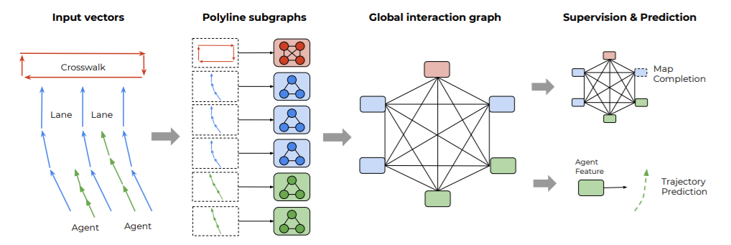
The implementation of VectorNet
Representing trajectories and maps
Constructing the polyline subgraphs
Global graph for high-order interactions
Figure 1. The total workflow of VectorNet

Slide 7
Representing trajectories and maps
There are only the agent trajectory and lane needed to represent according to the requirements. So, we firstly extract lane centerline point sets and agent trajectory point sets (I don’t consider the AV and OTHER object). Then I use average lane width to calculate lane two-side edge line point sets which are dummy lines. By incorporating two neighboring into one vector, we convert point sets to vector sets.

Slide 8
Constructing the polyline subgraphs
There

