Slide 1
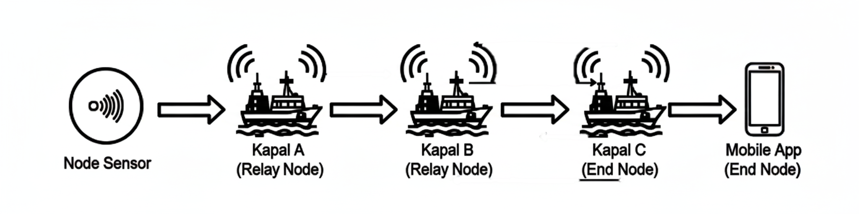

Slide 2

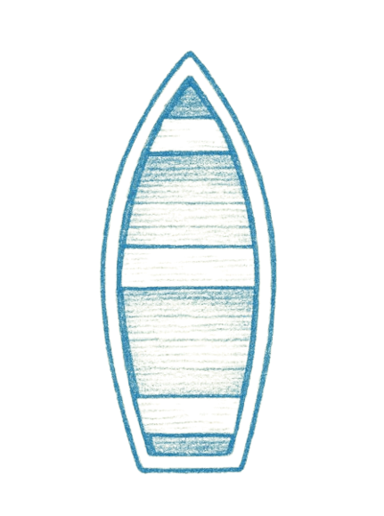

50-100m
1 km +

Slide 3
Sensor IoT
Model ML
Bluetooth Mesh
Input/Output
Data
TinyML
Bluetooth
Tindakan/Peringatan
Aplikasi
Aplikasi

Slide 4
Tidak
Membaca Data
Analisa ML
Risiko Tinggi
Lanjut Monitoring
Input/Output
Tindakan/Peringatan
Aplikasi
Ya
Processing
Filtering
Aplikasi

Slide 5
Model
Data
Data Makro
Data Hibrida
Model
Data Mikro

Slide 6
Server
Node
Gateway
Node
Gateway
Server

Slide 7
Suhu
Sensor
Praprocessing
Model
Tekanan
Logging
Input/Output
Peringatan
Data
ML Pipeline
Informasi
Validation
Model
Logging
Rekomendasi

Slide 8
Salinitas
Sensor
Praprocessing
Model
pH
Logging
Input/Output
Peringatan
Data
ML Pipeline
Informasi
Validation
Model
Logging
Rekomendasi

