Slide 1
microrestjs
A framework to develop microservices

Slide 2

Carlos Lozano Sánchez
Entrepreneur
Computer Engineer
Software Engineer

Slide 3
Problem
NodeJS provides a powerful platform for building fast and scalable network applications.
BUT, developers do not have tools to build and deploy systematically microservices.

Slide 4
Overview of microrestjs
Approach to build and deploy microservices
Specification to describe microservices
Framework to develop microservices
Core services to deploy common functionality

Slide 5
Service-oriented Architecture
“Service-Oriented Architecture (SOA) is a paradigm for organizing and utilizing distributed capabilities that may be under the control of different ownership domains.”
OASIS, SOA Reference Model

Slide 6
Services
“A service is a mechanism to enable access to one or more capabilities, where the access is provided using a prescribed interface and is exercised consistent with constraints and policies as specified by the service description.”
OASIS, SOA Reference Model

Slide 7
Microservices Architectural Style
“The microservices architectural style is an approach to develop a single application as a suite of small services, each running in its own process and communicating with lightweight mechanisms.”
James Lewis & Martin Fowler

Slide 8
SOA vs. Microservices Architectures
“In theory there is no difference. In practice SOA was applied to expose and reuse business services at enterprise level. Microservices architectures are used to structure individual applications.”
Adam Bien

Slide 9
Reinventing the wheel
Distributed capabilities
Services
Interfaces
Services descriptions
Communication mechanisms
Ownership

Slide 10
Service Design Principles
Reusability
Formal contract
Loose coupling
Abstraction
Composability
Autonomy
Statelessness
Discoverability

Slide 11
Overview of microrestjs
Approach to build and deploy microservices
Specification to describe microservices
Framework to develop microservices
Core services to deploy common functionality

Slide 12
Approach of microrestjs
Definition
Development
Deployment

Slide 13
Approach: Definition Phase
Definition
Development
Deployment

Slide 14
Approach: Definition Phase
Goal: Describe the service and its operations
How: Creating a JSON file with the description
Format: Microrestjs Service Description Specification
Principles: Formal contract, Loose Coupling, Abstraction, Composability, Autonomy and Discoverability

Slide 15
Approach: Definition Phase
{
“microrestSpecification”: 1,
“info”: {
“name”: “example-helloworld”,
“version”: “0.0.1”,
“api”: 1,
...
},
“config”: {
“location”: “directory”
“dependiencies”: { ... }
},

Slide 16
Approach: Definition Phase
“operations”: {
“greet”: {
“request”: {
“path”: “/greet/:username”,
“method”: “GET”,
...
},
“responses”: { ... },
“errors”: { ... }
}
}
}

Slide 17
Approach: Development Phase
Definition
Development
Deployment

Slide 18
Approach: Development Phase
Goal: Build the logic of the service
How: Creating a JavaScript file with the functionality
Format: Service Description
Principles: Composability, Autonomy, Statelessness

Slide 19
Approach: Development Phase
function greet(request, response) {
var greetBody = {
greet: “Hello ” + request.params.username
}
response.status(200).json(greetBody).end();
}

Slide 20
Approach: Deployment Phase
Definition
Development
Deployment

Slide 21
Approach: Deployment Phase
Goal: Deploy the services in a distributed context
How: Running an instance of microrestjs with the service description and service functionality.
Principles: Discoverability

Slide 22



Approach: Deployment Phase
Configure microrestjs
Save the service description and functionality
Execute: node Launcher.js

Slide 23
Overview of microrestjs
Approach to build and deploy microservices
Specification to describe microservices
Framework to develop microservices
Core services to deploy common functionality

Slide 24
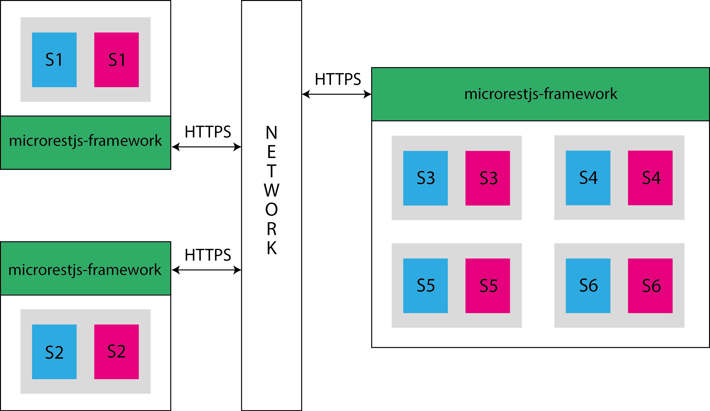
Framework: Architecture

Slide 25
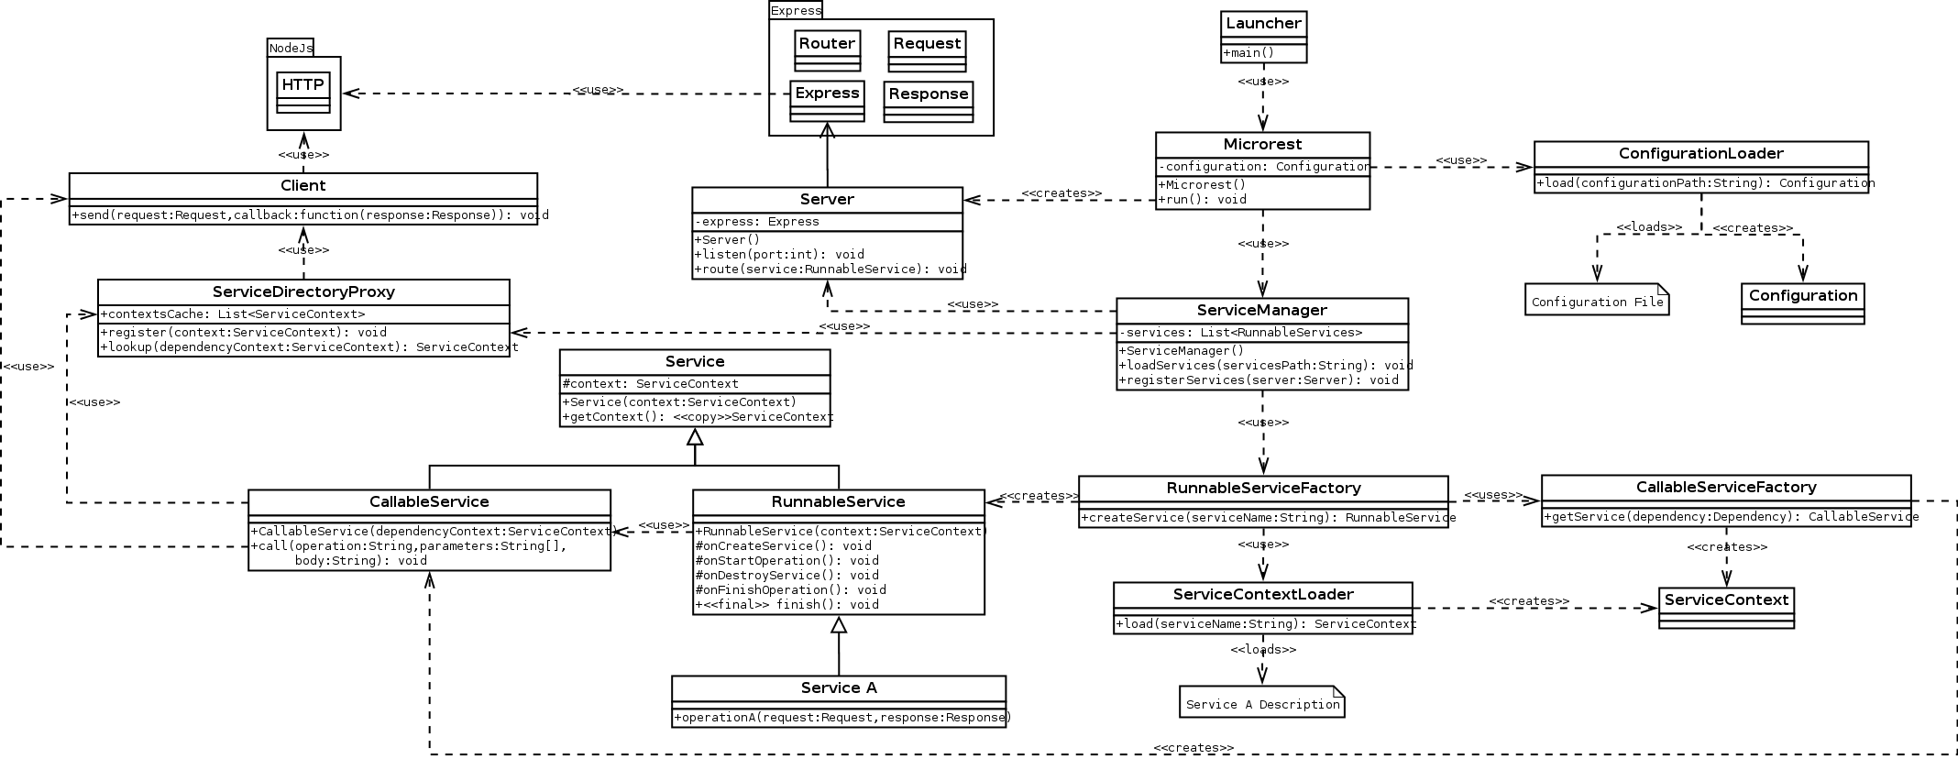
Framework: Architecture

Slide 26






Framework: Technologies

Slide 27
Framework: More and More
Universally accessible
RESTful API
Standard web technologies (HTTP)
Secure connections
Location transparency
OPEN SOURCE – MIT License

Slide 28
Overview of microrestjs
Approach to build and deploy microservices
Specification to describe microservices
Framework to develop microservices
Core services to deploy common functionality

Slide 29
Advantages and Drawbacks
Dynamic load without compilation
Decrease in development time
Increase in documentation quality
Production ready without lock-in
Not a silver bullet, not for everything
Weakly typed programming
Strict development approach
No standard descriptions

Slide 30
Conclusion
WSDL
SOAP
HTTPS
NodeJS
SOA
Microservices
JSON
RESTful API
Web

Slide 31
Conclusion
WSDL
SOAP
HTTPS
NodeJS
SOA
microrestjs
Microservices
JSON
RESTful API
Web

