Slide 1
Platform for designing, developing and deploying microservices
Carlos Lozano Sánchez
December 15, 2015

Slide 2
Presentation
20 min

Slide 3
Problem
Software systems are becoming more powerful and complex, resulting in the necessity of using new approaches for their development.
Microrestjs
(Microservice architecture)

Slide 4
Service-oriented Architecture
“Service-Oriented Architecture (SOA) is a paradigm for organizing and utilizing distributed capabilities that may be under the control of different ownership domains.”
OASIS, SOA Reference Model

Slide 5
Services
“A service is a mechanism to enable access to one or more capabilities, where the access is provided using a prescribed interface and is exercised consistent with constraints and policies as specified by the service description.”
OASIS, SOA Reference Model

Slide 6
Microservices Architectural Style
“The microservices architectural style is an approach to develop a single application as a suite of small services, each running in its own process and communicating with lightweight mechanisms.”
James Lewis & Martin Fowler

Slide 7
Overview of Microrestjs
Methodology to build microservices
Specification to describe microservices
Framework to develop/deploy microservices
Core services to provide common functionality

Slide 8
Overview of Microrestjs
Methodology to build microservices
Specification to describe microservices
Framework to develop/deploy microservices
Core services to provide common functionality

Slide 9
Microrestjs Methodology
Design
Implementation
Deployment

Slide 10
Methodology: Design Phase
Design
Implementation
Deployment

Slide 11
Methodology: Design Phase
Task: Describe the microservice and its operations
How: Creating a JSON file with the description
Tool: Microrestjs Service Description Specification

Slide 12
Methodology: Design Phase
{
“microrestSpecification”: 1,
“info”: {
“name”: “yellow-pages”,
“version”: “0.0.1”,
“api”: 1,
...
},
“config”: {
“location”: “directory”
“dependiencies”: { ... }
},

Slide 13
Methodology: Design Phase
“security”: { ... }
“operations”: {
“search”: {
“request”: {
“path”: “/:target”,
“method”: “GET”,
...
},
“responses”: { ... },
“errors”: { ... }
}
}
}

Slide 14
Methodology: Implementation Phase
Design
Implementation
Deployment

Slide 15
Methodology: Implementation Phase
Task: Implement the logic of the microservice
How: Creating a JavaScript file with the functionality
Tool: Service Description and Microrestjs Framework

Slide 16
Methodology: Implementation Phase
function search(request, response, sendFunction) {
var target = request.getPathParameter(“target”);
... (the items are searched)
response.setStatus(200).setBody(items);
sendFunction();
}

Slide 17
Methodology: Deployment Phase
Design
Implementation
Deployment

Slide 18
Methodology: Deployment Phase
Task: Deploy the microservice and make them
accessible from the network
How: Running an instance of Microrestjs with the
service description and the functionality.
Tool: Microrestjs Framework

Slide 19



Methodology: Deployment Phase
Configure Microrestjs
Save the service description and functionality
Execute: node Launcher.js

Slide 20
Overview of Microrestjs
Methodology to build microservices
Specification to describe microservices
Framework to develop/deploy microservices
Core services to provide common functionality

Slide 21
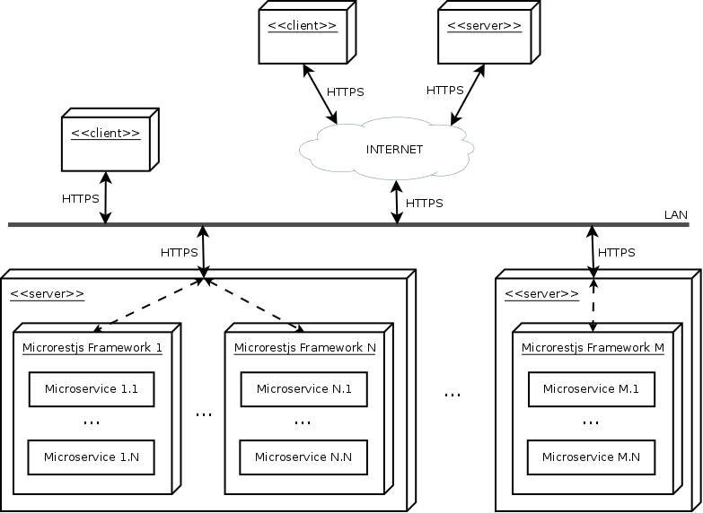
Framework: Architecture

Slide 22
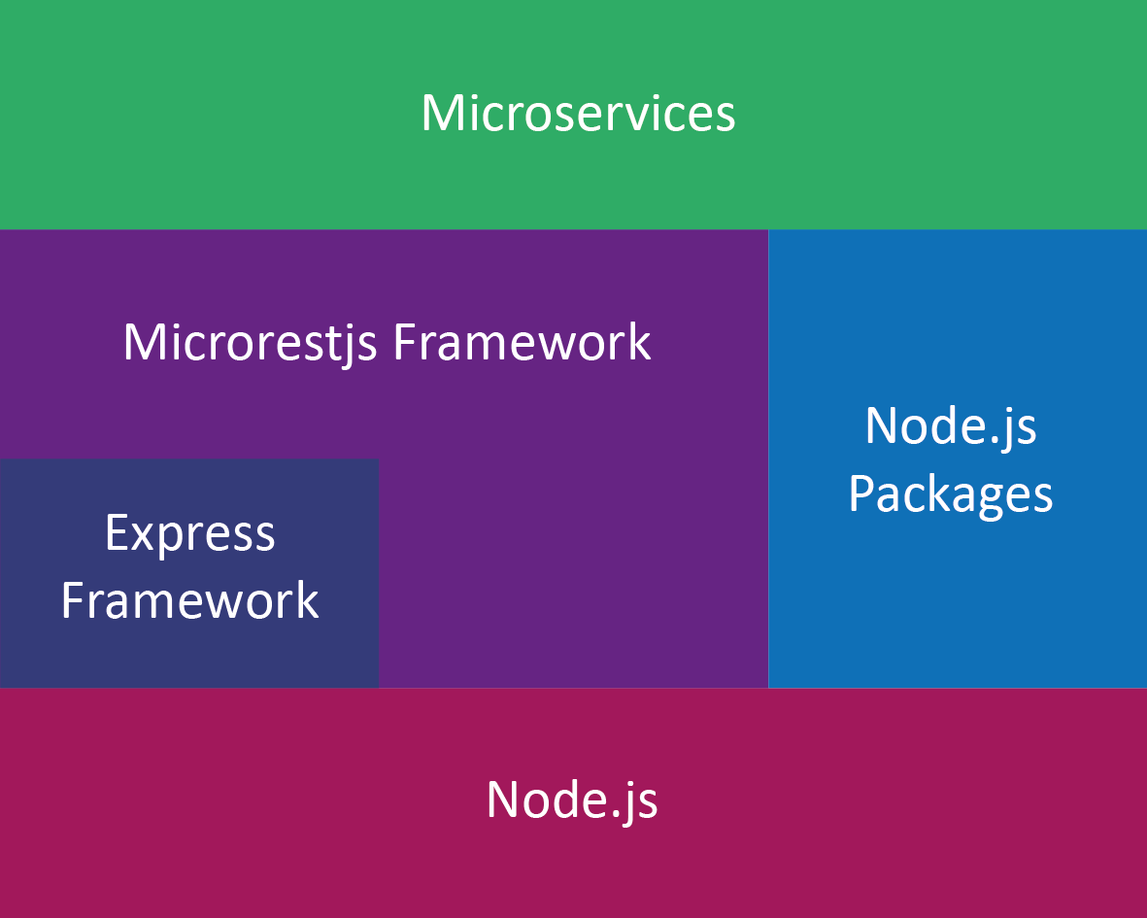
Framework: Architecture

Slide 23
Framework: Characteristics
Influenced by previous technologies
SOA- and REST-compliant microservices
Standard Web technologies (HTTP)
Secure network communications (TLS)
Uniform interfaces for interaction
Emphasis on automation
No technical lock-in

Slide 24
Framework: Properties
Simplicity
Scalability
Interoperability
Security
Reusability
Discoverability
Uniformity
Flexibility
Adaptability
Extensibility
Maintainability
Readability

Slide 25
Overview of Microrestjs
Methodology to build microservices
Specification to describe microservices
Framework to develop/deploy microservices
Core services to provide common functionality

Slide 26
Core Services
Service directory
Authentication and Authorization Services
None
Basic
(Token)

Slide 27
Advantages and Drawbacks
Improve overall quality
Reduce software complexity, costs, and risks
Dynamic deployment without compilation
Open source environment
Not a silver bullet, not for everything
Weakly typed programming
No standard descriptions
New environment

Slide 28
Conclusion
Microrestjs is an innovative platform
that aims to be the basis of the
future technologies.

Slide 29
Demo
5 min

Slide 30
Yellow Pages: Logical View

Slide 31
Yellow Pages: Deployment View

Slide 32
Yellow Pages: Summary
3 microservices working together
Search and filter functionality
Secure network communications
Authentication and authorization
< 120 lines of code

Slide 33
Conclusion
Microrestjs is an innovative platform
that aims to be the basis of the
future technologies.

